Slide 2
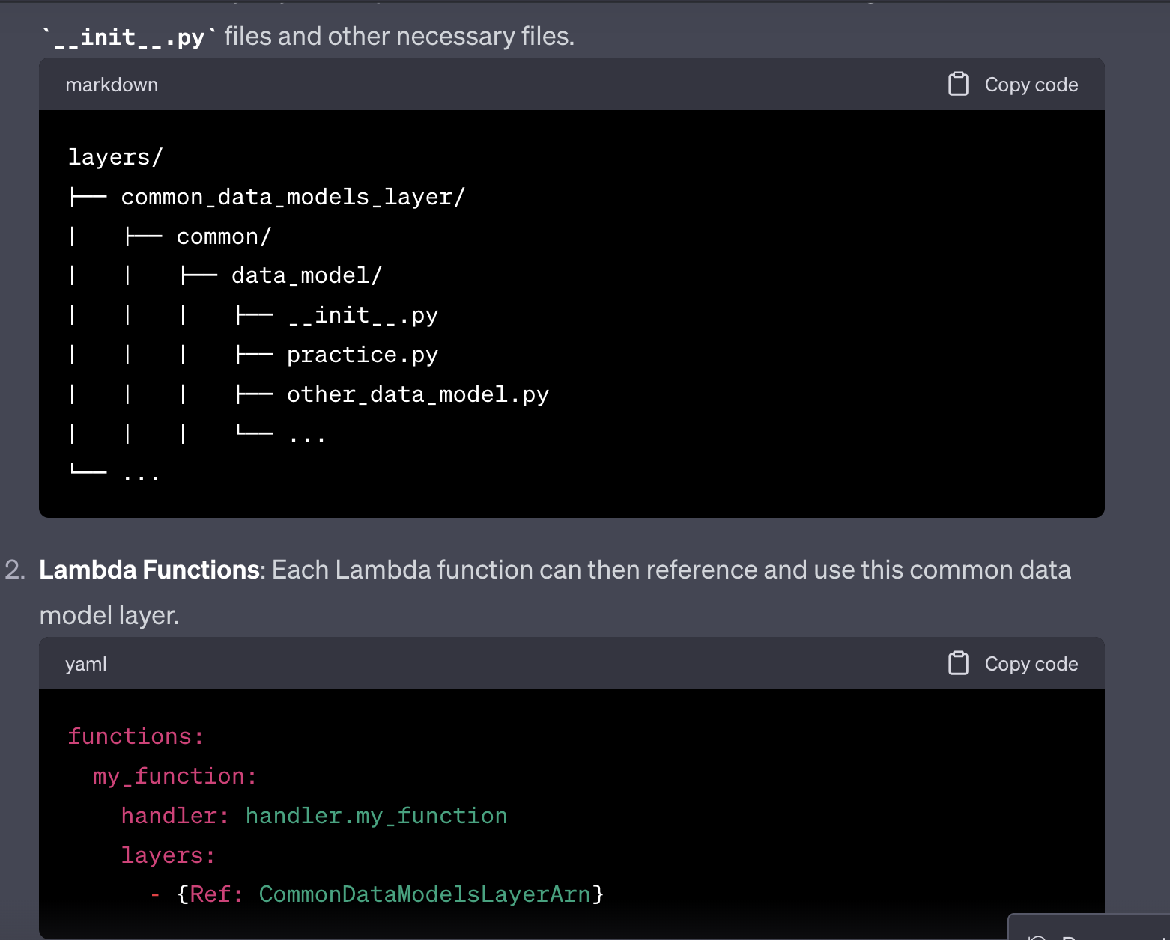
Lambda Layers for data models and database operational code.

