Slide 1





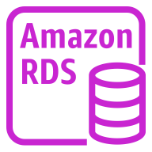










Virtual private cloud (VPC)
AWS CloudFormation
AWS Lambda
Amazon Virtual Private Cloud (Amazon VPC)
Amazon Cognito
Amazon RDS instance
Stack
Hosted zone
Lambda function
Amazon Route 53
Amazon API Gateway
Permissions
Role
AWS Identity and Access Management (IAM)
AWS Secrets Manager
Endpoint

Slide 2





S3 Object Lambda
Amazon Simple Storage Service (Amazon S3)
S3 Object Lambda Access Points
Bucket with
objects
S3 Standard

Slide 3
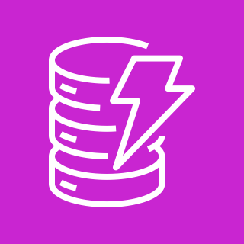








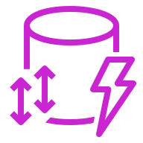
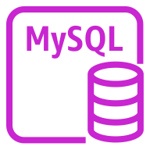


Amazon DynamoDB
Amazon Relational Database Service (Amazon RDS)
Stream
AWS Amplify
Attribute
Items
Multi-AZ
Item
Table
Standard Access table class
MySQL
instance
Amazon RDS instance
Attributes
Global secondary
index

Slide 4

AWS Cloud

Slide 5


AWS Cloud
Availability Zone
Virtual private cloud (VPC)
Internet gateway
Public subnet
10.0.0.0/19
10.0.0.0/16

Slide 6

Security group
Private subnet

