Slide 1








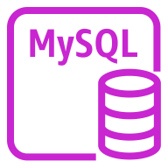




Deploy Database
AWS Secrets Manager
1. Get Master User Credentials
Amazon Relational Database Service (Amazon RDS)
S3 Standard
2. Create instance w/Master Credentials
AWS CloudFormation
Amazon Simple Storage Service (Amazon S3)
Bucket with
objects
Template
Stack
5. Restore
6. Create DB Users, get password from secrets manager
MySQL
instance
3. Stack Created
4. Dump
Topic
Lambda function
MySQL
Prod instance
Amazon Simple Notification Service (Amazon SNS)
AWS Lambda

