Slide 1
Salinity
By Ilana, Alexa, Lin, and Kannie

Slide 2
What is Salinity?
The amount of salt in bodies of water are measured in salinity and is typically measured in parts per thousand. Commonly known bodies of water containing salinity include the dead sea, oceans, and the Don Juan Pond in Antarctica. There are three types of salinity,
Primary/Natural salinity, which occurs over time in rainfall and erosion.
Secondary/Dryland salinity, which occurs when water carries salt over dry land
Tertiary/Irrigated salinity, which occurs from over planting a field watered through irrigation

Slide 3
What is the normal salinity?
Different type of water areas have varying salinity or salt levels. Salinity is measured and expressed in parts per thousand or ppt.
Fresh water usually has a salinity of 0.5 ppt.
Estuaries have varying levels of salinity that can range from 0.5 - 3.0 ppt.
Average salinity of ocean water is 35 ppt.
As seen above, oceans tend to have higher salinity levels, making it saltier.

Slide 4
How does changing salinities affect ocean creatures?
The Salinization of freshwater habitats has been correlated with reduced biodiversity and has been related to changes in aquatic community composition since the bodies of freshwaters have been getting saltier.
It is known that freshwater organisms have a sensitivity towards salinity and thus increasing salinity can be expected to alter community compositions by lossing specifies because of intoxication or through species interactions.
Salinities outside the tolerance range of a species will change their behavior, or limit reproduction, making them less fit in that environment.
This high salinity causes a rise in water density in addition to the alteration of the developmental phases of marine organisms.
Marine animals are adapted to keep their body salts at a constant level so that it doesn’t interfere with the metabolism within cells, but significant changes in salinity can cause problems for some.

Slide 5
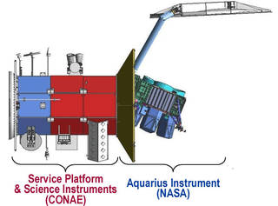
What is the Aquarius Satellite?
Launched June 10, 2011
Aka Satélite de Aplicaciones Científicas (SAC)-D satellite observatory
International Collaboration between NASA and Comisión Nacional de Actividades Espaciales (CONAE)
Participation from Brazil, Canada, France, and Italy
Collected 3 years and 9 months of data
Measures Salinity/Salt levels of the ocean in PSU, or practical salinity units
Surface Salinity of Pacific Ocean → 35 psu
Surface Salinity of Atlantic Ocean → 37 psu
Can measure to an accuracy of 0.2 psu
Half a gallon of water with a pinch of salt

Slide 6

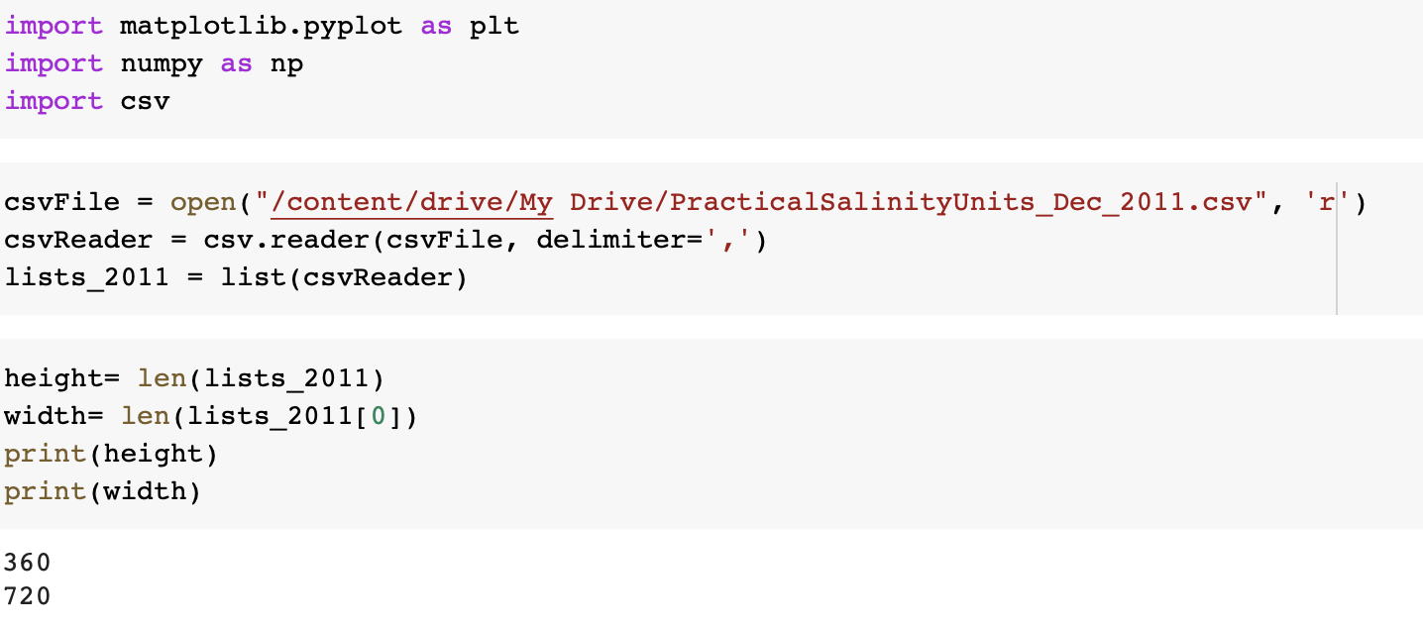
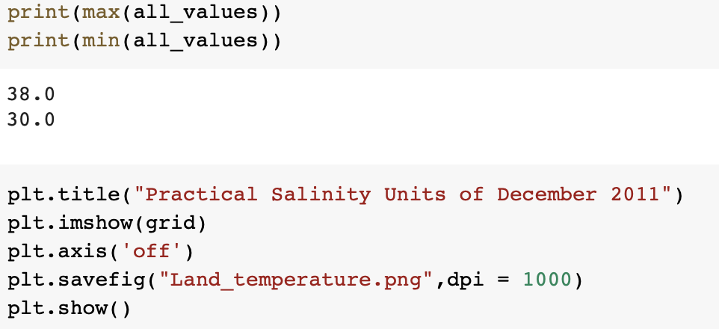
Coding

Slide 7
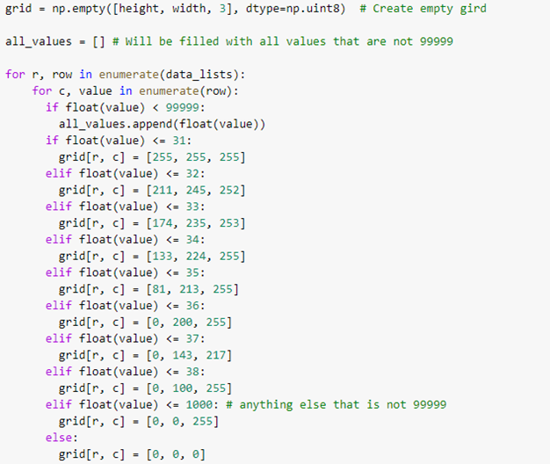
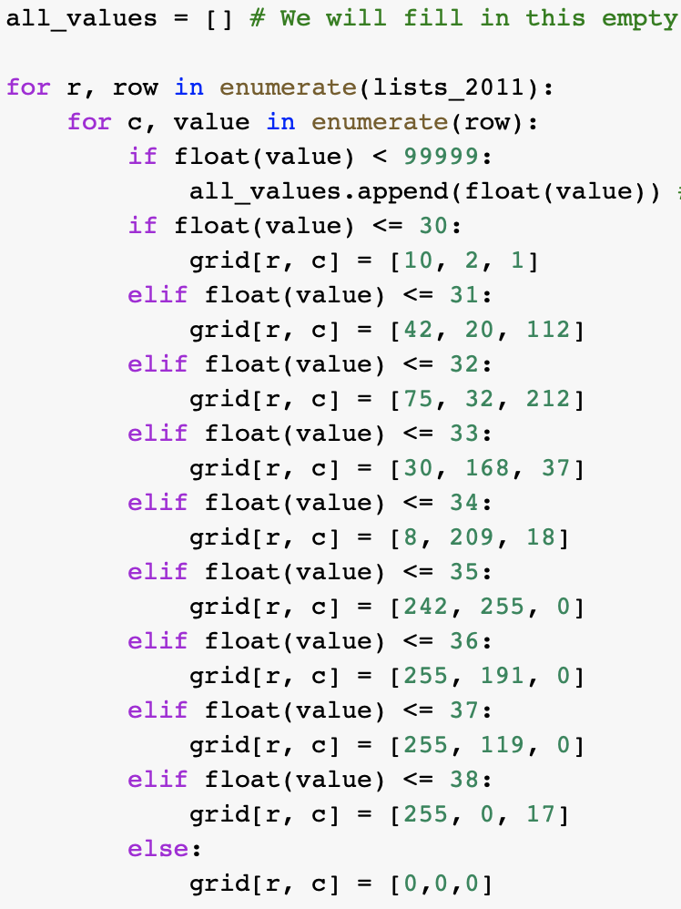
Coding (Part 2)

Slide 8
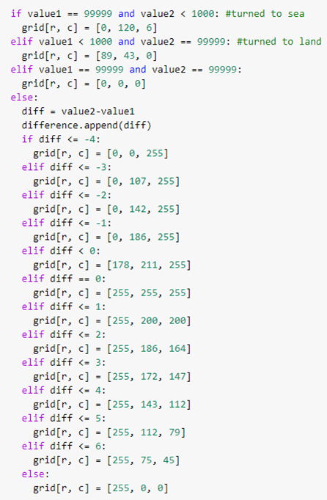
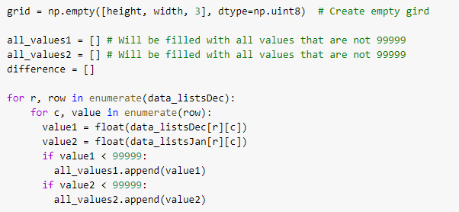
Coding (Part 3)

Slide 9
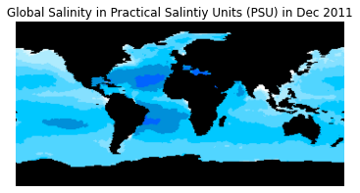
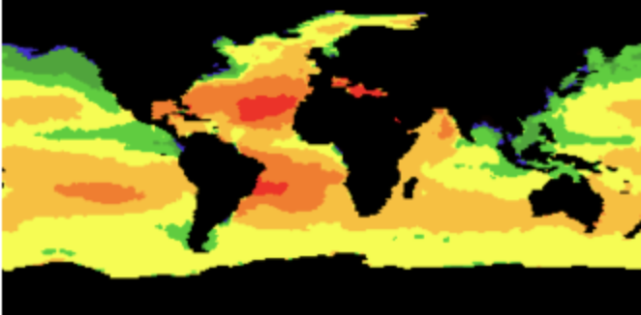
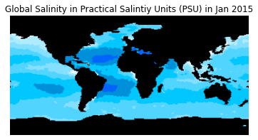
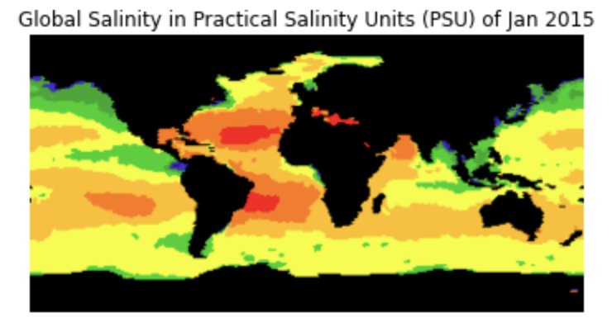


Salinity Maps
Global Salinity in Practical Salinity Units (PSU) of Dec 2011
More Salinity
Less Salinity
More Salinity
Less Salinity

Slide 10
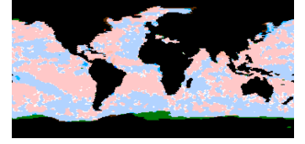
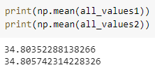
ΔSalinity Map
Salinity Changes Between Dec 2011 and Jan 2015
Over the course of the four years from 2011 to 2015, you can see the Earth’s oceanic surface gradually increase in salinity, especially around the equator and the edges of continents. Choosing different colors will help us see more drastic changes since you can see the contrast between the two colors.
Less Salinity
No Change
More Salinity

Slide 11
Challenges and solutions
Teamwork:
In terms of teamwork in the beginning of the week there was very little to no communication. However, once we started the project we were able to communicate a little more, being able to exchange enough concrete answer to divide and split roles so then we each could do our part in individually .
Code:
With the code, our team had several syntax errors that then when pointed in the error by the google colab, the team was able to fix whether it was a space issue or comma error.

Slide 12
Next Steps
To improve our current maps, we could create smaller maps for different regions to show more detail or make certain regions different colors. Additionally, we could create maps from different years to better show the changes of salinity over time as well as labeling different bodies of water.

