Slide 1
Distributed Database Systems Project
By Lin Nianyi and Rosalie Butte

Slide 2
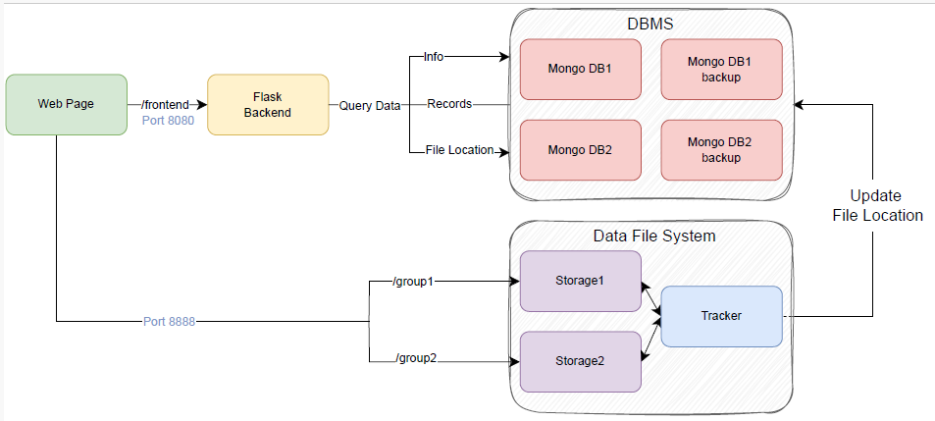
Overview Framework

Slide 3
Database MongoDB
Stores structured data
2 hot standby backup databases for fault tolerances
Backup also allows for datamigration
Possible for new DBs to join
Possible to drop DB at will with Docker command

Slide 4
Data File System FastDFS
Storage servers store unstructured data, e.g. videos, images
Tracker server:
manages and coordinates the storage servers
Makes connections between storage servers and clients
Monitors status and performance
Supports backup of files

Slide 5
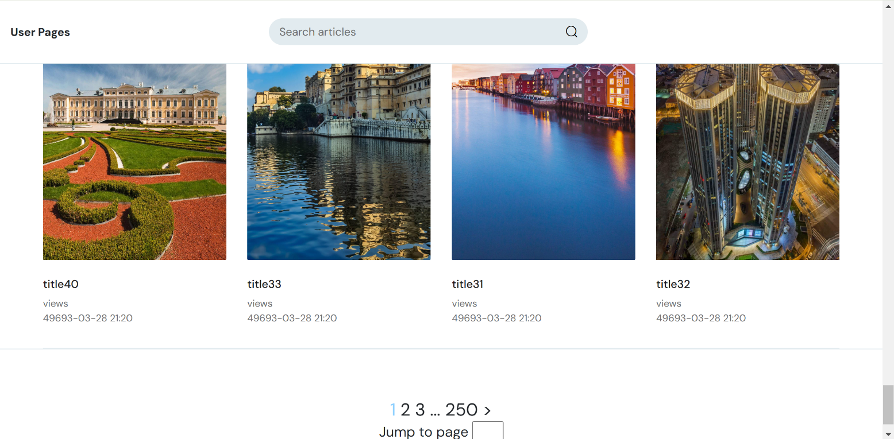
Frontend and Flask Backend
Backend responsible for querying information on
Users and their activities e.g. reading history, comments
Articles and their statistical information, e.g. number of views
Top 5 daily/weekly/monthly ranked articles
Search function for both users and articles
Frontend: user interface

Slide 6
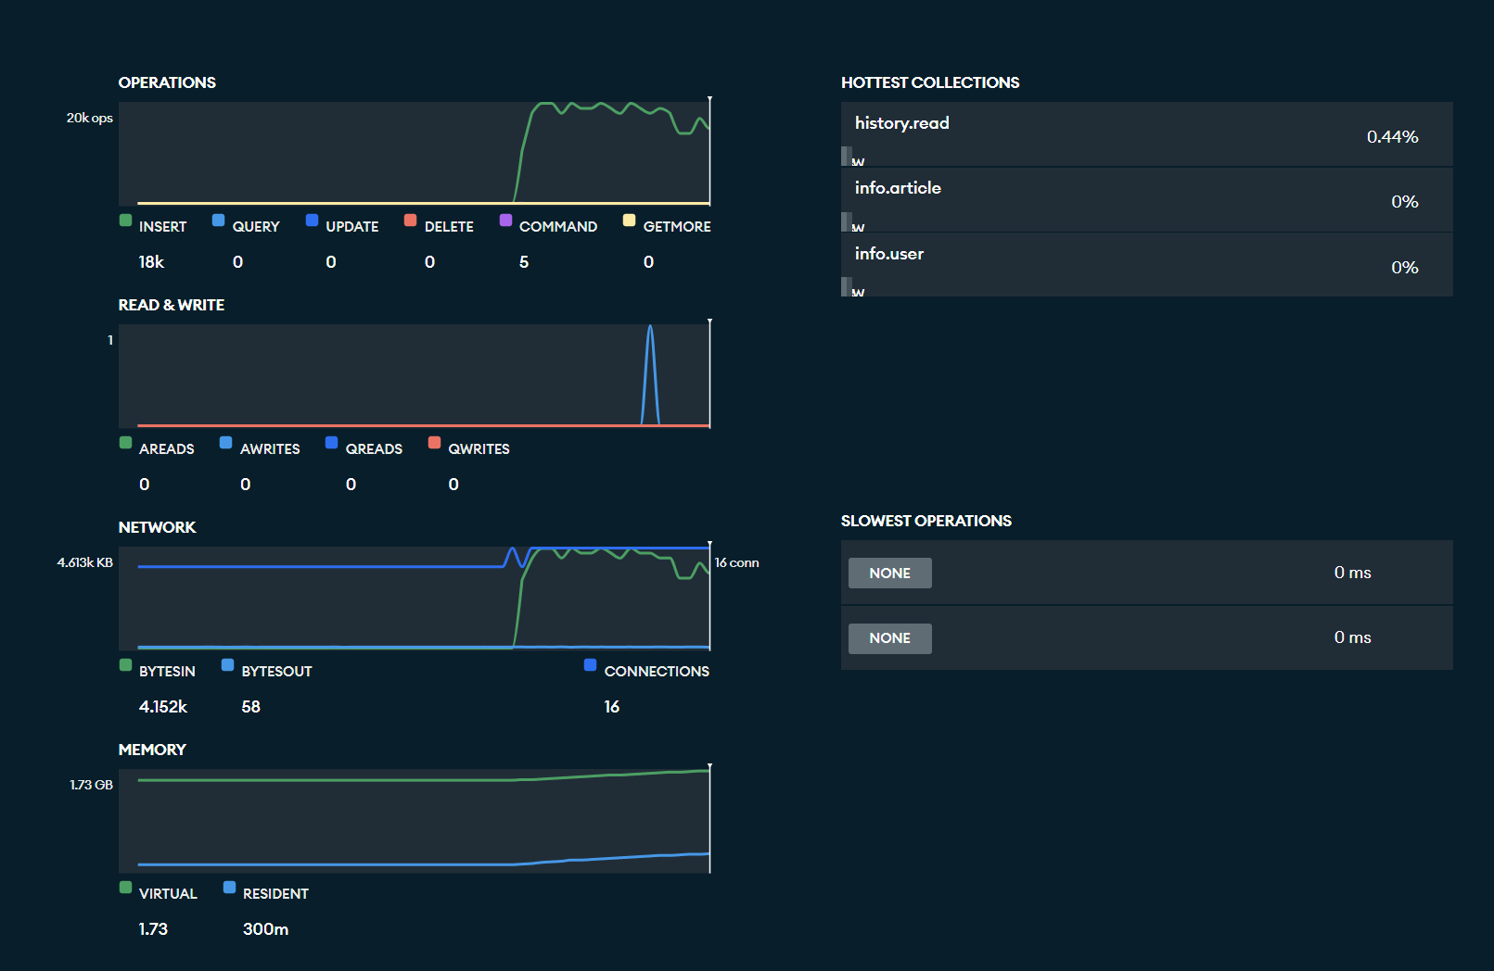
Monitoring with MongoDB Compass
Perform CRUD operations
Monitor workload:
Active operations
Slowest operation
Collections with most activity

Slide 7
Demo

