Slide 1
Weatherly
Linh H. Pham
Nixson Yeung

Slide 2
Requirements
• Location-based Weather: Auto-detect or manually input city.
• Hourly & 7-Day Forecast: With dynamic icons and summaries.
• Personalized Alerts: Rain, snow, temperature thresholds.
• Interactive Map: Real-time radar and satellite view.
• Custom Themes: Mood-based background images or user-uploaded ones.
• Weather Sharing: Create weather postcards or status images.
• Community Reports: Users can submit observations ("Windy here!", "Rainbow spotted").

Slide 3
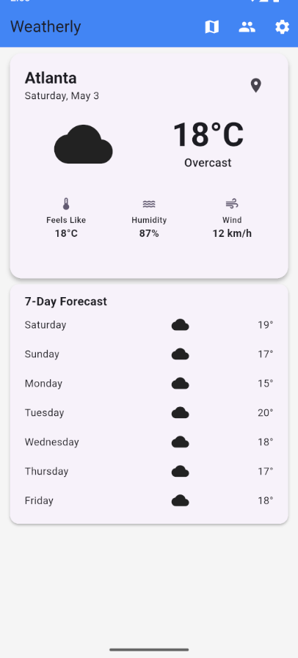
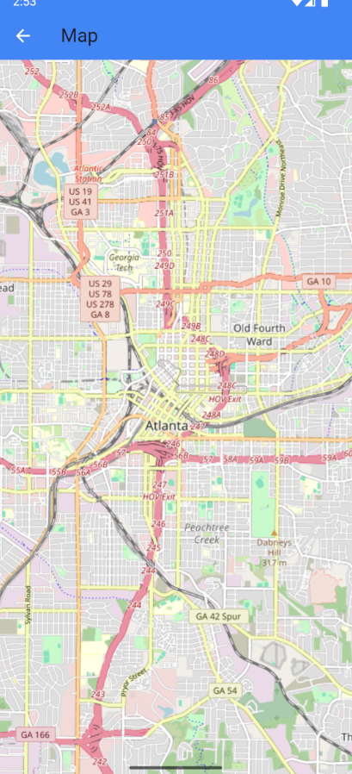
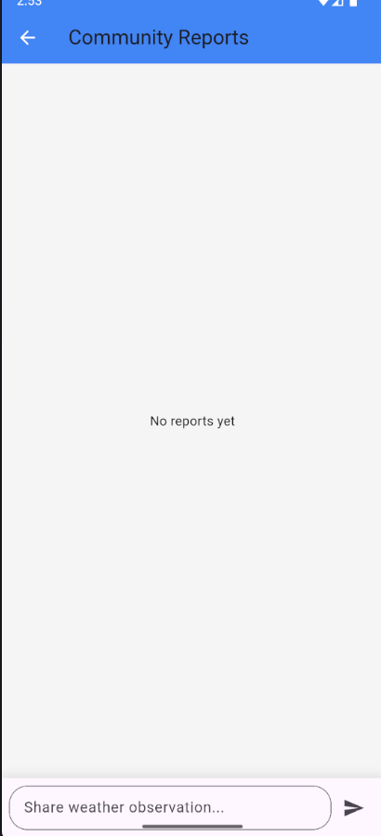
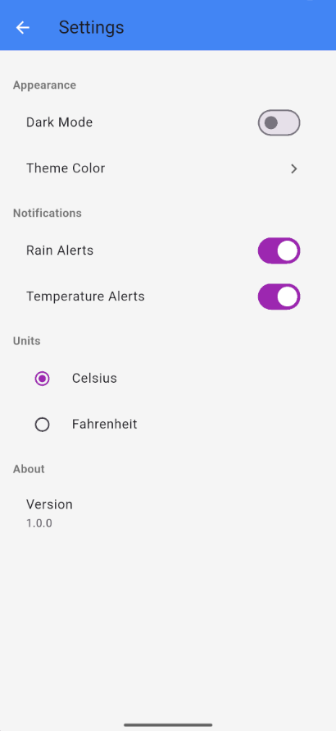
UI

Slide 4
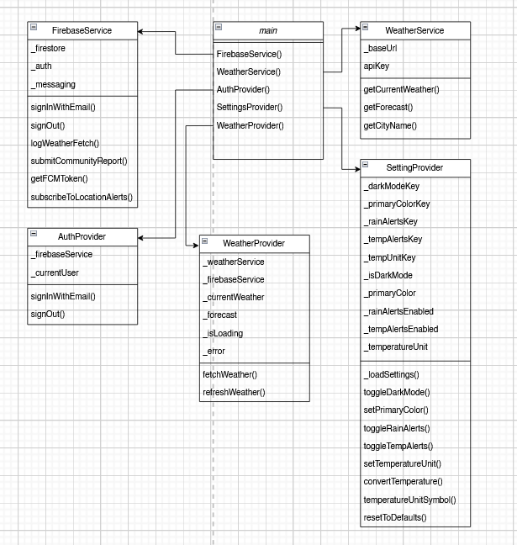
UML Diagram for Backend

Slide 5
Main
void main() async {
WidgetsFlutterBinding.ensureInitialized();
await Firebase.initializeApp(
options: DefaultFirebaseOptions.currentPlatform,
);
final firebaseService = FirebaseService();
final weatherService = WeatherService('YOUR_OPENWEATHERMAP_API_KEY');
runApp(
MultiProvider(
providers: [
ChangeNotifierProvider(create: (_) => AuthProvider(firebaseService)),
ChangeNotifierProvider(create: (_) => SettingsProvider()),
ChangeNotifierProvider(
create: (_) => WeatherProvider(weatherService, firebaseService),
),
],
child: const WeatherlyApp(),
),
);
}

Slide 6
Authentication Provider
void _init() {
FirebaseAuth.instance.authStateChanges().listen((user) {
_currentUser = user;
notifyListeners();
});
}
Future<void> signInWithEmail(String email, String password) async {
try {
await _firebaseService.signInWithEmail(email, password);
} catch (e) {
rethrow;
}
}
Future<void> signOut() async {
await _firebaseService.signOut();
}
}

Slide 7
Firebase Service
// User Management
Future<void> signInWithEmail(String email, String password) async {
await _auth.signInWithEmailAndPassword(email: email, password: password);
}
Future<void> signOut() async {
await _auth.signOut();
}
// Weather Data Logging
Future<void> logWeatherFetch(double lat, double lon) async {
final userId = _auth.currentUser?.uid;
if (userId != null) {
await _firestore.collection('userActivity').doc(userId).collection('weatherFetches').add({
'location': GeoPoint(lat, lon),
'timestamp': FieldValue.serverTimestamp(),
});
}
}
// Community Reports
Future<void> submitCommunityReport(CommunityReport report) async {
await _firestore.collection('communityReports').add(report.toFirestore());
}
// Push Notifications
Future<String?> getFCMToken() async {
await _messaging.requestPermission();
return await _messaging.getToken();
}
Future<void> subscribeToLocationAlerts(String locationId) async {
await _messaging.subscribeToTopic('location_$locationId');
}
}

Slide 8
Weather Service
class WeatherService {
static const String _baseUrl = 'https://api.openweathermap.org/data/2.5';
final String apiKey;
WeatherService(this.apiKey);
Future<WeatherData> getCurrentWeather(double lat, double lon) async {
final response = await http.get(
Uri.parse('$_baseUrl/weather?lat=$lat&lon=$lon&appid=$apiKey&units=metric'),
);
if (response.statusCode == 200) {
return WeatherData.fromJson(jsonDecode(response.body));
} else {
throw Exception('Failed to load weather data: ${response.statusCode}');
}
}

Slide 9
Weather Provider
Future<void> fetchWeather(double lat, double lon) async {
_isLoading = true;
_error = null;
notifyListeners();
try {
_currentWeather = await _weatherService.getCurrentWeather(lat, lon);
_forecast = await _weatherService.getForecast(lat, lon);
await _firebaseService.logWeatherFetch(lat, lon);
} catch (e) {
_error = e.toString();
} finally {
_isLoading = false;
notifyListeners();
}
}

Slide 10
Setting Provider
body: ListView(
padding: const EdgeInsets.all(16),
children: [
_buildSectionHeader('Appearance'),
SwitchListTile(
title: const Text('Dark Mode'),
value: settings.isDarkMode,
onChanged: (value) => settings.toggleDarkMode(value),
),
ListTile(
title: const Text('Theme Color'),
trailing: Icon(Icons.chevron_right, color: Theme.of(context).hintColor),
onTap: () => _showThemeColorPicker(context),
),
_buildSectionHeader('Notifications'),
SwitchListTile(
title: const Text('Rain Alerts'),
value: settings.rainAlertsEnabled,
onChanged: (value) => settings.toggleRainAlerts(value),
),
SwitchListTile(
title: const Text('Temperature Alerts'),
value: settings.tempAlertsEnabled,
onChanged: (value) => settings.toggleTempAlerts(value),
),

Slide 11
The End

