Slide 1
Personal Finance Manager
Group:

Slide 2
Requirements
Allow users to log transactions.
Categorize expenses.
Let users set goals and track progress.
Display simple charts of income vs. expenses.
Local storage

Slide 3
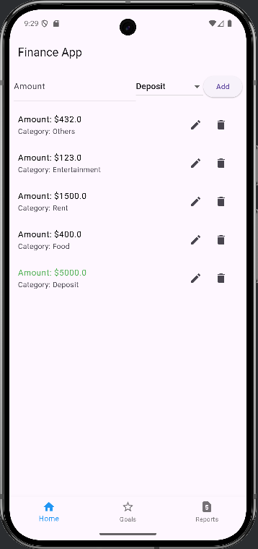
Navigation
int _selectedIndex = 0;
static final List<Widget> _widgetOptions = <Widget>[
TransactionsScreen(),
GoalsScreen(),
ReportsScreen(),
];
void _onItemTapped(int index) {
setState(() {
_selectedIndex = index;
});
}

Slide 4
Transaction Page
void saveTransaction()
void editTransaction(String id, double amount, String category)
void deleteTransaction(String id)
Expanded(
child: StreamBuilder(
stream: _firestore.collection('transactions').orderBy('timestamp', descending: true).snapshots(),
builder: (context, AsyncSnapshot<QuerySnapshot> snapshot) {

Slide 5
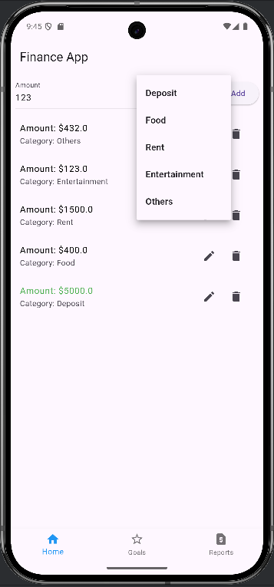
Create Transaction
try {
await _firestore.collection('transactions').add({
'amount': double.parse(amountController.text),
'category': selectedCategory,
'timestamp': FieldValue.serverTimestamp(),
});
amountController.clear();

Slide 6
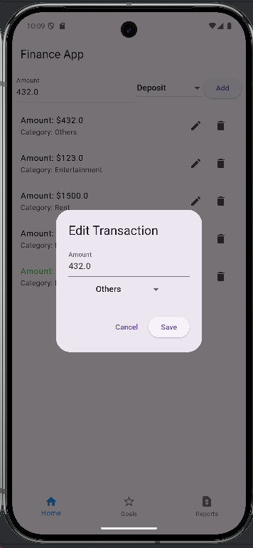
Edit Transaction
TextField(
controller: amountController,
decoration: InputDecoration(labelText: 'Amount'),
keyboardType: TextInputType.number,),
DropdownButton<String>(
value: selectedCategory,
items: ['Deposit','Food', 'Rent', 'Entertainment', 'Others']
.map((category) => DropdownMenuItem(
value: category,
child: Text(category),))
.toList(),
onChanged: (value) {
setState(() {
selectedCategory = value!;

Slide 7
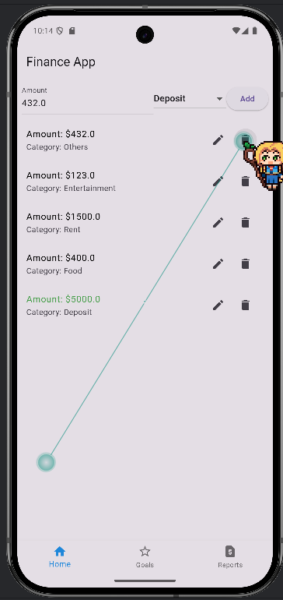
Delete Transaction
void deleteTransaction(String id) async {
await _firestore.collection('transactions').doc(id).delete();
}

Slide 8
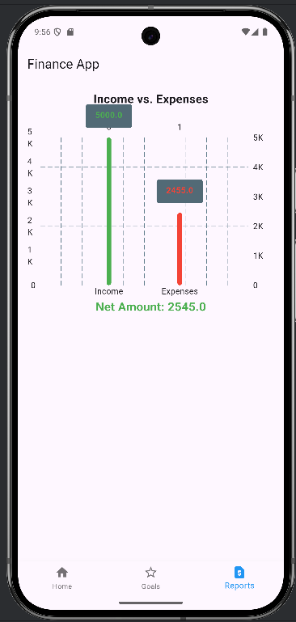
Report Page
for (var doc in querySnapshot.docs) {
var data = doc.data();
double amount = (data['amount'] as num).toDouble();
if (data['category'] == 'Deposit') {
income += amount;
} else {
expenses += amount;
}
}

