Slide 1


Introduction to Computer Science
Reichman University
Recitation 6
Notes:
‹#›

Slide 2

Standard IO
STD libraries
In
StdOut
StdDraw
StdAudio
StdRandom
The Color class
PPM Format
Image Processing
Midterm Review

Slide 3
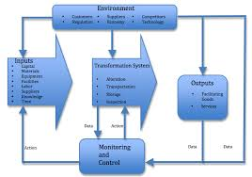
Introduction to Computer Science
Reichman University
Recitation 6
Input/Output

Slide 4
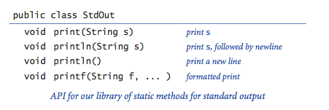
Standard IO
StdOut – standard output
In – Input
In in = new In (); // reads from terminal
In in = new In (string filePath); // reads from txt file
in.readLine(); // reads the next line
in.readInt(); // reads the next int
in.readString(); // reads the next string

Slide 5
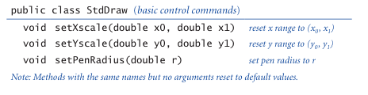
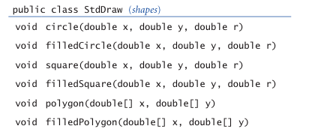
Standard IO
StdDraw – standard drawing

Slide 6
Question 1 – printAll numbers + Solution
The function in.isEmpty() checks if there are any more unread characters in the file.
Note: if a file with the name “data.txt” does not exist in the same folder as the program, an exception will be thrown.
public static void main(String[] args) {
In in = new In(”./data.txt");
while (!in.isEmpty()){
StdOut.println(in.readInt());
}
}
data.txt
output
4
2 5
1 9
7
4
2
5
1
9
7

Slide 7
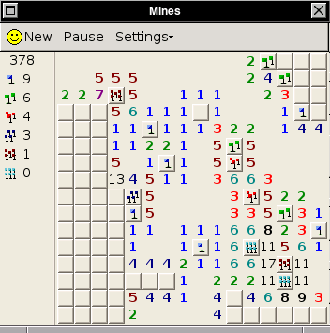
Question 2 – Mine Sweeper
In the popular game Mine Sweeper, a player has to guess where mines are located in a board.
If a square in the board does not contain a mine, then it lists the number of mines in all adjacent squares.
We will build a program to design a Mine Sweeper board.
Design a program which does the following:
Receives three command line arguments from the user:
Two integers N and M which will be the size of the board.
A double p, which will be the probability that a square contains a mine.
Prints the completed board, using ‘*’ to denote a mine.

Slide 8
Question 2 - Mine Sweeper
% java MineSweeper 5 5 0.4
2 * * 2 *
* 5 5 5 3
3 * * * *
3 * * * 3
* 3 3 2 1
% java MineSweeper 3 6 0.2
* 1 1 * * 1
2 2 2 2 3 2
1 * 1 0 1 *

Slide 9
Question 2 – Solution structure
public class MineSweeper {
/**
* Initializes a Minesweeper board with randomly placed mines based on the given probability.
*
* @param N Number of rows for the board (excluding padding).
* @param M Number of columns for the board (excluding padding).
* @param probability Probability of a cell containing a mine (value between 0 and 1).
* @return A 2D array representing the board, where 1 indicates a mine, and 0 indicates no mine.
*/
public static int[][] initializeMines(int N, int M, double probability);
/**
* Calculates the number of adjacent mines for each cell in the board.
*
* @param N Number of rows for the board (excluding padding).
* @param M Number of columns for the board (excluding padding).
* @param mines A 2D array indicating the placement of mines.
* @return A 2D array representing the board, where each cell contains the count of adjacent mines.
*/
public static int[][] calculateBoard(int N, int M, int[][] mines);
/**
* Prints the Minesweeper board, displaying '*' for mines and numbers for adjacent mine counts.
*
* @param N Number of rows for the board (excluding padding).
* @param M Number of columns for the board (excluding padding).
* @param mines A 2D array indicating the placement of mines.
* @param board A 2D array representing the board with adjacent mine counts.
*/
public static void printBoard(int N, int M, int[][] mines, int[][] board);
}

Slide 10
Question 2 – Solution initializeMines
/**
* Initializes a Minesweeper board with randomly placed mines based on the given probability.
*
* @param N Number of rows for the board (excluding padding).
* @param M Number of columns for the board (excluding padding).
* @param probability Probability of a cell containing a mine (value between 0 and 1).
* @return A 2D array representing the board, where 1 indicates a mine, and 0 indicates no mine.
*/
public static int[][] initializeMines(int N, int M, double probability) {
int[][] mines = new int[N + 2][M + 2];
for (int i = 1; i < N + 1; i++) {
for (int j = 1; j < M + 1; j++) {
if (Math.random() < probability) {
mines[i][j] = 1;
}
}
}
return mines;
}

Slide 11
Question 2 – Solution calculateBoard
/**
* Calculates the number of adjacent mines for each cell in the board.
*
* @param N Number of rows for the board (excluding padding).
* @param M Number of columns for the board (excluding padding).
* @param mines A 2D array indicating the placement of mines.
* @return A 2D array representing the board, where each cell contains the count of adjacent mines.
*/
public static int[][] calculateBoard(int N, int M, int[][] mines) {
int[][] board = new int[N + 2][M + 2];
for (int i = 1; i < N + 1; i++) {
for (int j = 1; j < M + 1; j++) {
board[i][j] = mines[i - 1][j] + mines[i - 1][j - 1] +
mines[i - 1][j + 1] + mines[i][j - 1] +
mines[i][j + 1] + mines[i + 1][j] +
mines[i + 1][j + 1] + mines[i + 1][j - 1];
}
}
return board;
}

Slide 12
Question 2 – Solution printBoard
/**
* Prints the Minesweeper board, displaying '*' for mines and numbers for adjacent mine counts.
*
* @param N Number of rows for the board (excluding padding).
* @param M Number of columns for the board (excluding padding).
* @param mines A 2D array indicating the placement of mines.
* @param board A 2D array representing the board with adjacent mine counts.
*/
public static void printBoard(int N, int M, int[][] mines, int[][] board) {
for (int i = 1; i < N + 1; i++) {
for (int j = 1; j < M + 1; j++) {
String cur = mines[i][j] == 0 ? board[i][j] + "" : "*";
System.out.print(cur + " ");
}
System.out.println();
}
}

Slide 13
Question 2 – Solution main
public class MineSweeper {
public static void main(String[] args) {
// Create an In instance to read from standard input
In in = new In();
// Take input for number of rows (N)
System.out.println("Enter the number of rows (N): ");
int N = in.readInt();
// Take input for number of columns (M)
System.out.println("Enter the number of columns (M): ");
int M = in.readInt();
// Take input for mine probability
System.out.println("Enter the probability of a mine (0 to 1): ");
double probability = in.readDouble();
// Initialize the game
int[][] mines = initializeMines(N, M, probability);
int[][] board = calculateBoard(N, M, mines);
// Print the game board
printBoard(N, M, mines, board);
}
}

Slide 14

Question 2, Expansion 1– MineSweeper.
Now that we know how to generate a board, we can make it more presentable.
Design a program which does the following:
Receives N and M (the size of the board) as command line arguments.
Reads from the standard input a minesweeper board of the appropriate size (assume the board size is legal).
Prints the board using StdDraw. If a square contains a bomb, use the following icon named “mine.png”.
StdDraw.picture(x, y , filename) draws the picture in filename centered at location (x, y)
So StdDraw.picture(0, 0, “mine.png”) will put the mine icon centered at the bottom left corner.
StdDraw.text(x, y, text) prints the string text centered at location (x, y).

Slide 15
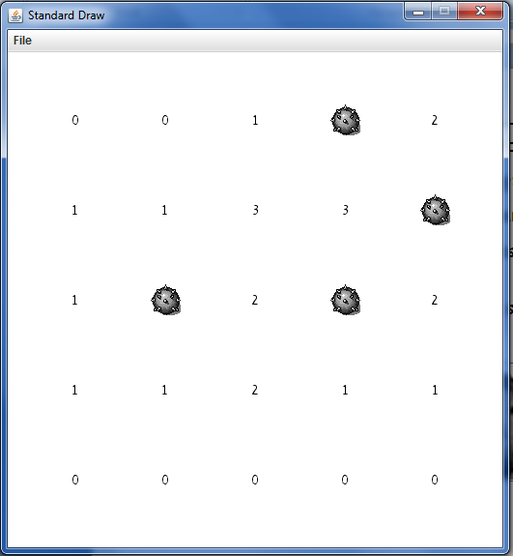
Question 2, Expansion 1– MineSweeper.
% java MineSweeper 5 5 0.2

Slide 16
Question 2, Expansion 1 – Solution
public class DrawMineSweeper {
public static void main (String[] args) {
int N = Integer.parseInt(args[0]);
int M = Integer.parseInt(args[1]);
//sets the scale of the drawing board.
StdDraw.setXscale(0, N);
StdDraw.setYscale(0, M);
In in = new In();
//at each cell put a number or a bomb
for (int i = 0; i < N; i++) {
for (int j = 0; j < M; j++) {
String s = in.readString();
if (s.equals("*")) {
StdDraw.picture(i + 0.5, j + 0.5,"mine.png");
} else {
StdDraw.text(i + 0.5, j + 0.5, s);
}
}
}
}
}

Slide 17
Question 3 – Battleships
Battleships is a classic strategy game that tests your tactical skills, memory, and intuition. Played between two opponents, the game revolves around a grid-based battlefield where players secretly position their fleets of ships. The objective is to locate and destroy the opponent's fleet before they destroy yours.
Each player has their own, for placing their ships and tracking hits/misses on the opponent’s grid. The fleet typically includes ships of varying sizes, such as a carrier, battleship, cruiser, submarine, and destroyer. Players take turns calling out coordinates (e.g., 0,1) to launch "attacks”. If a ship occupies the attacked coordinate, it’s a “hit”, otherwise it’s a “miss”. Ships are sunk when all their corresponding segments are hit.The first player to sink all of their opponent's ships wins.
Build your own single player Battleship game, the fleet contains ships in size 1X1 only. The game should start by selecting the grid size (N > 0) by input given by the user. Then it puts N battleships in N different locations.
Then After initializing the game you are required it is now time to play. In every round, you are asked to select coordinates, if they are out of bounds, lets you know, and repeat, the same as found/not found a battleship once they are done. The game let you know

Slide 18

Question 3 - Battleships
% java Battleship
What size game would you like to play?
2
enter your guess:
0 0
Nothing here, only water.
enter your guess:
1 1
You sunk my battleship, good job.
enter your guess:
3 0
Illegal coordinates, try again.
enter your guess:
0 1
You sunk my battleship, good job.
VICTORY!!!!!!

Slide 19
Question 3 – Solution
public class Battleships {
public static void main(String[] args){
StdOut.println("What size game would you like to play?");
In in = new In();
int N = in.readInt();
//create an N X N board
boolean[][] subs = new boolean[N][N];
//Choose N random locations for battleships.
for (int i = 0; i < N; i++){
int x = (int) (Math.random() * N);
int y = (int) (Math.random() * N);
while(subs[x][y]){
x = (int) (Math.random() * N);
y = (int) (Math.random() * N);
}
subs[x][y] = true;
}
...

Slide 20
Question 3 – Solution (Continued)
// ...
int userX = 0;
int userY = 0;
int sunk = 0;
//Keep playing the game until the number of sunk battleship reaches N
while (sunk < N){
StdOut.println("enter your guess:");
userX = in.readInt();
userY = in.readInt();
//check if the coordinates are within the board
if (userX >= N || userX < 0 || userY >= N || userY < 0){
StdOut.println("Illegal coordinates, try again.");
StdOut.println();
continue;
}
//if a battleship is in the coordinates update the data
if (subs[userX][userY]){
StdOut.println("You sunk my battleship, good job.");
sunk++;
subs[userX][userY] = false;
} else {
StdOut.println("Nothing here, only water.");
}
StdOut.println();
}
StdOut.println("VICTORY!!!!!");
}
}

Slide 21

Introduction to Computer Science
Reichman University
Recitation 6
The Color Class

Slide 22
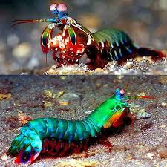
RGB Color System
Every color noticeable to the human eyes can be decomposed into its red, green and blue component.
The RGB system uses that fact to represent each color as 3 integers in the range [0,255]. The first integer corresponds to the intensity of red, the second corresponds to the intensity of green, and the third to blue.
Examples:
{255, 0, 0} is Red.
{0, 255, 0} is Green.
{0, 0 ,255} is Blue.
{199, 67, 117} is Pink Fuchsia.
An interesting note: this system is unique for humans. For example, the mantis shrimp can decompose colors into 16(!!) different base colors.

Slide 23

The Color class
While we can represent everything using 3-dimensional arrays, it can get cumbersome….
Fortunately, Java has a Color data type which makes handling images more straightforward.
Essentially a variable of type Color, is an array of 3 integers with values between 0 and 255. (Color is an advanced type)
To use this variable in your program you need to add ”import java.awt.Color;” as the first statement.
Initialization is done exactly like arrays.
Color c = new Color(255,0,0);
To check the r,g,b values we can use the functions getRed(), getGreen(), getBlue().
That is, c.getRed() will be 255.
https://docs.oracle.com/javase/7/docs/api/java/awt/Color.html
Notes:
‹#›

Slide 24
Example 1 – Color
import java.awt.Color;
public class Colors {
public static void main(String[] args) {
Color red = new Color(255,0,0);
Color green = new Color(0,255,0);
Color blue = new Color(0,0,255);
System.out.println(red.getRed()); // 255
System.out.println(red.getGreen()); // 0
System.out.println(green.getGreen()); // 255
Color[][] array = new Color[2][2];
array[0][0] = red;
array[0][1] = blue;
array[1][0] = green;
array[1][1] = new Color(100,100,100);
System.out.println(array[1][1].getGreen()); // 100
}
}

Slide 25

Introduction to Computer Science
Reichman University
Recitation 6
PPM Format & Image Processing

Slide 26
Digital Images – PPM format
PPM, is an uncompressed image format, and so is not widely used for real applications.
However, it’s simple enough to fit most basic exercises, which makes it ideal for learning how to deal with digital images.
Before explaining how the PPM format is organized, we give a brief explanation of some fundamental concepts of digital Images.

Slide 27

Pixels
Pixels are the ‘atoms’ of an image.
Each image is composed of many pixels.
A pixel has two characteristics
Location
Color
A black pixel
A white pixel

Slide 28
PPM
tinypic.ppm
P3
4 4
255
0 0 0 100 0 0 0 0 0 255 0 255
0 0 0 0 255 175 0 0 0 0 0 0
0 0 0 0 0 0 0 15 175 0 0 0
255 0 255 0 0 0 0 0 0 255 255 255

Slide 29
PPM
tinypic.ppm
P3
4 4
255
0 0 0 100 0 0 0 0 0 255 0 255
0 0 0 0 255 175 0 0 0 0 0 0
0 0 0 0 0 0 0 15 175 0 0 0
255 0 255 0 0 0 0 0 0 255 255 255
The header – will always be “P3”

Slide 30
PPM
tinypic.ppm
P3
4 4
255
0 0 0 100 0 0 0 0 0 255 0 255
0 0 0 0 255 175 0 0 0 0 0 0
0 0 0 0 0 0 0 15 175 0 0 0
255 0 255 0 0 0 0 0 0 255 255 255
Number of columns

Slide 31
PPM
tinypic.ppm
P3
4 4
255
0 0 0 100 0 0 0 0 0 255 0 255
0 0 0 0 255 175 0 0 0 0 0 0
0 0 0 0 0 0 0 15 175 0 0 0
255 0 255 0 0 0 0 0 0 255 255 255
P3
4 4
255
0 0 0 100 0 0 0 0 0 255 0 255
0 0 0 0 255 175 0 0 0 0 0 0
0 0 0 0 0 0 0 15 175 0 0 0
255 0 255 0 0 0 0 0 0 255 255 255
Number of rows

Slide 32
PPM
tinypic.ppm
P3
4 4
255
0 0 0 100 0 0 0 0 0 255 0 255
0 0 0 0 255 175 0 0 0 0 0 0
0 0 0 0 0 0 0 15 175 0 0 0
255 0 255 0 0 0 0 0 0 255 255 255
P3
4 4
255
0 0 0 100 0 0 0 0 0 255 0 255
0 0 0 0 255 175 0 0 0 0 0 0
0 0 0 0 0 0 0 15 175 0 0 0
255 0 255 0 0 0 0 0 0 255 255 255
Maximum intensity – will always be 255

Slide 33
PPM
tinypic.ppm
P3
4 4
255
0 0 0 100 0 0 0 0 0 255 0 255
0 0 0 0 255 175 0 0 0 0 0 0
0 0 0 0 0 0 0 15 175 0 0 0
255 0 255 0 0 0 0 0 0 255 255 255
P3
4 4
255
0 0 0 100 0 0 0 0 0 255 0 255
0 0 0 0 255 175 0 0 0 0 0 0
0 0 0 0 0 0 0 15 175 0 0 0
255 0 255 0 0 0 0 0 0 255 255 255
Each three numbers define RGB values for one pixel, this is the first pixel, it’s Black.

Slide 34
PPM
tinypic.ppm
P3
4 4
255
0 0 0 100 0 0 0 0 0 255 0 255
0 0 0 0 255 175 0 0 0 0 0 0
0 0 0 0 0 0 0 15 175 0 0 0
255 0 255 0 0 0 0 0 0 255 255 255
P3
4 4
255
0 0 0 100 0 0 0 0 0 255 0 255
0 0 0 0 255 175 0 0 0 0 0 0
0 0 0 0 0 0 0 15 175 0 0 0
255 0 255 0 0 0 0 0 0 255 255 255
Second pixel happens to be Bordeaux.

Slide 35
PPM
tinypic.ppm
P3
4 4
255
0 0 0 100 0 0 0 0 0 255 0 255
0 0 0 0 255 175 0 0 0 0 0 0
0 0 0 0 0 0 0 15 175 0 0 0
255 0 255 0 0 0 0 0 0 255 255 255
P3
4 4
255
0 0 0 100 0 0 0 0 0 255 0 255
0 0 0 0 255 175 0 0 0 0 0 0
0 0 0 0 0 0 0 15 175 0 0 0
255 0 255 0 0 0 0 0 0 255 255 255
Overall, there are 4 X 4 pixels. Pixels are arranged according to their location in the image.

Slide 36
PPM
tinypic.ppm
P3
4 4
255
0 0 0 100 0 0 0 0 0 255 0 255
0 0 0 0 255 175 0 0 0 0 0 0
0 0 0 0 0 0 0 15 175 0 0 0
255 0 255 0 0 0 0 0 0 255 255 255

Slide 37
Reading PPM files
In order to operate on digital images we must first represent them inside our program.
A very natural way is to store the image’s data inside a 3 - dimensional array.
The first two dimensions correspond to one pixel’s locations.
The third dimension will be of size 3, and correspond to the pixel’s RGB values.
{{{0 , 0 , 0 }, {100, 0 , 0 }, {0, 0 , 0 }, {255, 0 , 255 }},
{{0 , 0 , 0 }, {0 , 255, 175}, {0, 0 , 0 }, {0 , 0 , 0 }},
{{0 , 0 , 0 }, {0 , 0 , 0 }, {0, 15, 175}, {0 , 0 , 0 }},
{{255, 0 , 255}, {0 , 0 , 0 }, {0, 0 , 0 }, {255, 255, 255 }}}

Slide 38

Question 5 - Color Inverting
Using the RGB system allows us to invert colors.
Inversion of a color is done by subtracting it from 255.
So, the red inverse of {10, 20, 30} is {245, 20, 30}.
We can invert more than one color, if we invert all of the colors, the previous pixel becomes {245, 235, 225}.
We will use the following image as an example:

Slide 39
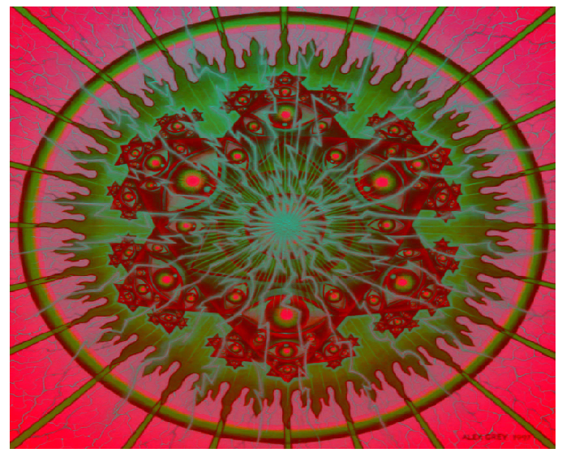
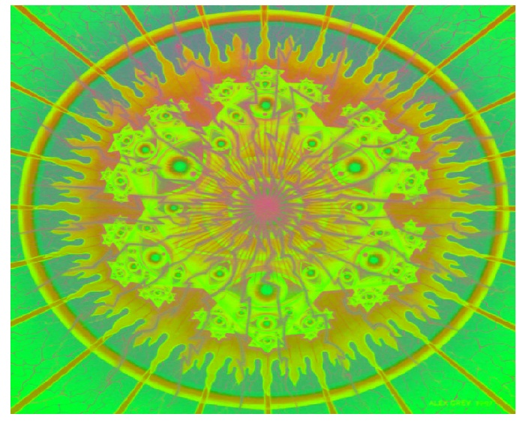
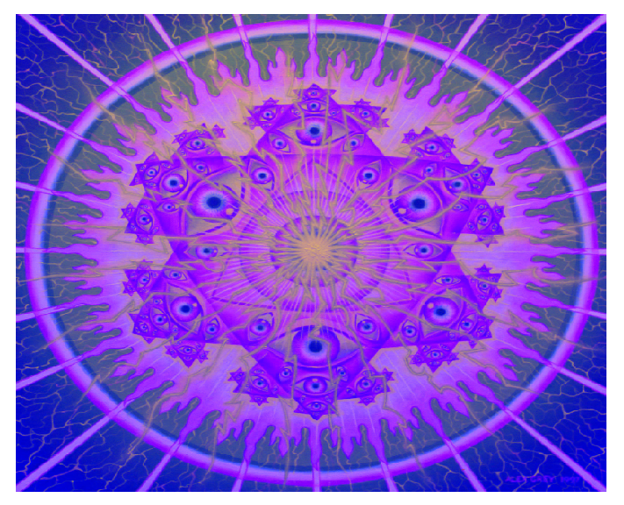
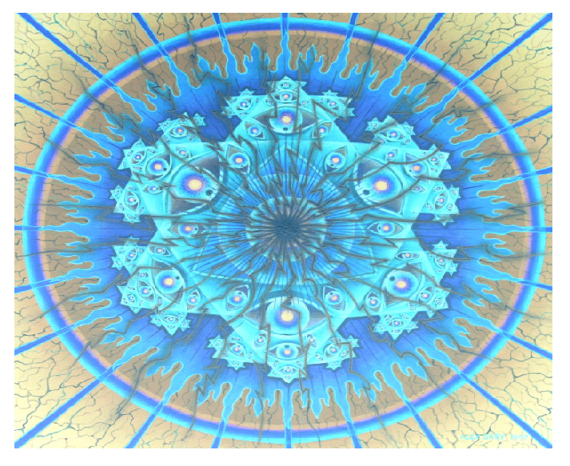
Inversions
Red Inversion
Green Inversion
Blue Inversion
Total

Slide 40
Question 5 – Solution
public class ColorInvertor{
public static final int MAX_INTENSITY = 255;
public static final int RED_IDX = 0;
public static final int GREEN_IDX = 1;
public static final int BLUE_IDX = 2;
/**
* Inverts all the colors of an image
* @param pic – the image
* @return the inverted image
*/
public static Color[][] invertAll(Color[][] pic){
pic = invertColor(pic, RED_IDX);
pic = invertColor(pic, GREEN_IDX);
pic = invertColor(pic, BLUE_IDX);
return pic;
}
public static Color[][] invertColor(Color[][] pic, int colorIdx){
...
}
public static Color invertPixel(Color pixel, int colorIdx){
...
}
}
The following class contains some functions to help us invert one or more colors of a given image.

Slide 41
Question 5 – Solution (Continued)
/**
* inverts one color of an image.
* @param pic - the picture to be inverted
* @param colorIdx - the index of the color to be inverted
* @return the inverted image
*/
public static Color[][] invertColor(Color[][] pic, int colorIdx){
Color[][] ans = new Color[pic.length][pic[0].length];
for (int i = 0; i < ans.length; i++) {
for (int j = 0; j < ans[0].length; j++) {
ans[i][j] = invertPixelColor(pic[i][j], color);
}
}
return ans;
}
/**
* invert one color of a given pixel.
* @param pixel - the color array to be inverted
* @param colorIdx - the index of the color to be inverted
* @return - the inverted pixel
*/
public static Color invertPixelColor(Color pixel, int colorIdx){
int[] newPixel = {pixel.getRed(), pixel.getGreen(), pixel.getBlue()};
newPixel[colorIdx] = MAX_INTENSITY - newPixel[colorIdx];
return new Color(newPixel[0], newPixel[1], newPixel[2]);
}

Slide 42

Introduction to Computer Science
Reichman University
Recitation 6
Mid term - Review

Slide 43
Question 6 – Mystery
public class Mystery {
public static int num = 3;
public static final int NUMBER = 3;
public static final int[] NUMBERS_ARRAY = {1, 2, 4};
public static void changeNum () {
num = 5;
}
public static void changeNumber () {
NUMBER = 5;
}
public static void changeNumbersI () {
NUMBERS_ARRAY = {4, 6, 7};
}
public static void changeNumbersII () {
NUMBERS_ARRAY[0] = 5;
}
}
Detail for each of the following functions, what will happen if it were to run individually, what the output will be?

Slide 44
Question 6 – Mystery (ANSWER)
public class Mystery {
public static int num = 3;
public static final int NUMBER = 3;
public static final int[] NUMBERS_ARRAY = {1, 2, 4};
public static void changeNum () {
num = 5; // will be run successfully, num will be 5 at the end of the program
}
public static void changeNumber () {
NUMBER = 5; // Error, since we defined ‘NUMBER’ as final it can’t be redeclared
}
public static void changeNumbersI () {
NUMBERS_ARRAY = {4, 6, 7}; // Error, since we defined ‘NUMBERS_ARRAY’
as final it can’t be redeclared
}
public static void changeNumbersII () {
NUMBERS_ARRAY[0] = 5; // will be run successfully, NUMBERS_ARRAY
} // will be {5, 2, 4} at the end of the program
}
Detail for each of the following functions, what will happen if it were to run individually, what the output will be?
Notes:
ההגדרה של
Final
היא על המערך לא על הערכים שבתוכו ולכן תקין.

Slide 45
Question 7.1 – Mystery (2021 Question 1)
public class Mystery {
public static void main (String [] args) {
int x = 3;
int[] y = {1, 2, 3};
triple1(x);
triple2(y);
System.out.println(x);
for (int i = 0; i < x; i++){
System.out.print(y[i] + " ");
}
}
public static void triple1 (int a) {
a = 3 * a;
}
public static void triple2 (int[] a) {
for (int i = 0; i < x; i++){
a[i] = 3 * a[i];
}
}
}
Write the program’s output? Explain.

Slide 46
Question 7.1 – Solution
Variables and Methods:
x: Initialized as an int with value 3.
It is passed to triple1 as a value (primitive type in Java).
y: Initialized as an array {1, 2, 3}.
It is passed to triple2 as a reference.
Method triple1(int a):
Receives a copy of the value of x (3).
Modifies the local variable a by setting it to 3 * a (i.e., 9).
This change affects only a, not x, because x was passed by value.
Method triple2(int[] a):
Receives a reference to the array y.
Attempts to modify the array elements by tripling them, but it uses x (an undeclared variable in triple2) in the loop condition.
This will cause a compilation error because x is not in the scope of triple2.
Notes:
‹#›

Slide 47
Question 7.2 – Mystery
public class Mystery {
public static void main (String [] args) {
int x = 3;
int[] y = {1, 2, 3};
triple1(x);
triple2(y, x);
System.out.println(x);
for (int i = 0; i < x; i++){
System.out.print(y[i] + " ");
}
}
public static void triple1 (int a) {
a = 3 * a;
}
public static void triple2 (int[] a, int x) {
for (int i = 0; i < x; i++){
a[i] = 3 * a[i];
}
}
}
Write the program’s output? Explain.

Slide 48
Question 7.2 – Solution
Output for Fixed Code:
triple1(x):
x remains 3 because triple1 modifies only the local copy of the variable.
triple2(y, x):
The array y is modified by tripling each element:
y[0] = 3 * 1 = 3
y[1] = 3 * 2 = 6
y[2] = 3 * 3 = 9
Output:
3
3 6 9
Explanation:
Primitive types (int x) are passed by value. Modifications to the parameter inside
the method (a) do not affect the original variable (x).
Array references (int[] y) are passed by reference. Modifications to the array elements inside the method affect the original array.
Notes:
‹#›

Slide 49
Question 8 – Find difference between maxValue and minValue in array
The file ‘MyArrays’ contains an integer array ’arr’ as a class static variable.
The function ‘findDiffBetweenMaxAndMin’ array returns a long variable which holds the difference between the max value of the array and the min value of the array.
Notes:
‹#›

Slide 50
Question 8 – Solution
public class MyArrays {
public static int[] arr = {6, 7, 1, -56, 93, 10, 30, -3, -23};
public static void main (String [] args) {
System.out.println(findDiffBetweenMaxAndMin());
}
public static long findDiffBetweenMaxAndMin() {
long minValue = Integer.MAX_VALUE;
long maxValue = Integer.MIN_VALUE;
for (int i = 0; i < arr.length; i++){
if (minValue > arr[i]) {
minValue = arr[i];
}
if (maxValue < arr[i]) {
maxValue = arr[i];
}
}
return maxValue – minValue;
}
}

Slide 51
Question 9 – Decimal to Hexadecimal (2022 Question 2)
Hexadecimal count (or hex’ for short) is a representation of number with base 16. There are total of 16 digits.
The digits 0 to 9, which hold the same value as the decimal presentation.
The letters A to F, which hold the values from 10 to 15 (in the decimal representation), respectively. (A is 10, B is 11 etc.)
Converting a number from a decimal base (base 10) to hex’ base is being done in a series of division operations. The first thing you need to do is get the reminder of the number by dividing the number by 16, find the according hex’ digit which represents the reminder and write it down, then we will divide the number by 16. The process will repeat itself until we reach 0. The letters should be written from right to left.
For example, let’s take the number 1071 and find its representation in hex’:
We will divide 1071 by 16 and get 66 with reminder 15. The hex’ digit ‘F’ represents 15, therefore we will write down the hex’ digit F. (Current solution: F)
We will divide 66 by 16 and get 4 with reminder 2. The hex’ digit ‘2’ represents 2, therefore we will write down the hex’ digit 2. (Current solution: 2F)
We will divide 4 by 16 and get 0 with reminder 4. The hex’ digit ‘4’ represents 4, therefore we will write down the hex’ digit 4. (Current solution: 42F)
We reached 0. Therefore, we finished. 1071 in hex’ is 42F.
Write a function ‘decToHex’ which receives a non-negative decimal number and returns a String which represents the hex’ value of the given number.
Notes:
‹#›

Slide 52
Question 9 – Solution
public class Hex {
public static void main (String[] args) {
System.out.println(decToHex(1071)); // output: “42F”
}
public static String decToHex(int num) {
if (num == 0){
return "0";
}
int cur = num;
String hexDigits = "0123456789ABCDEF";
String hex = "";
while (cur > 0) {
int remainder = cur % 16;
hex = hexDigits.charAt(remainder) + hex;
cur /= 16;
}
return hex;
}
}

Slide 53
Question 10 – Run-Length Encoding
Runlength Encoding is a data compression technique in which runs of 0 and 1 values with repetition are stored by numbers that represent their length. For example, the data set {1,1,1,0,0,0,0,0,1,1,1,1} is encoded as “3,5,4”. The method is implemented by the ‘compressed’ function. The function assumes that the data contains only 0’s and 1’s and starts with the value 1, there is no need to test it.
Notes:
‹#›

Slide 54
Question 10 – Solution
public class Compressed {
public static String compressed(int[] arr) {
String str = "";
int currNum = 1;
int count = 1;
for (int i = 1; i < arr.length; i++) {
if (arr[i] == currNum) {
count++;
} else {
str += count + ",";
count = 1;
currNum = 1 - currNum; // cases: currNum = 1 -> 1 - 1 = 0; currNum = 0 -> 1 - 0 = 1
}
if (i == arr.length - 1) {
str += "" + count;
}
}
return str;
}
}

Slide 55
Question 11 – Contains in string array
The function containsInArray receives an array of lower case letter only strings, and a String ‘val’ (also only lowercase), the functions check whether the string ‘val’ appears in the array.
Notes:
‹#›

Slide 56
Question 11 – Solution
public class ContainsInStringArray {
public static boolean containsInArray(String[] arr, String val) {
for (int i = 0; i < arr.length; i++) {
if (arr[i].equals(val)){
return True;
}
}
return false;
}
}

Slide 57
Question 12 – Classroom Seating Chart
Create a class called `ClassroomSeating` that manages a seating chart for a classroom using a static 2D array. Implement the following requirements:
Initialize a static 5x5 2D array of strings called `seatingChart` to represent the classroom seating arrangement.
Create a static method `initializeSeats()` that sets all seats to “Empty”.
Implement a static method `assignSeat(int row, int col, String studentName)` that assigns a student to a specific seat.
Create a static method `printSeatingChart()` that displays the current seating arrangement.
In the `main` method, demonstrate the usage of these methods by initializing the seating chart, assigning a few students to seats, and printing the chart after each assignment.
Add a static method `moveStudent(int fromRow, int fromCol, int toRow, int toCol)` that moves a student from one seat to another.
Implement a static method `findStudent(String studentName)` that returns the seat location (row and column) of a given student.
Create a static method `getClassSize()` that returns the number of occupied seats.
Add a static method `getRowCapacity(int row)` that returns the number of available seats in a specific row.
Notes:
‹#›

