Slide 1
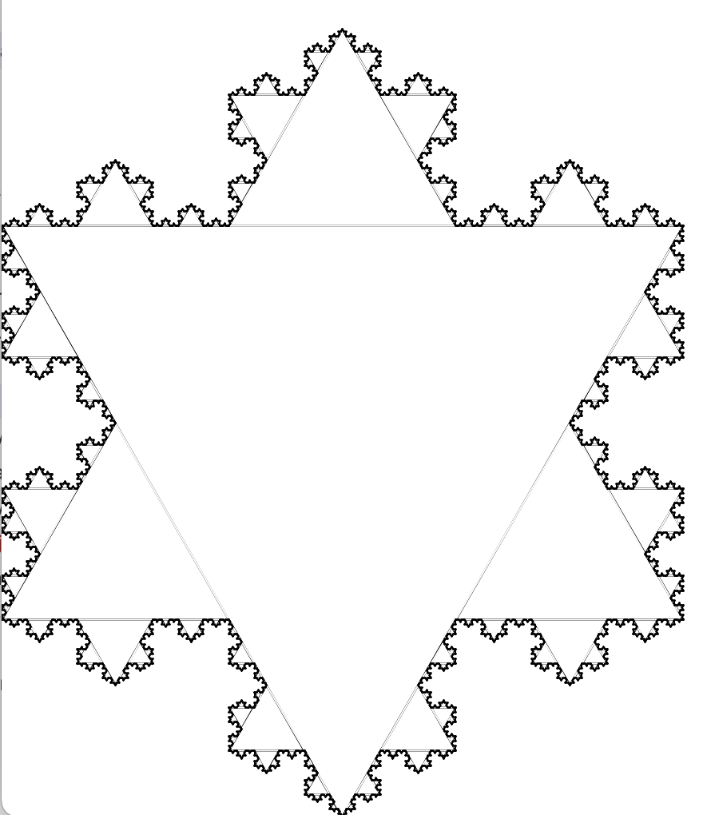
curve 1
curve 2
curve 3

