Slide 1
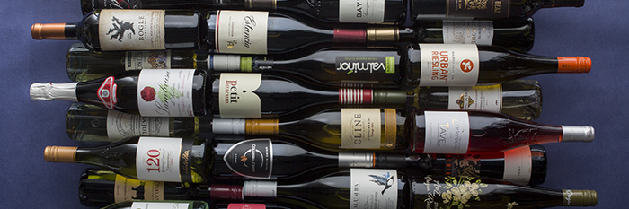
Mini-Project: Predicting Wine Review Scores
Predicting the Wine Enthusiast Ratings (www.winemag.com) based on Machine Learning Algorithms

Slide 2
Motivation
Problem -> How can we predict how sommeliers rank wine
Ever wondered why some wines are ‘better’ rated over others?

Slide 3
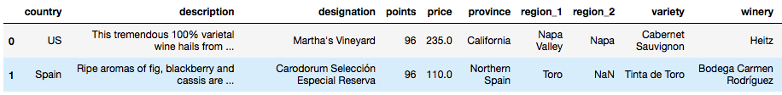
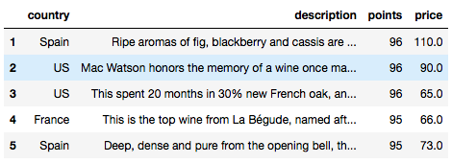

Step 1: Data Preparation
Data Outlook
Data set has been scraped from www.winemag.com and contains around 150k observations.
Target variable(y) = points | Feature variables(x) = country, price, description
Due to time constraints, drop some features
Data cleaning required

Slide 4
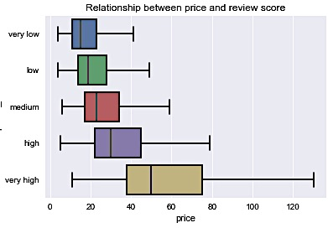
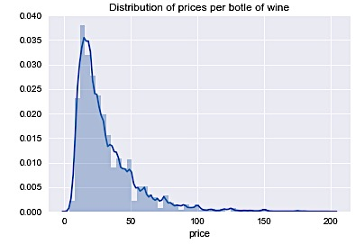
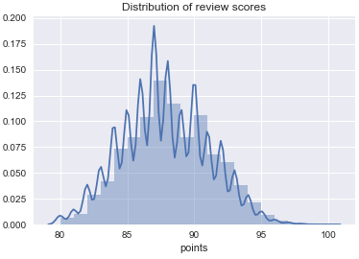
Step 1: Data Preparation
Making the price column ‘ready ‘for Machine Learning
1st transformation: control for outliers in the feature variable ‘price’ – drop rows with price larger than 200 and missing values. (reduction to 136k observations)

Slide 5
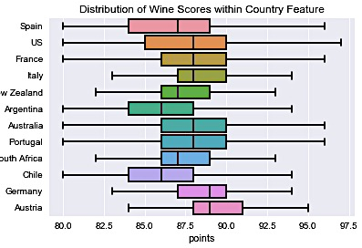
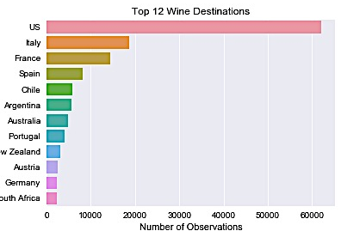
Step 1: Data Preparation
Making the country feature ‘ready’ for Machine Learning
2nd transformation: drop rows of countries that do not belong to the TOP 12 (reduction to 133k observations)

Slide 6
Step 1: Data Preparation
Split Data Set into Training, Validation & Test Set
Finally, splitting Data into three different Sets using a random split method to ensure that models train on the same sets:
Training Set = 70%
Validation Set = 15%
Test Set = 15%
Regression Problem: need to create dummy variables for categorical feature ‘country’.
The categorical feature ‘description’ needs special treatment: sklearn’s Count Vectorizer yields approx. 6550 distinct terms!
Part 1: Regression with features ‘country’ and ‘price’
Part 2: Regression with feature ‘description’

Slide 7
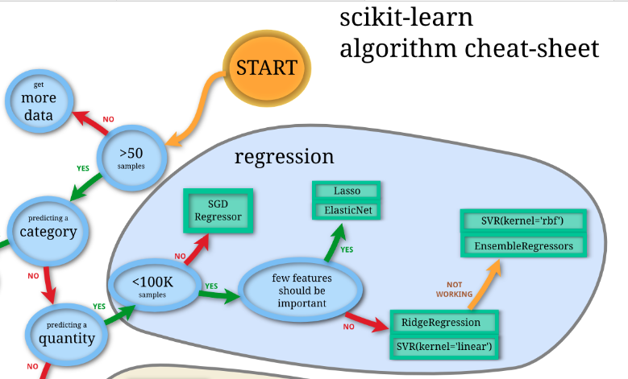
Step 2: Decision Trees - Regression
Choosing the right estimator for 1st Model (on validation set)
Regression of Choice: Decision Trees! Why?:
SGD Regression yields a negative R²
Elastic Net yields an R² of 0.3
Linear SVR yields R² of 0.3
Decision Trees yield a R² of > 0.3, hence best model!
Decision Trees (DTs) are a supervised learning method. The goal is to create a model that predicts the value of a target variable by learning simple decision rules inferred from the data features of different scales.
Simple to understand and to interpret.
Easy and fast to apply to large data sets
Able to handle both numerical and categorical data.
Possible to validate model with statistical tests.
Decision Trees are fairly simple and yield robust results → stick with Occam's Razor!

Slide 8
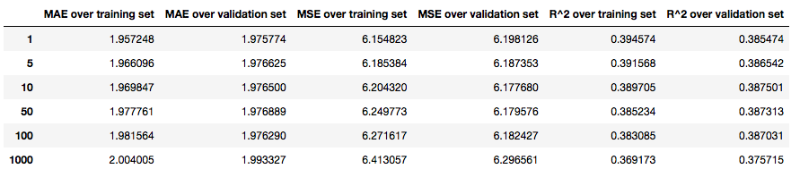
Step 2: Decision Trees - Regression
Selecting the optimal Decision Tree model parameter for price and country
Best R² over validation set is when min. leaf size is 1

Slide 9
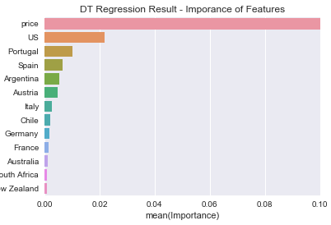
Step 2: Decision Trees - Regression
Price dominates score prediction!
A closer look reveals that price explains most in the variation of the score!
Weight of price > 0.9
2nd best = US with 0.02
Are sommeliers influenced by price?! ☺ This confirms what we saw in in the box plots

Slide 10
Step 3: Linear SVR
Choosing the right Regression for the 2nd model (over validation set)
Regression of Choice: Linear SVR Why?:
Decision Trees yield R² of 0.45
SGD Regression yields negative R²
Linear SVR yields R² of 0.7
Support Vector Regression (SVR) is a supervised learning method.
Goal = find a regression line that deviates by at most ‘epsilon’ from the target
Effective in high dimensional space (many feature attributes)

Slide 11
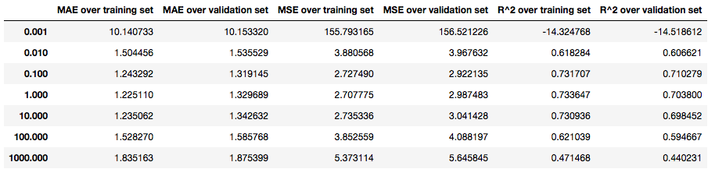
Step 3: Linear SVR
Selecting the optimal Linear SVR model parameter
optimal penalty parameter of the error term C => 0.10
The smaller penalty parameter C is, the higher the regularization of the model = protection against over fitting.

Slide 12
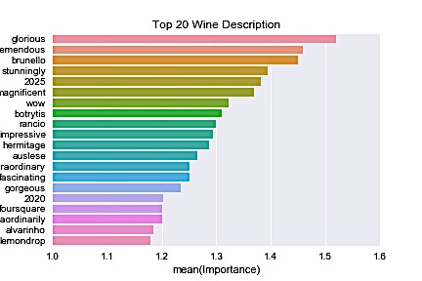
Step 3: Linear SVR
Result of Linear SV Regression
With optimal penalty C = 0.10 able to produce a reasonable table of key words
Most predictive words in the wine description show:
positive relationship between positive adjectives and good scores

Slide 13
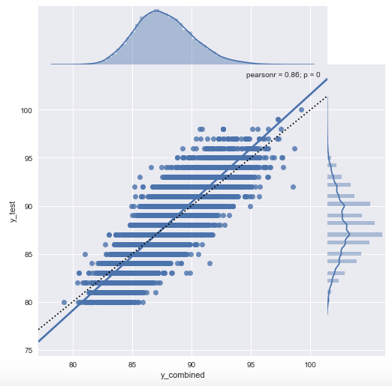
Step 4: Combining both models
Selecting optimal combination
Build own python function to optimize the weight
Optimal model = average of approx. 20% Model 1 and 80% Model 2
Separate two models combined:
Final R² Score over test set = 0.7310
slight increase explanatory power
Model does good job in approximating the identity line

Slide 14
Conclusion
Able to built a good predictive model for wine reviews
Could be used to extract wine-related sentiment from Twitter tweets
Most important factor is feature ‘description’, followed by ‘price’.
Positive descriptive adjectives and high price tend to yield better scores.
‘country’ (destination of wine) seems less important.
Question for further research:
More features / more specific region descriptions

