Slide 1
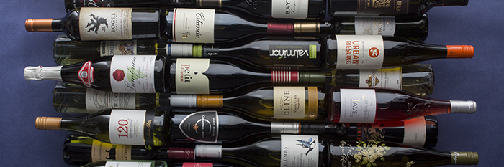
Mini-Project: Predicting Wine Review Scores
Predicting the WineEnthusiast Ratings (www.winemag.com) based on Machine Learning Algorithms

Slide 2
Motivation
Problem -> How can we predict how sommeliers rank wine
Ever wondered why some wines are ‘better’ rated over others?
Utilising of Python’s Scikit Learn library to built a predictive model

Slide 3
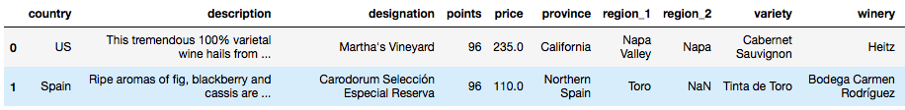
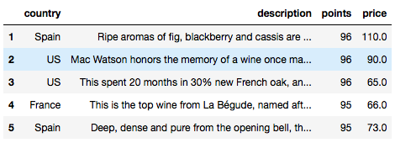

Step 1: Data Preparation
Data Outlook
Data set has been web scraped from the www.winemag.com and contains around 150k observations.
Target variable(y) = points | Feature variable(x) = country, price, description
Due to constraints, drop non-features
Data cleaning required

Slide 4
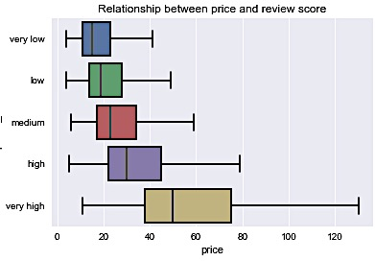
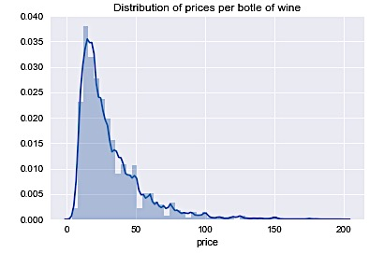
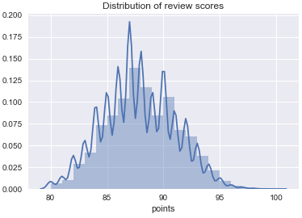
Step 1: Data Preparation
Cleaning the price column ‘ready ‘for Machine Learning
1st transformation: control for outliers in the feature variable ‘price’ – drop rows with price larger than 200 and NA values. (reduction to 136k observations)

Slide 5
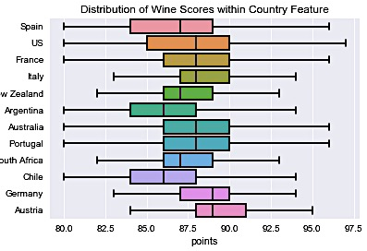
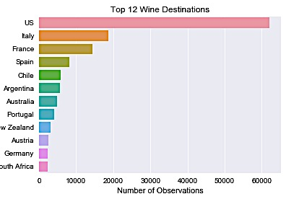
Step 1: Data Preparation
Making the country feature ‘ready’ for Machine Learning
2nd transformation: drop rows of countries that do not belong to the TOP 12 (reduction to 133k observations)

Slide 6
Step 1: Data Preparation
Split Data Set into Training, Validation & Test Set
Finally, splitting Data into three different Sets using a static split method via pd.split() to ensure that models train on the same sets:
Training Set = 70%
Validation Set = 15%
Test Set = 15%
Regression Problem: need to create dummy variables for categorical feature ‘country’;
pandas built in dummy creation function, pd.get_dummies() .
The categorical feature ‘description’ needs special treatment: sklearn’s Count Vectorizer yields approx. 6550 distinct terms!
Part 1: Regression with features ‘country’ and ‘price’
Part 2: Regression with feature ‘description’

Slide 7
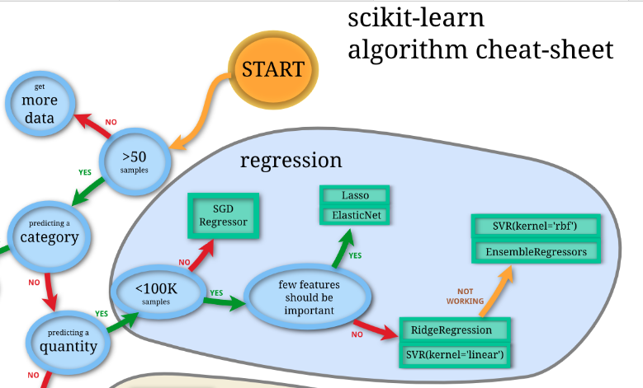
Step 2: Decision Trees - Regression
Choosing the right estimator for 1st Model
Regression of Choice: Decision Trees! Why?:
SGD Regression yields a negative R^2
Elastic Net yields an R^2 of 0.3
Linear SVR yields R^2 of 0.3
Decision Trees yield a R^2 of >0.3, hence best model!
Decision Trees (DTs) are a supervised learning method. The goal is to create a model that predicts the value of a target variable by learning simple decision rules inferred from the data features of different scales.
Simple to understand and to interpret.
Easy and fast to apply to large data sets
Able to handle both numerical and categorical data.
Possible to validate model with statistical tests.
Decision Trees are fairly simple and yield robust results → stick with Occam's Razor!

Slide 8
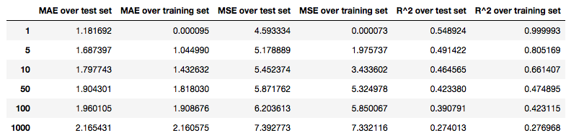
Step 2: Decision Trees - Regression
Selecting the optimal Decision Tree model parameter for price and country
Optimal minimal tree leaf is 5, hence this setup can predict the highest level of variance in the model.
Choosing min. Leaf of 1 is possible, but we probably get issues due to over-fitting

Slide 9
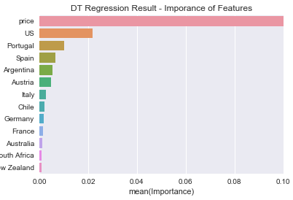
Step 2: Decision Trees - Regression
Price dominates explaining scores!
A closer look reveals that price explains most in the variation of the score!
Weight of price > 0.9
2nd best = US with 0.02
Are sommeliers influenced by price?! ☺

Slide 10
Step 3: Linear SVR
Choosing the right Regression for the 2nd model
Regression of Choice: Linear SVR Why?:
Decision Trees yield R^2 of 0.45
SGD Regression yields negative R^2
Elastic Net broke down!
Linear SVR yields R^2 of 0.7
Support Vector Regression (SVR) is a supervised learning method.
Goal = create a model that predicts the value of a target variable by optimally separating space to fit a regression line.
Effective in high dimensional space (many feature attributes)

Slide 11
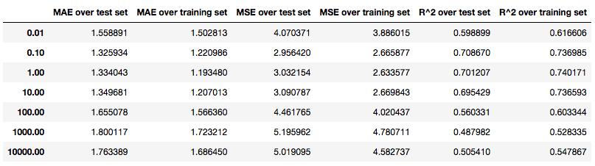
Step 3: Linear SVR
Selecting the optimal Linear SVR model parameter
optimal penalty parameter of the error term C => 0.10
(The penalty parameter determines how regulated the SV regression is)

Slide 12
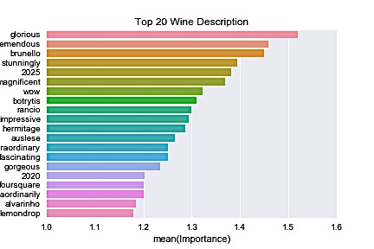
Step 3: Linear SVR
Result of Linear SV Regression
With optimal penalty C = 0.10 able to produce a reasonable table of key words
positive relationship between positive adjectives and good scores

Slide 13
Step 4: Combining both models
Selecting optimal combination
Build own python function to optimize the weight
Optimal weights = approx. 0.8% Model 2 and 0.2% Model 1
y_combined = (1-w) * y_pred_test + w * y_pred2_test
R^2 Score over test set = 0.7310
slight increase explanatory power over sub models

Slide 14
Conclusion
Most important factor is feature ‘description’, followed by ‘price’.
Positive descriptive adjectives and high price tend to yield better scores.
Origin (feature ‘country’) seems less important.
Question for further research:
Are wine scores meaningful?

