Slide 1
Class Choice System
Zhaoyu Yan

Slide 2
Pages
secure
student
Select course
success
Log in
logout
teacher
Create course
Sign up

Slide 3
Database
users
username | varchar | prime key
password | varchar
enable | 1
userinfo
id | int | prime key
username | varchar | foreign key
otherinfo | varchar
user_roles
username | varchar | foreign key
roles | varchar

Slide 4
Database
userinfo
id | int | prime key
username | varchar | foreign key
otherinfo | varchar
courses
id | int | prime key
coursename | varchar
details | varchar
user_course_detail
userId | int | foreign key
courseId | int | foreign key

Slide 5
Access Database
pages
DAO
Entity
Service
DAOImp

Slide 6
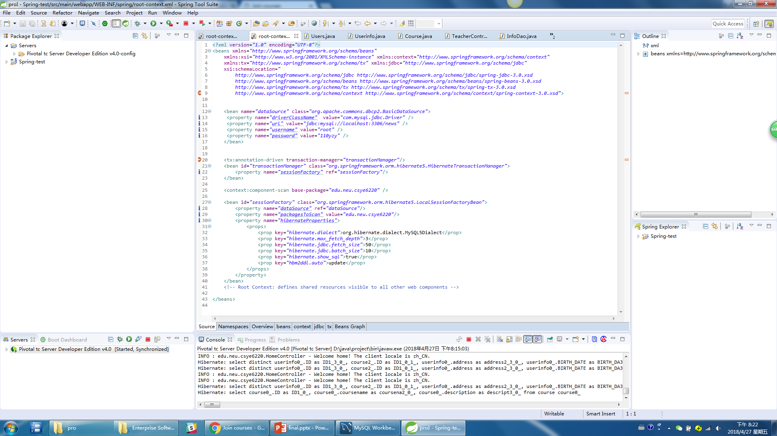
Hibernate Config

Slide 7
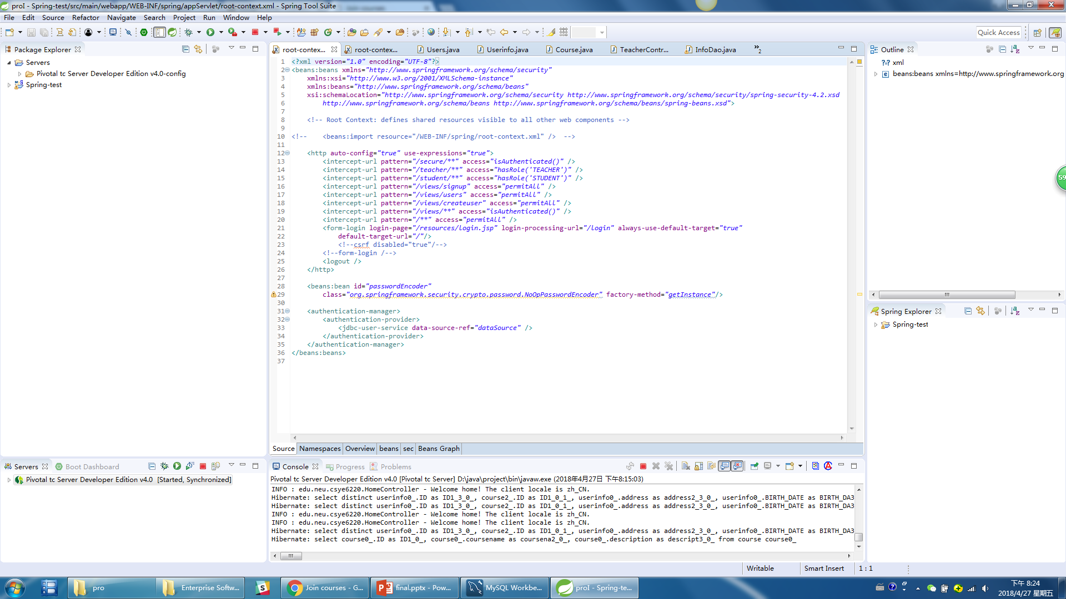
Security Config

Slide 8
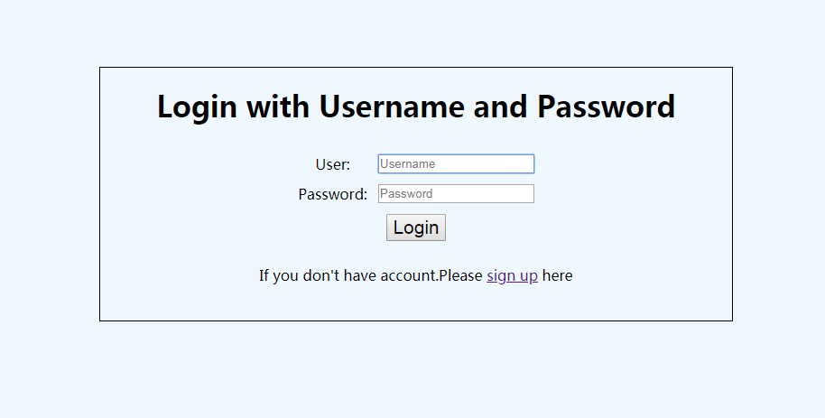
Log in

Slide 9
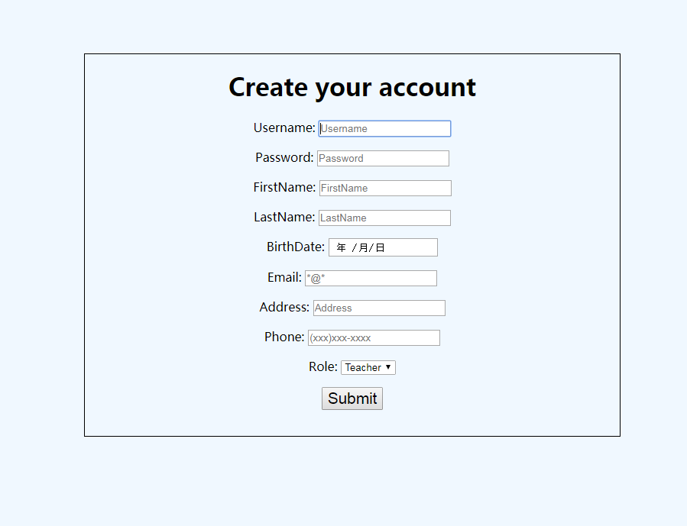
Sign up

Slide 10
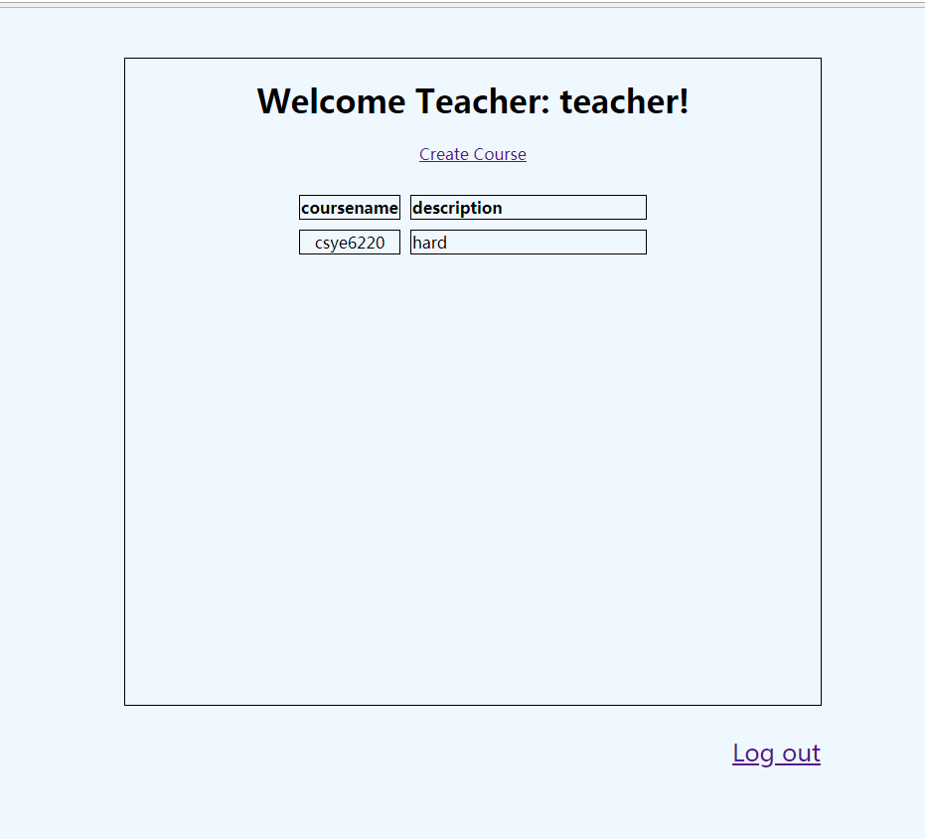
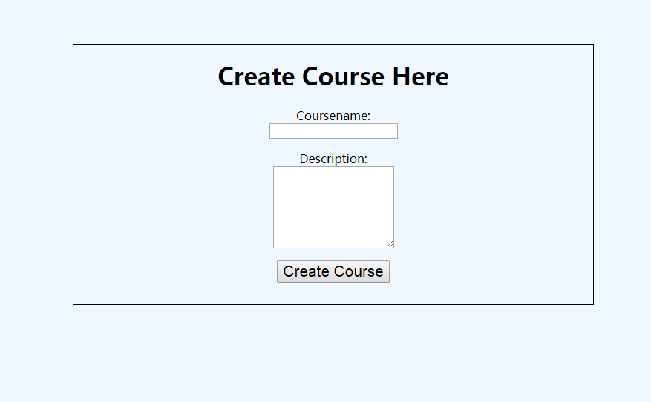
Teacher

Slide 11
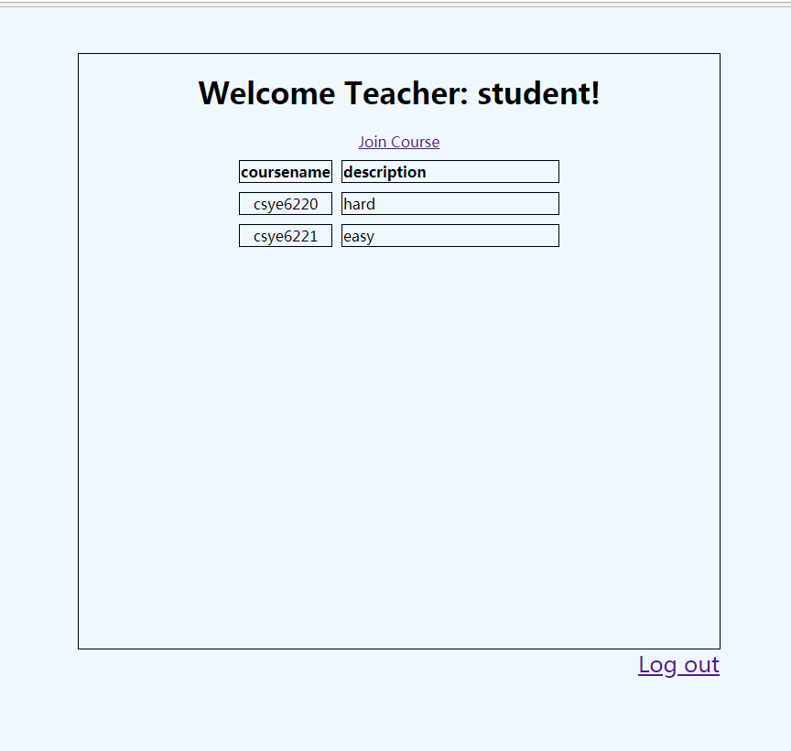
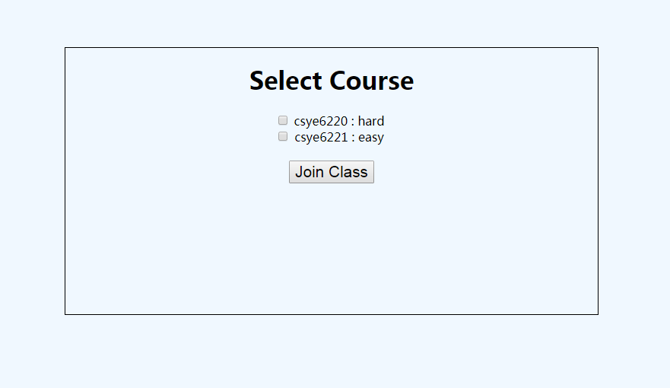
Student

