Slide 1

CSE 591 Final Review
Ross Maciejewski
rmacieje@asu.edu

Slide 2
What is Visualization?
“The use of computer-supported, interactive visual representations of data to amplify cognition.”¹
This is not simply the process of making a graphic or an image, the goal is to create insight, not pretty pictures
We want to help people form a mental image of something and internalize their own understanding
We want to promote discovery, decision making and explanations
1-Readings in Information Visualization: Using Vision to Think, SK Card, J Mackinlay and B.Shneiderman, 1999

Slide 3
The Information Seeking Mantra
Overview first,
then zoom and filter,
details on demand
1 - B. Shneiderman. The Eyes Have It: A Task by Data Type Taxonomy for Information Visualizations. In the Proceedings of the IEEE Symposium on Visual Languages, pp. 336-343, 1996.

Slide 4
Tasks for Visualization
Searching and browsing - find a specific piece of information, inspect data, seek information
Analyze – do comparisons, differences, look for outliers, extrema and patterns
Monitor – look for changes and trends

Slide 5
Data Types
Nominal
Data whose categories have no implied ordering
Examples include political affiliations of a population
Ordinal
Data that has a specified order, but no specified distance metric
Examples include beverage sizes at McDonalds (Small, medium, large)
Interval
Data that has measurable distances
Examples include periods of time (second, minute, etc.) – the zero point is arbitrary
Ratio
Same as interval, but include a zero point
Example include Celsius scale, height above sea level
1- SS Stevens, “On the Theory of Scales of Measurement,” Science, 103(2684):677-680, 1946.

Slide 6
Mapping Data
We need to know how to assign quantitative dimensions of our data to aesthetic attributes¹ of the data
Form | Surface | Motion | Sound | Text
Position Size Shape polygon glyph image Rotation Resolution | Color hue brightness saturation Texture pattern granularity orientation Blur Transparency | Direction Speed Acceleration | Tone Volume Rhythm Voice | Label
L Wilkinson (2005) The Grammar of Graphics

Slide 7
Aesthetic Attributes
An attribute must be capable of representing both continuous and categorical variables
When representing a continuous variable, an attribute must vary primarily on one psychophysical dimension
In order to use multidimensional attributes (such as color), we must scale them on a single dimension
An attribute does not imply a linear perceptual scale
Much of the skill in graphic design is knowing what combination of attributes should be avoided¹
1-SM Kosslyn (1994), The Elements of Graph Design

Slide 8
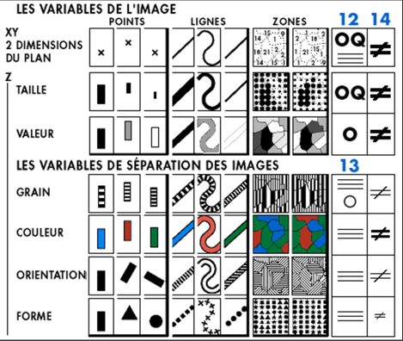
Bertin’s Visual Variables
Visualization is concerned primarily with a mapping to visual form
[x,y]
Position
[z]
Size (Taille)
Value (Valeur)
Color (Couleur)
Texture (Grain)
Orientation
Shape (Forme)
J Bertin (1967), The Semiology of Graphics

Slide 9
Combinatorics of Encodings
Challenge:
Pick the best encodings from the exponential number of possibilities (n+1)⁸
Principle of Consistency: The properties of the image should match the properties of the data
Principle of Importance Ordering: Encode the most important information in the most effective way
1 – This slide is borrowed from Pat Hanrahan’s “From Data to Image” lecture: http://graphics.stanford.edu/courses/cs448b-04-winter/lectures/encoding/

Slide 10
The Expressiveness & Effectiveness Criteria
Expressiveness: A set of facts is expressible in a visual language if the visualizations express all the facts in the set of data, and only the facts in the data
Effectiveness: A visualization is more effective than another visualization if the information conveyed by one visualization is more readily perceived than the information in the other visualization
1 – J. Mackinlay, Automating the Design of Graphical Presentations of Relational Information, ACM Transactions on Graphics, 5(2): 110-141, 1986.

Slide 11
Perception
A key goal of visualization is to produce images of data that support visual analysis¹
Human perception plays an important role in visualization
How we “see” details directly impacts the efficiency and effectiveness of an image (remember Mackinlay’s criteria from last lecture²)
By understanding perception, we can improve the quality and quantity of information being displayed³
1 - C. Healey and J. Enns, “Attention and Visual Memory in Visualization and Computer Graphics”, IEEE Transactions on Visualization and Computer Graphics, 2011 (Pre-print)
2 - J. Mackinlay, Automating the Design of Graphical Presentations of Relational Information, ACM Transactions on Graphics, 5(2): 110-141, 1986.
3 - Ware, C. Information Visualization: Perception for Design. Morgan Kaufmann Publishers, Inc., San Francisco, California, 2000.

Slide 12
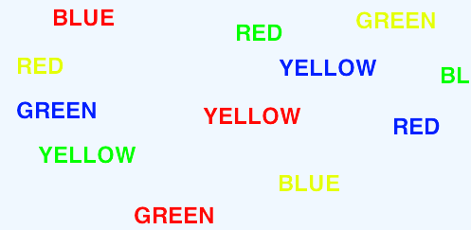
Selective Visual Attention
It is difficult to attend to more than one thing at the same time
When we attend to one task over the other, this is selective attention
Classic Stroop task – Read aloud the color of the word, not the word itself
Stroop, John Ridley (1935). "Studies of interference in serial verbal reactions". Journal of Experimental Psychology 18 (6): 643–66

Slide 13
Theoretical Interpretations of Selective Attention
Bottleneck/filter theories
A bottleneck is a mechanism that limits the amount of information to be attended to
Early selection¹ - select one message for further processing and all others are lost
Attenuation² – select one message for full processing, others are partially processed
Late selection³ – all messages get through but only one is selected for processing
1 – D. E. Broadbent, Perception and Communication. Oxford, United Kingdom: Oxford University Press, 1958
2 – A. Triesman, “Monitoring and storage of irrelevant messages in selective attention,” Psychological Review 87: 272-300
3 – J. A. Deutsch and D. Deutsch, "Attention: some theoretical considerations,“ Psychological Review 70: 80–90

Slide 14





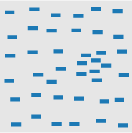

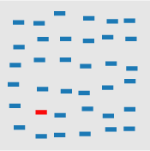
Partial List of Pre-Attentive Visual Features
Blob orientation length, width closure size
Curvature density, contrast number, estimation color(hue)
C. Healey and J. Enns, “Attention and Visual Memory in Visualization and Computer Graphics”, IEEE Transactions on Visualization and Computer Graphics, 2011 (Pre-print)

Slide 15
Color
Results from research on visual attention can be used to assign visual features to data values
One of the key components of visually representing data is choosing the appropriate color scale
There is no “best” color scale
Choice depends on^{1,2}
data type
problem domain
visual representation
Questions the analyst is asking of the data
While there is no “best” choice, there are design principles
1 - H. Levkowitz and G. T. Herman, "Color scales for image data," IEEE Computer Graphics and Applications, vol. 12, pp. 72-80, 1992
2 - P. Rheingans, "Task-based color scale design," Proceedings of Applied Image and Pattern Recognition, pp. 35-43, 1999.

Slide 16
Design Principles for Color Schemes
Order¹ – Given a univariate data type, the color scale that is chosen to map the data must represent a perceived ordering
Separation² – Important differences between ranges of the variable should be represented by colors that can be perceived as being different
Not only should they be perceived as different, but also equal
Aesthetics³ – color map should be aesthetically pleasing, contain a maximum perceptual resolution, and ordering should be intuitive
1 - B. E. Trumbo, “Theory for Coloring Bivariate Statistical Maps," The American Statistician, vol. 35, no. 4, pp. 220-226, 1981.
2 - H. Levkowitz and G. T. Herman, "Color scales for image data," IEEE Computer Graphics and Applications, vol. 12, pp. 72-80, 1992
3 - K. Moreland, “Diverging Color Maps for Scientific Visualization," Proceedings of the 5th International Symposium on Visual Computing, December 2009.

Slide 17


Univariate Color Schemes
Qualitative scheme
Rainbow color scale is one of the most commonly used, but it is a poor color map in a large variety of domain problems
Ordering of the hues is unintuitive
Nominal data types can use this scale as no ordering is implied
1 - D. Borland and R. M. Taylor, “Rainbow Color Map (Still) Considered Harmful,“ Computer Graphics & Applications, vol. 27, no. 2, pp. 14-17, 2007.
2 -P. Rheingans, “Task-based color scale design," Proceedings of Applied Image and Pattern Recognition, pp. 35-43, 1999.
3 - M. A. Harrower and C. A. Brewer, “ColorBrewer.org: An online tool for selecting color schemes for maps," The Catrtographic Journal, vol. 40, no. 1, pp. 27-37, 2003.

Slide 18

Univariate Color Schemes
Sequential color scheme
Simplest is the gray scale map where variable is mapped to brightness
Sequential maps represent ordered data
Dark colors typically represent high ranges, bright, low
Benefits are that the scale is intuitive
Weakness is that limited number of distinguishable colors can be represented
1 - D. Borland and R. M. Taylor, “Rainbow Color Map (Still) Considered Harmful,“ Computer Graphics & Applications, vol. 27, no. 2, pp. 14-17, 2007.
2 -P. Rheingans, “Task-based color scale design," Proceedings of Applied Image and Pattern Recognition, pp. 35-43, 1999.
3 - M. A. Harrower and C. A. Brewer, “ColorBrewer.org: An online tool for selecting color schemes for maps," The Catrtographic Journal, vol. 40, no. 1, pp. 27-37, 2003.

Slide 19
Histograms
Typical first look visualization method
Shows the shape of the data distribution
The choice of the histogram bin width greatly impacts the resultant visualization
There is no “best” number of bins, instead, different bin sizes can reveal different features of the data
Some methods work to determine an optimal number of bins, but these methods make assumptions on the underlying data distribution

Slide 20
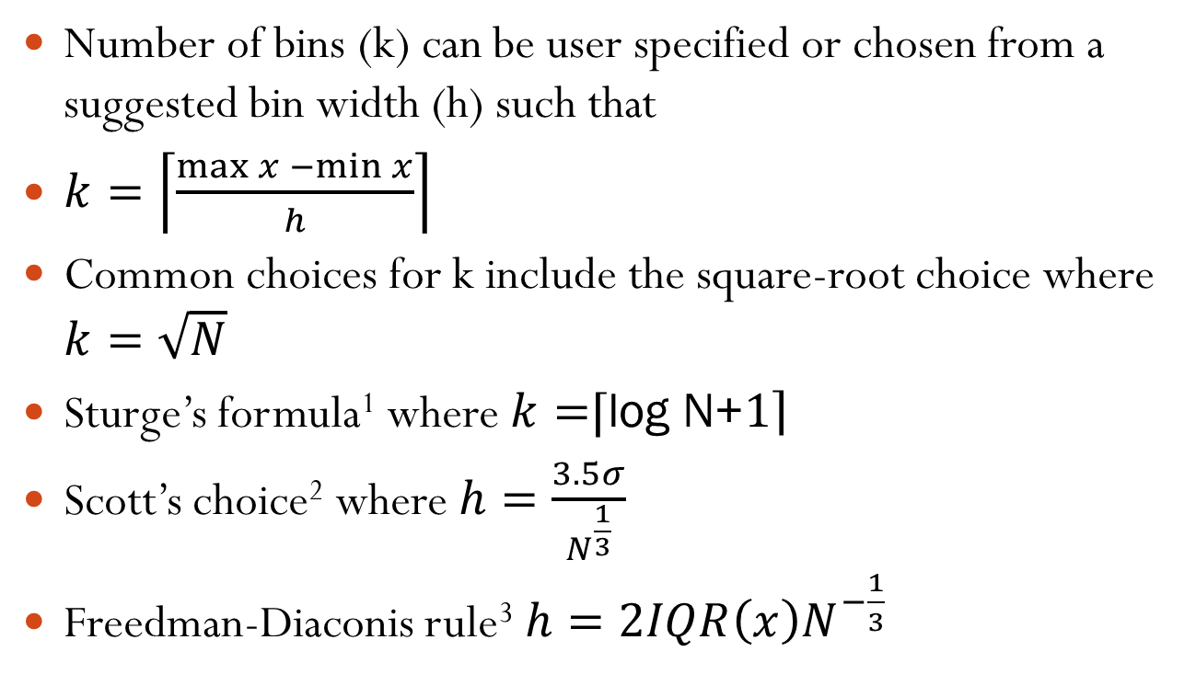
Histogram Binning
Number of bins (k) can be user specified or chosen from a suggested bin width (h) such that
$k=\left\lceil \left.\frac{\max{x −\min{x}}}{h}\right\rceil \right.$
Common choices for k include the square-root choice where $k=\sqrt{N}$
Sturge’s formula¹ where $k=$⌈log N+$\left.1\right\rceil$
Scott’s choice² where $h=\frac{3.5σ}{N^{\frac{1}{3}}}$
Freedman-Diaconis rule³ $h=2IQR\left(x\right)N^{−\frac{1}{3}}$
1 – H. A. Sturges. The choice of a class interval. Journal of the American Statistical Association, p. 65-66, 1926
2 - D. W. Scott. On optimal and data-based histograms. Biometrika, 66(3):605-610, 1979.
3 - Freedman, David; Diaconis, Persi, "On the histogram as a density estimator: L₂ theory". Probability Theory and Related Fields (Heidelberg: Springer Berlin) 57 (4): 453–476, 1981.
.

Slide 21
Quantiles
Quantiles – points taken at regular intervals from the cumulative distribution function of a random variable
Data is divided into q equal-sized data subset
The k^{th} q-quantile for a random variable is the value x such that the probability that the random variable will be less than x is at most k/q
The 2-quantile is the median
The 4-quantiles are called quartiles

Slide 22
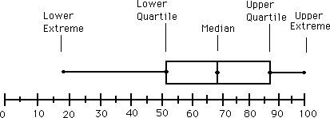
Box and Whisker Plots
Graphically depict groups of numerical data through their five-number summaries:
Smallest observation
Lower quartile
Median
Upper quartile
Sample maximum
Interquantile range (IQR) is the difference between the upper and lower quartile (Q₃-Q₁)

Slide 23
Q-Q Plots
Plot comparing the probability distribution by plotting their quantiles against each other
A point (x,y) on the plot corresponds to one of the quantiles of the second distribution
If the two distributions being compared are similar, the points in the Q-Q plot will approximately lie on the line y=x
If the distributions are linearly related they will lie approximately on a line, but not necessarily y=x
Q-Q plots can also be used as a graphical means of estimating parameters in a location-scale family of distributions
Wilk, M.B.; Gnanadesikan, R. (1968), "Probability plotting methods for the analysis of data", Biometrika (Biometrika Trust) 55 (1): 1–17.

Slide 24
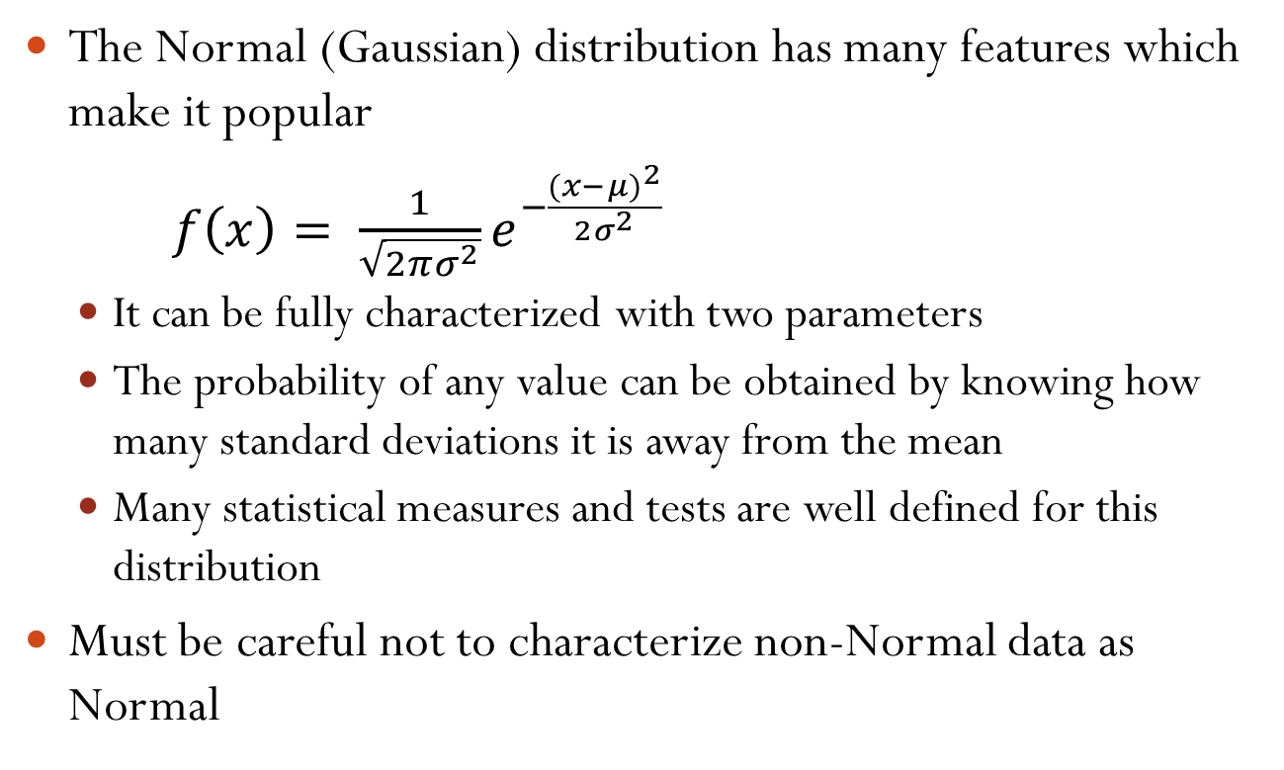
The Normal Distribution
The Normal (Gaussian) distribution has many features which make it popular
$f\left(x\right)= \frac{1}{\sqrt{2πσ^{2}}}e^{−\frac{(x−μ)^{2}}{2σ^{2}}}$
It can be fully characterized with two parameters
The probability of any value can be obtained by knowing how many standard deviations it is away from the mean
Many statistical measures and tests are well defined for this distribution
Must be careful not to characterize non-Normal data as Normal

Slide 25

Mean and Standard Deviation
For a sample population X = {x₁, … , x_{N}} the mean is defined as: $μ= \frac{1}{N}\sum_{i=0}^{N}{x_{i}}$
The standard deviation is defined as: $σ=\sqrt{\frac{1}{N}\sum_{i=0}^{N}{(x_{i}−μ)^{2}}}$

Slide 26
Skewness
Measure of the asymmetry of the probability distribution
Can be positive, negative or undefined
Negative skew indicates that the tail on the left side is longer than on the right
Positive skew indicates that the tail on the right side is longer than on the left
A zero value indicates the tails are relatively evenly distributed on both sides of the mean, but does not necessarily imply symmetry

Slide 27
The Power Transformation
We can transform data to a normal approximation by a power transformation¹
Such transformations reduce the effects of:
Skewness (transformations changes the range of data values and helps fit data onto the display)
Random noise (transformations can help show global trends)
Monotone spread
1 – J. W. Tukey. On the comparative anatomy of transformations. Annals of Mathematical Statistics, 28: 602-632, 1955.
Notes:
Show examples of skewness and random noise power transforms

Slide 28
Non-Data Components of Graphs
Axes and legends can often be as important as the data themselves
Poor axis choices and label choices can lead to confusing visualizations
Axis tick labels provide cognitive context for most basic plot types
They support estimation and contribute to the overall appearance of the graphic
Cleveland suggests choosing the scales so that the data rectangle fills up as much of the scale-line rectangle as possible
W. S. Cleveland. The Elements of Graphing Data. Wadsworth Publ. Co., Belmont, CA, USA, 1985.

Slide 29
Graph Aspect Ratios
Our ability to perceive trends and patterns in a given display is heavily influenced by the aspect ratio
Aspect ratio affects densities, relative distances and orientations
Several methods have been proposed for automatically selecting the aspect ratio
Aspect ratio: a = width/height

Slide 30
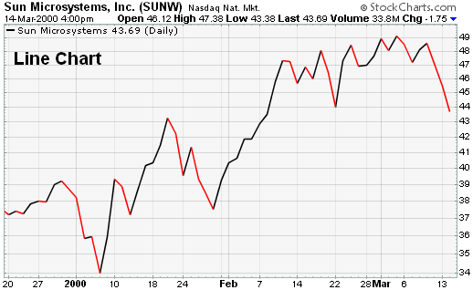
Univariate Case
In univariate representations, we think of data case as being shown along one dimension and value in another
4
3
Frequency count of batting average
2
1
.287
.292
.297
.302
.307
.312
.316
.321
.326
.331
.336
Batting average

Slide 31
Bivariate Case – Stacked Bar Graph
4
A. Ethier
A. Gonzalez
3
M. Byrd
J. Werth
R. Braun
A. Pujols
2
S. Castro
P. Polanco
M. Prado
R. Zimmerman
M. Holiday
J. Votto
1
O. Infante
J. Keppinger
A. Pagan
H. Ramirez
A. Huff
T. Tulowitzki
D. Uggla
C. Gonzalez
0
40
50
60
70
80
90
100
110
120
Runs Batted In
T. N. Dang, L. Wilkinson and A. Anand, “Stacking Graphic Elements to Avoid Over-Plotting," IEEE Transactions on Visualization and Computer Graphics, vol. 14, no. 6, pp. 1044-1052, 2010.

Slide 32
Bivariate Case - Scatterplot
Visualizes discrete data values along two axes
Used as a means of analyzing bivariate relationships
Quick means of assessing outliers, clusters and distributions
Putting a line through the data can help assess trends, but can also mislead viewer
Batting Average
Number of Runs

Slide 33
Multivariate Case - Mosaic Plot
Graphical display that allows you to examine the relationship among two or more categorical variables
Start as a square with length one
Divide first into horizontal bars whose widths are proportional to the probabilities associated with the first categorical variable
Next each bar is split vertically by the conditional probability of the second categorical variable

Slide 34
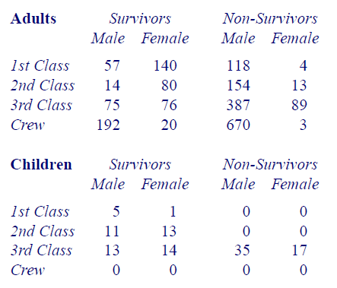
The Titanic Example

Slide 35
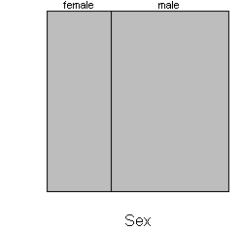
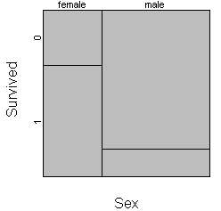
The Titanic Example
Mortality rates between men and women on the Titanic
http://www.childrensmercy.org/stats/definitions/mosaic.htm.

Slide 36
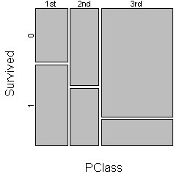
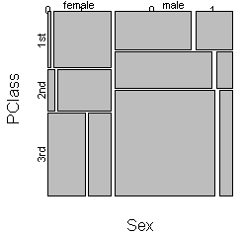
The Titanic Example

Slide 37
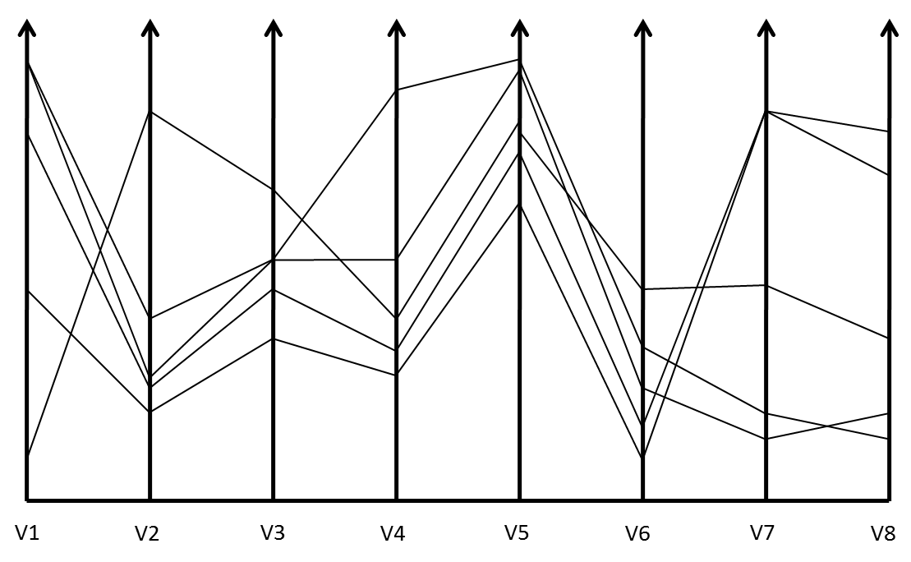
Parallel Coordinate Plots
1 - Inselberg A (1985) The Plane with Parallel Coordinates. The Visual Computer1(4):69-91
2 - Ankerst M, Berchtold B, Keim DA (1998) Similarity clustering of dimensions for an enhanced visualization of multidimensional data. IEEE Symposium on Information Visualization pp 52-62

Slide 38
Issues With Parallel Coordinate Plots
Different variables can take different values with very different ranges
Need to normalize data ranges (maybe do a power transformation and then a normalization?)
Order of the parallel coordinate plots has a major impact on the resultant visualization
The more variables we plot, the more lines we get and the more clutter that we get
1 -Yang, J., Peng, W., Ward, M.O., Rundensteiner, E.A., Interactive hierarchical dimension ordering, spacing and filtering for exploration of high dimensional datasets. In Proc. of IEEE Symposium on Information Visualization (2003), pp. 105–112.
2 – Zhou, H., Yuan, X., Qu, Huamin, Cui, W., Chen, B., “Visual Clustering in Parallel Coordinates,” Computer Graphics Forum 27(3) 1047-1054, 2008.

Slide 39
Star Plot
Lay out axes in a radial layout, length of a ray emanates from a central point
Rays are then joined together by a polyline drawn around the outside
At Bats
Runs
Batting Average
Infante
RBI
Gonzalez
Votto
S. E. Fienberg,”Graphical Methods in Statistics," The American Statistician, vol. 33 pp. 156-178, 1979.

Slide 40
K-Means
Given K, the K-means algorithm is implemented in four steps:
1. Choose K points at random as cluster centres (centroids)
2. Assign each instance to its closest cluster centre using certain distance measure (usually Euclidean or Manhattan)
3. Calculate the centroid of each cluster, use it as the new cluster centre (one measure of centroid is mean)
4. Go back to Step 2, stop when cluster centres do not change any more

Slide 41
Moving Average
A simple moving average is formed by computing the average price of a measure over a specific number of periods.
In this example we’ll look at stock market closing prices
A 5-day simple moving average is the five day sum of closing prices divided by five.
As its name implies, a moving average is an average that moves. Old data is dropped as new data comes available.
This causes the average to move along the time scale. Below is an example of a 5-day moving average evolving over three days.
Daily Closing Prices: 11,12,13,14,15,16,17
First day of 5-day SMA: (11 + 12 + 13 + 14 + 15) / 5 = 13 Second day of 5-day SMA: (12 + 13 + 14 + 15 + 16) / 5 = 14 Third day of 5-day SMA: (13 + 14 + 15 + 16 + 17) / 5 = 15

Slide 42
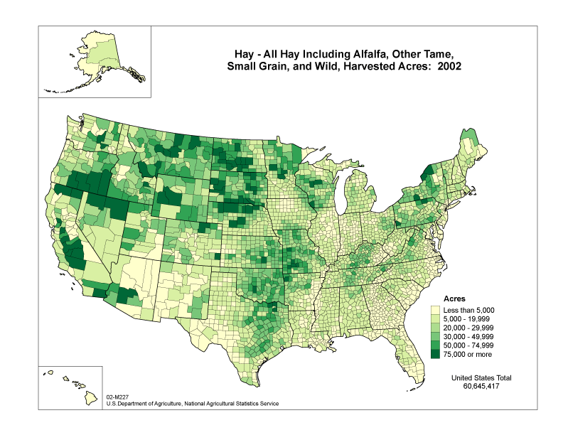
Choropleth Maps¹
Areas of the map are shaded in proportion to a measured variable
Coloring is based on a classification (histogram binning) of the distribution of the measured variable
http://www.nass.usda.gov
1 – J. K. Wright. Problems in Population Mapping. Notes on Statistical Mapping, with Reference to the Mapping of Population Phenomena. AGS and Population Association of America, p. 1-18, 1938.

Slide 43
Coloring Choropleth Maps¹
The number of colors depends on the number of classes (bins)
Too many classes can overwhelm the user and distract them from seeing trends
Too many classes can compromise legibility as colors become difficult to distinguish
Typical cartographic rule of thumb is 5-7 classes
Typical coloring schemes⁸ include sequential, divergent and qualitative
For more details on mapping as a visual representation, see ²
1 – C. A. Brewer. http://colorbrewer.org
2 – A. MacEachren. How Maps Work. Guilford Press, 1995.

Slide 44


Color Schemes¹
11 – C. A. Brewer. http://colorbrewer.org
Sequential Color Schemes
Suited for ordered data
Lightness steps dominate the look of the scheme
Light values are low data values, dark are high
Good for Ordinal, interval and ratio data types
Diverging Color Schemes
Puts an emphasis on critical midrange values
Color change represents deviation from a meaningful midrange critical value
Good for ratio data types where looking at data above and below a ‘zero’ point
Qualitative Color Schemes
Does not imply magnitude difference
Used to show differences between classes
Good for Nominal data types
1 – C. A. Brewer. http://colorbrewer.org

Slide 45
Class Interval Selection
The visual representation of the choropleth map is highly influenced by the class interval selection
This is similar to the concept of histogram binning
Popular choices for class interval selection include
Equal interval selection
Jenks’ Natural Breaks¹
Minimum boundary error²
Again, these choices for optimizing the class interval selection are highly dependent on the underlying data distribution
1– G. F. Jenks. The data model concept in statistical mapping. International Yearbook of Cartography, 26:186-190, 1967.
2 – E. K. Cromley and R. G. Cromley. An analysis of alternative classifications schemes for medical atlas mapping. European Journal of Cancer. Series B (Methodological), 26(2):211-252, 1964.

Slide 46
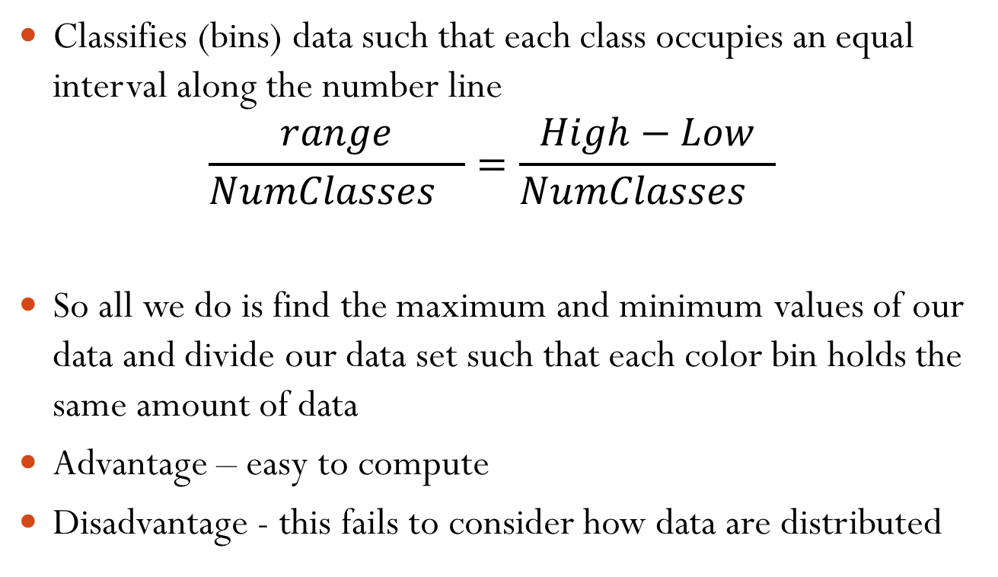
Equal Interval
Classifies (bins) data such that each class occupies an equal interval along the number line
$$\frac{range}{Nu{mClasses}_{}}=\frac{High−Low}{Nu{mClasses}_{}}$$
So all we do is find the maximum and minimum values of our data and divide our data set such that each color bin holds the same amount of data
Advantage – easy to compute
Disadvantage - this fails to consider how data are distributed
TA Slocum, RB McMaster, FC Kessler and HH Howard, “Thematic Cartography and Geovisualization,” Prentice Hall Series, 2009.

Slide 47
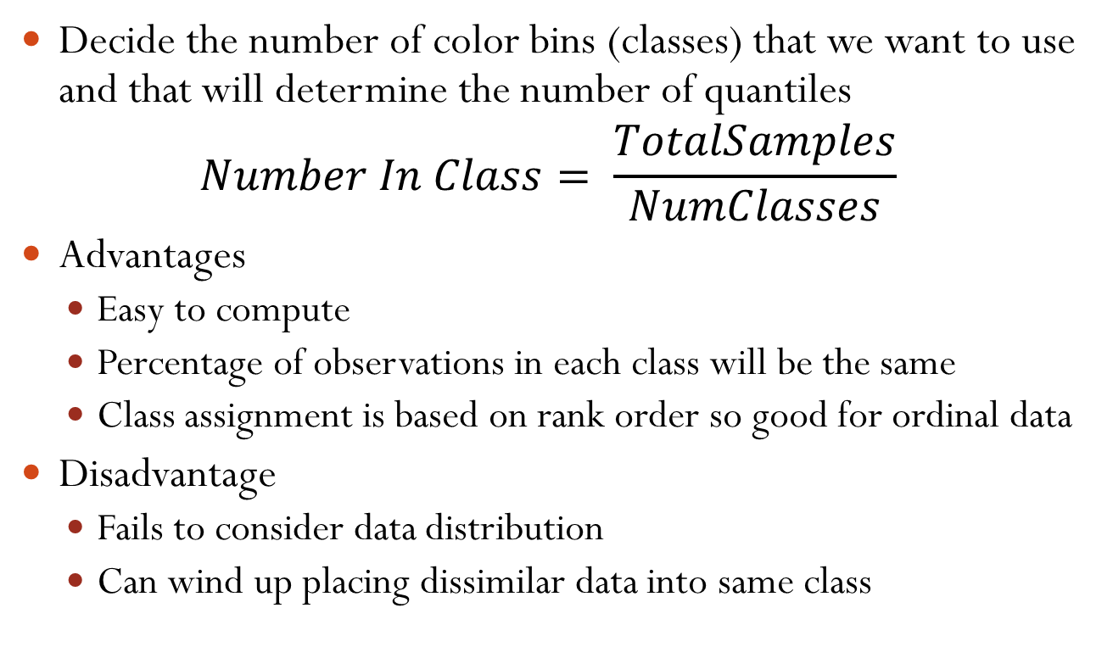
Quantiles
Decide the number of color bins (classes) that we want to use and that will determine the number of quantiles
$$Number In Class= \frac{TotalSamples}{NumClasses}$$
Advantages
Easy to compute
Percentage of observations in each class will be the same
Class assignment is based on rank order so good for ordinal data
Disadvantage
Fails to consider data distribution
Can wind up placing dissimilar data into same class
TA Slocum, RB McMaster, FC Kessler and HH Howard, “Thematic Cartography and Geovisualization,” Prentice Hall Series, 2009.

Slide 48
Quantiles
Decide the number of color bins (classes) that we want to use and that will determine the number of quantiles
$$Number In Class= \frac{TotalSamples}{NumClasses}$$
Advantages
Easy to compute
Percentage of observations in each class will be the same
Class assignment is based on rank order so good for ordinal data
Disadvantage
Fails to consider data distribution
Can wind up placing dissimilar data into same class
TA Slocum, RB McMaster, FC Kessler and HH Howard, “Thematic Cartography and Geovisualization,” Prentice Hall Series, 2009.

Slide 49
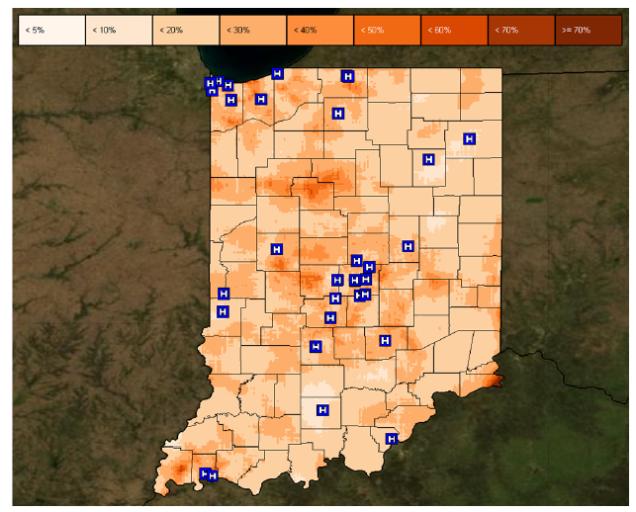
Isopleth Map
Isarithmic map or contour map is created by interpolating a set of isolines between sample points of known values
Created from collection of point data and then interpolating unknown values between them
Interpolation methods:
Kernel density estimation (see earlier lectures)
Inverse distance
Kriging
TA Slocum, RB McMaster, FC Kessler and HH Howard, “Thematic Cartography and Geovisualization,” Prentice Hall Series, 2009.

Slide 50
Proportional Symbol Mapping
Represent numerical data associated with point locations
Utilizes a symbol and scales the size to show data
Proportional symbols can be used for two forms of point data
True point data – actual measurements at point locations (number of calls made from a phone booth)
Conceptual point data – data collected over an area, but data is conceived as being located at points (for example the centroid)
TA Slocum, RB McMaster, FC Kessler and HH Howard, “Thematic Cartography and Geovisualization,” Prentice Hall Series, 2009.

Slide 51
Adjacency Matrix
y
 | 1 | 2 | 3 | 4 | 5 | 6 | 7 | 8 | 9 | 10
1 | 0 | 1 | 0 | 1 | 0 | 0 | 0 | 0 | 0 | 0
2 | 1 | 0 | 0 | 0 | 1 | 0 | 0 | 0 | 0 | 0
3 | 0 | 0 | 0 | 1 | 0 | 1 | 0 | 0 | 0 | 0
4 | 1 | 0 | 1 | 0 | 1 | 0 | 1 | 0 | 0 | 0
5 | 0 | 1 | 0 | 1 | 0 | 0 | 0 | 1 | 0 | 0
6 | 0 | 0 | 1 | 0 | 0 | 0 | 1 | 0 | 0 | 0
7 | 0 | 0 | 0 | 1 | 0 | 1 | 0 | 1 | 1 | 0
8 | 0 | 0 | 0 | 0 | 1 | 0 | 1 | 0 | 0 | 1
9 | 0 | 0 | 0 | 0 | 0 | 0 | 1 | 0 | 0 | 1
10 | 0 | 0 | 0 | 0 | 0 | 0 | 0 | 1 | 1 | 0
1
4.55
2
5.54
x
3
2.24
4
-5.15
5
9.02
6
3.1
7
-4.39
8
-2.09
9
.46
10
-3.06
MJ de Smith, MF Goodchild and PA Longley. Geospatial Analysis: A Comprehensive Guide to Principles, Techniques and Software Tools, 2007

Slide 52
Transitioning Between Data Views
Many interfaces schemes exist that allow users to move between focused and contextual views of a data set
Can categorize these schemes into four sorts of approaches
Overview+detail
Uses a spatial separation between focused and contextual views
Zooming
Uses a temporal separation
Focus+Context
Displays focus within the context
Cue-Based
Selectively highlight/supress
A. Cockburn, A. Karlson, and B. Bederson, "A Review of Overview+Detail, Zooming, and Focus+Context Interfaces", ACM Computing Surveys, Vol. 41, No. 1, Dec. 2008, pp. 2:1-2:31.

Slide 53
Traditional Interface Mechanisms
Traditional mechanisms involve trade-offs between allowing information to be moved or spatially partitioned
Movement
Paging
Scrolling
Panning
Spatial
Windowing
Menus
While Windowing and Scrolling are standard in most interfaces, they introduce a discontinuity between the information displayed at different times and places
A. Cockburn, A. Karlson, and B. Bederson, "A Review of Overview+Detail, Zooming, and Focus+Context Interfaces", ACM Computing Surveys, Vol. 41, No. 1, Dec. 2008, pp. 2:1-2:31.

Slide 54
What is a Graph?
Vertices (nodes) connected by Edges (links)
We have several ways to represent a graph
Adjacency list
Adjacency matrix (this is analogous to the weights matrix in last lecture)
Adjacency List
1:3
2:3
3:1,2
2
1
3
 | 1 | 2 | 3
1 | 0 | 0 | 1
2 | 0 | 0 | 1
3 | 1 | 1 | 0

Slide 55
Graph Visualization Task Taxonomy
Attribute-based tasks
On the nodes
Find the nodes having a specific attribute value
On the edges
Given a node, find the nodes connected only by certain kinds of edges
Browsing tasks
Follow path
Revisit
Overview task
Compound exploratory task
Estimate size of a network
Find patterns
B. Lee, C. Plaisant, C. Sims Parr, J.-D. Fekete, N. Henry, "Task Taxonomy for Graph Visualization", Proc. of BELIV '06, April '06, pp. 1-5.
Some details from this slide borrowed from John Stasko’s Graph lecture: http://www.cc.gatech.edu/~stasko/7450/Notes/graph1.pdf

Slide 56
Small-World Network
A type of mathematical graph in which most nodes are not neighbors of one another, but most can be reached from every other by a small number of hops
Defined to be a network where the typical distance L between two randomly chosen nodes is$L∝log⁡(N)$
Such networks tend to contain cliques
Clique – sub-networks which have connections between almost any two nodes
The concept of a clique is related to that of clustering coefficient
D. J. Watts and S. H. Strogatz, “Collective dynamics of `small-world' networks,” Nature, Vol. 393, No. 6684. (4 June 1998), pp. 440-442

Slide 57
Clustering Coefficient
Measure of degree to which nodes in a graph tend to cluster together
Evidence suggests that in most real-world networks (particularly social networks), nodes tend to create tightly knit groups characterized by a high density of ties
This likelihood tends to be greater than the average probability of a tie randomly established between two nodes
There are two types of clustering coefficients
Global clustering coefficient
Local clustering coefficient

Slide 58
Global Clustering Coefficient
Based on triplets of nodes
Triplet – three nodes that are connected by either two or three undirected ties
Open triplet – two undirected ties
Closed triplet – three undirected ties
Clustering coefficient is the number of closed triplets over the total number of triplets
R. D. Luce and A. D. Perry (1949). "A method of matrix analysis of group structure". Psychometrika 14 (1): 95–116.

Slide 59
Local Clustering Coefficient
This is measured at the vertex level of a graph
Quantifies how close a vertex’s neighbors are to being a clique (a complete graph)
The neighborhood N_{i} for a vertex v_{i} is defined as its immediately connected neighbors
Let k_{i} be the number of vertices in the neighborhood
The local clustering coefficient for a vertex then is the proportion of links between the vertices within its neighborhood divided by the number of links that could possible exist between them
D. J. Watts and S. H. Strogatz, “Collective dynamics of `small-world' networks,” Nature, Vol. 393, No. 6684. (4 June 1998), pp. 440-442

Slide 60
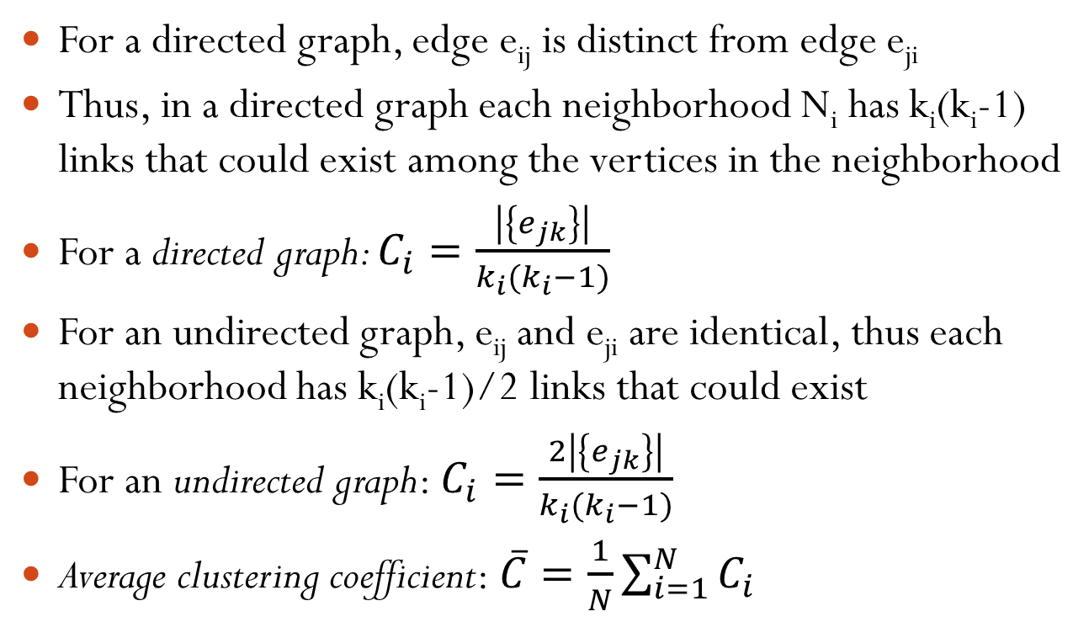
Local Clustering Coefficient
For a directed graph, edge e_{ij} is distinct from edge e_{ji}
Thus, in a directed graph each neighborhood N_{i} has k_{i}(k_{i}-1) links that could exist among the vertices in the neighborhood
For a directed graph: $C_{i}=\frac{\left|\left\{e_{jk}\right\}\right|}{k_{i}(k_{i}−1)}$
For an undirected graph, e_{ij} and e_{ji} are identical, thus each neighborhood has k_{i}(k_{i}-1)/2 links that could exist
For an undirected graph: $C_{i}=\frac{2\left|\left\{e_{jk}\right\}\right|}{k_{i}(k_{i}−1)}$
Average clustering coefficient: $\overline{C}=\frac{1}{N}\sum_{i=1}^{N}{C_{i}}$

Slide 61
Graph Centrality
Another means of characterizing nodes is based on their relative importance in the graph
To do this, we utilize measures of centrality that were first developed in social network analysis
There are four measures of centrality that are widely used:
Degree centrality
Closeness
Betweenness
Eigenvector Centrality

Slide 62
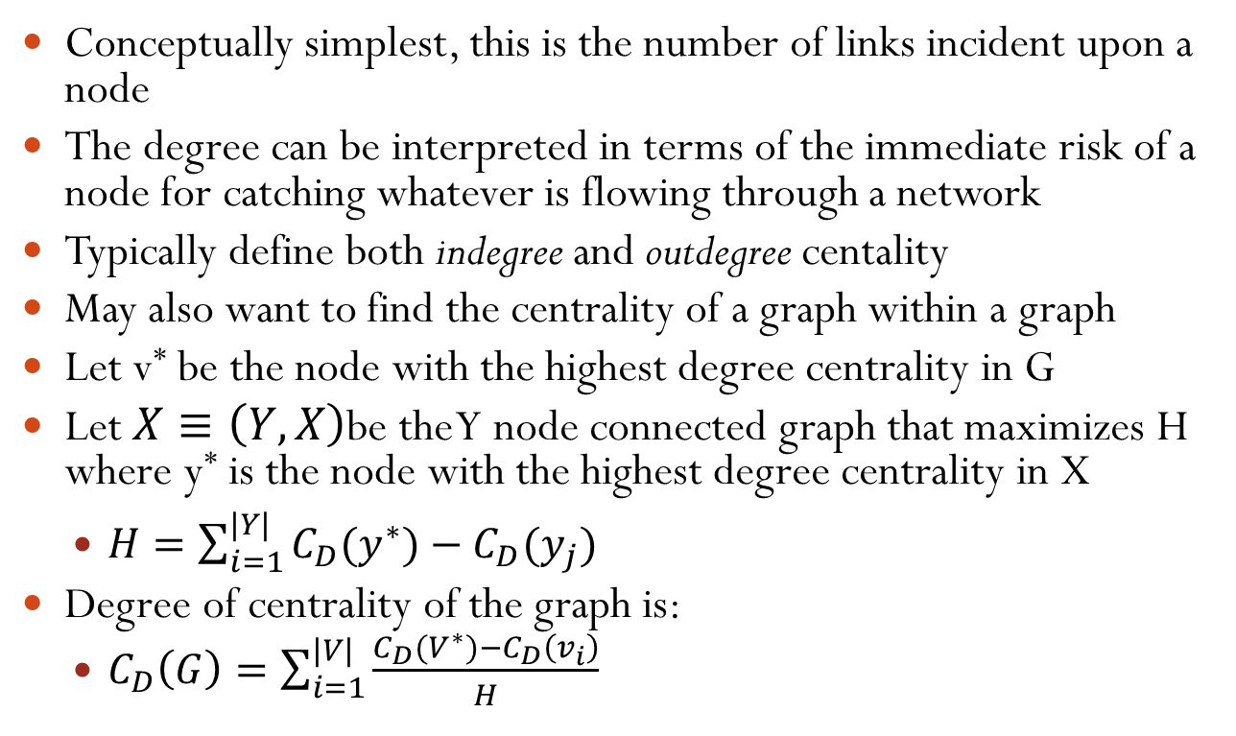
Degree Centrality
Conceptually simplest, this is the number of links incident upon a node
The degree can be interpreted in terms of the immediate risk of a node for catching whatever is flowing through a network
Typically define both indegree and outdegree centality
May also want to find the centrality of a graph within a graph
Let v* be the node with the highest degree centrality in G
Let $X≡\left(Y,X\right)$be the Y node connected graph that maximizes H where y* is the node with the highest degree centrality in X
$H=\sum_{i=1}^{|Y|}{C_{D}(y^{∗})−C_{D}(y_{j})}$
Degree of centrality of the graph is:
$C_{D}\left(G\right)=\sum_{i=1}^{|V|}{\frac{C_{D}(V^{∗})−C_{D}\left(v_{i}\right)}{H}}$

Slide 63
Closeness Centrality
In graphs, there is a natural distance metric between nodes
This is the length of their shortest paths
Farness: Sum of the distances to all other nodes
Closeness: The inverse of farness
Can be regarded as a measure of how long it will take to spread information from a starting node to all other nodes
The more central a node is, the lower its total distance to all other nodes

Slide 64
Node-Link Shortcomings
Difficult to encode more variables of data cases
Shape
Size
Color
All of these can clash with the basic node-link structure
Parts of this slide borrowed from John Stasko’s Information Visualization Course Lecture: Hierarchies and Trees 2(Space Filling): http://www.cc.gatech.edu/~stasko/7450/Notes/tree2.pdf

Slide 65
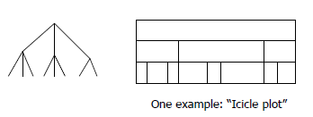
Space-Filling Representation
Each item now occupies an area
Children are contained under the parent
Parts of this slide borrowed from John Stasko’s Information Visualization Course Lecture: Hierarchies and Trees 2(Space Filling): http://www.cc.gatech.edu/~stasko/7450/Notes/tree2.pdf

Slide 66
Treemap
Space filling representation developed by Johnson and Shneiderman
Children are drawn inside their parent
Alternate horizontal and vertical slicing at each successive level
Use area to encode other variable of data items
Johnson, B. and Shneiderman, B. Treemaps: A Space-Filling Approach to the Visualization of Hierarchical Information Structures. In Proceedings of the IEEE Information Visualization ’91, pages 275–282, IEEE, 1991.

Slide 67
Treemap Algorithm
Draw()
{
1) Change orientation from parent (horiz/vert)
2) Read all files and directories at this level
3) Make rectangles for each, scaled to size
4) Draw rectangles using appropriate size and color
5) For each directory
a) Make recursive call using its rectangle as focus
}
Parts of this slide borrowed from John Stasko’s Information Visualization Course Lecture: Hierarchies and Trees 2(Space Filling): http://www.cc.gatech.edu/~stasko/7450/Notes/tree2.pdf

Slide 68
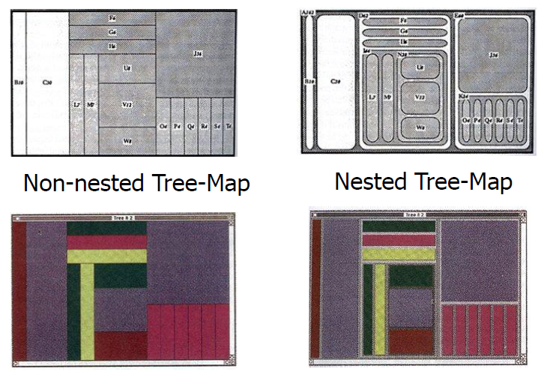
Nested vs. Non-Nested
Parts of this slide borrowed from John Stasko’s Information Visualization Course Lecture: Hierarchies and Trees 2(Space Filling): http://www.cc.gatech.edu/~stasko/7450/Notes/tree2.pdf

Slide 69
Hierarchical Clustering
Two main types of hierarchical clustering
Agglomerative:
Start with the points as individual clusters
At each step, merge the closest pair of clusters until only one cluster (or k clusters) left
Divisive:
Start with one, all-inclusive cluster
At each step, split a cluster until each cluster contains a point (or there are k clusters)
Traditional hierarchical algorithms use a similarity or distance matrix
Merge or split one cluster at a time

Slide 70
Animation for Transitions
Can animation help “soften the blow” when a view changes?
Animation preserves context by allowing the viewer to track where things on the screen went
So what kinds of animations are most effective?
* - Material borrowed from John Stasko’s lecture on Animation: http://www.cc.gatech.edu/~stasko/7450/Notes/animation.pdf

Slide 71
Suite of Transitions
Heer and Robertson developed and explored a variety of different transitions and applications
Performed experiments to see how these are perceived
http://www.youtube.com/watch?v=vLk7mlAtEXI
Discussion
What types of animation did they use?
How did they use animation?
J. Heer and G. Robertson. "Animated Transitions in Statistical Data Graphics," IEEE Transactions on Visualization and Computer Graphics Vol. 13, No. 6, Nov.-Dec. 2007, pp. 1240-1247.

Slide 72
Transition Types
View transformation
Substrate transformation
Filtering
Ordering
Timestep
Visualization change
Data schema change
J. Heer and G. Robertson. "Animated Transitions in Statistical Data Graphics," IEEE Transactions on Visualization and Computer Graphics Vol. 13, No. 6, Nov.-Dec. 2007, pp. 1240-1247.

Slide 73
Design Principles
Congruence (mental matching)
Maintain valid data graphics during transitions
Use consistent syntactic-semantic mappings
Respect semantic correspondence
Avoid ambiguity
Apprehension (easily perceivable)
Group similar transitions
Minimize occlusion
Use simple transitions
Use staging for complex transitions
Make transitions as long as needed, but not longer
J. Heer and G. Robertson. "Animated Transitions in Statistical Data Graphics," IEEE Transactions on Visualization and Computer Graphics Vol. 13, No. 6, Nov.-Dec. 2007, pp. 1240-1247.

Slide 74
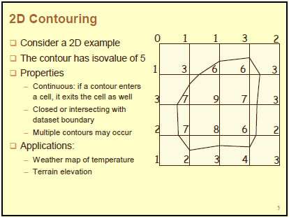

Slide 75
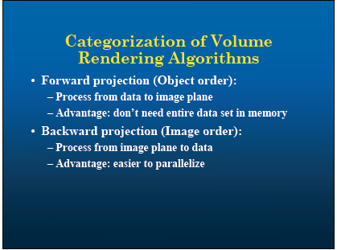

Slide 76
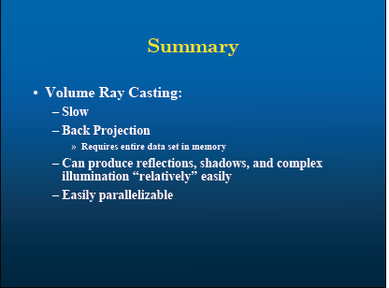

Slide 77
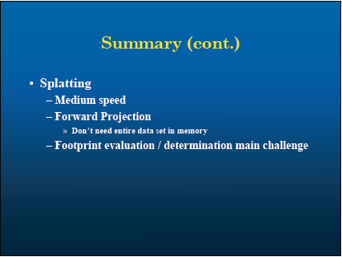

Slide 78
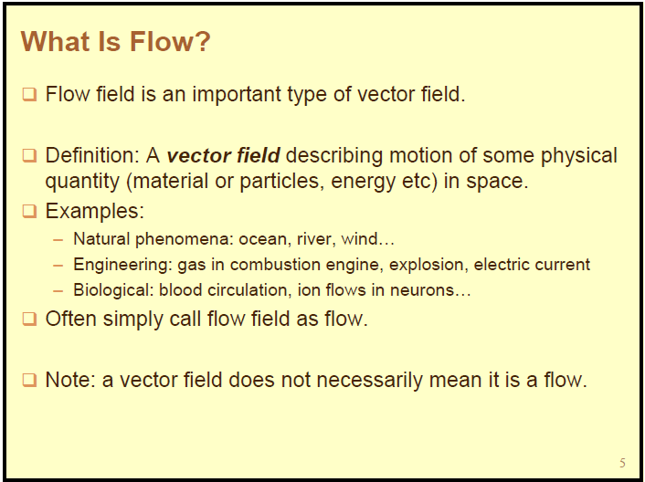

Slide 79
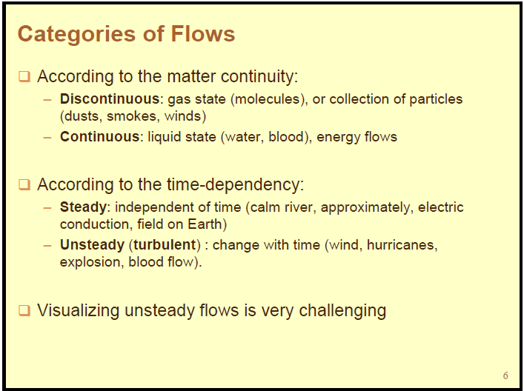

Slide 80
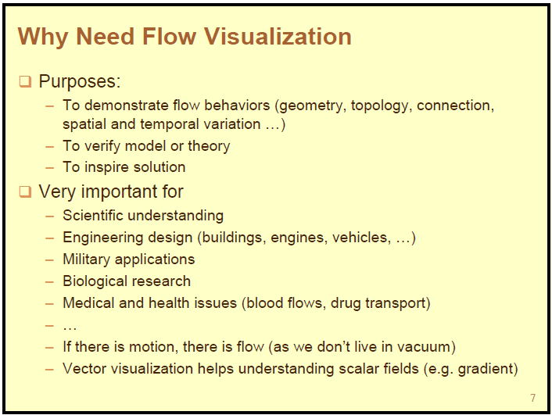

Slide 81
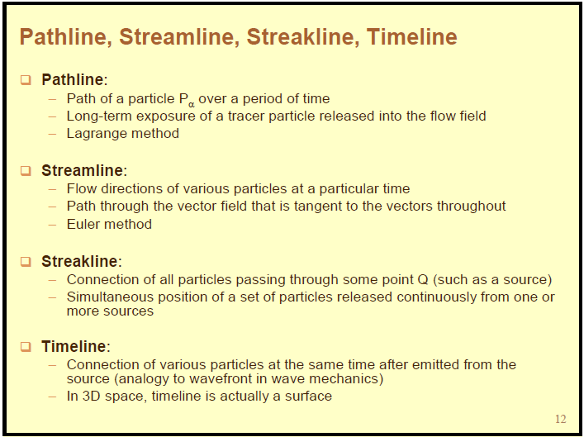

Slide 82
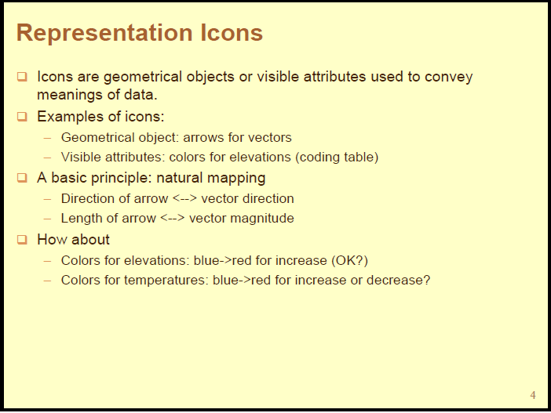

Slide 83
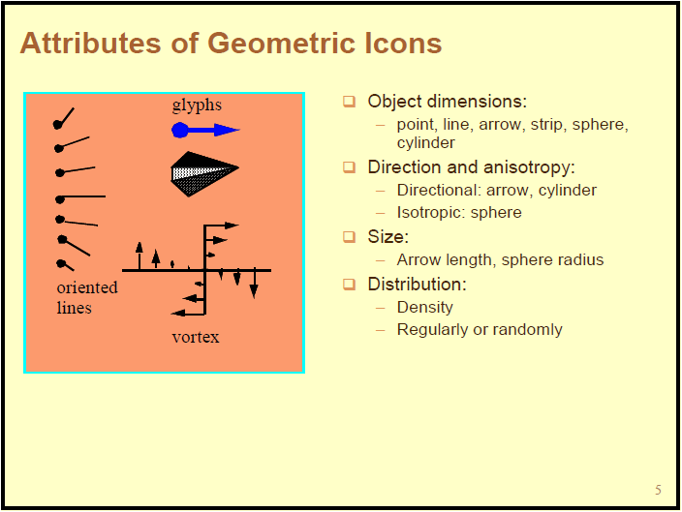

Slide 84
Announcements
Final is worth 20% of your grade

