Slide 1

CSE 591 Data Representations
Ross Maciejewski
rmacieje@asu.edu

Slide 2
Data Models
Data models/representations are structured forms suitable for computer-based transformations
These structures exist in the original data or are derivable from the original data
Structures retain the information and knowledge content and the related context within the original data
These structures are transformable into lower-dimensional representations for visualization and analysis

Slide 3
Data Models vs. Conceptual Models
Data models are mathematical abstractions
We can perform numerical operations, addition, subtraction, etc.
Conceptual models are our mental constructs
These contain semantic structure and support reasoning
Think of giving directions to someone using landmarks

Slide 4
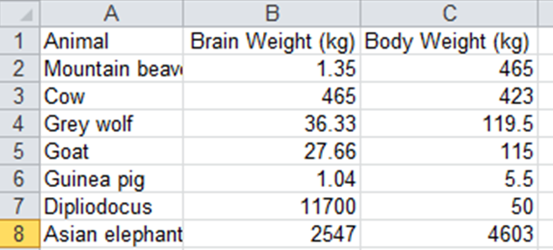
What Types of Data Models Do We Have?
Relational Data Models
These are data records that you deal with in excel, or typical database records
Data records are of fixed length and well-defined
Data is in rows and columns where each column has a domain type
There may be a relationship defined in a schema between tables
A database is a collection of these relations
Codd, E.F. (1970). “A Relational Model of Data for Large Shared Data Banks”. Communications of the ACM 13(6): 377-387

Slide 5
What Types of Data Models Do We Have?
Statistical Data Models
This consists of variables or measurements (think of things like the census)
Categories are factors relating to the measurements
Observations or cases
Patient ID | Date | Chief Complaints | Location
9398 | 4/16/09 | Ear pain | Karachi
10816 | 4/16/09 | Stuffy nose | Lebanon
1491 | 4/16/09 | Fever | Allepo
16237 | 4/16/09 | Head bleed | Yemen

Slide 6
Data Types
Nominal
Data whose categories have no implied ordering
Examples include political affiliations of a population
Ordinal
Data that has a specified order, but no specified distance metric
Examples include beverage sizes at McDonalds (Small, medium, large)
Interval
Data that has measurable distances
Examples include periods of time (second, minute, etc.) – the zero point is arbitrary
Ratio
Same as interval, but include a zero point
Example include Celsius scale, height above sea level
1- SS Stevens, “On the Theory of Scales of Measurement,” Science, 103(2684):677-680, 1946.

Slide 7
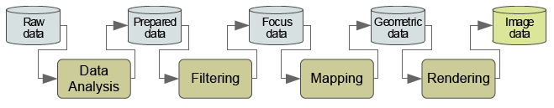
The Visualization Pipeline
We want to take these different data types and map them to an appropriate visual representation
Data Analysis – data are prepared for visualization (smooth, interpolate, transform)
Filtering – A subset of the data (usually user defined) is selected for visualization
Mapping – Data are mapped to geometric primitives and their attributes
Rendering – Geometric data are transformed to image data
Image taken from http://www.infovis-wiki.net/index.php/Visualization_Pipeline
Haber, R. & McNabb, D. A. (1990). Visualization idioms: A conceptual model for scientific visualization systems. In Visualization
in Scientific Computing.

Slide 8
Mapping Data
We need to know how to assign quantitative dimensions of our data to aesthetic attributes¹ of the data
Form | Surface | Motion | Sound | Text
Position Size Shape polygon glyph image Rotation Resolution | Color hue brightness saturation Texture pattern granularity orientation Blur Transparency | Direction Speed Acceleration | Tone Volume Rhythm Voice | Label
L Wilkinson (2005) The Grammar of Graphics

Slide 9
Aesthetic Attributes
An attribute must be capable of representing both continuous and categorical variables
When representing a continuous variable, an attribute must vary primarily on one psychophysical dimension
In order to use multidimensional attributes (such as color), we must scale them on a single dimension
An attribute does not imply a linear perceptual scale
Much of the skill in graphic design is knowing what combination of attributes should be avoided¹
1-SM Kosslyn (1994), The Elements of Graph Design

Slide 10
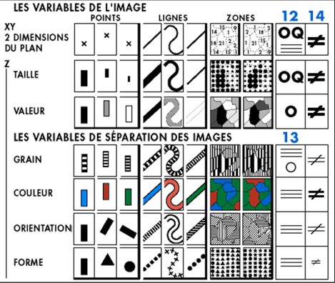
Bertin’s Visual Variables
Visualization is concerned primarily with a mapping to visual form
[x,y]
Position
[z]
Size (Taille)
Value (Valeur)
Color (Couleur)
Texture (Grain)
Orientation
Shape (Forme)
J Bertin (1967), The Semiology of Graphics

Slide 11
Position
Position refers to a location in a multi-dimensional space
Bertin restricts his analysis to a piece of paper (or a plane) but in computer graphics, we need not have such a restriction
Continuous variables map to densely distributed locations
Categorical variables map to a lattice
Positions are ordered, but the ordering may or may not have meaning in terms of what is being measured
Sometimes, position is just a way to keep things from overlapping
L Wilkinson (2005) The Grammar of Graphics

Slide 12
Position¹
Cleveland² rates position on a common scale as the best way to represent a quantitative dimension visually
This reflects research findings that points or line lengths placed adjacent to a common axis enable judgments with the least bias or error
However, this recommendation has a caveat, it depends on how far the graphic primitive (point, line, etc.) is from a reference axis³
If a graphic is far from an axis, the multiple steps needed to store and decode the variation can impair judgment
1 - L Wilkinson (2005) The Grammar of Graphics
2 – WS Cleveland, The Elements of Graphing Data, 1985
3 – D Simkin and R Hastie (1987). An information processing analysis of graph perception. Journal of the American Statistical Association, 82, 454-465

Slide 13
Size¹
Bertin² defines size variation in terms of length or area
For three dimensions we have volume
Cleveland³ ranks area and volume representations among the worst attributes to use for graphing data
Some designers assign size to only one dimension of an object
Think of the bar chart where the width of the bar is typically constant, but the height is varied
1 - L Wilkinson (2005) The Grammar of Graphics
2 – J Bertin (1967), The Semiology of Graphics
3 – WS Cleveland, The Elements of Graphing Data, 1985

Slide 14
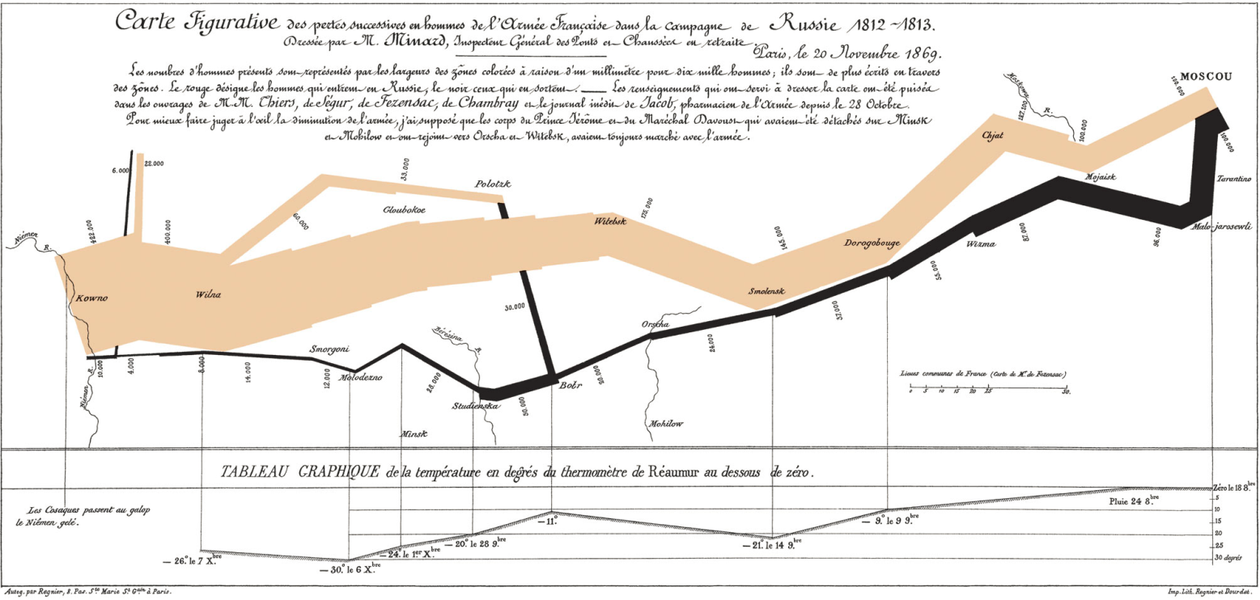
Size
Size for lines is usually equivalent to thickness
This is less likely to induce perceptual distortion
Size can be used to great effect with path
1 – Charles Joseph Minard: Mapping Napoleon’s March, 1861 by John Corbett, Center for Spatially Integrated Social Science

Slide 15
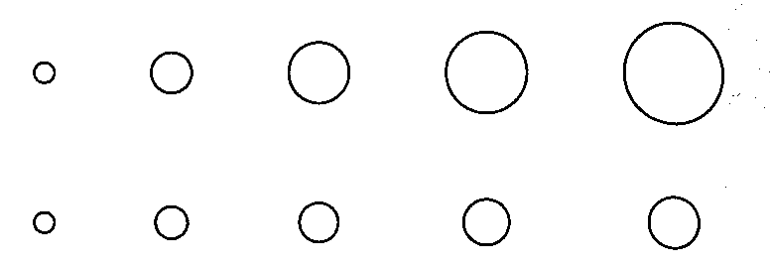
Size
For objects with rotational symmetry, we can map size to the diameter rather than area
Representing data through area or volume should probably be confined to positively skewed data that can benefit from the perceptual equivalent of the square root transformation
Top row changes diameter from 1-5
Bottom row changes area from 1-5
L Wilkinson (2005) The Grammar of Graphics

Slide 16
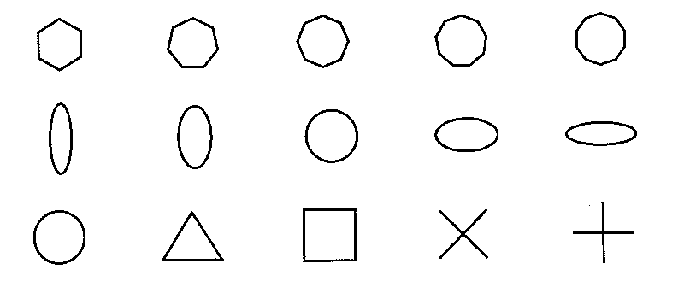
Shape
Shape refers to the shape or boundary of an object
Examples would include map symbols
Shape must vary without affecting size, rotation and other attributes
L Wilkinson (2005) The Grammar of Graphics

Slide 17
Rotation
This is the rotational angle of the graphic primitive
Lines, areas and surfaces can only rotate if they are positionally unconstrained
L Wilkinson (2005) The Grammar of Graphics

Slide 18
Color
Color is really a psychological phenomenon
The physical stimulus for color is light
We see color because of the photoreceptors in our retina
We will discuss color in-depth in a future lecture
Rainbow
Sequential
Grayscale
Divergent
Qualitative
V₂
V₂
V₃
V₁
V₁

Slide 19
Texture
Texture includes pattern, granularity and orientation
Granularity is the repetition of a pattern per unit of area
Orientation is the angle of the pattern
Textures can be described in a variety of ways
Fourier transform – decomposes a grid of brightness values into sums of trigonometric components
This decomposition is orientation dependent
Auto-correlogram – characterize the spatial moments of a texture
L Wilkinson (2005) The Grammar of Graphics

Slide 20
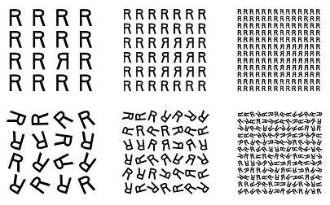
Texture
Texture alone can be a basis for perception
Two gray areas that have the same overall level of brightness can be discriminated if their texture is different
L Wilkinson (2005) The Grammar of Graphics

Slide 21
Texture
Granularity – Changing the size or resolution of patterns in a texture changes the granularity
Less grainy patterns (those with low-frequency spatial components) are more difficult to resolve
Pattern – Patterns make use of increasing degrees of randomness to encode data
L Wilkinson (2005) The Grammar of Graphics

Slide 22

Texture
Orientation – Variation in texture orientation can introduce visual illusions (making lines not seem parallel) and is typically avoided as an encoding in textures
L Wilkinson (2005) The Grammar of Graphics

Slide 23
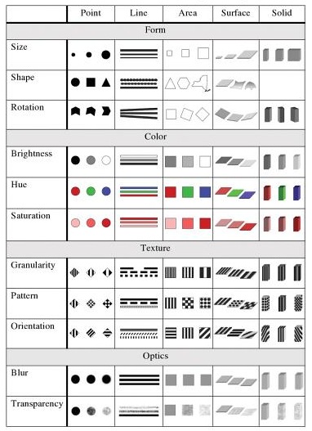
L Wilkinson (2005) The Grammar of Graphics, p. 317

Slide 24
How Many Variables to Use?
The number of visual variables necessary for the representation is at least equal to the number of components in the information
With three components, the information can be perceived as a single image
Otherwise, we need several images (this is often termed small multiples and will be discussed in a future lecture)
The number of components is the best basis for a classification of graphic constructions
J Bertin (1967), The Semiology of Graphics

Slide 25
Bertin’s “Levels of Organization”
Components of information do not all involve the same intellectual approach
For example, we may choose to order qualitative (nominal) categories to compare ordered categories
A component can be classified as qualitative, ordered or quantitative
The visual variables which represent each component must permit parallel perceptual approaches
J Bertin (1967), The Semiology of Graphics

Slide 26
Bertin’s “Levels of Organization”
N – Nominal (Qualitative)
O – Ordered (Ordinal)
Q – Quantitative (Interval)
Position
N
O
Q
Size
N
O
Q
Value
N
O
Q
Texture
N
O
Color
N
Orientation
N
Shape
N
J Bertin (1967), The Semiology of Graphics

Slide 27
Bertin’s “Levels of Organization”
Visual variables each have their own level of organization
An order will not be perceptible if the variable is not ordered
A ratio will not be perceptible if the variable is not quantitative
J Bertin (1967), The Semiology of Graphics

Slide 28
Bertin’s “Levels of Organization”
The ordering of qualitative data, the comparison of ordered components, and the groupings resulting from a quantitative component are the basis for the graphic processing of information
The visual variables must have a level of granularity at least equal to that of the components which they represent
J Bertin (1967), The Semiology of Graphics

Slide 29
Levels of Organization
Selective – A variable is selective when it enables us to immediately isolate all the correspondences belonging to the same category
Associative – A variable is associative when it permits the immediate grouping of all the correspondences differentiated by this variable
Ordered – A variable is ordered when the visual classing of its categories is immediate
Quantitative – A variable is quantitative when the visual distance between two categories of an ordered component can be immediately expressed by a numerical ratio
J Bertin (1967), The Semiology of Graphics

Slide 30
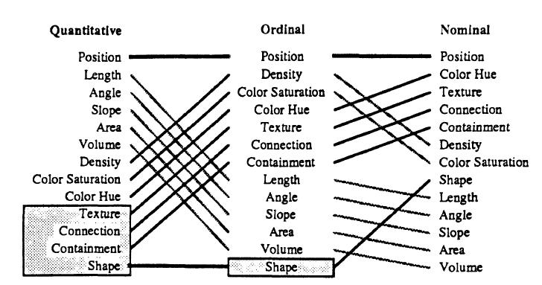
How Do I Choose the Encoding?
This is Mackinlay’s ranking of perceptual data (tasks in gray are not relevant to that data type)
J Mackinlay. Automating the Design of Graphical Presentations of Relational Information, ACM TOG 5:2, 1986.

Slide 31
Groups of Representation
Bertin describes four groups of representations
Diagrams – correspondences are between a single component (think of things like a bar chart or a line graph)
Networks – correspondences between different components are linked together
Maps – correspondences between components are arranged according to geography
Symbols – correspondences between components is linked to a symbol or a shape
J Bertin (1967), The Semiology of Graphics

Slide 32
Taxonomy by Data Type¹
1D (sets and sequences)
Temporal
2D (maps)
3D (shapes)
nD (relational)
Trees (hierarchies)
Networks (graphs)
Text and Documents²
1 – B. Shneiderman. The Eyes Have It: A Task by Data Type Taxonomy for Information Visualizations. In the Proceedings of the IEEE Symposium on Visual Languages, pp. 336-343, 1996.
2 –Borrowed from Pat Hanrahan’s “From Data to Image” lecture: http://graphics.stanford.edu/courses/cs448b-04-winter/lectures/encoding/

Slide 33
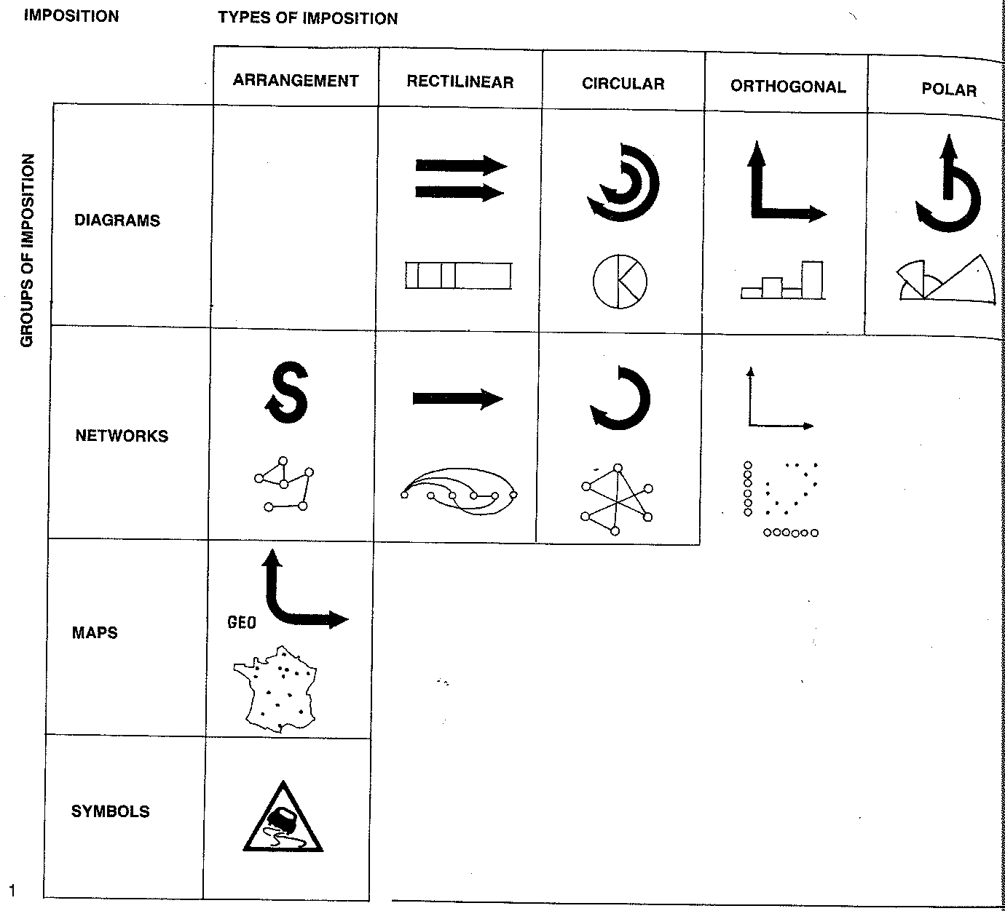
Types of Graphic Representation
J Bertin (1967), The Semiology of Graphics, p. 52

Slide 34
Cleveland’s Heirarchy¹
Cleveland evaluated elements when isolated
Tasks were restricted to magnitude and ratio comparisons
Research indicates this hierarchy may be best in pre-attentive stages or when focusing only on portions of a graphic^{2,3,4}
Best
1 - Position along a common scale
2 – Position along nonaligned scales
3 – Length
4 – Angle/Slope
5 – Area
6 – Volume
7 - Color
Worst
1 – WS Cleveland, The Elements of Graphing Data, 1985
2 – Spence, I., and Lewandowsky, S. (1991). Displaying proportions and percentages. Applied Cognitive Psychology 5, 61-77
3 – Simkin, D., and Hastie, R. (1987). An information processing analysis of graph perception. Journal of the American Statistical Association, 82, 454-465
4 – Carswell, C. M. (1992). Choosing specifiers: An evaluation of the basic tasks model of graphical perception. Human Factors, 4, 535-554

Slide 35
What if I Combine Encodings?
So, what happens when we combine several scales in a single display?
Can we represent one quantitative dimension with color and another with orientation and expect a perceiver to respond to both dimensions?
Do these things make psychological sense?
L Wilkinson (2005) The Grammar of Graphics

Slide 36
Integral Versus Separable Dimensions
“A configuration has properties that have to be expressed as some form of interaction or interrelation between the components, be they features or dimensions.”¹
Integral dimensions are not as easily decomposable by perceivers as separable dimensions
Separating hue from brightness in a color (integral dimensions) are harder to decompose than say size and texture (separable dimensions)
1 – Garner, W. R. (1981). The analysis of unanalyzed perceptions. In M. Kubovy and J. R. Pomerantz (Eds.), Perceptual Organization (pp. 119-139). Hillsdale, NJ: Lawrence Erlbaum.

Slide 37
Integral Versus Separable Dimensions
Discriminations between classes defined by multiple integral stimuli are more difficult than those between classes defined by separable stimuli
Selective attention to only one dimension is more difficult with integral stimuli
Redundant cues in classification improve performance for integral stimuli and degrade performance for separable

Slide 38
Combinatorics of Encodings
Challenge:
Pick the best encodings from the exponential number of possibilities (n+1)⁸
Principle of Consistency: The properties of the image should match the properties of the data
Principle of Importance Ordering: Encode the most important information in the most effective way
1 – This slide is borrowed from Pat Hanrahan’s “From Data to Image” lecture: http://graphics.stanford.edu/courses/cs448b-04-winter/lectures/encoding/

Slide 39
The Expressiveness & Effectiveness Criteria
Expressiveness: A set of facts is expressible in a visual language if the visualizations express all the facts in the set of data, and only the facts in the data
Effectiveness: A visualization is more effective than another visualization if the information conveyed by one visualization is more readily perceived than the information in the other visualization
1 – J. Mackinlay, Automating the Design of Graphical Presentations of Relational Information, ACM Transactions on Graphics, 5(2): 110-141, 1986.

Slide 40
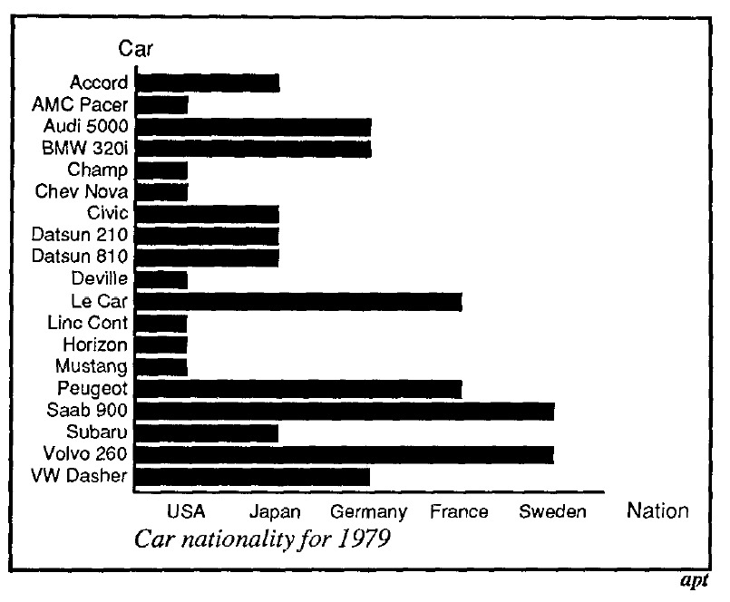
1 – J. Mackinlay, Automating the Design of Graphical Presentations of Relational Information, ACM Transactions on Graphics, 5(2): 110-141, 1986.

Slide 41
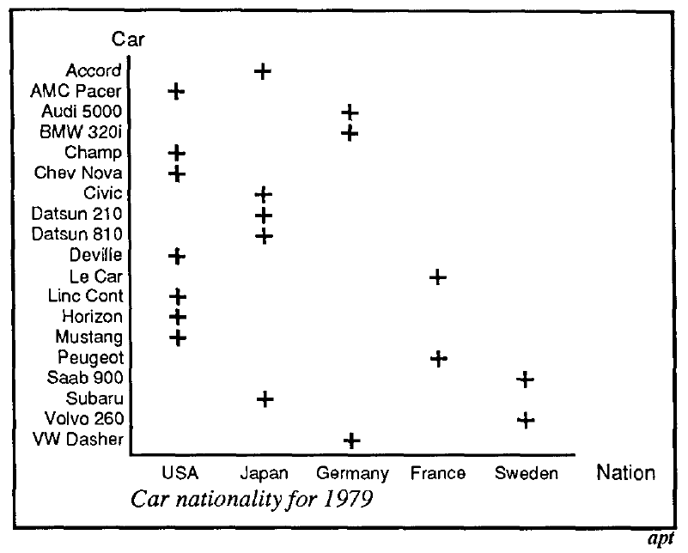
1 – J. Mackinlay, Automating the Design of Graphical Presentations of Relational Information, ACM Transactions on Graphics, 5(2): 110-141, 1986.

Slide 42
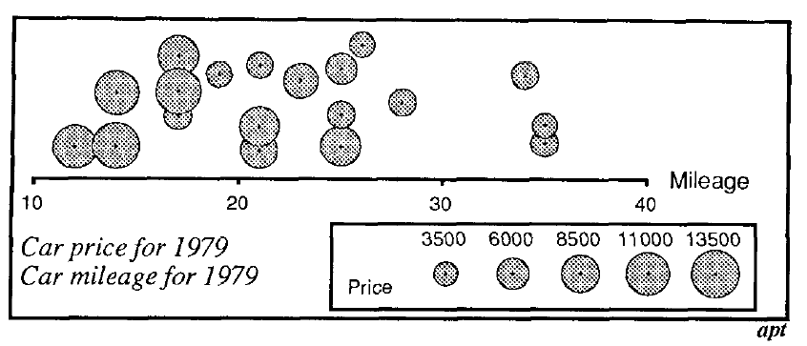
1 – J. Mackinlay, Automating the Design of Graphical Presentations of Relational Information, ACM Transactions on Graphics, 5(2): 110-141, 1986.

Slide 43
Potentially Expressive/Effective
Extensions to the expressive/effectiveness criteria are necessary under interaction
Potential Expressiveness: A visualization is potentially expressive if it has the potential, under user control, to display all its assigned information over time
Potential Effectiveness: A visualization is potentially effective if over time it can present the information sufficiently clearly
1 – C. Beshers and S. Feiner, Auto Visual: Rule-Based Design of Interactive Multivariate Visualizations, IEEE Computer Graphics & Applications, 13(4): 41-49, 1993.
2 - H Senay and E Ignatius, A Knowledge-Based System for Visualization Design, IEEE Computer Graphics & Applications, 14(6): 36-47, 1994

Slide 44
Readings and Homework
Milestone #1 and Homework #1 have been assigned
Required readings and suggested readings are posted on the course webpage (datavisualization.courses.asu.edu)
All required readings are also posted on blackboard

Slide 45
Questions?

