Slide 1

CSE 591 Visual Perception
Ross Maciejewski
rmacieje@asu.edu

Slide 2


Slide 3
Perception
A key goal of visualization is to produce images of data that support visual analysis¹
Human perception plays an important role in visualization
How we “see” details directly impacts the efficiency and effectiveness of an image (remember Mackinlay’s criteria from last lecture²)
By understanding perception, we can improve the quality and quantity of information being displayed³
1 - C. Healey and J. Enns, “Attention and Visual Memory in Visualization and Computer Graphics”, IEEE Transactions on Visualization and Computer Graphics, 2011 (Pre-print)
2 - J. Mackinlay, Automating the Design of Graphical Presentations of Relational Information, ACM Transactions on Graphics, 5(2): 110-141, 1986.
3 - Ware, C. Information Visualization: Perception for Design. Morgan Kaufmann Publishers, Inc., San Francisco, California, 2000.

Slide 4
Psychophysics
The scientific study of the relation between the stimulus and the sensation¹
The analysis of the perceptual processes by studying the effect on a subject’s experience or behaviour of systematically varying the properties of a stimulus along one or more physical dimensions²
Refers to a general class of methods that can be applied to study a perceptual system
1 – G. Gescheider, Psychophysics: The Fundamentals. Lawrence Erlbaum Associates. 1997
2 – V Bruce, PR Green and MA Georgeson. Visual perception (3rd ed.). Psychology Press. 1996

Slide 5
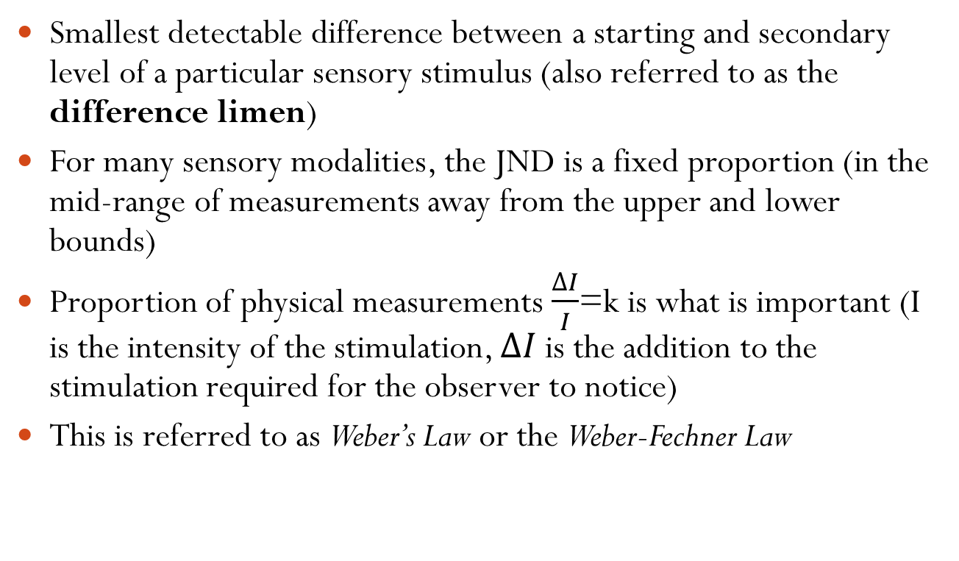
Just Noticeable Difference (JND)
Smallest detectable difference between a starting and secondary level of a particular sensory stimulus (also referred to as the difference limen)
For many sensory modalities, the JND is a fixed proportion (in the mid-range of measurements away from the upper and lower bounds)
Proportion of physical measurements $\frac{∆I}{I}$=k is what is important (I is the intensity of the stimulation, $∆I$ is the addition to the stimulation required for the observer to notice)
This is referred to as Weber’s Law or the Weber-Fechner Law
EH Weber, HE Ross and DJ Murray, EH Weber on the Tactile Senses. Psychology Press; 2nd Revised edition edition (January 1, 1996)

Slide 6
Just Noticeable Difference
This is a statistical measurement, not an exact quantity
From trial to trial, the difference one notices will vary
Must conduct many trials in order to determine a threshold
JND is usually reported as the difference at which a person notices 50% of the time
Depends on the situational, motivational and perceptual factors

Slide 7
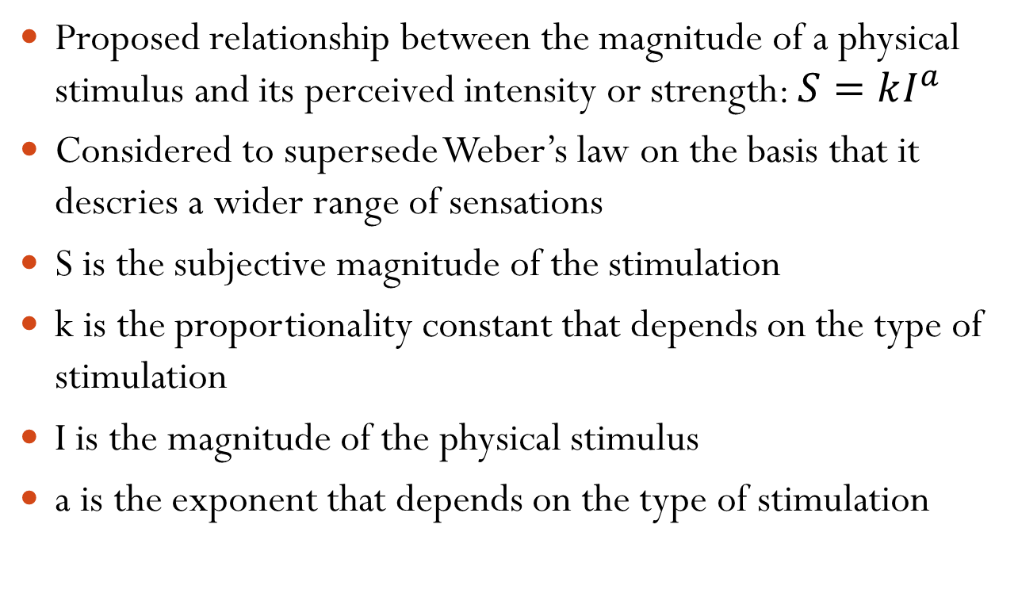
Steven’s Power Law
Proposed relationship between the magnitude of a physical stimulus and its perceived intensity or strength: $S=kI^{a}$
Considered to supersede Weber’s law on the basis that it descries a wider range of sensations
S is the subjective magnitude of the stimulation
k is the proportionality constant that depends on the type of stimulation
I is the magnitude of the physical stimulus
a is the exponent that depends on the type of stimulation
Stevens, S.S. (1957). "On the psychophysical law". Psychological Review 64 (3): 153–181

Slide 8
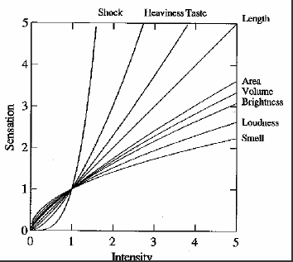
Steven’s Power Law
Sensation | Exponent
Loudness | .6
Brightness | .33
Smell | .55 (Coffee) - .6 (Heptane)
Temperature | 1.0 (Cold) – 1.6 (Warm)
Heaviness | .1.45
Electric Shock | 3.5
Stevens, S.S. (1957). "On the psychophysical law". Psychological Review 64 (3): 153–181

Slide 9
Visual Processing
Detailed vision is only possible within a small portion of the visible field (approximately an area the size of your thumbnail at an arms length away¹)
To see detailed information from more than one region, the eyes move rapidly between areas
This alternates between a brief stationary period (a fixation) and flicking rapidly to a new location during a brief period of blindness (a saccade – takes at least 200 ms)
This occurs 3-4 times per second with little awareness on our part²
1 - C. Healey and J. Enns, “Attention and Visual Memory in Visualization and Computer Graphics”, IEEE Transactions on Visualization and Computer Graphics, 2011 (Pre-print)
2 – A. Yarbus, Eye Movements and Vision. New York, New York: Plenum Press, 1967

Slide 10
Visual Attention
Visual attention is the term used to denote the mechanisms which determine which regions of an image are selected for more focus
What is attention?
Ability to focus on a task
Ability to concentrate
Aspects of attention
Selective attention
Divided attention
Automaticity
1 - C. Healey and J. Enns, “Attention and Visual Memory in Visualization and Computer Graphics”, IEEE Transactions on Visualization and Computer Graphics, 2011 (Pre-print)

Slide 11
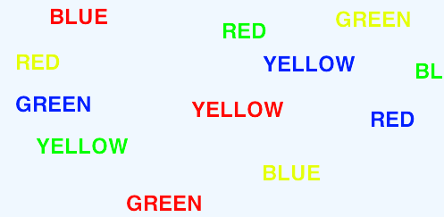
Selective Visual Attention
It is difficult to attend to more than one thing at the same time
When we attend to one task over the other, this is selective attention
Classic Stroop task – Read aloud the color of the word, not the word itself
Stroop, John Ridley (1935). "Studies of interference in serial verbal reactions". Journal of Experimental Psychology 18 (6): 643–66

Slide 12
Theoretical Interpretations of Selective Attention
Bottleneck/filter theories
A bottleneck is a mechanism that limits the amount of information to be attended to
Early selection¹ - select one message for further processing and all others are lost
Attenuation² – select one message for full processing, others are partially processed
Late selection³ – all messages get through but only one is selected for processing
1 – D. E. Broadbent, Perception and Communication. Oxford, United Kingdom: Oxford University Press, 1958
2 – A. Triesman, “Monitoring and storage of irrelevant messages in selective attention,” Psychological Review 87: 272-300
3 – J. A. Deutsch and D. Deutsch, "Attention: some theoretical considerations,“ Psychological Review 70: 80–90

Slide 13
Theoretical Interpretations of Divided Attention
Divided attention is the act of trying to attend to two stimuli at once and making multiple responses rather than making one response to multiple stimuli
Capacity Theories
A limited amount of resources are available to conduct tasks¹
Only one cognitive process can occur at a time²
1 – D. Kahneman (1973). Attention and effort. Englewood Cliffs, NJ: Prentice-Hall.
2 – H. Pashler, “Dual-Task Interference in Simple Tasks: Data and Theory,” Psychological Bulletin, 116(2): 220-244

Slide 14
Pre-attentive Processing
Early studies made an important discovery – a limited set of visual features can be detected very rapidly by low-level, fast-acting processes
Human vision rapidly and automatically categorizes visual images into regions and properties based on simple computations
These computations are done in parallel across the image
These properties are called pre-attentive since their detection seems to precede focused attention
C. Healey and J. Enns, “Attention and Visual Memory in Visualization and Computer Graphics”, IEEE Transactions on Visualization and Computer Graphics, 2011 (Pre-print)

Slide 15
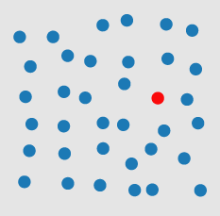

Pre-attentive Processing
Tasks that can be performed on large multi-element displays in less than 200-250 ms are considered pre-attentive
An example of searching for a target red circle based on a difference in hue: (a) target is present in a sea of blue circle distractors; (b) target is absent
C. Healey and J. Enns, “Attention and Visual Memory in Visualization and Computer Graphics”, IEEE Transactions on Visualization and Computer Graphics, 2011 (Pre-print)

Slide 16


Pre-attentive Processing
An example of searching for a target red circle based on a difference in curvature: (a) target is absent in a sea of red square distractors; (b) target is present
C. Healey and J. Enns, “Attention and Visual Memory in Visualization and Computer Graphics”, IEEE Transactions on Visualization and Computer Graphics, 2011 (Pre-print)

Slide 17
Pre-attentive Processing
In the last two examples, we saw hue and shape as a pre-attentive visual feature
A target identified by a unique visual property allows it to “pop out” of the display
This implies that it is easily detected regardless of the distracters
What happens if we combined two or more visual features?
C. Healey and J. Enns, “Attention and Visual Memory in Visualization and Computer Graphics”, IEEE Transactions on Visualization and Computer Graphics, 2011 (Pre-print)

Slide 18
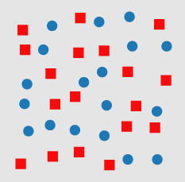
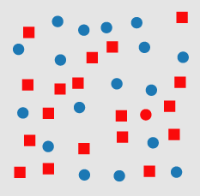
Pre-attentive Processing
An example of a conjunction search for a target red circle: (a) target is absent in a sea of red square and blue circle distractors; (b) target is present
C. Healey and J. Enns, “Attention and Visual Memory in Visualization and Computer Graphics”, IEEE Transactions on Visualization and Computer Graphics, 2011 (Pre-print)

Slide 19
Pre-attentive Features
Experiments in psychology have used features to perform the following pre-attentive visual tasks
Target detection – users rapidly and accurately detect the presence or absence of a target with a unique visual feature
Boundary detection – users rapidly and accurately detect a texture boundary between two groups of elements, where all of the elements in each group have a common visual property
Region tracking – users track one or more elements with a unique visual feature as the move in time and space
Counting and estimation – users count or estimate the number of elements with a unique visual feature
C. Healey and J. Enns, “Attention and Visual Memory in Visualization and Computer Graphics”, IEEE Transactions on Visualization and Computer Graphics, 2011 (Pre-print)

Slide 20





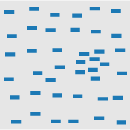

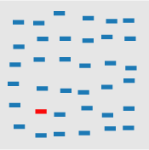
Partial List of Pre-Attentive Visual Features
Blob orientation length, width closure size
Curvature density, contrast number, estimation color(hue)
C. Healey and J. Enns, “Attention and Visual Memory in Visualization and Computer Graphics”, IEEE Transactions on Visualization and Computer Graphics, 2011 (Pre-print)

Slide 21

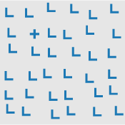
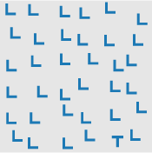
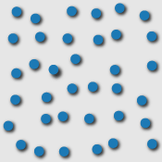
Partial List of Pre-Attentive Visual Features
Intensity/luminance intersection terminators 3D depth cues
Others include direction of motion, velocity of motion and lighting direction
C. Healey and J. Enns, “Attention and Visual Memory in Visualization and Computer Graphics”, IEEE Transactions on Visualization and Computer Graphics, 2011 (Pre-print)

Slide 22
Pre-Attentive Visual Features
These features were measured through a series of experiments using target and boundary detection
Performance was measured by response time and accuracy
Response time – viewers are asked to complete the task as quickly as possible while maintaining a high level of accuracy
Accuracy – display is shown for a small duration then removed, if the viewer can complete the task accurately regardless of the number of distractors then a feature is assumed to be preattentive
C. Healey and J. Enns, “Attention and Visual Memory in Visualization and Computer Graphics”, IEEE Transactions on Visualization and Computer Graphics, 2011 (Pre-print)

Slide 23

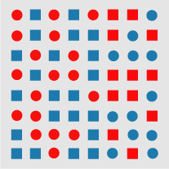
Boundary Detection Experiment
An example of a boundary detection from Treisman's experiments: (a) a boundary defined by a unique feature hue (red circles and red squares on the top, blue circles and blue squares on the bottom) is pre-attentively classified as horizontal; (b) a boundary defined by a conjunction of features (red circles and blue squares on the left, blue circles and red squares on the right) cannot be pre-attentively classified as vertical
C. Healey and J. Enns, “Attention and Visual Memory in Visualization and Computer Graphics”, IEEE Transactions on Visualization and Computer Graphics, 2011 (Pre-print)

Slide 24

Feature Integration Theory
Posited that there are two stages of visual processing, the pre-attentive stage and the focused attention stage
Pre-attentive stage
Primary visual features are processed
Objects are analyzed with details (shape, color, etc.)
Each aspect is processed in different areas of the brain
Focused attention stage
Integrate individual features in order to perceive object
If object is familiar, associations between object and prior knowledge are made
1 - Anne Treisman and Garry Gelade (1980). "A feature-integration theory of attention." Cognitive Psychology, Vol. 12, No. 1, pp. 97-136
2 - C. Healey and J. Enns, “Attention and Visual Memory in Visualization and Computer Graphics”, IEEE Transactions on Visualization and Computer Graphics, 2011 (Pre-print)

Slide 25
Texton Theory
Suggests that early visual system detects a group of features called textons which can be put into three categories
Elongated blobs with specific properties
Terminators
Crossings of line segments
Postulated that only a difference in textons or their density can be detected pre-attentively
As in previous theory, suggests that pre-attentive processing occurs in parallel, focused attention in serial
1 - Julesz, B (March, 1981). "Textons, the Elements of Texture Perception, and their Interactions". Nature 290 (5802): 91–972
2 - C. Healey and J. Enns, “Attention and Visual Memory in Visualization and Computer Graphics”, IEEE Transactions on Visualization and Computer Graphics, 2011 (Pre-print)

Slide 26
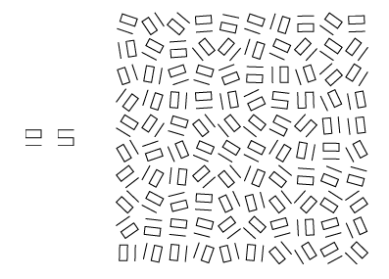
Texton Theory
An example of textons: two textons (A and B) that appear different in isolation, but have the same size, number of terminators, and join points; (c) a target group of B-textons is difficult to detect in a background of A-textons when a random rotation is applied
1 - Julesz, B (March, 1981). "Textons, the Elements of Texture Perception, and their Interactions". Nature 290 (5802): 91–972
2 - C. Healey and J. Enns, “Attention and Visual Memory in Visualization and Computer Graphics”, IEEE Transactions on Visualization and Computer Graphics, 2011 (Pre-print)

Slide 27
Similarity Theory
Not all researchers believe in the parallel/serial dichotomy
Similarity theory assumes that search ability varies depending on both the type of task and display conditions
Search time is based on two criteria
T-N similarity: amount of similarity between targets and non-targets
N-N similarity: amount of similarity within the non-targets
As T-N similarity increases, search efficiency decreases and search time increases
As N-N similarity decreases, search efficiency decreases and search time increases
1 - Duncan, J. and Humphreys, G. W. Visual search and stimulus similarity. Psychological Review 96, 3 (1989), 433–458.
2 - C. Healey and J. Enns, “Attention and Visual Memory in Visualization and Computer Graphics”, IEEE Transactions on Visualization and Computer Graphics, 2011 (Pre-print)

Slide 28
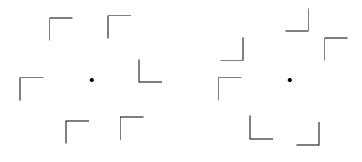
Similarity Theory
Example of N-N similarity affecting search efficiency for a target shaped like the letter L: (a) high N-N (nontarget-nontarget) similarity allows easy detection of target L; (b) low N-N similarity increases the difficulty of detecting the target L
1 - Duncan, J. and Humphreys, G. W. Visual search and stimulus similarity. Psychological Review 96, 3 (1989), 433–458.
2 - C. Healey and J. Enns, “Attention and Visual Memory in Visualization and Computer Graphics”, IEEE Transactions on Visualization and Computer Graphics, 2011 (Pre-print)

Slide 29
Guided Search Theory
Posits that there are two ways in which pre-attentive processes can be used to direct attention:
Bottom-up processing – stimulus driven
Top-down processing – user driven
Information from these two processes create a ranking of items in order of their attentional priority
Follows concepts of the parallel search processing work
1 - Wolfe, J. M. Guided Search 2.0: A revised model of visual search. Psychonomic Bulletin & Review 1, 2 (1994), 202–238.
2 - C. Healey and J. Enns, “Attention and Visual Memory in Visualization and Computer Graphics”, IEEE Transactions on Visualization and Computer Graphics, 2011 (Pre-print)

Slide 30
Boolean Map Theory
Divides visual search task into two parts
Selection: involves choosing a set of objects from a scene
Access: determines what properties of the selected objects a viewer can apprehend
Previous work describes these steps as a whole, boolean theory posits them as separate steps
Proposes that visual system is capable of dividing a scene into exactly two parts: selected elements and excluded elements
1 - Huang, L. and Pashler, H. A boolean map theory of visual attention. Psychological Review 114, 3 (2007), 599–631
2 - C. Healey and J. Enns, “Attention and Visual Memory in Visualization and Computer Graphics”, IEEE Transactions on Visualization and Computer Graphics, 2011 (Pre-print)

Slide 31
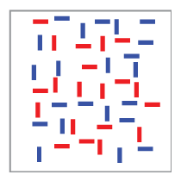
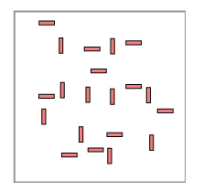
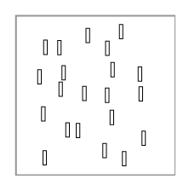
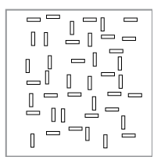
Boolean Map Theory
An example of creating boolean maps from an image.
1 - Huang, L. and Pashler, H. A boolean map theory of visual attention. Psychological Review 114, 3 (2007), 599–631
2 - C. Healey and J. Enns, “Attention and Visual Memory in Visualization and Computer Graphics”, IEEE Transactions on Visualization and Computer Graphics, 2011 (Pre-print)

Slide 32
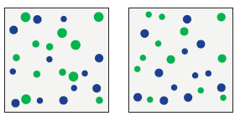
Ensemble Encoding
Low level visual processes are also able to generate quick summaries of how simple visual features are distributed
Experiments have shown that observers could:
Extract the average size of a large number of dots¹
Extract the average orientation of a simple edge
Extract average color
Even extract higher level qualities such as emotoins
1 - D. Ariely, “Seeing sets: Representation by statistical properties,”Psychological Science, vol. 12, no. 2, pp. 157–162, 2001.
2 - C. Healey and J. Enns, “Attention and Visual Memory in Visualization and Computer Graphics”, IEEE Transactions on Visualization and Computer Graphics, 2011 (Pre-print)

Slide 33
Feature Hierarchy
One of the most important considerations for a visualization designer is deciding how to present information in a display without producing visual confusion
Feature hierarchies suggest the most important data attributes should be displayed with the most salient visual features
Theories on how visual features compete for attention point to a rough order of processing
Determine the 3D layout of a scene
Determine surface structures and volume
Establish object movement
Interpret luminance gradients across surfaces
Use color to fine-tune these interpretations
C. Healey and J. Enns, “Attention and Visual Memory in Visualization and Computer Graphics”, IEEE Transactions on Visualization and Computer Graphics, 2011 (Pre-print)

Slide 34
Cleveland’s Heirarchy¹
Cleveland evaluated elements when isolated
Tasks were restricted to magnitude and ratio comparisons
Research indicates this hierarchy may be best in pre-attentive stages or when focusing only on portions of a graphic^{2,3,4}
Best
1 - Position along a common scale
2 – Position along nonaligned scales
3 – Length
4 – Angle/Slope
5 – Area
6 – Volume
7 - Color
Worst
1 – WS Cleveland, The Elements of Graphing Data, 1985
2 – Spence, I., and Lewandowsky, S. (1991). Displaying proportions and percentages. Applied Cognitive Psychology 5, 61-77
3 – Simkin, D., and Hastie, R. (1987). An information processing analysis of graph perception. Journal of the American Statistical Association, 82, 454-465
4 – Carswell, C. M. (1992). Choosing specifiers: An evaluation of the basic tasks model of graphical perception. Human Factors, 4, 535-554

Slide 35
Post-attentive Vision
Pre-attentive processing asks “What visual properties draw our eyes?”
Another question is: “What happens to the visual representation of an object when we stop attending and look at something else?”
Our memory for detail between glances at a scene is very limited
Evidence suggests that a viewer’s current state of mind plays a critical role in what is seen, not seen and seen next
C. Healey and J. Enns, “Attention and Visual Memory in Visualization and Computer Graphics”, IEEE Transactions on Visualization and Computer Graphics, 2011 (Pre-print)

Slide 36
Post-attentive Amnesia
One might assume that seeing a scene in advance would help with target detection
To test this, targets were designed with two properties¹
Conjunction of features (cannot be detected pre-attentively)
Arbitrary combination of color and shape (cannot be recognized semantically and remembered)
Results showed that previewing an image provided no advantage
If post-attentive search has no advantage, then pre-attentive methods may be critical for efficient data exploration!
1 - J. M. Wolfe, N. Klempen, and K. Dahlen, “Post attentive vision,” The Journal of Experimental Psychology: Human Perception and
Performance, vol. 26, no. 2, pp. 693–716, 2000.
2 - C. Healey and J. Enns, “Attention and Visual Memory in Visualization and Computer Graphics”, IEEE Transactions on Visualization and Computer Graphics, 2011 (Pre-print)

Slide 37
Attention Guided by Memory and Prediction
Contextual cuing – viewers find a target more rapidly for a subset of the displays that are presented repeatedly – but in random order
When tested, viewers showed no awareness that some displays were repeated
Appears to involve guided attention to a target by subtle regularities in past experience
Attention can be affected by incidental knowledge about global context
Visualization might be able to harness such incidental spatial knowledge of a scene by tracking both the number of views and time spent viewing images that are later re-examined by the viewer
1 - M. M. Chun and Y. Jiang, “Contextual cueing: Implicit learning and memory of visual context guides spatial attention,” Cognitive
Psychology, vol. 36, no. 1, pp. 28–71, 1998.
2 - C. Healey and J. Enns, “Attention and Visual Memory in Visualization and Computer Graphics”, IEEE Transactions on Visualization and Computer Graphics, 2011 (Pre-print)

Slide 38
Attention Guided by Memory and Prediction
Inhibition of return¹ – viewers have an unconscious tendency to look for targets in novel locations in the display as opposed to looking at locations that have already been examined
This has shown to be distinct from strategic influences such as choosing to search left-to-right
Rapid resumption² – viewers can resume an interrupted search much faster than they can start a new search
This suggests that viewers may benefit from unconscious perceptual predictions that they make about the target based on partial information acquired during an initial glimpse of the display
1 - M. I. Posner and Y. Cohen, “Components of visual orienting,” in Attention & Performance X, H. Bouma and D. Bouwhuis, Eds.
Hillsdale, New Jersey: Lawrence Erlbaum and Associates, 1984, pp. 531–556.
2 - A. Lleras, R. A. Rensink, and J. T. Enns, “Rapid resumption of an interrupted search: New insights on interactions of vision and
memory,” Psychological Science, vol. 16, no. 9, pp. 684–688, 2005.
3 - C. Healey and J. Enns, “Attention and Visual Memory in Visualization and Computer Graphics”, IEEE Transactions on Visualization and Computer Graphics, 2011 (Pre-print)

Slide 39
Change Blindness
Vision is a dynamic process, things being built in our mind are short lived models of the external world
What a viewer is searching for and what is presented can all have an effect on performance
An interruption in what is being seen (a blink or blank screen) can render us “blind” to changes that occur in the scene during interruption
Fun examples
Static pictures (Ron Rensink, UBC)
http://www.psych.ubc.ca/~rensink/flicker/download/
1 - R. A. Rensink, J. K. O’Regan, and J. J. Clark, “To see or not to see: The need for attention to perceive changes in scenes,”
Psychological Science, vol. 8, pp. 368–373, 1997.
2 - C. Healey and J. Enns, “Attention and Visual Memory in Visualization and Computer Graphics”, IEEE Transactions on Visualization and Computer Graphics, 2011 (Pre-print)

Slide 40
Inattentional Blindness
Viewers can completely fail to perceive visually salient objects or activities
http://viscog.beckman.illinois.edu/flashmovie/15.php
1 - H. E. Egeth and S. Yantis, “Visual attention: Control, representation, and time course,” Annual Review of Psychology, vol. 48, pp.
269–297, 1997.
2 - C. Healey and J. Enns, “Attention and Visual Memory in Visualization and Computer Graphics”, IEEE Transactions on Visualization and Computer Graphics, 2011 (Pre-print)

Slide 41
Attentional Blink
Attentional blink – used to study the availability of attention across time
Findings indicate that when two targets are presented in rapid succession, the second of the two targets cannot be detected or identified when it appears within approximately 100-500 ms following the first target
If the second target is presented immediately after the first, reports of the second target are quite accurate
1 - D. E. Broadbent and M. H. P. Broadbent, “From detection to identification: Response to multiple targets in rapid serial visual
presentation,” Perception and Psychophysics, vol. 42, no. 4, pp. 105– 113, 1987.
2 - C. Healey and J. Enns, “Attention and Visual Memory in Visualization and Computer Graphics”, IEEE Transactions on Visualization and Computer Graphics, 2011 (Pre-print)

Slide 42
Implications of “Blindness” on Visualization
Significant changes in data may be missed
Need to insure that attention is fully deployed on a specific location in a visualization
Attending to data elements in one frame of an animation may render us temporarily blind to what follows at a location
C. Healey and J. Enns, “Attention and Visual Memory in Visualization and Computer Graphics”, IEEE Transactions on Visualization and Computer Graphics, 2011 (Pre-print)

Slide 43
Perception in Visualization and Graphics
Proper choice of visual features will focus attention to areas in a visualization that contain important data
Properly weighting the perceptual strength of the chosen data representation can help this
Can also track attention to predict where a viewer will look allowing different parts of an image to be managed based on the amount of attention it is expected to receive
C. Healey and J. Enns, “Attention and Visual Memory in Visualization and Computer Graphics”, IEEE Transactions on Visualization and Computer Graphics, 2011 (Pre-print)

Slide 44
Readings and Homework
Require Readings:
C. Healey and J. Enns, “Attention and Visual Memory in Visualization and Computer Graphics,” IEEE Transactions on Visualization and Computer Graphics, 2011 (Pre-print).
Good References:
Colin Ware:
http://www.ccom-jhc.unh.edu/vislab/VisCourse/
The Joy of Visual Perception:
http://www.yorku.ca/eye
Chris Healey
http://www.csc.ncsu.edu/faculty/healey/PP/PP.html
Homework:
Milestone #1 is due in ~1.5 weeks!

