Slide 1
Image Foreground/Background Segmentation using Max-Flow
Group Member：
Chengeng Liu
Shaowei Lin
Fei Gao
Siyuan Zhang
Runchuan Feng
2022/12/08

Slide 2

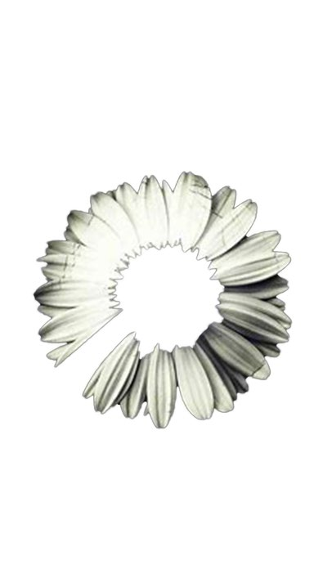
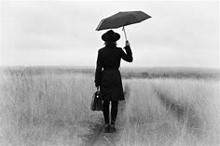

Problem: Segment Foreground and Background
Image segmentation: Partitioning a digital image into multiple segments according to some certain features.
Selecting a region of background pixels and another region of foreground pixels from the given gray scale images.

Slide 3
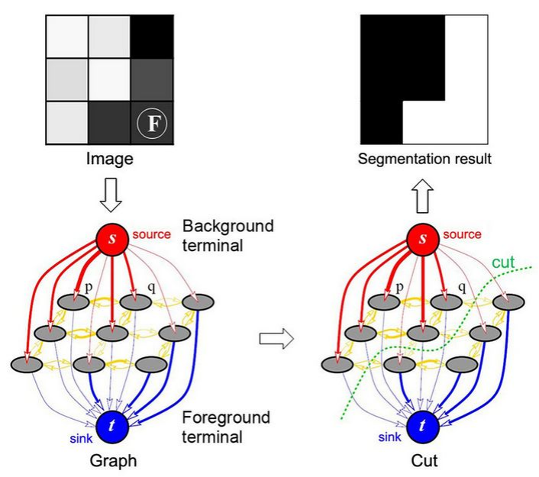
Based on Min-Cut Max-Flow Theorem
Transform the input image into network flow graph
Using max-flow algorithms to find the min-cut which leads to a optimal segmentation

Slide 4
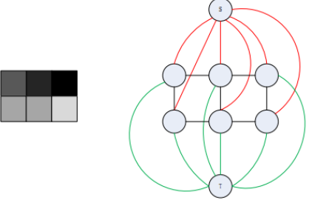
Based on Min-Cut Max-Flow Theorem
Transform Image into Graph
1.Each pixel in the image is considered as a node
Two more specially designated terminal nodes: S(source) and T(sink)
2.Neighboring nodes are connected by edges in a regular grid-like fashion.(n-link)
Another kinds of edges are used to connect nodes to terminals(t-link)
3.All graph edges are assigned some different nonnegative weight(cost)
A image with 3*2 pixels and its graph

Slide 5
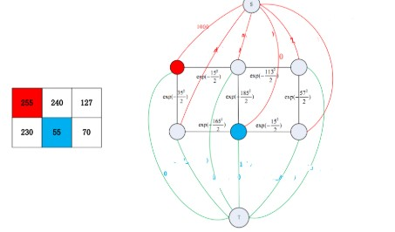


Based on Min-Cut Max-Flow Theorem
Calculation of Edge Weight
T-links of terminals:
①S-T & T-S:set to be a large value
②S-S & T-T:set to be 0
Other links:
Here, Ip and Iq are the intensities of pixels p and q respectively and σ from empirical results was chosen to be 30.

Slide 6
Max-Flow Algorithms
Edmonds-Karp（EK ）
1. It’s an implementation of the Ford-Fulkerson method that uses BFS for finding augmenting paths
2. The algorithm runs in time.
3. The flow of an edge cannot exceed the capacity. Source s only has an outgoing flow, sink t has only incoming flow.
capacity[u][v] -= new_flow
capacity[v][u] += new_flow;
4. When there’s no augmenting path can be found, Current flow = max flow.

Slide 7
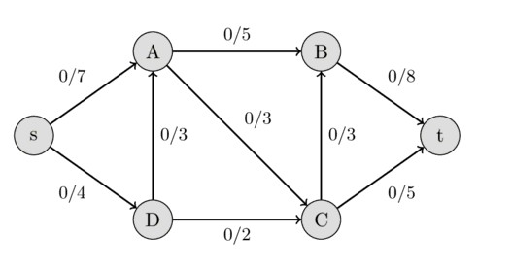
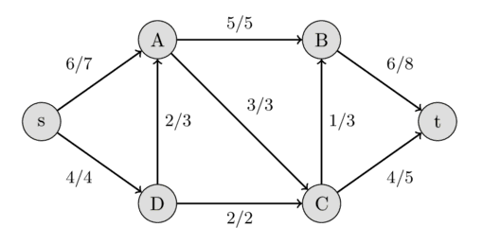
Initial flow network
Ford-Fulkerson method
maximal flow in the flow network

Slide 8
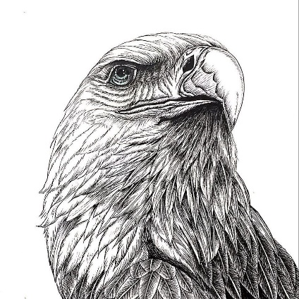



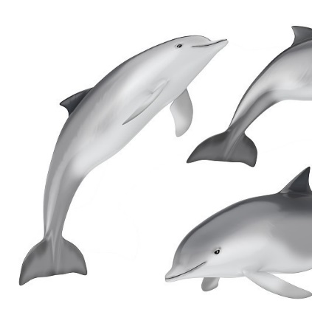


Image Segmentation
50×50
100×100
To shorten the calculation time of the algorithm, we choose to reduce the image to 50 * 50 pixels and then segment.

Slide 9
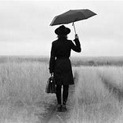


Image Segmentation
Different source/sink point choose

Slide 10




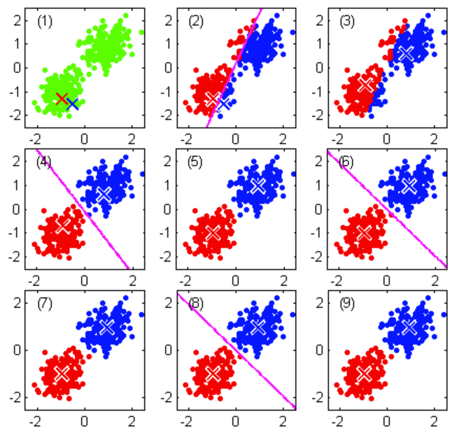
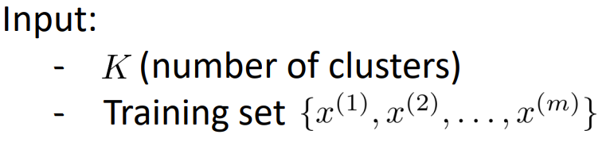
Compare with other algorithm
K-means algorithm
Randomly initialize K cluster centroids
Repeat {
for = 1 to
:= index (from 1 to K) of cluster centroid closest to
for = 1 to K
:= average (mean) of points assigned to cluster
}

Slide 11
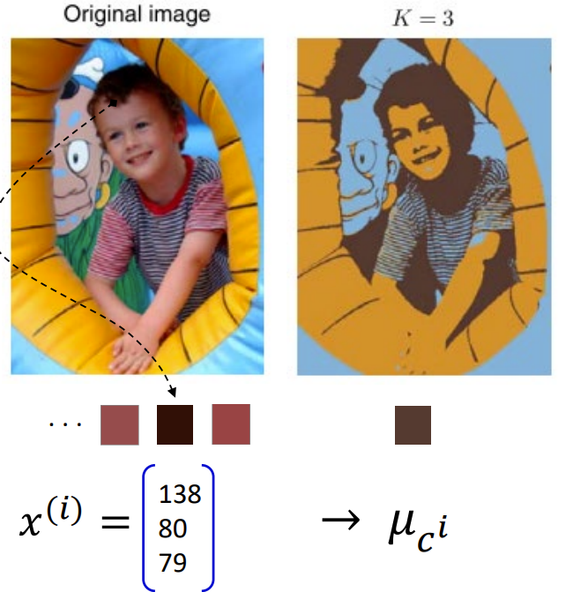
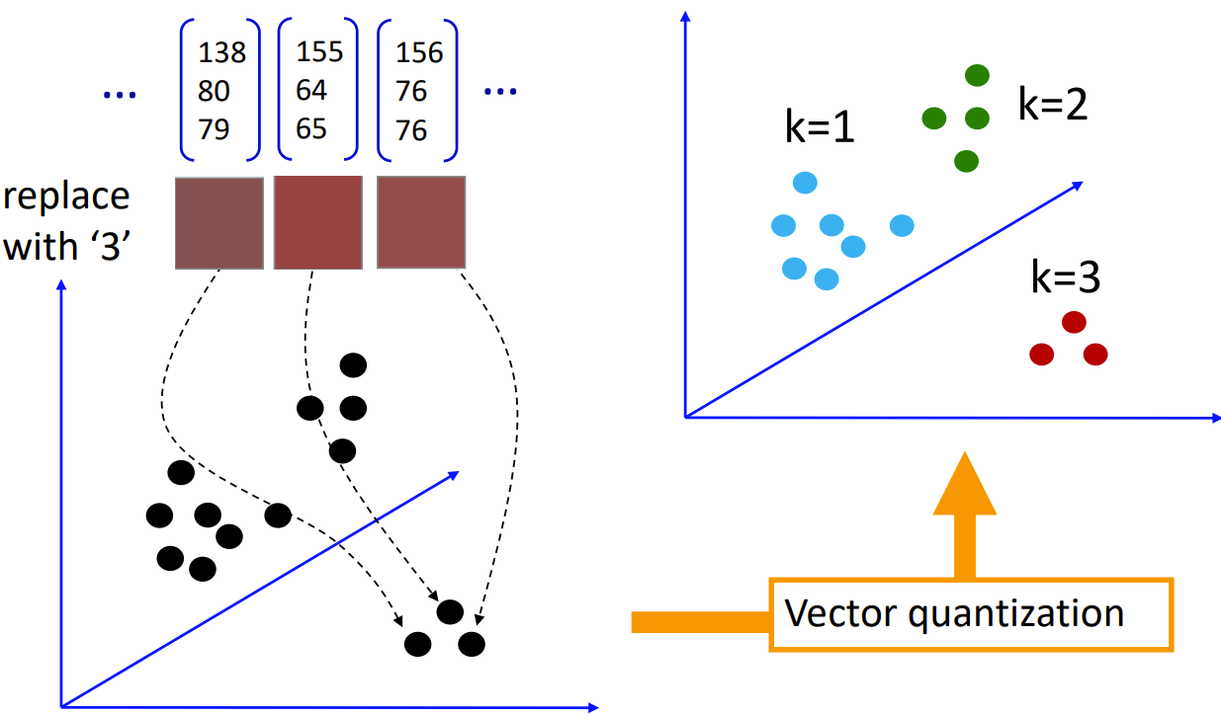

K-means For Image Segmentation
Compress an image using clustering
Each {R, G, B} pixel value is an input vector
Cluster into K clusters (using k-means)
Replace each vector by its cluster’s index (K possible values)
For display, show the mean

Slide 12
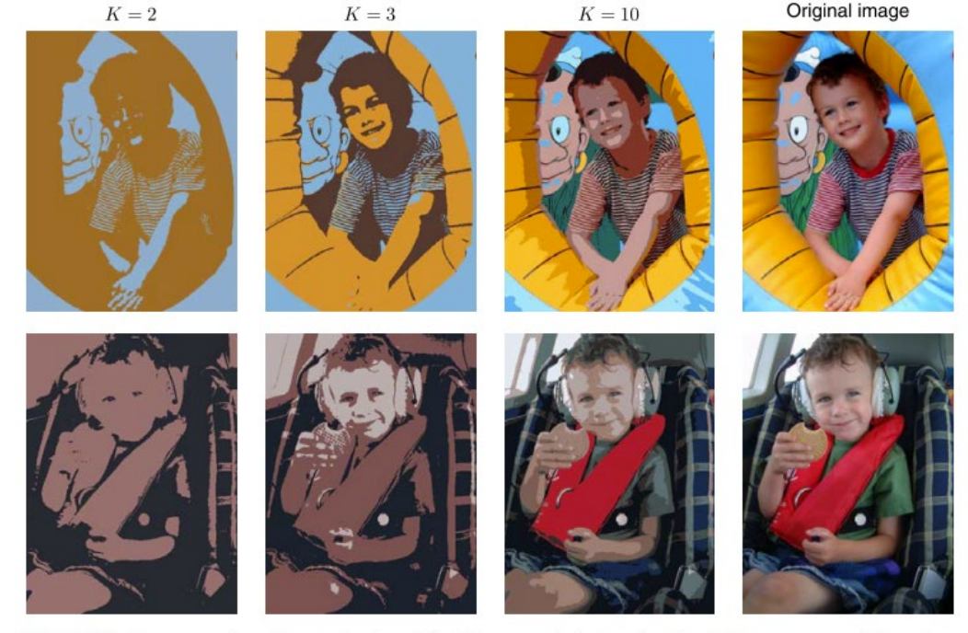
K-means For Image Segmentation
Figure 4: Two example of the application of the K-means clustering algorithm to image segmentation showing the intial images together with their K-means segmentations obtained using various values of K.

Slide 13
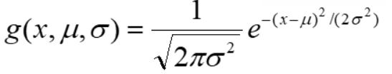
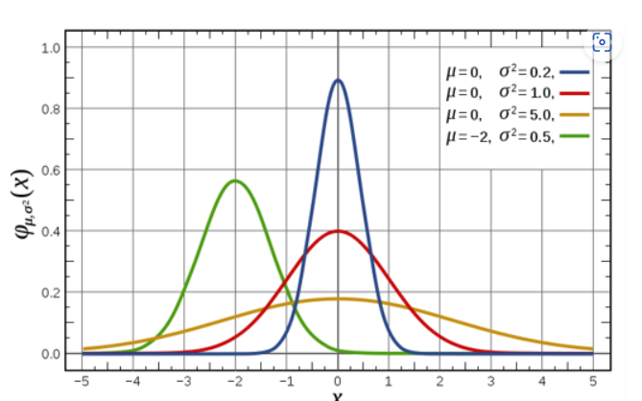
Compare with other algorithm
Gaussian Mixture Model
All data are generated by one of the gaussian distribution

Slide 14
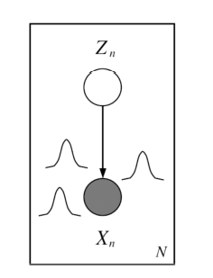
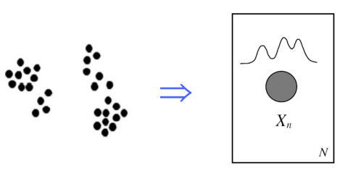
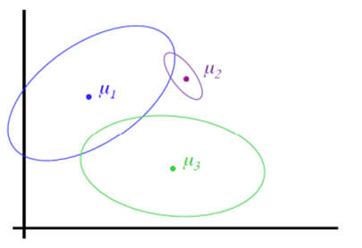

Gaussian Mixture Model
(a)
(b)
(c)
(d)

Slide 15
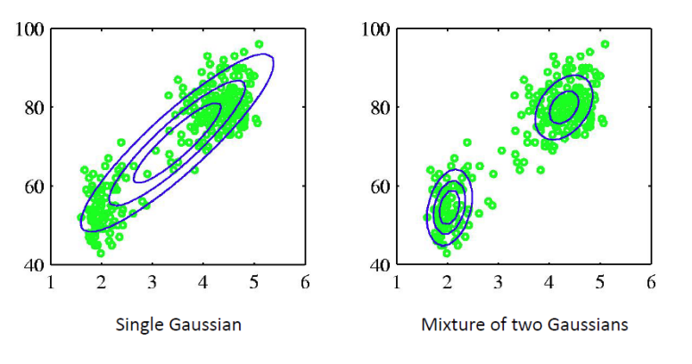
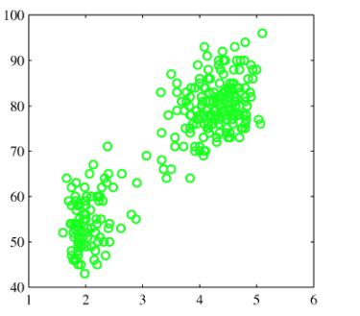
Gaussian Mixture Model
Use Expectation-Maximization method to train

Slide 16
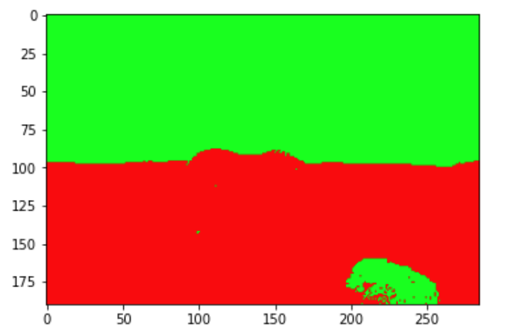
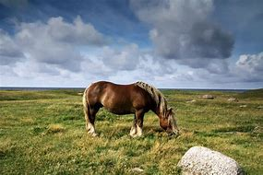
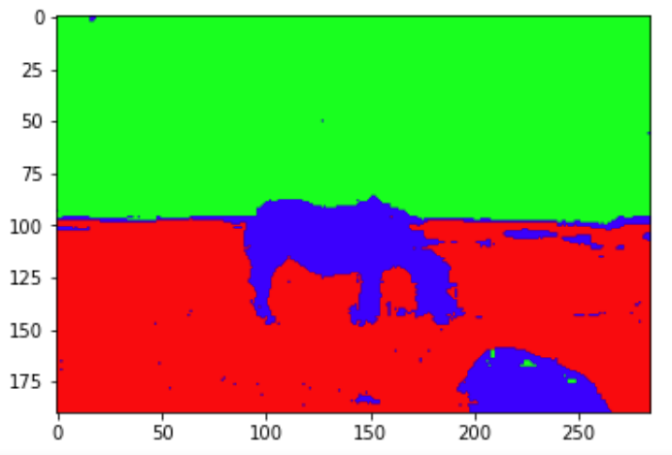
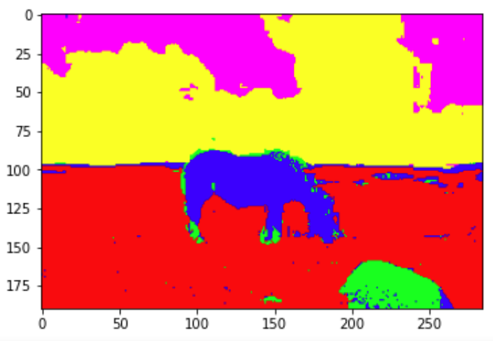
Gaussian Mixture Model
(K=2)
(K=3)
(original)
(K=5)

Slide 17
Thank You

