Slide 1
03 Function BY 108316101 林濟棟 108316135 林廣濤

Slide 2
Advantages of function
Facilitate the design, implementation, operation and maintenance of large programs
使程序變得更簡短而清晰
有利於程序維護
可以提高程序開發的效率
提高了代碼的重用性
Divide and conquer technique
Construct a large program from small, simple pieces (e.g., components)
Allow programmers to modularize(模組化) a program by separating its tasks into self-contained units

Slide 3
1. Function call
A function is invoked by(調用) a function call

Slide 4
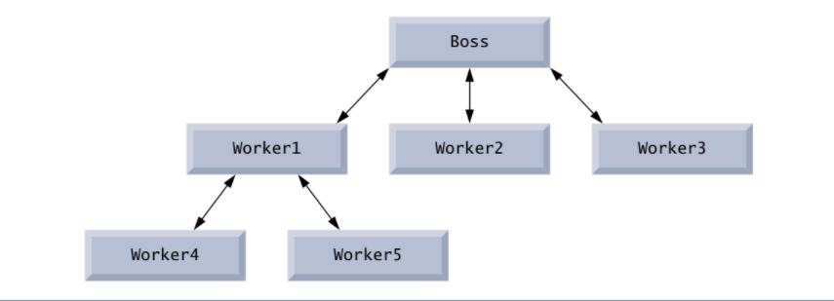
Function call :
function name + arguments ( information that the called function needs to perform its designated task )
pow(3,2) – Math function
Called function either returns a result (return value) or simply returns to the caller.
Function calls form hierarchical relationships(層次关系)

Slide 5
Function Call
Invoking functions
• Provide function name and arguments (data)
• Function returns results or none
Function call analogy:
• Boss asks worker to complete task
– Worker gets information, does task, returns result
– Information hiding: boss does not know details

Slide 6
Function Definitions
Function Definitions format:
return-value-type function-name( parameter-list )
{
declarations and statements
}
Function-name: any valid identifier
Return-value-type: data type of the result : void – indicates that the function returns nothing
Parameter-list: comma separated list, declares parameters
A type must be listed explicitly for each parameter.

Slide 7
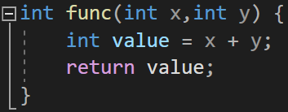
The basic structure of function
Return value type
(void if no return value)
Parameters declaration
(type and name)
Function name
Body

Slide 8
Function Prototype
ALSO KNOWN AS FUNCTION DECLARATION
Indicates to the compiler:
Name of the function
Type of data returned by the function
Parameters the function expects to receive
Number of parameters
Types of those parameters
Order of those parameters

Slide 9
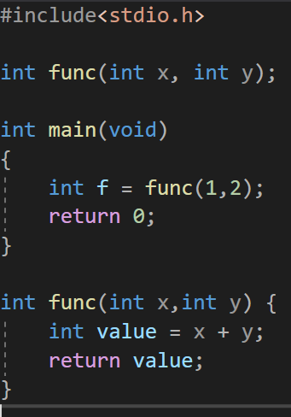
Function Prototype
Compiler uses a function prototype to:
Check that calls to the function contain the correct number and types of arguments in the correct order
Ensure that the value returned by the function is used correctly in the expression that called the function
function call
function definition

Slide 10
常見的錯誤
參數宣告錯誤
int wow(int x,y)
{
//statements;
}
int wow(int x, int y)
{
//statements;
}
應為

Slide 11
常見的錯誤
int wow(int x, int y);
重複宣告
int main()
{
wow(x ,y);
...
}
int wow(int x, int y)
{
int x,y;
//statements;
}

Slide 12
常見的錯誤
參數宣告的型態(或是傳入值得總數)與prototype 宣告不一致
int wow(int x, int y);
int main()
{
int a=0,b=0;
wow(a,b);
...
}
int wow(float x, float y)
{
//statements;
}

Slide 13
常見的錯誤
參數宣告的型態(或是傳入值得總數)與prototype 宣告不一致
int wow(int x, int y);
int main()
{
int a=0,b=0,c=0;
wow(a,b,c);
...
}
int wow(int x, int y)
{
//statements;
}

Slide 14
2. Call by value , reference

Slide 15
Function
Call by value
-複製參數到自訂函數
-不會改變原本的值
-如果不想修改到原本的值
可以用call by value
Call by reference
-傳該值的地址給function
-可以改變原本的數值
-只開放給特定幾個需要
改原本值的function

Slide 16
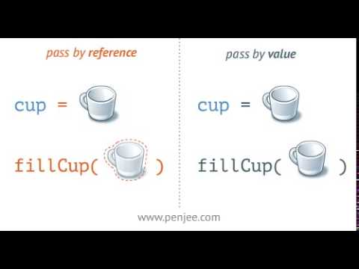
差異

Slide 17
Call by value範例
#include <stdio.h>
void swap(int x, int y);
int main() {
int a, b;
scanf("%d%d", &a, &b)
swap(a, b);
printf("%d %d\n", a, b);
return 0;
}
void swap(int x, int y) {
int temp;
printf("%d %d\n", x, y);
temp = x;
x = y;
y = temp;
printf("%d %d\n", x, y);
}
a
b
4
3
temp
4
x
y

Slide 18
Call by reference
* operator反參照運算子
int* number
void doublenumber(int* x) {
*x = *x * 2;
}
表示此變數是一個存放記憶體位址的變數
number 是一個存放位址的變數，存放的位址指向一個空間，指向的空間可存放型態為 int 的數值

Slide 19
Call by reference範例
#include <stdio.h>
void swap( int *x, int *y );
int main() {
int a, b;
scanf("%d%d", &a, &b);
swap( &a, &b );
printf("%d %d", a, b);
return 0;
}
void swap(int *x, int *y)
{
int temp;
printf("%d %d", *x, *y);
temp = *x;
*x = *y;
*y = temp;
printf("%d %d", *x, *y);
}
a
b
4
3
temp
3
x
y

Slide 20

Thanks!
Any questions?
You can find me at:
108316135@gms.tcu.edu.tw
108316101@gms.tcu.edu.tw

