Slide 1
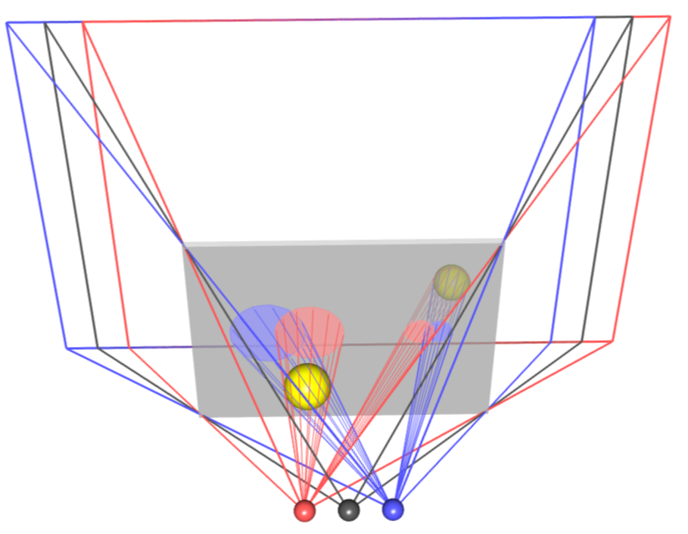
Screen
right frustum
left frustum
left eye
center eye
right eye

Slide 2
screenWidth
zZeroParallax
viewDir
zNear
zFar
eyeSeparation*screenWidth

Slide 3
screenWidth
x
z
viewDir
zFar
zNear
observerLocation
eyeSeparationDirection
eyeSeparation*screenWidth

Slide 4
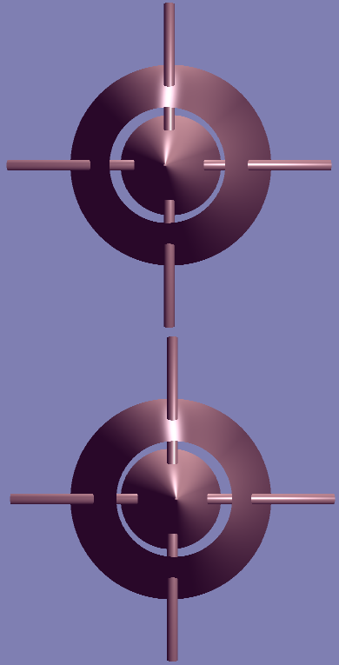

highlights centered to pole
highlights more to right of pole
highlights more to left of pole
highlights centered to pole

Slide 5
