Slide 1

Task-based Interaction with an Integrated Multilingual,
Multimedia Information System:
A Formative Evaluation
Pengyi Zhang
INFM700
Information Architecture,
Jimmy Lin
April 7, 2008

Slide 2
Outline
Background
Formative evaluation
  Objectives
  Participants
  Procedures
  Findings
Lessons learned

Slide 3
Background
The project: Global Autonomous Language Exploitation (GALE)
The system: Rosetta
Our user study team @ Maryland

Slide 4
A Sample Problem
Task Scenario: London Terrorists Arrests (abridged version)
On April 24, 2007, British anti-terror police arrested six people in a series of raids who were said to be assisting to collect funds for terrorist activities related to the November 2004 attacks in London.
You are assisting with the U.S. Homeland Security Department to identify if there is any tie exists between the arrested suspects and the terrorists threats to the U.S. Compile all possible information about these six suspects you could find. Your supervisor will use these data for decisions upon further actions to take.
For each suspect you identify, please give as detailed information as possible about the individual and the group(s) they are associated with, along with your opinions on the possible connections that might exists.

Slide 5



Analysts with different language skills
  Read, listen to, and watch multilingual news
  Select important information
  Integrate what they found
  Produce a summary for decision-makers

Slide 6
The System
Rosetta produces English text
from printed or spoken news in many languages (Arabic, Chinese, Spanish, …)

Slide 7
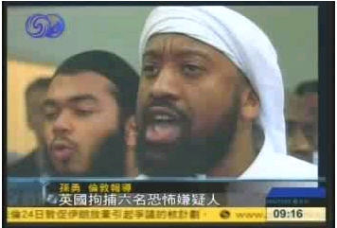
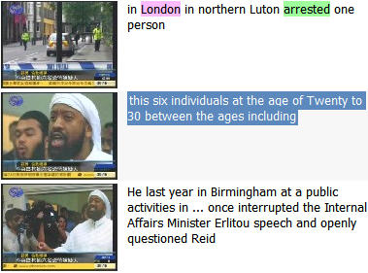
Input:
Broadcast news (video, text)
…六名嫌疑人的年龄在20至30岁之间…
Output:
English translation associated with frames

Slide 8
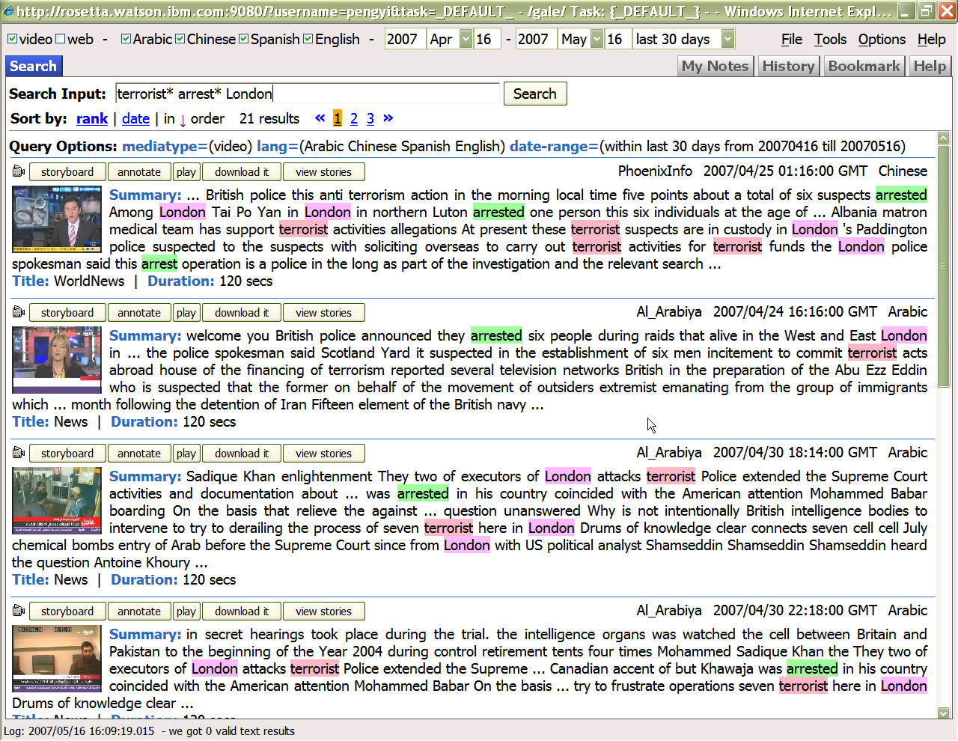

Slide 9
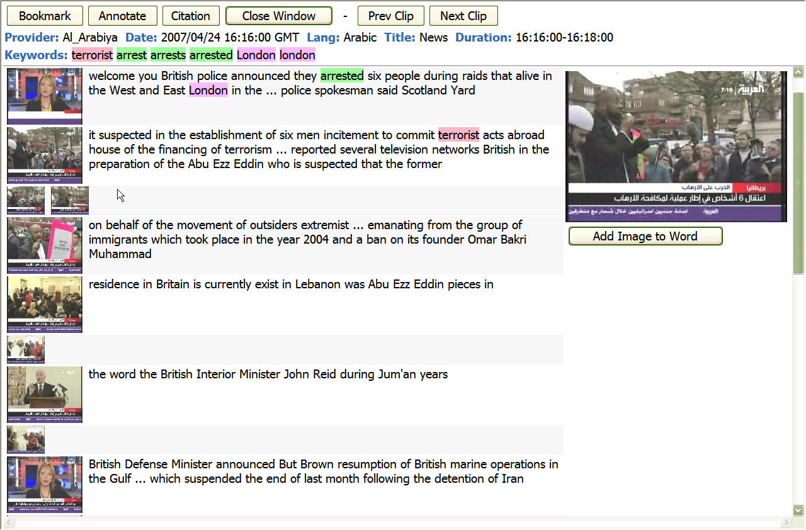

Slide 10
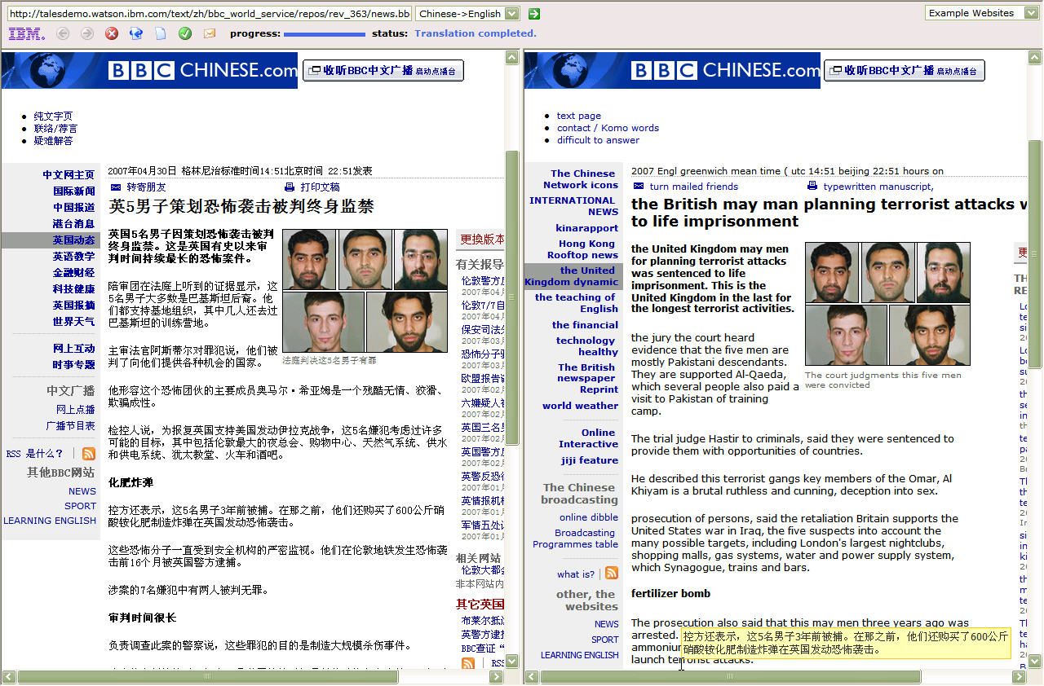
Side-by-side Translation

Slide 11
User Study Team @ Maryland
PIs: Dr. Judith Klavans and Dr. Doug Oard
Consists of 9 graduate students mostly from the iSchool
  6 observers / assessors
  2 tech support

Slide 12
Formative Evaluation
Formative evaluation feeds system design
Fast feedback redesign

Slide 13
Objectives
Evaluate a system that uses an ASR-MT cascade to transform broadcast news in several languages to English text.
  Find out how well it supports English-speaking information analysts.
  In particular to find out how information analysts cope with ASR and MT errors.
Based on user feedback, make design recommendations for system improvements.

Slide 14
Participants
12 users with requisite search skills
  9 information studies students
  2 practicing librarians
  1 history Ph.D. student (a domain expert)
6 observers
  5 information studies graduate students
  1 speech sciences graduate student

Slide 15
Study Design
37 sessions from June 2006 – May 2007
Three-hour user sessions
  3-8 users
  3-5 observers

Slide 16
Procedure
Before each session
  set up session goals (a list of questions)
  design the task scenario
  test-run it using the System
The actual evaluation sessions
After each session
  Data analysis
  Session reports
  Bugs reports and design improvement suggestions

Slide 17
The Actual Evaluation Session
Training
  Complete system training for first-time users
  Bi-weekly updates on new features
Search
  Users: search and produce a report
  Observers: take notes on users' behavior
Debrief
  Reaction paper
  Questionnaire for User Interaction Satisfaction (QUIS)
  Post-Search Interview
  Group Discussion (for larger groups)

Slide 18
Task Scenario Development:
Realistic Simulation
A task scenario consists of:
Context
  topical background information and situational context
Information needs
  from specific factual questions to broad analysis.
Required output format
  fact gathering,
  compilation of biographical dossiers,
  hypothesis testing,
  comparison of the way an event was reported
Notes:
Situational context explained why the information was needed and what role the user was playing and the intended audience

Slide 19
A Sample Task Scenario
Task Scenario: Hezbollah (abridged version) Time: 60 min.
Foreign (U.S., Canadian, Australian, and European) citizens are evacuating Lebanon as a result of the recent armed conflict between Israel, Palestinian fighters, and Hezbollah [Hizbullah].
You are assisting with the extraction of US citizens. Compile sites of recent armed conflict (in the last month) in this area. Your supervisor will use these data to develop evacuation plans.
For each attack you find, place a number on the map and complete as much as you can of the following template:
Location: Date:
Type of attack: Number killed/wounded:
Include attacks in an areas not shown on the map. For multiple attacks, list each occurrence.

Slide 20
Data Collected
Search logs
Task reports
Observation notes
Interview notes
Group discussion notes
Free-style reaction papers
Survey answers

Slide 21
Design Suggestions
Reported about 200 system improvement suggestions
  adding/modifying functions
  re-arranging interface layouts
  labeling tabs
  fixing bugs
Examples:
  Relevance feedback
  Use of translation
  Facts, opinions, and sense-making
  Novel ways to use video

Slide 22
Relevance Feedback
Finding:
Users are reluctant to provide negative feedback and want the task-profiling process exposed.
Design implication:
System should provide explanations for its adaptive behavior, for example, when passages are determined to be redundant, displaying similarity measures between them and other results marked relevant helps users understand why.

Slide 23
Use of Machine-Translation
  Finding:
  User used query terms attempting to compensate common mistranslation problems
  For example: Iran nuclear file for Iran nuclear program
  Design Implications:
  Alternate translations could be suggested as query terms, possibly making an effort to array translations according to different senses of the foreign language term.
Notes:
In the task scenario about Iran's nuclear program, one user recognized a mistranslation and used it in searching. He retrieved several documents containing the expression "nuclear file" instead of "nuclear program"; the user recognized "file" as a mistranslation that might also appear in other documents. He used "nuclear file" in his query and retrieved several additional results.

Slide 24
Facts, Opinions, and Sense-making
Finding:
Users had difficulty with higher level opinion questions when they had to draw inferences from the context.
Design implication:
Context clues from the original source must be preserved. There need to be clear boundaries for different news stories; otherwise, with ASR-MT text it is very difficult for users to identify where a new story starts.

Slide 25
Novel Ways to Use Video
Finding:
Users invented novel ways to use video. Example, "man-on-the-street" opinions about the trials and sentence of Saddam Hussein.
Design implication:
If there are images or videos in the document, the system should visually present any associations between images and text.
Notes:
The “man-on-the-street” concept can not be expressed as a text query

Slide 26
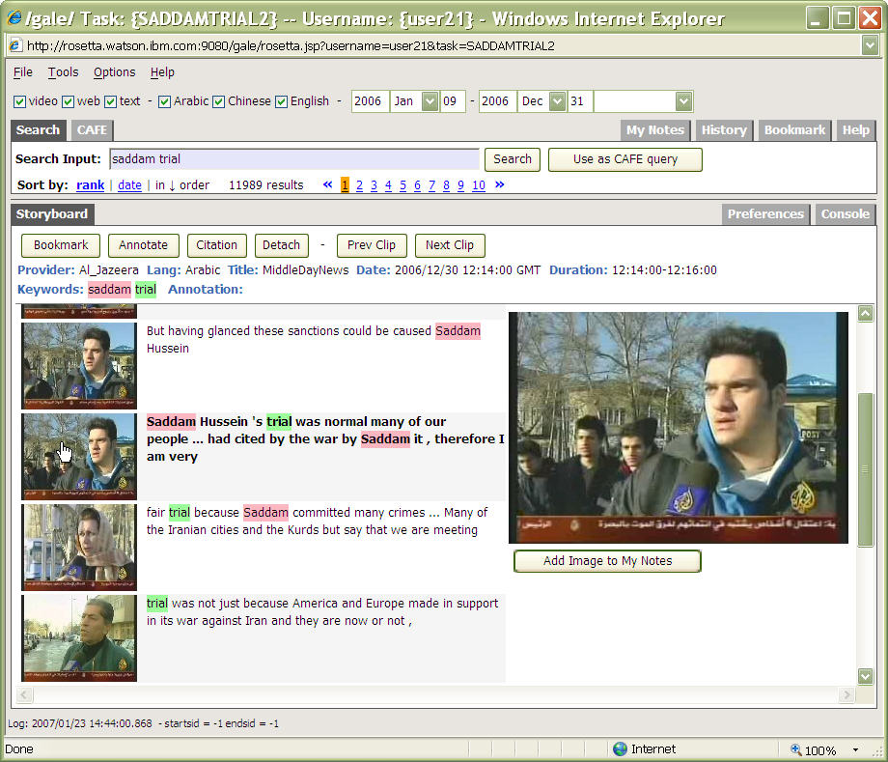
Notes:
Participants were asked to gather opinions of ordinary Iraqi people (what news reporters refer to as "man-on-the-street" opinions) about the trials and sentence of Saddam Hussein. The report was to assist a special task force whose tasked with providing security for parties involved in the trial.
As she viewed the storyboard (not shown here), she saw three images of people talking to the camera. They appeared to be ordinary Iraqi people. There was a snippet of text associated with each of the three pictures. The first man said "it is the best news in my life, but I cannot assume the sentence is fair or not." A woman said "it is fair because Saddam committed many crimes..." A third person said it is a "political game" and "unfair." The user gathered these pieces of information. She browsed more video clips, and was able to gather several examples of the public reaction to Saddam's trials and sentence.

Slide 27
Cooperation with Developers
Close cooperation with developers of different modules of the system – mutual benefit
Examples:
  One session with Maryland’s MT team
    What was the resulting benefit? MT team envisioned potential to correct translation errors
  Two sessions with System developer’s
  from IBM, CMU, and Stanford
  through tele-conference
    For developers – importance of user experiences and involvement
    For us – advices on training
Notes:
I am note sure what you wanted to say with the MT team

Slide 28
Strengths
Realistic task scenarios
Rich data collection
  Combination of search logs, task reports, observation notes and interviews.
  Observer notes aligned with search logs
Quick feedback
  Feedback / Re-design cycle of two weeks
Notes:
Need revision

Slide 29
Limitations
Surrogate subjects
  Different from intelligence analysts
Small number of subjects
  Not enough for statistical analysis

Slide 30
Lessons Learned about
Doing a Formative Evaluation

Slide 31
Important Questions to Consider When Doing a Formative Evaluation
Who is doing it?
  System developers vs. user study team
What are the questions you want to answer?
  Have a focus (or several focuses)
When in the development stage and at what frequency to do it?

Slide 32
Cont.
Who are the participants?
  Real users vs. surrogate users
Qualitative vs. quantitative
  Qualitative:
  more detailed, rich data; more informing
  Quantitative:
  statistical power; controlled variables
Data collection methods

Slide 33
Challenges
System instability
Dealing with users
Communicating with the system developers
Many other things you may not expect…

Slide 34

Acknowledgement
This is a collaborative work with Lynne Plettenberg,
Judith Klavans, Doug Oard, and Dagobert Soergel.
This work has been supported in part by DARPA contract HR-0011-06-2-0001 (GALE).
pengyi@umd.edu

