Slide 1

INFM 700: Session 12
Summative Evaluations
Jimmy Lin
The iSchool
University of Maryland
Monday, April 21, 2008
This work is licensed under a Creative Commons Attribution-Noncommercial-Share Alike 3.0 United States
See http://creativecommons.org/licenses/by-nc-sa/3.0/us/ for details

Slide 2
Types of Evaluations
Formative evaluations
  Figuring out what to build
  Determining what the right questions are
Summative evaluations
  Finding out if it “works”
  Answering those questions

Slide 3
Today’s Topics
Evaluation basics
System-centered evaluations
User-centered evaluations
Case Studies
Tales of caution
Evaluation
Basics
System-centered
Evaluations
User-centered
Evaluations
Case Studies
Tales of Caution

Slide 4
Evaluation as a Science
Formulate a question: the hypothesis
Design an experiment to answer the question
Perform the experiment
  Compare with a baseline “control”
Does the experiment answer the question?
  Are the results significant? Or is it just luck?
Report the results!
Rinse, repeat…
Evaluation
Basics
System-centered
Evaluations
User-centered
Evaluations
Case Studies
Tales of Caution

Slide 5
The Information Retrieval Cycle
Source
Selection
Resource
Query
Formulation
Query
Search
Results
Selection
Documents
Evaluation
Basics
System-centered
Evaluations
User-centered
Evaluations
Case Studies
Tales of Caution
System discovery
Vocabulary discovery
Concept discovery
Document discovery
Examination
Information
source reselection
Delivery

Slide 6
Questions About Systems
Example “questions”:
  Does morphological analysis improve retrieval performance?
  Does expanding the query with synonyms improve retrieval performance?
Corresponding experiments:
  Build a “stemmed” index and compare against “unstemmed” baseline
  Expand queries with synonyms and compare against baseline unexpanded queries
Evaluation
Basics
System-centered
Evaluations
User-centered
Evaluations
Case Studies
Tales of Caution

Slide 7
Questions That Involve Users
Example “questions”:
  Does keyword highlighting help users evaluate document relevance?
  Is letting users weight search terms a good idea?
Corresponding experiments:
  Build two different interfaces, one with keyword highlighting, one without; run a user study
  Build two different interfaces, one with term weighting functionality, and one without; run a user study
Evaluation
Basics
System-centered
Evaluations
User-centered
Evaluations
Case Studies
Tales of Caution

Slide 8
The Importance of Evaluation
Progress is driven by the ability to measure differences between systems
  How well do our systems work?
  Is A better than B?
  Is it really?
  Under what conditions?
Desiderata for evaluations
  Insightful
  Affordable
  Repeatable
  Explainable
Evaluation
Basics
System-centered
Evaluations
User-centered
Evaluations
Case Studies
Tales of Caution

Slide 9
Types of Evaluation Strategies
System-centered studies
  Given documents, queries, and relevance judgments
  Try several variations of the system
  Measure which system returns the “best” hit list
User-centered studies
  Given several users and at least two systems
  Have each user try the same task on both systems
  Measure which system works the “best”
Evaluation
Basics
System-centered
Evaluations
User-centered
Evaluations
Case Studies
Tales of Caution

Slide 10
System-Centered Evaluations
Query
Search
Results
Evaluation
Basics
System-centered
Evaluations
User-centered
Evaluations
Case Studies
Tales of Caution

Slide 11
User-Centered Evaluations
Query
Formulation
Query
Search
Results
Selection
Documents
Evaluation
Basics
System-centered
Evaluations
User-centered
Evaluations
Case Studies
Tales of Caution
System discovery
Vocabulary discovery
Concept discovery
Document discovery
Examination
Information

Slide 12
Evaluation Criteria
Effectiveness
  How “good” are the documents that are gathered?
  How long did it take to gather those documents?
  Can consider system only or human + system
Usability
  Learnability, satisfaction, frustration
  Effects of novice vs. expert users
Evaluation
Basics
System-centered
Evaluations
User-centered
Evaluations
Case Studies
Tales of Caution

Slide 13
Good Effectiveness Measures
Should capture some aspect of what users want
Should have predictive value for other situations
Should be easily replicated by other researchers
Should be easily comparable
Evaluation
Basics
System-centered
Evaluations
User-centered
Evaluations
Case Studies
Tales of Caution

Slide 14
Set-Based Measures
Precision = A ÷ (A+B)
Recall = A ÷ (A+C)
Miss = C ÷ (A+C)
False alarm (fallout) = B ÷ (B+D)
 | Relevant | Not relevant
Retrieved | A | B
Not retrieved | C | D
Collection size = A+B+C+D
Relevant = A+C
Retrieved = A+B
Evaluation
Basics
System-centered
Evaluations
User-centered
Evaluations
Case Studies
Tales of Caution
When is precision important?
When is recall important?

Slide 15
Another View
Space of all documents
Relevant
Relevant +
Retrieved
Retrieved
Evaluation
Basics
System-centered
Evaluations
User-centered
Evaluations
Case Studies
Tales of Caution
Not Relevant + Not Retrieved

Slide 16
Precision and Recall
Precision
  How much of what was found is relevant?
  Important for Web search and other interactive situations
Recall
  How much of what is relevant was found?
  Particularly important for law, patent, and medicine
How are precision and recall related?
Evaluation
Basics
System-centered
Evaluations
User-centered
Evaluations
Case Studies
Tales of Caution

Slide 17
Automatic Evaluation Model
Focus on systems, hence system-centered
(also called “batch” evaluations)
Query
Documents
Retrieval
System
Ranked List
Evaluation
Basics
System-centered
Evaluations
User-centered
Evaluations
Case Studies
Tales of Caution
Evaluation
Module
Relevance Judgments
Measure of Effectiveness

Slide 18
Test Collections
Reusable test collections consist of:
  Collection of documents
    Should be “representative”
    Things to consider: size, sources, genre, topics, …
  Sample of information needs
    Should be “randomized” and “representative”
    Usually formalized topic statements
  Known relevance judgments
    Assessed by humans, for each topic-document pair
    Binary judgments are easier, but multi-scale possible
Measure of effectiveness
  Usually a numeric score for quantifying “performance”
  Used to compare different systems
Evaluation
Basics
System-centered
Evaluations
User-centered
Evaluations
Case Studies
Tales of Caution

Slide 19
Critique
What are the advantage of automatic, system-centered evaluations?
What are their disadvantages?
Evaluation
Basics
System-centered
Evaluations
User-centered
Evaluations
Case Studies
Tales of Caution

Slide 20
User-Center Evaluations
Studying only the system is limiting
Goal is to account for interaction
  By studying the interface component
  By studying the complete system
Tool: controlled user studies
Evaluation
Basics
System-centered
Evaluations
User-centered
Evaluations
Case Studies
Tales of Caution

Slide 21
Controlled User Studies
Select independent variable(s)
  e.g., what info to display in selection interface
Select dependent variable(s)
  e.g., time to find a known relevant document
Run subjects in different orders
  Average out learning and fatigue effects
Compute statistical significance
Evaluation
Basics
System-centered
Evaluations
User-centered
Evaluations
Case Studies
Tales of Caution

Slide 22
Additional Effects to Consider
Learning
  Vary topic presentation order
Fatigue
  Vary system presentation order
Expertise
  Ask about prior knowledge of each topic
Evaluation
Basics
System-centered
Evaluations
User-centered
Evaluations
Case Studies
Tales of Caution

Slide 23
Critique
What are the advantage of controlled user studies?
What are their disadvantages?
Evaluation
Basics
System-centered
Evaluations
User-centered
Evaluations
Case Studies
Tales of Caution

Slide 24
Koenemann and Belkin (1996)
Well-known study on relevance feedback in information retrieval
Questions asked:
  Does relevance feedback improve results?
  Is user control over relevance feedback helpful?
  How do different levels of user control effect results?
Evaluation
Basics
System-centered
Evaluations
User-centered
Evaluations
Case Studies
Tales of Caution
Jürgen Koenemann and Nicholas J. Belkin. (1996) A Case For Interaction: A Study of Interactive Information Retrieval Behavior and Effectiveness. Proceedings of CHI 1996.

Slide 25
What’s the best interface?
Opaque (black box)
  User doesn’t get to see the relevance feedback process
Transparent
  User shown relevance feedback terms, but isn’t allowed to modify query
Penetrable
  User shown relevance feedback terms and is allowed to modify the query
Evaluation
Basics
System-centered
Evaluations
User-centered
Evaluations
Case Studies
Tales of Caution
Which do you think worked best?

Slide 26
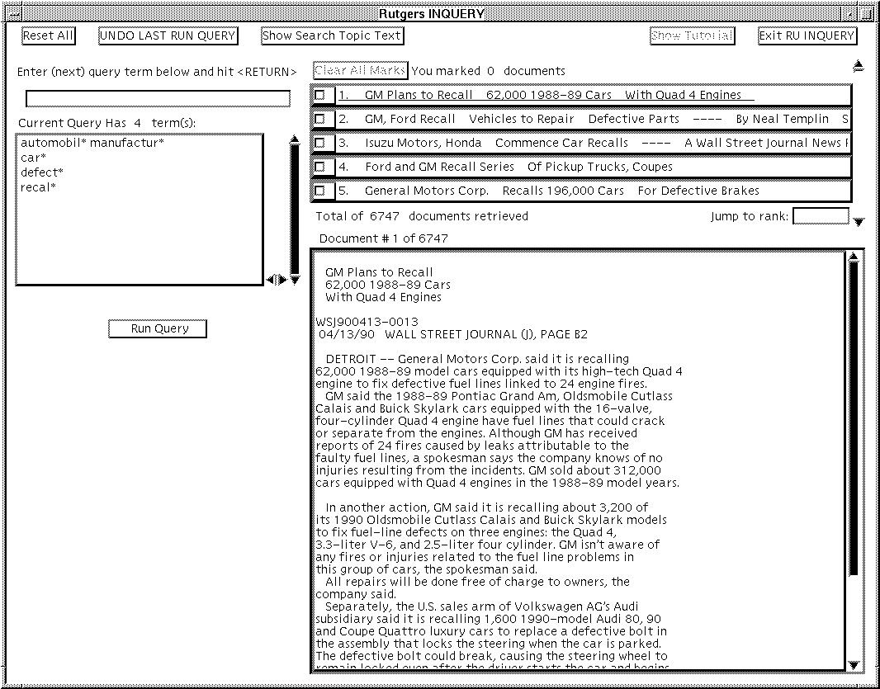
Query Interface
Evaluation
Basics
System-centered
Evaluations
User-centered
Evaluations
Case Studies
Tales of Caution

Slide 27
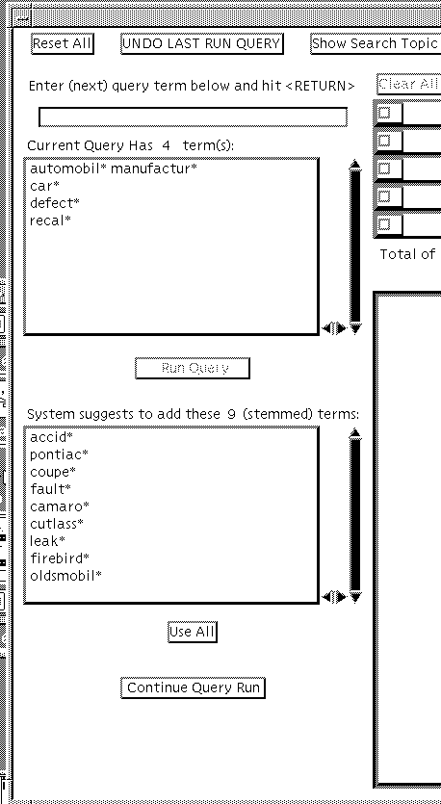
Penetrable Interface
Users get to select which terms they want to add
Evaluation
Basics
System-centered
Evaluations
User-centered
Evaluations
Case Studies
Tales of Caution

Slide 28
Study Details
Subjects started with a tutorial
  64 novice searchers (43 female, 21 male)
Goal is to keep modifying the query until they’ve developed one that gets high precision
INQUERY system used
TREC collection (Wall Street Journal subset)
Two search topics:
  Automobile Recalls
  Tobacco Advertising and the Young
Relevance judgments from TREC and experimenter
Evaluation
Basics
System-centered
Evaluations
User-centered
Evaluations
Case Studies
Tales of Caution

Slide 29
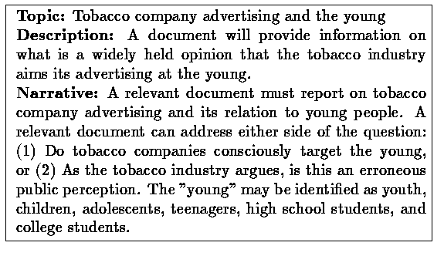
Sample Topic
Evaluation
Basics
System-centered
Evaluations
User-centered
Evaluations
Case Studies
Tales of Caution

Slide 30
Procedure
Baseline (Trial 1)
  Subjects get tutorial on relevance feedback
Experimental condition (Trial 2)
  Shown one of four modes: no relevance feedback, opaque, transparent, penetrable
Evaluation metric used: precision at 30 documents
Evaluation
Basics
System-centered
Evaluations
User-centered
Evaluations
Case Studies
Tales of Caution

Slide 31
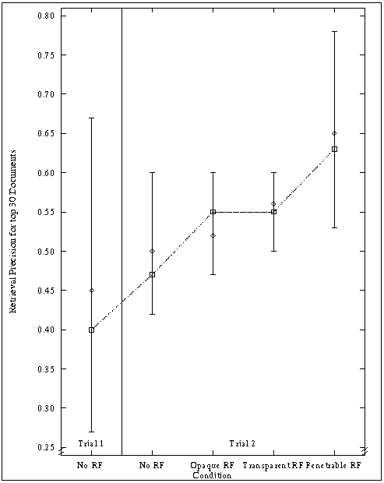
Results: Precision
Evaluation
Basics
System-centered
Evaluations
User-centered
Evaluations
Case Studies
Tales of Caution

Slide 32
Relevance feedback works!
Subjects using the relevance feedback interfaces performed 17-34% better
Subjects in the penetrable condition performed 15% better than those in opaque and transparent conditions
Evaluation
Basics
System-centered
Evaluations
User-centered
Evaluations
Case Studies
Tales of Caution

Slide 33
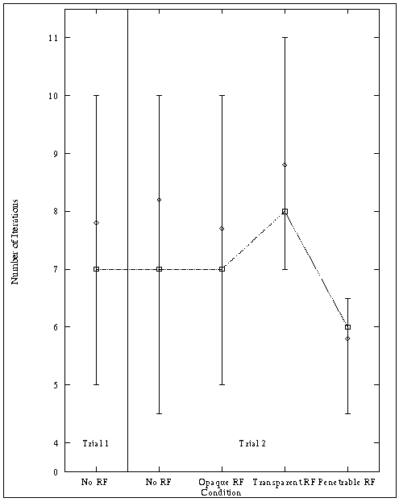
Results: Number of Iterations
Evaluation
Basics
System-centered
Evaluations
User-centered
Evaluations
Case Studies
Tales of Caution

Slide 34
Results: User Behavior
Search times approximately equal
Precision increased in first few iterations
Penetrable interface required fewer iterations to arrive at final query
Queries with relevance feedback are longer
  But fewer terms with the penetrable interface ⎯ users were more selective about which terms to add
Evaluation
Basics
System-centered
Evaluations
User-centered
Evaluations
Case Studies
Tales of Caution

Slide 35
Lin et al. (2003)
Different techniques for result presentation
  KWIC, TileBars, etc.
Focus on KWIC interfaces
  What part of the document should the system extract?
  How much context should you show?
Evaluation
Basics
System-centered
Evaluations
User-centered
Evaluations
Case Studies
Tales of Caution
Jimmy Lin, Dennis Quan, Vineet Sinha, Karun Bakshi, David Huynh, Boris Katz, and David R. Karger. (2003) What Makes a Good Answer? The Role of Context in Question Answering. Proceedings of INTERACT 2003.

Slide 36
How Much Context?
How much context for question answering?
Possibilities
  Exact answer
  Answer highlighted in sentence
  Answer highlighted in paragraph
  Answer highlighted in document
Evaluation
Basics
System-centered
Evaluations
User-centered
Evaluations
Case Studies
Tales of Caution

Slide 37
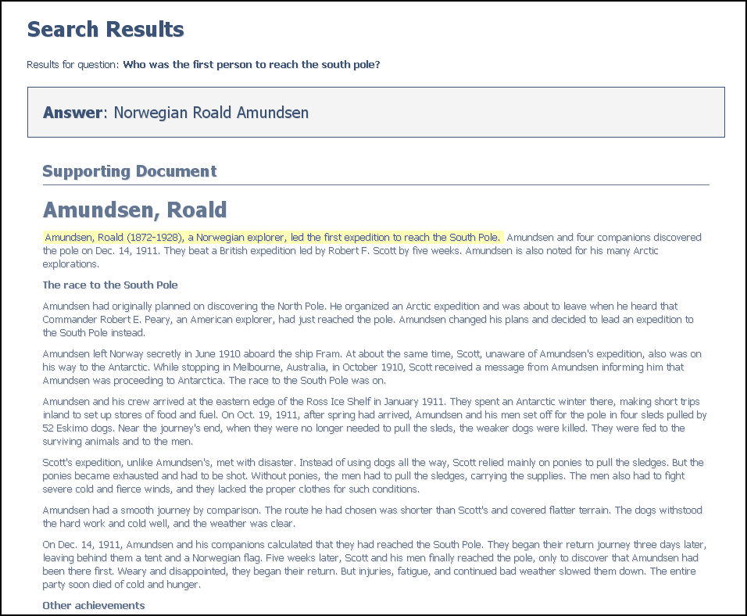
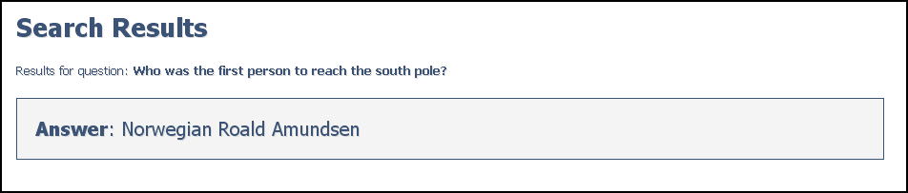
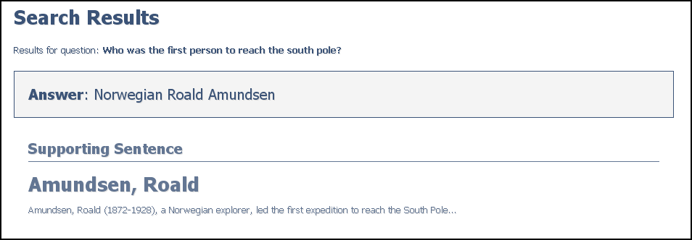
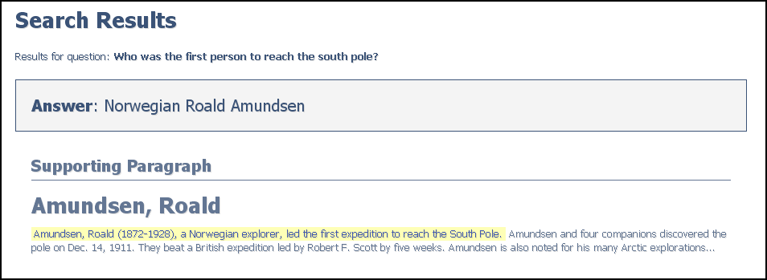
Interface Conditions
Who was the first person to reach the south pole?
Document
Exact Answer
Sentence
Evaluation
Basics
System-centered
Evaluations
User-centered
Evaluations
Case Studies
Tales of Caution
Paragraph

Slide 38
User study
Independent variable: amount of context presented
Test subjects: 32 MIT undergraduate/graduate computer science students
  No previous experience with QA systems
Actual question answering system was canned:
  Isolate interface issues, assuming 100% accuracy in answering factoid questions
  Answers taken from WorldBook encyclopedia
Evaluation
Basics
System-centered
Evaluations
User-centered
Evaluations
Case Studies
Tales of Caution

Slide 39
Question Scenarios
User information needs are not isolated…
  When researching a topic, multiple, related questions are often posed
  How does the amount of context affect user behavior?
Two types of questions:
  Singleton questions
  Scenarios with multiple questions
Evaluation
Basics
System-centered
Evaluations
User-centered
Evaluations
Case Studies
Tales of Caution
When was the Battle of Shiloh?
What state was the Battle of Shiloh in?
Who won the Battle of Shiloh?

Slide 40
Setup
Materials:
  4 singleton questions
  2 scenarios with 3 questions
  1 scenarios with 4 questions
  1 scenarios with 5 questions
Each question/scenario was paired with an interface condition
Users asked to answer all questions as quickly as possible
Evaluation
Basics
System-centered
Evaluations
User-centered
Evaluations
Case Studies
Tales of Caution

Slide 41
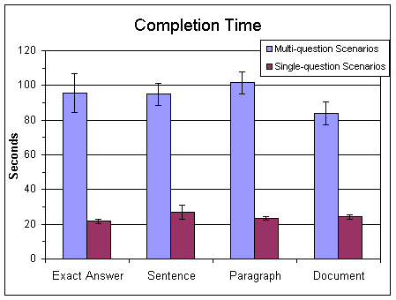
Results: Completion Time
Answering scenarios, users were fastest under the document interface condition
  Differences not statistically significant
Evaluation
Basics
System-centered
Evaluations
User-centered
Evaluations
Case Studies
Tales of Caution

Slide 42
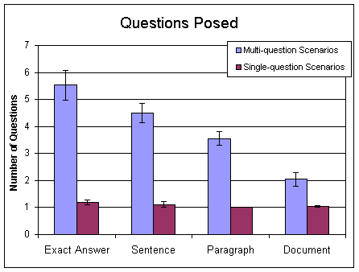
Results: Questions Posed
With scenarios, the more the context, the fewer the questions
  Results were statistically significant
  When presented with context, users read
Evaluation
Basics
System-centered
Evaluations
User-centered
Evaluations
Case Studies
Tales of Caution

Slide 43
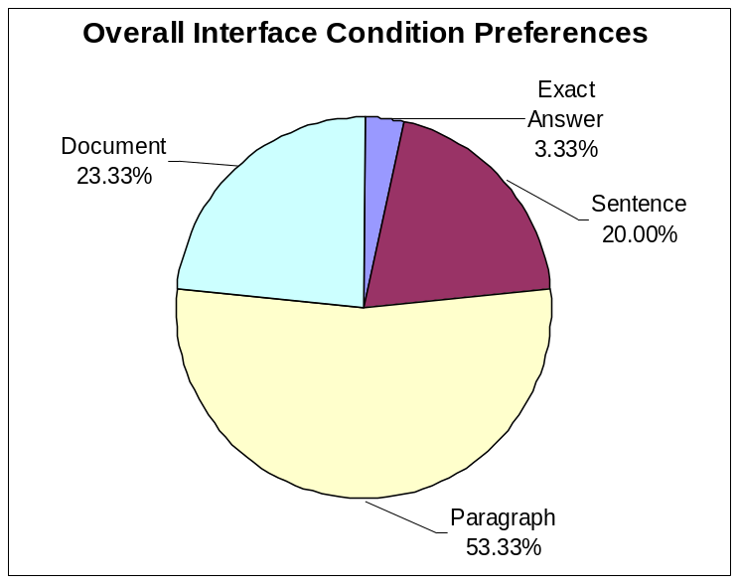
A Story of Goldilocks…
The entire document: too much!
The exact answer: too little!
The surrounding paragraph: just right…
It occurred on July 4, 1776.
What does this pronoun refer to?
Evaluation
Basics
System-centered
Evaluations
User-centered
Evaluations
Case Studies
Tales of Caution

Slide 44
Lessons Learned
Keyword search culture is engrained
Discourse processing is important
Users most prefer a paragraph-sized response
Context serves to
  “Frame” and “situate” the answer within a larger textual environment
  Provide answers to related information
When was the Battle of Shiloh?
And where did it occur?
Evaluation
Basics
System-centered
Evaluations
User-centered
Evaluations
Case Studies
Tales of Caution

Slide 45
System vs. User Evaluations
Why do we need both system- and user-centered evaluations?
Two tales of caution:
  Self-assessment is notoriously unreliable
  System and user evaluations may give different results
Evaluation
Basics
System-centered
Evaluations
User-centered
Evaluations
Case Studies
Tales of Caution

Slide 46
Blair and Maron (1985)
A classic study of retrieval effectiveness
  Earlier studies were on unrealistically small collections
Studied an archive of documents for a law suit
  40,000 documents, ~350,000 pages of text
  40 different queries
  Used IBM’s STAIRS full-text system
Approach:
  Lawyers stipulated that they must be able to retrieve at least 75% of all relevant documents
  Search facilitated by paralegals
  Precision and recall evaluated only after the lawyers were satisfied with the results
Evaluation
Basics
System-centered
Evaluations
User-centered
Evaluations
Case Studies
Tales of Caution
David C. Blair and M. E. Maron. (1984) An Evaluation of Retrieval Effectiveness for a Full-Text Document-Retrieval System. Communications of the ACM, 28(3), 289-299.

Slide 47
Blair and Maron’s Results
Average precision: 79%
Average recall: 20% (!!)
Why recall was low?
  Users can’t anticipate terms used in relevant documents
  Differing technical terminology
  Slang, misspellings
Other findings:
  Searches by both lawyers had similar performance
  Lawyer’s recall was not much different from paralegal’s
“accident” might be referred to as “event”, “incident”, “situation”, “problem,” …
Evaluation
Basics
System-centered
Evaluations
User-centered
Evaluations
Case Studies
Tales of Caution

Slide 48
Turpin and Hersh (2001)
Do batch and user evaluations give the same results? If not, why?
Two different tasks:
  Instance recall (6 topics)
  Question answering (8 topics)
What countries import Cuban sugar?
What tropical storms, hurricanes, and typhoons have caused property damage or loss of life?
Evaluation
Basics
System-centered
Evaluations
User-centered
Evaluations
Case Studies
Tales of Caution
Which painting did Edvard Munch complete first, “Vampire” or “Puberty”?
Is Denmark larger or smaller in population than Norway?
Andrew Turpin and William Hersh. (2001) Why Batch and User Evaluations Do No Give the Same Results. Proceedings of SIGIR 2001.

Slide 49
Study Design and Results
Compared of two systems:
  a baseline system
  an improved system that was provably better in batch evaluations
Results:
 | Instance Recall |  | Question Answering
 | Batch MAP | User recall | Batch MAP | User accuracy
Baseline | 0.2753 | 0.3230 | 0.2696 | 66%
Improved | 0.3239 | 0.3728 | 0.3544 | 60%
Change | +18% | +15% | +32% | -6%
p-value (paired t-test) | 0.24 | 0.27 | 0.06 | 0.41
Evaluation
Basics
System-centered
Evaluations
User-centered
Evaluations
Case Studies
Tales of Caution

Slide 50
Analysis
A “better” IR system doesn’t necessary lead to “better” end-to-end performance!
Why?
Are we measuring the right things?
Evaluation
Basics
System-centered
Evaluations
User-centered
Evaluations
Case Studies
Tales of Caution

Slide 51
Today’s Topics
Evaluation basics
System-centered evaluations
User-centered evaluations
Case Studies
Tales of caution
Evaluation
Basics
System-centered
Evaluations
User-centered
Evaluations
Case Studies
Tales of Caution

