Slide 1

INFM 700: Session 13
System Building Issues
Jimmy Lin
The iSchool
University of Maryland
Monday, April 28, 2008
This work is licensed under a Creative Commons Attribution-Noncommercial-Share Alike 3.0 United States
See http://creativecommons.org/licenses/by-nc-sa/3.0/us/ for details

Slide 2
Today’s Topics
Development Models
Managing Systems
Open source software
Cloud Computing
Development
Models
Managing
Systems
Open Source
Software
Cloud Computing

Slide 3
The System Life Cycle
Understanding user needs
  Formative evaluation: figuring out what to build
Going out to build it (and other options)
Making sure it addresses user needs
  Summative evaluation: does it work as intended?
Keeping it running
Development
Models
Managing
Systems
Open Source
Software
Cloud Computing
Notes:
3

Slide 4
Decisions, Decisions
“Buy” or “Build”
“Off-the-shelf” or “Custom”
“In-house” or “Out-source”
“Integrated Solution” or “Best of Breed”
“Proprietary” or “Open Source”
Development
Models
Managing
Systems
Open Source
Software
Cloud Computing

Slide 5
Different Architectures
Desktop applications
  What we normally think of as software
Batch processing (e.g., recall notices)
  Save it up and do it all at once
Timesharing (e.g., OPAC)
  Everyone uses the same machine
Client-Server (e.g., databases)
  Some functions done centrally, others locally
Peer-to-Peer (e.g., Kazaa)
  All data and computation is distributed
Web service (e.g., Gmail)
Development
Models
Managing
Systems
Open Source
Software
Cloud Computing
Notes:
10

Slide 6
Requirements
Availability
  Mean Time Between Failures (MTBF)
  Mean Time To Repair (MTTR)
  Measured for each component and for entire system
Capacity
  Number of users (typical and maximum)
  Response time (typical and maximum)
Flexibility
  Upgrade path
  Interoperability with other applications
Development
Models
Managing
Systems
Open Source
Software
Cloud Computing
Notes:
9

Slide 7
The Waterfall Model
Key idea: upfront investment in design
  An hour of design can save a week of debugging!
Five stages:
  Requirements: figure out what needs to be built
  Design: figure out how the software will work
  Implementation: actually build the software
  Verification: makes sure that it works
  Maintenance: makes sure that it keeps working
Development
Models
Managing
Systems
Open Source
Software
Cloud Computing

Slide 8

The Waterfall Model
Requirements
Design
Implementation
Verification
Development
Models
Managing
Systems
Open Source
Software
Cloud Computing
Maintenance

Slide 9
The Spiral Model
Key idea: iteratively build prototypes
  Each prototype is closer to the final product
Steps:
  Define requirements
  Develop first prototype quickly
  Revaluate requirements based on prototype
  Build second prototype based on lessons learned
  Iterate (until you run are happy or run out of money)
Development
Models
Managing
Systems
Open Source
Software
Cloud Computing
Notes:
Barry Boehm 1988

Slide 10
The Spiral Model
2.3
1.2
0.5
1.1
2.2
1.0
Development
Models
Managing
Systems
Open Source
Software
Cloud Computing
2.1
2.0
3.0

Slide 11
Unpleasant Realities
The waterfall model doesn’t work well
  Requirements usually incomplete or incorrect
The spiral model is expensive
  Redesign leads to recoding and retesting
Development
Models
Managing
Systems
Open Source
Software
Cloud Computing

Slide 12
A Hybrid Model
Goal: explore requirements
  Recognizing that they will change later
Start with part of the functionality
  That will (hopefully) yield insight on the requirements
Build a prototype
  Focus on functionality
  Save for later: efficiency, making it “pretty”
Use the prototype to refine the requirements
Repeat the process, expanding functionality
Development
Models
Managing
Systems
Open Source
Software
Cloud Computing

Slide 13
A Hybrid Model
Update
Requirements
Write
Specification
Initial
Requirements
Choose
Functionality
Create
Software
Build
Prototype
Development
Models
Managing
Systems
Open Source
Software
Cloud Computing
Write
Test Plan

Slide 14
Testing
Component testing
End-to-end testing
Formal verification
User testing
Development
Models
Managing
Systems
Open Source
Software
Cloud Computing

Slide 15
Management Issues
Maintenance and administration
  Beware of recurring costs
Retrospective conversion
  Moving from “legacy systems”
  Even converting electronic information is expensive!
Management information
  Log data, audit trails, etc.
  Sometimes costs more to collect than it is worth!
  Sometimes easy to collect, difficult to analyze
Training
  Staff, end users
Privacy, Security
Development
Models
Managing
Systems
Open Source
Software
Cloud Computing
Notes:
13

Slide 16
Things will go wrong…
No software is defect-free. Why?
  Sheer size
  Example: Windows XP (2002) was ~40M lines of code
  Almost impossible to predict all possible use contexts
  Example: driver incompatibilities
  Concurrency
  Example: lots of applications running at the same time
The importance of disaster recovery
  Backups (periodicity, storage location)
  Tradeoffs between “safety” and “being close by”
Development
Models
Managing
Systems
Open Source
Software
Cloud Computing

Slide 17
TCO
TCO = “Total cost of ownership”
Buying/developing software isn’t the only cost!
Other (hidden) costs:
  Planning, installation, integration
  Disruption and migration
  Ongoing support and maintenance
  Training (of staff and end users)
Development
Models
Managing
Systems
Open Source
Software
Cloud Computing
Notes:
13

Slide 18
What is open source?
Proprietary vs. open source software
Open source used to be a crackpot idea:
  Bill Gates on Linux (3/24/1999):
  “I don’t really think in the commercial market, we’ll see it in any significant way.”
  MS 10-Q quarterly filing (1/31/2004):
  “The popularization of the open source movement continues to pose a significant challenge to the company’s business model”
Open source…
  For tree hugging hippies?
  Make love, not war?
Development
Models
Managing
Systems
Open Source
Software
Cloud Computing

Slide 19
Basic Definitions
What is a program?
What is source code?
What is object/executable code (binaries)?
An organized list of instructions that, when executed, causes the computer to behave in a predetermined manner. Like a recipe.
Program instructions in their original, human-readable form.
Development
Models
Managing
Systems
Open Source
Software
Cloud Computing
Program instructions in a form that can be directly executed by a computer. A compiler takes source code and generates executable code.

Slide 20
Proprietary Software
Distribution in machine-readable binaries only
Payment for a license
  Grants certain usage rights
  Restrictions on copying, further distribution, modification
Analogy: buying a car…
  With the hood welded shut
  That only you can drive
  That you can’t change the rims on
Development
Models
Managing
Systems
Open Source
Software
Cloud Computing

Slide 21
Open Source Principles
Free distribution and redistribution
  “Free as in speech, not as in beer”
Source code availability
Provisions for derived works
“The license may not restrict any party from selling or giving away the software as a component of an aggregate software distribution containing programs from several different sources. The license may not require royalty or other fee for such sale.”
“The program must include source code, and must allow distribution in source code as well as compiled form”.
Development
Models
Managing
Systems
Open Source
Software
Cloud Computing
“The license must allow modifications and derived works, and must allow them to be distributed under the same terms as the license of the original software.”

Slide 22
Open Source vs. Proprietary
Who gets the idea to develop the software?
Who actually develops the software?
How much does it cost?
Who can make changes?
Development
Models
Managing
Systems
Open Source
Software
Cloud Computing

Slide 23
Open Source is already here…
Apache Web server has ~50% market share of the public Internet
Linux is a very popular OS for servers
Lots more… but sales figure unreliable
Development
Models
Managing
Systems
Open Source
Software
Cloud Computing

Slide 24
Examples
 | Proprietary | Open Source
Operating system | Windows XP | Linux
Office suite | Microsoft Office | OpenOffice
Image editor | Photoshop | GIMP
Web browser | Internet Explorer | Mozilla
Web server | IIS | Apache
Database | Oracle | MySQL
Development
Models
Managing
Systems
Open Source
Software
Cloud Computing

Slide 25
Server vs. Desktop
Open source has made significant inroads in the server market
The next big challenge: the desktop market
Development
Models
Managing
Systems
Open Source
Software
Cloud Computing

Slide 26
Open Source: Pros
Peer-reviewed code
Dynamic community
Iterative releases, rapid bug fixes
Released by engineers, not marketing people
High quality
No vendor lock-in
Simplified licensed management
Development
Models
Managing
Systems
Open Source
Software
Cloud Computing

Slide 27
Pros in Detail
Peer-reviewed code
  Everyone gets to inspect the code
  More eyes, fewer bugs
Dynamic community
  Community consists of coders, testers, debuggers, users, etc.
  Any person can have multiple roles
  Both volunteers and paid by companies
  Volunteers are highly-motivated to work on something that interests them
Development
Models
Managing
Systems
Open Source
Software
Cloud Computing

Slide 28
Pros in Detail
Iterative releases, rapid bug fixes
  Anyone can fix bugs
  Bugs rapidly fixed when found
  Distribution of “patches”
Released by engineers, not marketing people
  Stable versions ready only when they really are ready
  Not dictated by marketing deadlines
High quality
Development
Models
Managing
Systems
Open Source
Software
Cloud Computing

Slide 29
Pros in Detail
No vendor lock-in
  Lock in: dependence on a specific program from a specific vendor
  Putting content in MS Word ties you to Microsoft forever
  Open formats: can use a variety of systems
Simplified licensed management
  Can install any number of copies
  No risk of illegal copies or license audits
  No anti-piracy measures (e.g. CD keys, product activation)
  No need to pay for perpetual upgrades
  Doesn't eliminate software management, of course
Development
Models
Managing
Systems
Open Source
Software
Cloud Computing

Slide 30
Cons of Open Source
Dead-end software
Fragmentation
Developed by engineers, often for engineers
Community development model
Inability to point fingers
Development
Models
Managing
Systems
Open Source
Software
Cloud Computing

Slide 31
Cons in Detail
Dead-end software
  Development depends on community dynamics: What happens when the community loses interest?
  How is this different from the vendor dropping support for a product? At least the source code is available
Fragmentation
  Code might “fork” into multiple versions: incompatibilities develop
  In practice, rarely happens
Development
Models
Managing
Systems
Open Source
Software
Cloud Computing

Slide 32
Cons in Detail
Developed by engineers, often for engineers
  My favorite “pet feature”
  Engineers are not your typical users!
Community development model
  Cannot simply dictate the development process
  Must build consensus and support within the community
Inability to point fingers
  Who do you call up and yell at when things go wrong?
  Buy a support contract from a vendor!
Development
Models
Managing
Systems
Open Source
Software
Cloud Computing

Slide 33
Open Source Business Models
Support Sellers (“Give Away the Recipe, Open A Restaurant”)
Loss Leader
Widget Frosting
Accessorizing
Give away the software, but sell distribution, branding, and after-sale service.
Give away the software as a loss-leader and market positioner for closed software.
If you’re in the hardware business, giving away software doesn’t hurt you and has it’s advantages. What are they?
Development
Models
Managing
Systems
Open Source
Software
Cloud Computing
Sell accessories: books, compatible hardware, complete systems with open-source software pre-installed. (open-source T-shirts, coffee mugs, Linux penguin dolls, etc.)

Slide 34
Mature? Yes
Some open source software have been around for 15+ years
Lots of servers already running open source software
Development
Models
Managing
Systems
Open Source
Software
Cloud Computing

Slide 35
Sustainable? Yes
Businesses and governments are choosing open source
Many companies are creating are supporting open source (Google, Yahoo, IBM, Sun, HP, ...)
Many schools are considering or adopting open source software
Development
Models
Managing
Systems
Open Source
Software
Cloud Computing

Slide 36
Open Source in Government
Freedom of Information Act – free, open access to public records
  What are the implications of using a proprietary format?
Recognition by the government
  On July 1, 2004, U.S. Office of Management and Budget officially recognized Open Source software as a viable option for civilian agencies of the federal government
Open source gaining traction internationally
Development
Models
Managing
Systems
Open Source
Software
Cloud Computing

Slide 37
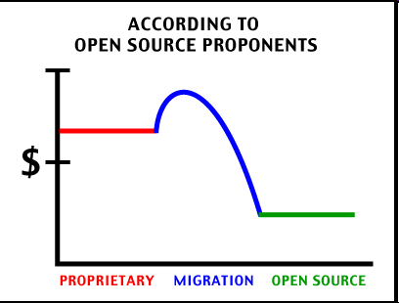
It comes down to cost…
Development
Models
Managing
Systems
Open Source
Software
Cloud Computing

Slide 38
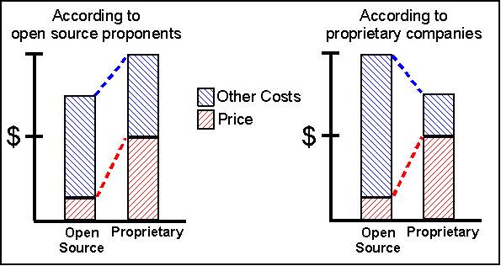
The TCO Debate
Development
Models
Managing
Systems
Open Source
Software
Cloud Computing

Slide 39
Is open source right for you?
Do you have access to the necessary expertise?
Do you have buy-in from the stakeholders?
Are you willing to retool your processes?
Are you willing to retrain staff and users?
Are you prepared for a period of disruption?
Do you have a well-thought out plan for rolling out open source software?
Development
Models
Managing
Systems
Open Source
Software
Cloud Computing

Slide 40
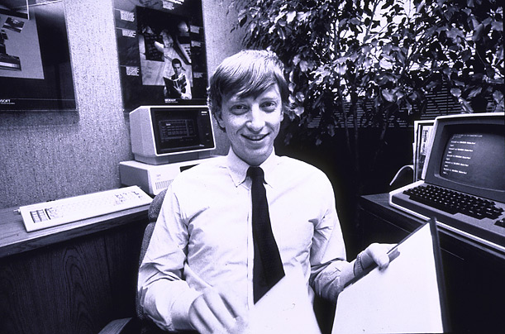
How much data?
Google processes 20 PB a day (2008)
CERN’s LHC will generate 15 PB a year (2008)
NOAA has ~1 PB climate data (2007)
Wayback machine has ~2 PB (2006)
“all words ever spoken by human beings” ~ 5 EB
640K ought to be enough for anybody.
Development
Models
Managing
Systems
Open Source
Software
Cloud Computing

Slide 41
How do you crunch all that?
Currently, the only feasible solution:
  Divide-and-conquer
  Throwing more hardware at the problem
Maybe in the future…
  Quantum computing
  Biocomputing
  Nanocomputing
Development
Models
Managing
Systems
Open Source
Software
Cloud Computing

Slide 42
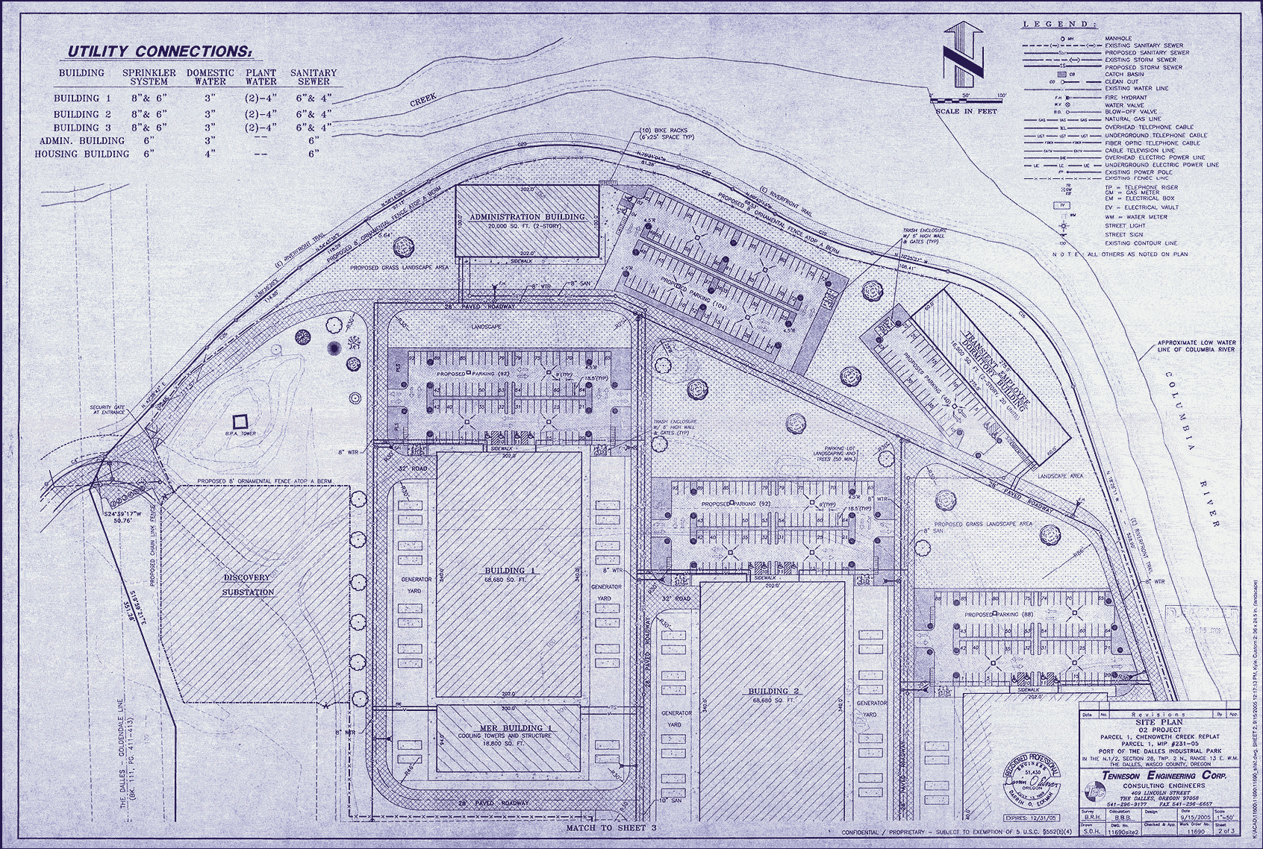
Data Centers: Centralization
Development
Models
Managing
Systems
Open Source
Software
Cloud Computing
“The network is the computer”
… so last century!
“The data center is the computer!” (CACM, 1/2008)
Figure from Harper’s (Feb, 2002)

Slide 43
Challenges
Scheduling, data distribution
Synchronization, inter-process communication
Robustness, fault tolerance
Development
Models
Managing
Systems
Open Source
Software
Cloud Computing

Slide 44
Google’s Solution
Programming framework called MapReduce
  Iterate over a large number of records
  Map: extract something of interest from each
  Shuffle and sort intermediate results
  Reduce: aggregate intermediate results
  Generate final output
Google processes 20 PB a day with this technology
Development
Models
Managing
Systems
Open Source
Software
Cloud Computing

Slide 45
It’s just divide and conquer!
Data Store
Initial kv pairs
Initial kv pairs
Initial kv pairs
Initial kv pairs
map
map
map
map
k₁, values…
k₃, values…
k₁, values…
k₃, values…
k₁, values…
k₃, values…
k₁, values…
k₃, values…
k₂, values…
k₂, values…
k₂, values…
k₂, values…
Barrier: aggregate values by keys
Really large distributed sort problem!
Development
Models
Managing
Systems
Open Source
Software
Cloud Computing
k₁, values…
k₂, values…
k₃, values…
reduce
reduce
reduce
final k₁ values
final k₂ values
final k₃ values

Slide 46
Why should you care?
Rise of Internet-scale computing
  Limitations of individual machines
  The cloud can be accessible from anywhere
The importance of education
  Think parallel, not serial
How does one gain access to the clouds?
Development
Models
Managing
Systems
Open Source
Software
Cloud Computing

Slide 47
Utility Computing
Computing as a utility
  Rent cycles instead of buying machines
  Maintenance is someone else’s problem
Example: Amazon’s EC2 and S3
Development
Models
Managing
Systems
Open Source
Software
Cloud Computing
“I think there is a world market for about five computers” – Thomas Watson (1943)

Slide 48
Utility Computing Issues
Privacy
Government surveillance
Reliability
Security
Liability
Intellectual property
Lack of national boundaries
…
Development
Models
Managing
Systems
Open Source
Software
Cloud Computing

Slide 49
Today’s Topics
Development Models
Managing Systems
Open source software
Cloud Computing
Development
Models
Managing
Systems
Open Source
Software
Cloud Computing

