Slide 1

INFM 700: Session 14
Understanding PubMed Users for Enhanced Text Retrieval
Jimmy Lin
The iSchool
University of Maryland
Monday, May 5, 2008
This work is licensed under a Creative Commons Attribution-Noncommercial-Share Alike 3.0 United States
See http://creativecommons.org/licenses/by-nc-sa/3.0/us/ for details

Slide 2
Context
Enhancing text retrieval with PubMed
  Deliver better result set to users
  Support serendipitous knowledge discovery
How?
  First, understand behavior of current users
  See what works: enhance it
  See what doesn’t work: fix it

Slide 3
Executive Summary
How do users interact with PubMed?
Methodology: statistical analysis of log data
Finding: There is some predictability in users’ interactions with PubMed.
Finding: Related article links appear to be a very useful.
Why is related article search useful?
Methodology: visual analysis and statistical characterization of related article networks
Finding: Relevant articles tend to cluster together, thus browsing related article links is useful.
Can we better exploit related article networks?
Methodology: reranking experiments with ad hoc retrieval test collections
Finding: Related document networks can be exploited using PageRank to improve retrieval effectiveness.

Slide 4
Understanding Users
PubMed users leave a record of their activities
  Mine logs to characterize users?
  Mine logs to improve search results?
  Everyone’s doing it!
Privacy issues need to be thought through…

Slide 5
Dataset
Collection characteristics
  Collected over 8-day span (June 20-27, 2007)
  8.68 million browser sessions
  41.8 million transactions
Pre-processing steps:
  Removed singleton sessions (5.5m, 63%)
  Removed sessions with over 500 transactions (162 sessions, 271k transactions)
  Removed sessions not primarily involving PubMed (2.72m sessions)
  Working data set: 476k sessions, 7.65m transactions

Slide 6
Sequence Analysis
Treat user modeling as a sequence analysis problem
  Develop an alphabet of user actions
  Encode user activity as string sequences
Why?
  Leverage techniques from natural language processing
  Leverage techniques form bioinformatics

Slide 7
Distribution of User Actions
Query: user issued a query | 2.52m | 32.9%
Retrieve: user looked at an abstract | 3.04m | 39.7%
Next: user asked for next page of results | 658k | 8.6%
Related Link: user clicked on a related article | 285k | 3.7%
More Links: user requested more related articles | 53k | 0.7%
Modify View: user employed advanced feature | 516k | 6.7%
P: other MEDLINE | 288k | 3.8%
X: other PubMed | 291k | 3.8%
Total | 7.65m
Example of real sessions:
QNRRRRLRQNRQQQQQQRR…
QNQQQQQQQNQNQQQQN…
QNNNNNQNRQVNRRQNRQNRNRLNRNVNRRRQQQQNQRR…

Slide 8
Sessions and Episodes
Sessions can be divided into multiple meaningful units of activities
  Call these “episodes”
  Standard technique is to use an inactivity threshold
What’s the distribution of PubMed user episodes?
  Based on different inactivity thresholds

Slide 9
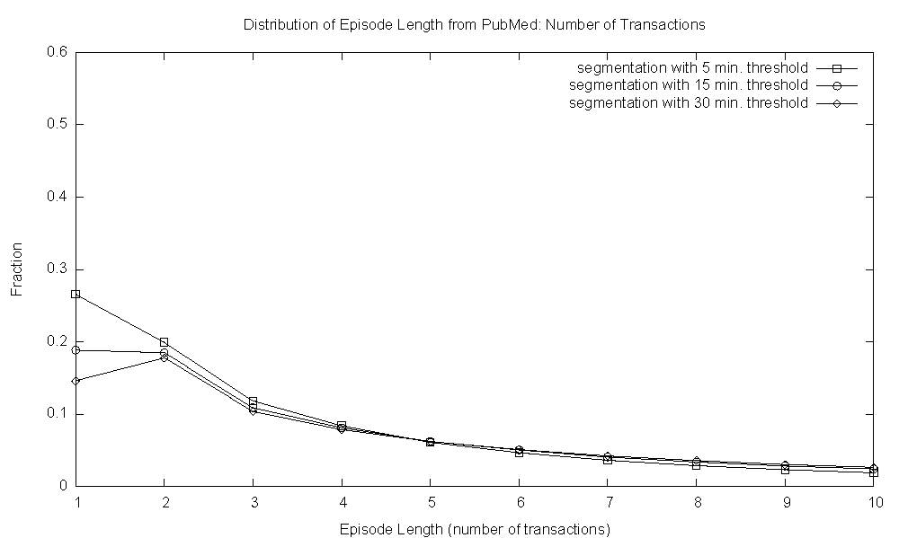
Episode Length: Transactions
Distribution of Episode Length: Number of Transactions
Fraction
Episode Length (Number of Transactions)

Slide 10
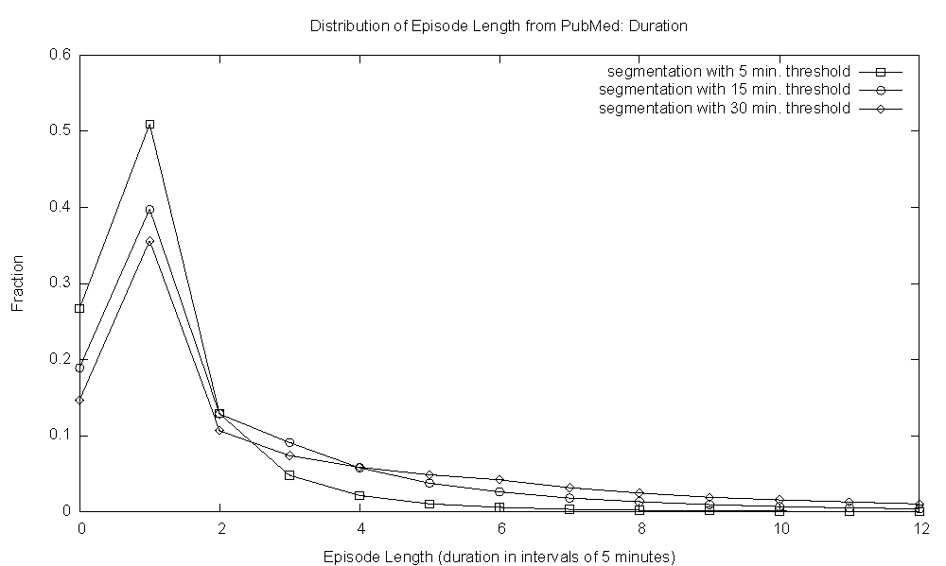
Episode Length: Duration
Distribution of Episode Length: Duration
Fraction
Episode Length (Increments of 5 minutes)

Slide 11
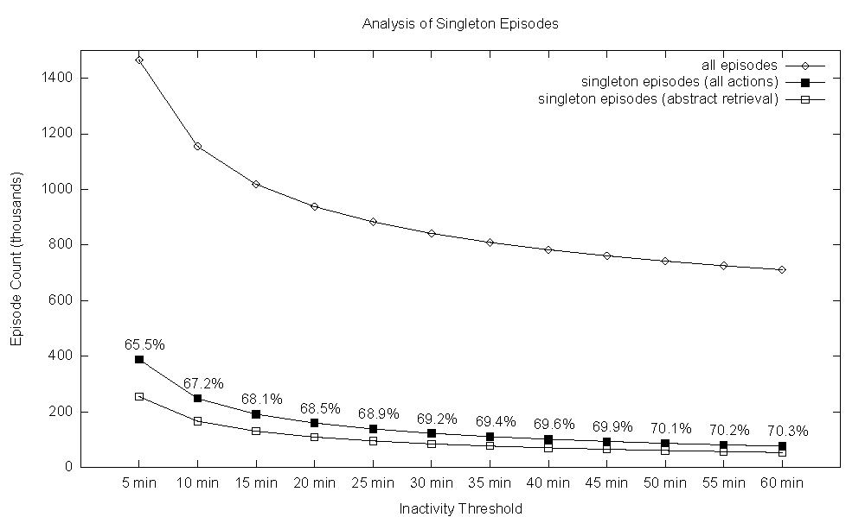
Singleton Episodes
Analysis of Singleton Episode
Count (thousands)
Inactivity Threshold

Slide 12

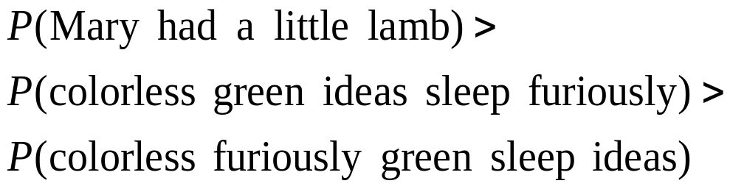
Language Models
Language models define a probability distribution over string sequences
Why are they useful?

Slide 13
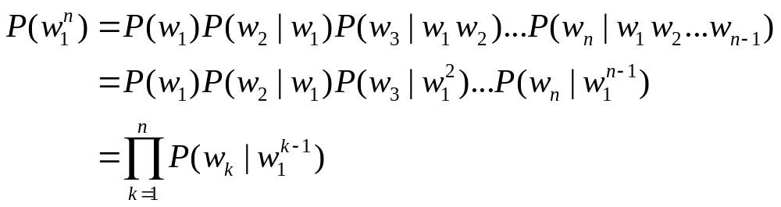
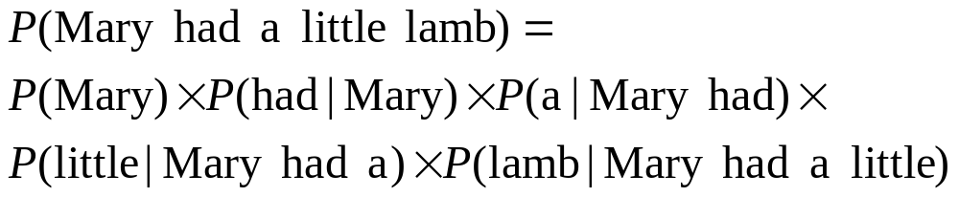
Language Models
How do you compute the probability of a sequence?
That’s a lot of probabilities to keep track of!

Slide 14



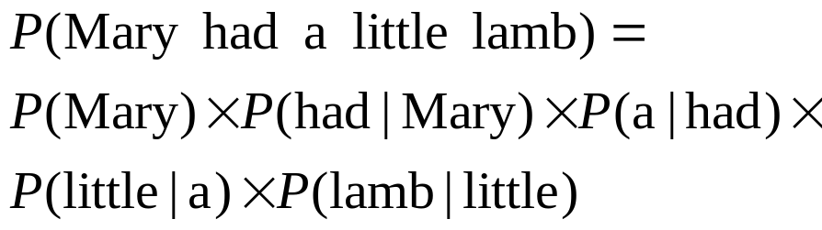
Language Models
Markov assumption: consider only N preceding symbols
  Bigrams:
  Trigams:
  N-grams:
For example, with bigrams:
What’s the tradeoff with longer histories?

Slide 15
N-Gram Activity Models
N-gram language models in NLP tasks:
  Automatic speech recognition
  Machine translation
  …
Can we apply n-gram language models to activity sequences?
Experimental setup:
  Build models of episodes: 2-grams to 8-grams
  Use in a prediction task: predict most likely next action
  Evaluate in terms of prediction accuracy

Slide 16
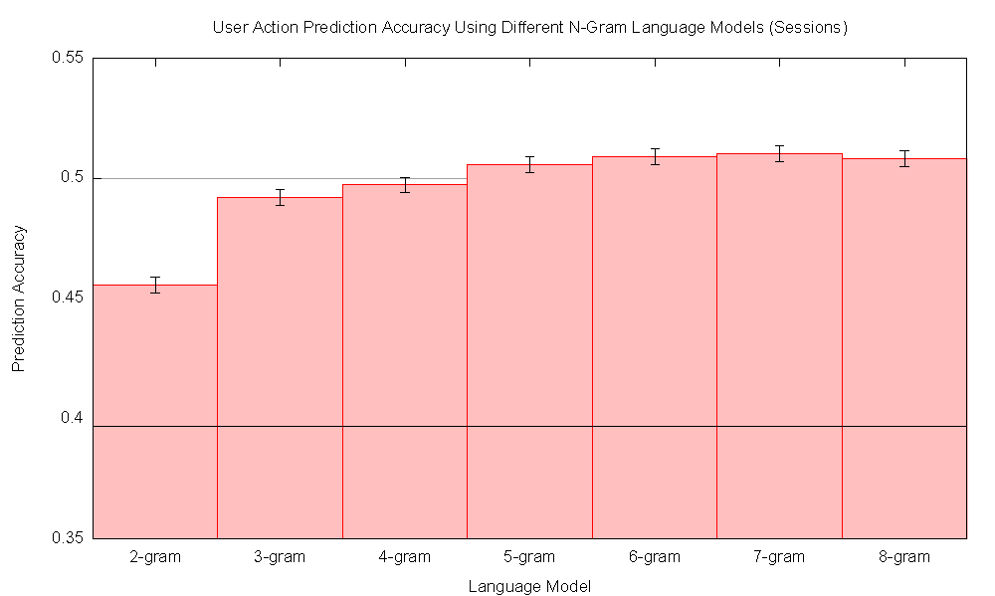
Prediction Accuracy
User action prediction accuracy with different n-gram language models
Prediction Accuracy
Baseline
n-gram language model

Slide 17
So what?
There’s signal here!
  Some level of predictability of user actions
  Impoverished data (no privacy concerns)
  Possible improvements with richer features
Implications
  It is possible to build user models to capture strategies, topics, etc.
  Demographics is one key to good Web search
  Lots of future work here…
What’s the equivalent of targeted advertising in PubMed?

Slide 18
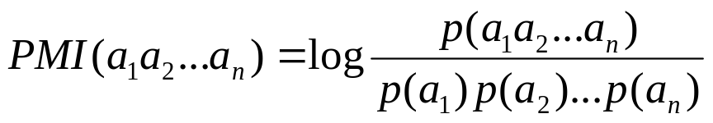
Activity Collocates
Collocates in natural language: words that co-occur much more frequently than chance
  These are usually meaningful multi-world phrases
  Common techniques for learning collocates: PMI, Log-likelihood ratio, …
Activity collocates: patterns of activities that co-occur much more frequently than chance
  What do they mean?
  My hypothesis: fragments of information seeking strategies, or search tactics
Examples: hot dog, breast cancer, school bus

Slide 19
Activity Sequences in PubMed
Meaningful Collocates
Frequent Patterns
Sequence | Count | log p | PMI
L L | 100k | -1.77 | 1.08
L M | 10.8k | -2.74 | 0.84
P P | 53.2k | -2.05 | 0.80
N N | 224k | -1.42 | 0.71
M M | 1.3k | -3.67 | 0.64
L L L | 55.1k | -2.00 | 2.27
L L M | 5.3k | -3.02 | 1.99
M M M | 162 | -4.53 | 1.94
P P P | 23.4k | -2.37 | 1.90
M R M | 4.2k | -3.12 | 1.60
M M M M | 44 | -5.07 | 3.56
L L L L | 33.3k | -2.19 | 3.51
L L L M | 3.0k | -3.24 | 3.20
P P P P | 14.1k | -2.57 | 3.14
L M M M | 33 | -5.20 | 2.71
Sequence | Count | log p | PMI
R R | 1109k | -0.73 | 0.07
Q Q | 905k | -0.82 | 0.15
Q R | 730k | -0.91 | -0.03
R Q | 670k | -0.95 | -0.06
N N | 224k | -1.42 | 0.71
R R R | 606k | -0.96 | 0.24
Q Q Q | 498k | -1.05 | 0.40
R Q R | 282k | -1.29 | -0.01
Q R R | 272k | -1.31 | -0.03
Q Q R | 255k | -1.34 | 0.03
R R R R | 380k | -1.14 | 0.46
Q Q Q Q | 306k | -1.23 | 0.70
Q R R R | 125k | -1.62 | 0.06
Q Q Q R | 120k | -1.64 | 0.21
R Q Q Q | 110k | -1.68 | 0.17

Slide 20
Are PubMed users like rats?
Given consecutive actions of a particular type, how likely are users going to continue with the same action?
 | P(X|X₁)/P(X) | P(X|X₂)/P(X) | P(X|X₃)/P(X) | P(X|X₄)/P(X)
Link | 11.9 | 15.4 | 16.8 | 18.5
Query | 1.4 | 1.7 | 1.9 | 2.1
Retrieve | 1.2 | 1.5 | 1.7 | 1.9
Next | 4.9 | 6.6 | 7.6 | 8.2

Slide 21
Executive Summary
How do users interact with PubMed?
Methodology: statistical analysis of log data
Finding: There is some predictability in users’ interactions with PubMed.
Finding: Related article links appears to be a very useful PubMed feature.
We are here
Why is related article search useful?
Methodology: visual analysis and statistical characterization of related article networks
Finding: Relevant articles tend to cluster together, thus browsing related article links is useful.
Can we better exploit related article networks?
Methodology: reranking experiments with ad hoc retrieval test collections
Finding: Related document networks can be exploited using PageRank to improve retrieval effectiveness.

Slide 22
Why are related links useful?
Related links = content-similarity browsing
Theoretical foundations:
  Cluster hypothesis: relevant documents tend to cluster together
  Information foraging theory: relevant information is found in “information patches”
Once a relevant document is encountered, other relevant documents are likely to be “nearby”
  Local exploration facilitated by related links
  More efficient than reformulating queries
Question: how might be formalize this intuition?

Slide 23

Right Tool for the Job
Test collections are standard tools for IR research, consisting of:
  A document collection
  A collection of information needs
  Relevance judgments
Why?
  Support rapid, repeatable experiments
  Do not require manual intervention
How?
  Typically created from TREC evaluations

Slide 24
TREC 2005 Genomics Track
Collection
  Ten year subset of MEDLINE (1994-2003)
  4.6 million citations
Information Needs
  Generic Topic Templates (GTT)
  Prototypical needs with “slots”
  5 templates, 50 topics total
Relevance judgments
  Pooled from 59 submissions
  Judgments from Ph.D. in biology and undergraduate

Slide 25
TREC 2005 Genomics Track
Information describing standard [methods or protocols] for doing some sort of experiment or procedure.
methods or protocols: how to “open up” a cell through “electroporation”
Information describing the role(s) of a [gene] involved in a [disease].
gene: interferon-beta
disease: multiple sclerosis
Information describing the role of a [gene] in a specific [biological process].
gene: nucleoside diphosphate kinase (NM23)
biological process: tumor progression
Information describing interactions between two or more [genes] in the [function of an organ] or in a [disease].
genes: CFTR and Sec61
function of an organ: degradation of CFTR
disease: cystic fibrosis
Information describing one or more [mutations] of a given [gene] and its [biological impact or role].
gene with mutation: BRCA1 185delAG mutation
biological impact: role in ovarian cancer

Slide 26
Experimental Design
Construct related article networks from TREC test collection
  Start with relevant documents for each topic
  For each document, add top five related links
  Build a network for every TREC topic
Analyze networks
  Examine in a visualization tool
  Compute statistical characteristics

Slide 27
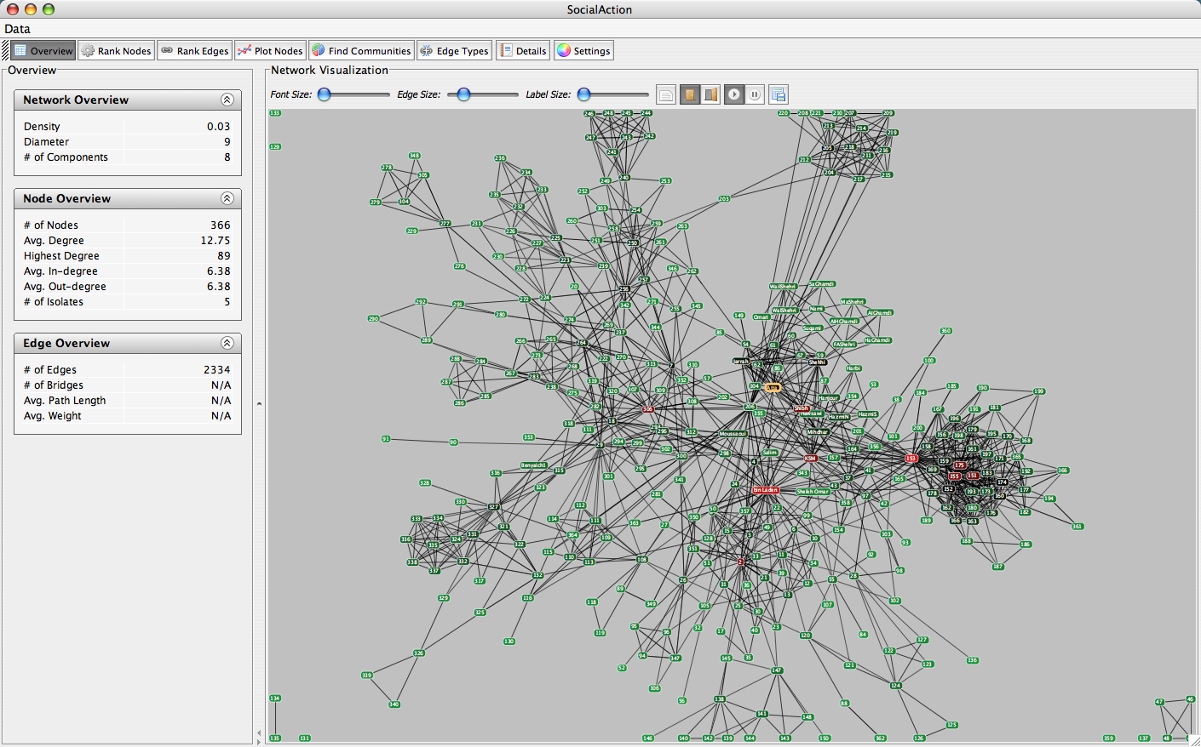
Viz Tool: SocialAction
Adam Perer and Ben Shneiderman. (2008) Integrating Statistics and Visualization: Case Studies of Gaining Clarity during Exploratory Data Analysis. Proceedings of CHI 2008.

Slide 28
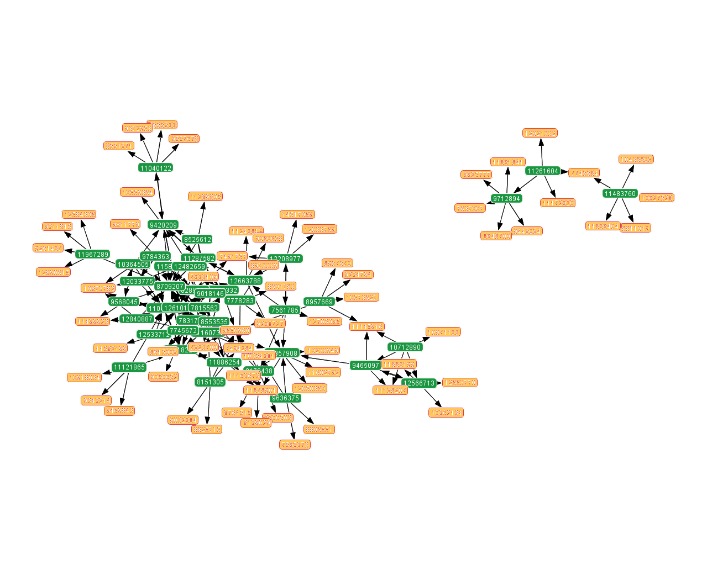
High-Density Network
Topic 131: Provide information on the genes L1 and L2 in the HPV11 virus in the role of L2 in the viral capsid.
(42 reldocs, 108 nodes, 86% nodes in largest component)

Slide 29
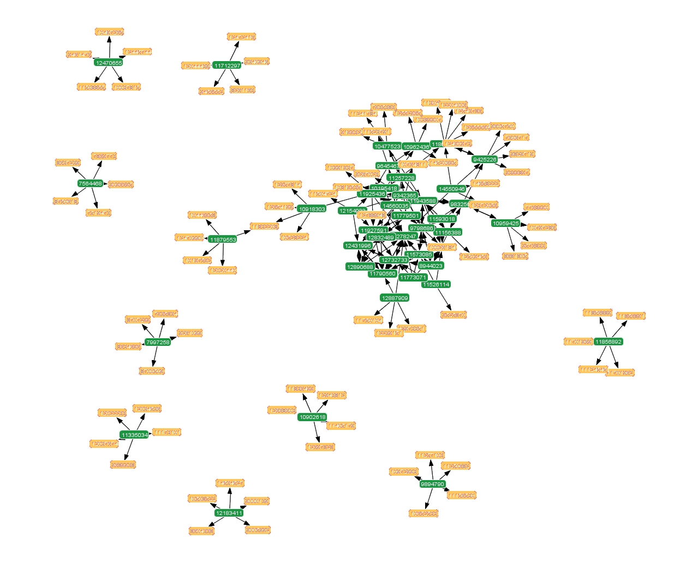
Medium-Density Network
Topic 121: Provide information on the role of the gene BARD1 in the process of BRCA1 regulation.
(42 reldocs, 129 nodes, 58% nodes in largest component)

Slide 30
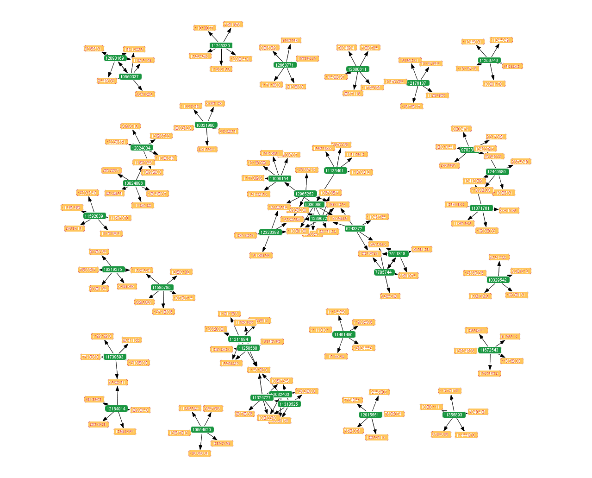
Low-Density Network
Topic 129: Provide information on the role of the gene Interferon-beta in the process of viral entry into host cell.
(38 reldocs, 190 nodes, 19% nodes in largest component)

Slide 31
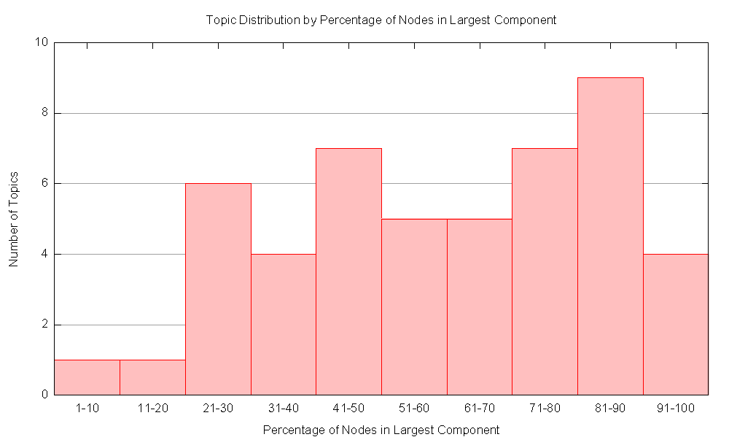
Density of Networks
Topic Distribution by Percentage of Nodes in Largest Component
Dense networks = good for browsing
Sparse networks = bad for browsing
Number of Topics
Percentage of Nodes in Largest Component

Slide 32
Expected Recall
Can we precisely quantify browsing effectiveness for different networks?
Experimental design:
  For a topic, randomly select one relevant document as starting point
  Count how many other relevant documents are reachable via browsing
  Quantify in terms of residual recall
  Take the expected residual recall over all relevant documents for that topic

Slide 33
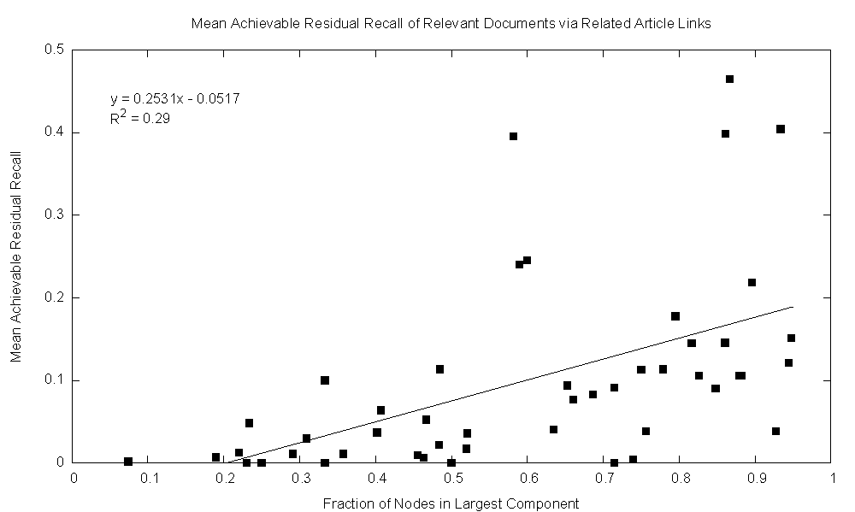
Recall by Browsing
Mean Residual Recall via Browsing Related Article Links
Mean Residual Recall
Fraction of Nodes in Largest Component

Slide 34
Findings
Related links are useful because relevant documents tend to cluster together
Related links provide an effective browsing tool

Slide 35
Executive Summary
How do users interact with PubMed?
Methodology: statistical analysis of log data
Finding: There is some predictability in users’ interactions with PubMed.
Finding: Related article links appears to be a very useful PubMed feature.
Why is related article search useful?
Methodology: visual analysis and statistical characterization of related article networks
Finding: Relevant articles tend to cluster together, thus browsing related article links is useful.
We are here
Can we better exploit related article networks?
Methodology: reranking experiments with ad hoc retrieval test collections
Finding: Related document networks can be exploited using PageRank to improve retrieval effectiveness.

Slide 36
Exploiting Network Structure
Findings thus far:
  Relevant documents tend to cluster together
  Users are likely to encounter more relevant documents by browsing related article links
Can we exploit these networks?
Hyperlink graph on the Web
Nodes: Web pages
Links: User-defined hyperlinks
Link analysis: PageRank, HITS, …
Related article networks in MEDLINE
Nodes: MEDLINE citations
Links: Content-similarity links
Link analysis: PageRank, HITS, …??
Some previous work (Kurland and Lee, SIGIR 2005),
but not for biomedical text retrieval…

Slide 37
Brief Detour: What’s PageRank?
Random walk model:
  User starts at a random Web page
  User randomly clicks on links, surfing from page to page
PageRank: What’s the amount of time that will be spent on any given page?

Slide 38
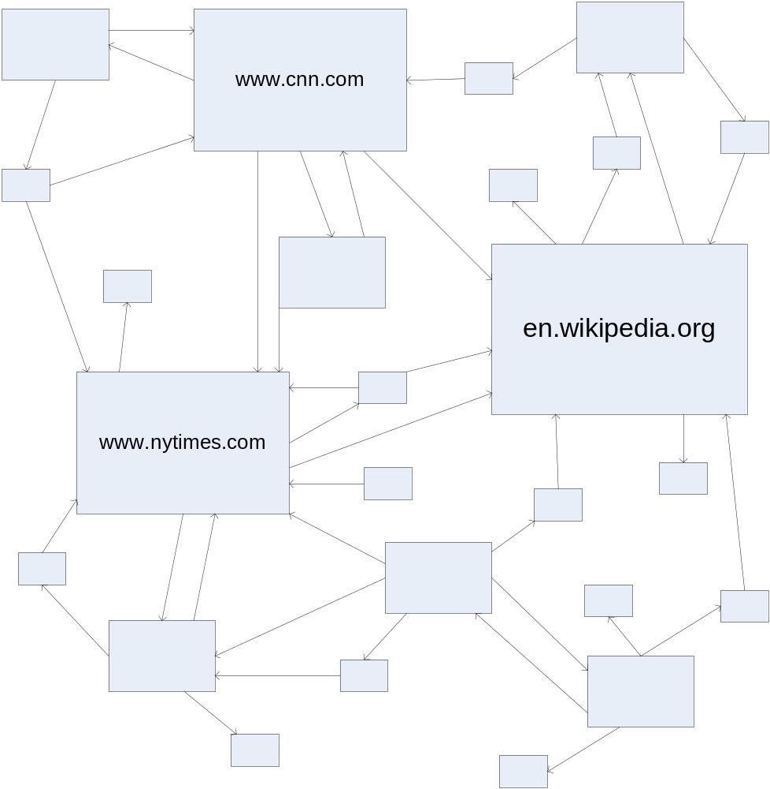
PageRank: Visually

Slide 39
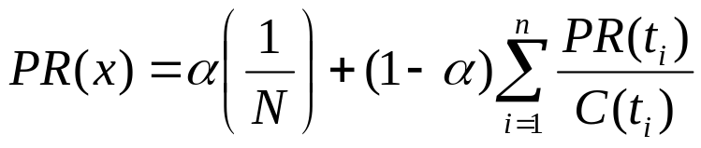
PageRank: Defined
Given page x with in-bound links t₁…t_{n}, where
  C(t) is the out-degree of t
  α is probability of random jump
  N is the total number of nodes in the graph
We can define PageRank as:
t_{i}
X
t₁
…
t_{n}

Slide 40
Computing PageRank
Properties of PageRank
  Can be computed iteratively
  Effects at each iteration is local
Sketch of algorithm:
  Start with seed PR_{i} values
  Each page distributes PR_{i} “credit” to all pages it links to
  Each target page adds up “credit” from multiple in-bound links to compute PR_{i+1}
  Iterate until values converge

Slide 41
Experimental Design
Topic 131: Provide information on the genes L1 and L2 in the HPV11 virus in the role of L2 in the viral capsid.
Terrier
1. Retrieve ranked list from Terrier
1
2. Construct related document network by expanding related documents of hits.
2
3. Compute PageRank over related document network
3
4. Combine Terrier and PageRank scores to rerank hits.
4
5. Assess differences in retrieval effectiveness.
5
Terrier ranking: 1, 2, 3, 4, 5
Terrier+PageRank ranking: 4, 2, 5, 1, 3

Slide 42
Detailed Setup
Matrix design
  50 topics from TREC 2005 genomics track
  Varied number of expansions: 5, 10, 15, 20
  Varied link analysis algorithm: PageRank, HITS
  Varied λ weight to control interpolation of features
Evaluation
  Mean average precision at 20 and 40 documents
  Precision at 20 documents

Slide 43
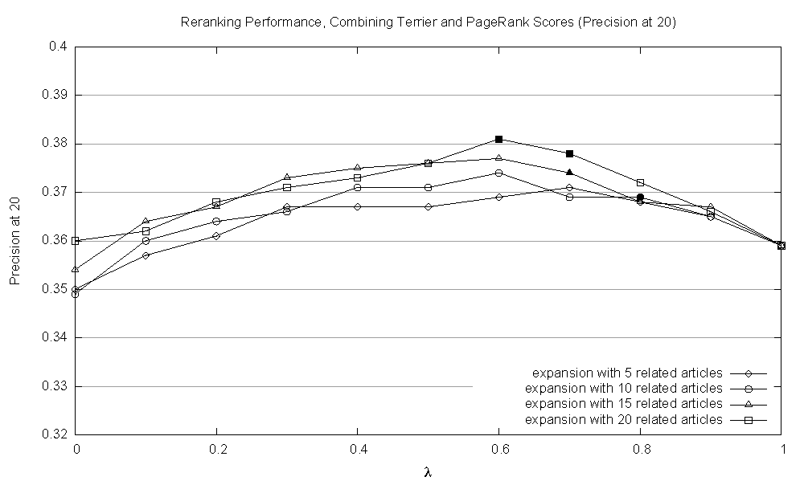
PageRank + Terrier
Reranking Performance, Terrier + PageRank (P20)
+ 6.1% (sig., p<0.05)
Precision at 20
λ (weight given to Terrier scores)

Slide 44
More Observations
PageRank >> HITS
Performance increases with network density

Slide 45
Executive Summary
How do users interact with PubMed?
Methodology: statistical analysis of log data
Finding: There is some predictability in users’ interactions with PubMed.
Finding: Related article links appears to be a very useful PubMed feature.
Why is related article search useful?
Methodology: visual analysis and statistical characterization of related article networks
Finding: Relevant articles tend to cluster together, thus browsing related article links is useful.
Can we better exploit related article networks?
Methodology: reranking experiments with ad hoc retrieval test collections
Finding: Related document networks can be exploited using PageRank to improve retrieval effectiveness.

Slide 46
Acknowledgements
Research support
  David Lipman
  David Landsman
Collaborators
  John Wilbur
  Mike DiCuccio
  Vahan Grigoryan
  G. Craig Murray
  Zhiyong Lu

