Slide 1

INFM 700: Session 2
Principles of Information Architecture
Jimmy Lin
The iSchool
University of Maryland
Monday, February 4, 2008
This work is licensed under a Creative Commons Attribution-Noncommercial-Share Alike 3.0 United States
See http://creativecommons.org/licenses/by-nc-sa/3.0/us/ for details

Slide 2
Today’s Topics
User’s information needs
  What do users want?
  How do users behave?
Organization Systems
  The structure of the information space
  Mostly static
Navigation Systems
  How users move through the information space
  Dynamic in nature
Page layout and design
Users’ Needs
Organization
Systems
Navigation
Systems
Page Layout
and Design
What about Labeling Systems (from M&R)?

Slide 3
Analogy: Printed Book
Organization System:
  Chapters
  Sections
  Paragraphs
Navigation System:
  Table of contents
  Index
  Page numbers
  Cross-references
  …
Users’ Needs
Organization
Systems
Navigation
Systems
Page Layout
and Design
Established over 500 years… Not all present at the dawn of printing

Slide 4
Common Information Needs
Everything
A few good things
≠ exploratory
seeking
The right thing
Users’ Needs
Organization
Systems
Navigation
Systems
Page Layout
and Design
≠ known-item
seeking
Need it again
from M&R, p. 35

Slide 5
Precision vs. Recall
Everything
= Recall-oriented Searching
Orthogonal concepts:
A few good things
Exploratory seeking
Known-item seeking
Users’ Needs
Organization
Systems
Navigation
Systems
Page Layout
and Design
The right thing
= Precision-oriented Searching

Slide 6
Additional Dimensions
Not necessarily involves computers!
Retrospective vs. prospective
Focused vs. unfocused vs. serendipitous
Finding information vs. finding people
Users’ Needs
Organization
Systems
Navigation
Systems
Page Layout
and Design

Slide 7
User, Task, Context
Characteristics of the User
  Expert vs. layman
  Current state of knowledge
  …
Characteristics of the Task
  Duration and scope of need
  Complexity of the task
  …
Additional context
  Requirement for specific sources
  Reference to external events
  …
Users’ Needs
Organization
Systems
Navigation
Systems
Page Layout
and Design

Slide 8
Relevance
The property of how “good” the information is
  Harder to pin down than you think!
  Complex function of user, task, and context
Types of relevance:
  Topical relevance: is it about the right thing?
  Task-based relevance: does it help in what I’m doing?
  Utility: is it actually useful?
Users’ Needs
Organization
Systems
Navigation
Systems
Page Layout
and Design

Slide 9
Picking Berries
A sketch of a searcher… “moving through many actions towards a general goal of satisfactory completion of research related to an information need.”
Q2
Q4
Q3
Users’ Needs
Organization
Systems
Navigation
Systems
Page Layout
and Design
Q1
Q5
Q0
Marcia J. Bates. (1991) The Berry-Picking Search: User Interface Design. In M. Dillon, editor, Interfaces for Information Retrieval and Online Systems: The State of the Art. New Jersey: Greenwood Press.

Slide 10
Information Foraging Theory
Analogy: human information seekers behave like foragers in hunter-gatherer society
Primary goal: maximize information gain per unit time (i.e., efficiency)
Key Concepts:
  Information patches
  Information scent
Model of user behavior:
  Inter-patch activities
  Between-patch activities
Implications for system design?
Users’ Needs
Organization
Systems
Navigation
Systems
Page Layout
and Design
Peter Pirolli and Stuart Card. (1999) Information Foraging. Psychology Review, 106(4):643-675.

Slide 11
Taylor’s Model
The visceral need (Q1) ⎯ the actual, but unexpressed, need for information
The conscious need (Q2) ⎯ the conscious within-brain description of the need
The formalized need (Q3) ⎯ the formal statement of the question
The compromised need (Q4) ⎯ the question as presented to the information system
Users’ Needs
Organization
Systems
Navigation
Systems
Page Layout
and Design
Robert S. Taylor. (1962) The Process of Asking Questions. American Documentation, 13(4), 391--396.

Slide 12
Taylor’s Model and IR Systems
Visceral need (Q₁)
Conscious need (Q₂)
Question
Negotiation
Formalized need (Q₃)
naïve users
Compromised need (Q₄)
Users’ Needs
Organization
Systems
Navigation
Systems
Page Layout
and Design
IR System
Results

Slide 13
Recall Mizzaro’s Model
RIN₀
Real information needs (RIN)
= visceral need
PIN₀
…
PIN_{m}
Perceived information needs (PIN)
= conscious need
r₀
r₁
r_{n}
Request
= formalized need
Users’ Needs
Organization
Systems
Navigation
Systems
Page Layout
and Design
q₀
q₁
q₂
q₃
q_{r}
Query
= compromised need
Stefano Mizzaro. (1999) How Many Relevances in Information Retrieval? Interacting With Computers, 10(3), 305-322.

Slide 14
The Fundamental Problem
Computer performance
transistors
speed
storage
...
Human performance
Users’ Needs
Organization
Systems
Navigation
Systems
Page Layout
and Design
1950
1990
2050

Slide 15
Observations about Users
Users don’t read
Users don’t scroll
Users are easily lost
Users are easily frustrated
Users are strangely persistent
Users are different!
Users’ Needs
Organization
Systems
Navigation
Systems
Page Layout
and Design

Slide 16
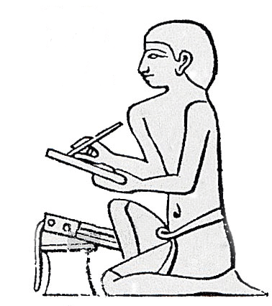
Organization of Information
Probably as old as writing itself
Many different approaches:
  Library and Information Science: thesauri, indexing, etc.
  Computer Science: knowledge representations
  Cognitive Science: how do humans grasp concepts?
  Philosophy: epistemology (“the nature of knowledge”)
  …
Users’ Needs
Organization
Systems
Navigation
Systems
Page Layout
and Design
Hmmm… where did I put that tablet?

Slide 17
“Exact” Systems
Alphabetical
Chronological
Geographical
Organizational (for Intranets)
Any inherent attribute of entities
Users’ Needs
Organization
Systems
Navigation
Systems
Page Layout
and Design

Slide 18
“Inexact” Systems
Topic
Task
User
Metaphors
Hybrid
Organizational (in general)
Process
Any inherent attribute of entities, interpreted
Users’ Needs
Organization
Systems
Navigation
Systems
Page Layout
and Design

Slide 19
Hierarchical Organization
Systems of organization are mostly hierarchical
  Represents a specific mode of thinking: reductionistic, decompositional, general-to-specific
Why?
  “Natural order”
  Convention and familiarity
  Physical limitations
  Cognitive limitations
Hierarchies are everywhere:
  Human organizations
  Computer file systems
  Physical file systems
  Biological organisms
Users’ Needs
Organization
Systems
Navigation
Systems
Page Layout
and Design

Slide 20
Depth vs. Breadth
“shallow but wide”
“narrow but deep”
Users’ Needs
Organization
Systems
Navigation
Systems
Page Layout
and Design
What are the tradeoffs?

Slide 21
Non-Hierarchical Systems
Hypertext
  Direct links between different information segments
  Pre-dates the Web
Social tagging
  “Wisdom of the mob”
  Shows what everyone else likes
  Web 2.0 (hype?)
Users’ Needs
Organization
Systems
Navigation
Systems
Page Layout
and Design

Slide 22
Hypertext
Balmoral
Charles
Elizabeth
Diana
Users’ Needs
Organization
Systems
Navigation
Systems
Page Layout
and Design
Elizabeth
Tony
Philip

Slide 23
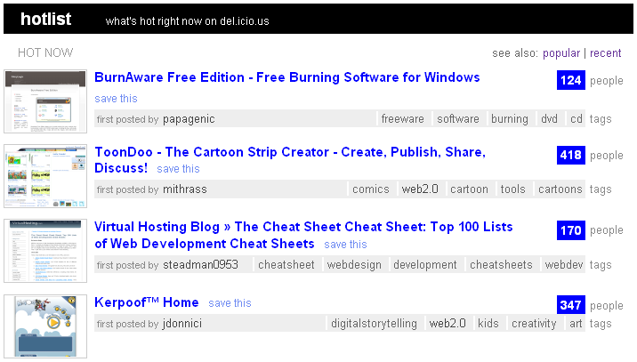
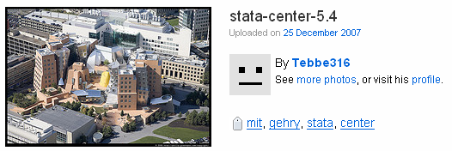
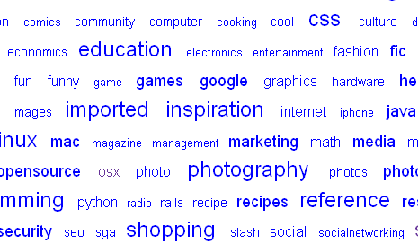
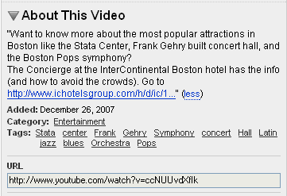
Social Tagging
del.icio.us
flickr
Users’ Needs
Organization
Systems
Navigation
Systems
Page Layout
and Design
YouTube
del.icio.us

Slide 24
Ideas in Tension
Doesn’t a hierarchical organization system defeat the entire point of hypertext?
Doesn’t social tagging eliminate the need for organization systems?
Users’ Needs
Organization
Systems
Navigation
Systems
Page Layout
and Design

Slide 25
Organization and Behavior
Bookmarks
Arrangement of tabs and windows
Social tagging
Personal homepage
Blogs
Users’ Needs
Organization
Systems
Navigation
Systems
Page Layout
and Design

Slide 26
Blueprints
Blueprints are diagrams outlining the organization system of an information space
Can provide overview at different levels
  Conceptual level
  Physical level (i.e., how pages are actually linked)
Keep it simple and uncluttered!
  Choose the appropriate level of detail
Users’ Needs
Organization
Systems
Navigation
Systems
Page Layout
and Design

Slide 27
Blueprint: Conceptual
Main
Homepage
Teaching
Research
Other
Activities
LBSC 690
Ph.D.
Students
IR
Colloquium
Users’ Needs
Organization
Systems
Navigation
Systems
Page Layout
and Design
INFM 718R
Publications
TREC
INFM 700
Projects

Slide 28
Blueprint: Physical
Index Page
“teaching”
“research”
“other”
Users’ Needs
Organization
Systems
Navigation
Systems
Page Layout
and Design
Index Page
“teaching”
“research”
“other”

Slide 29

Design Navigation Systems
Chess analogy: a few simple rules that disguise an infinitely complex game
The three-part structure
  Openings: many strategies, lots of books about this
  End game: well-defined, well-understood
  Middle game: nebulous, hard to describe
Information navigation has a similar structure!
  Middle game is underserved
Users’ Needs
Organization
Systems
Navigation
Systems
Page Layout
and Design
Marti A. Hearst, Preston Smalley, and Corey Chandler. (2006) Faceted Metadata for Information Architecture and Search. Tutorial at CHI 2006.

Slide 30
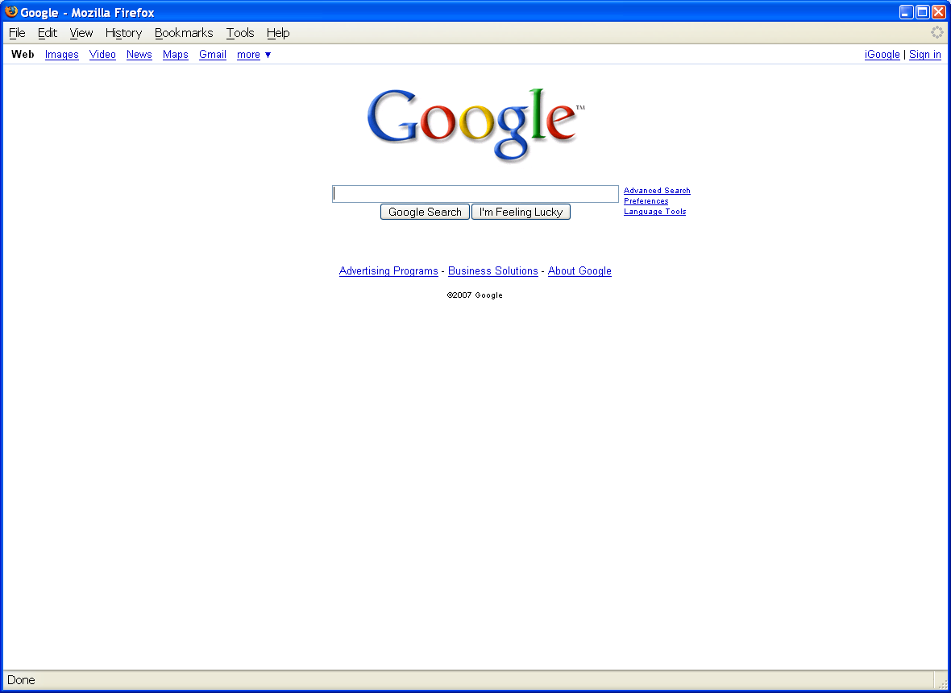
Opening Moves
Users’ Needs
Organization
Systems
Navigation
Systems
Page Layout
and Design

Slide 31
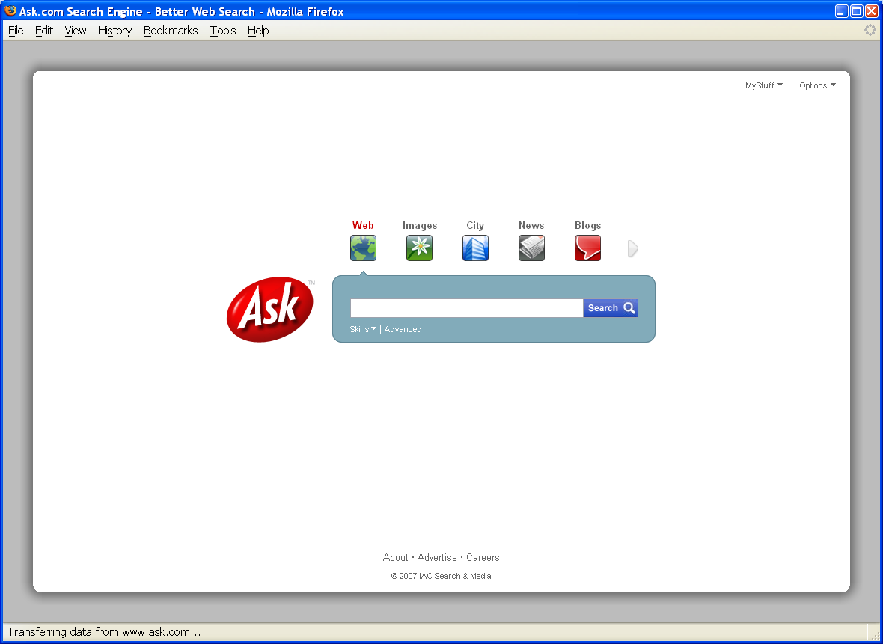
Opening Moves
Users’ Needs
Organization
Systems
Navigation
Systems
Page Layout
and Design

Slide 32
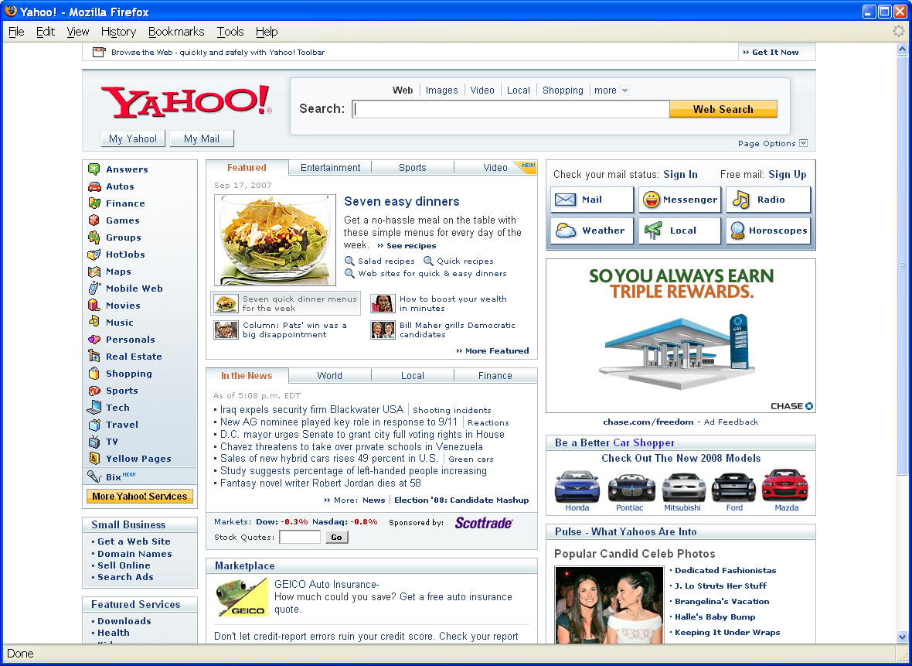
Opening Moves
Users’ Needs
Organization
Systems
Navigation
Systems
Page Layout
and Design

Slide 33
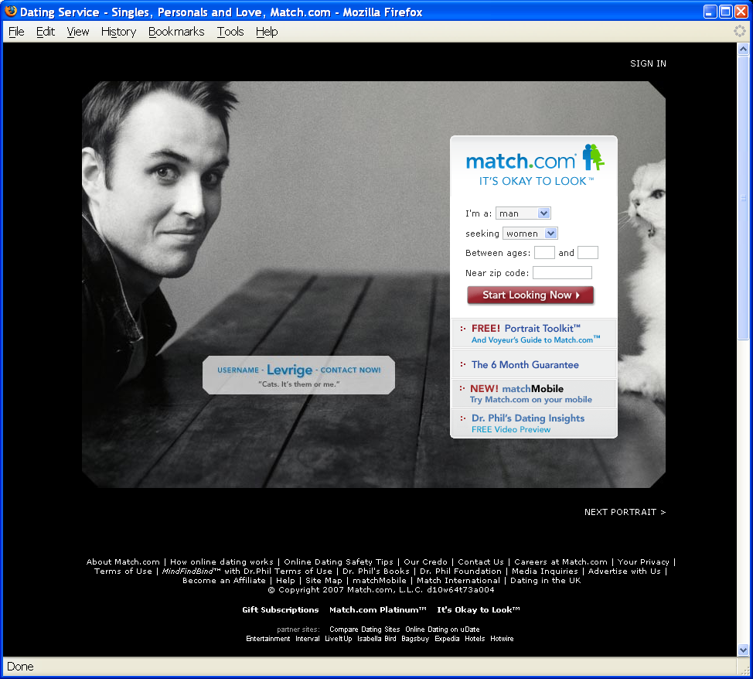
Opening Moves
Users’ Needs
Organization
Systems
Navigation
Systems
Page Layout
and Design

Slide 34
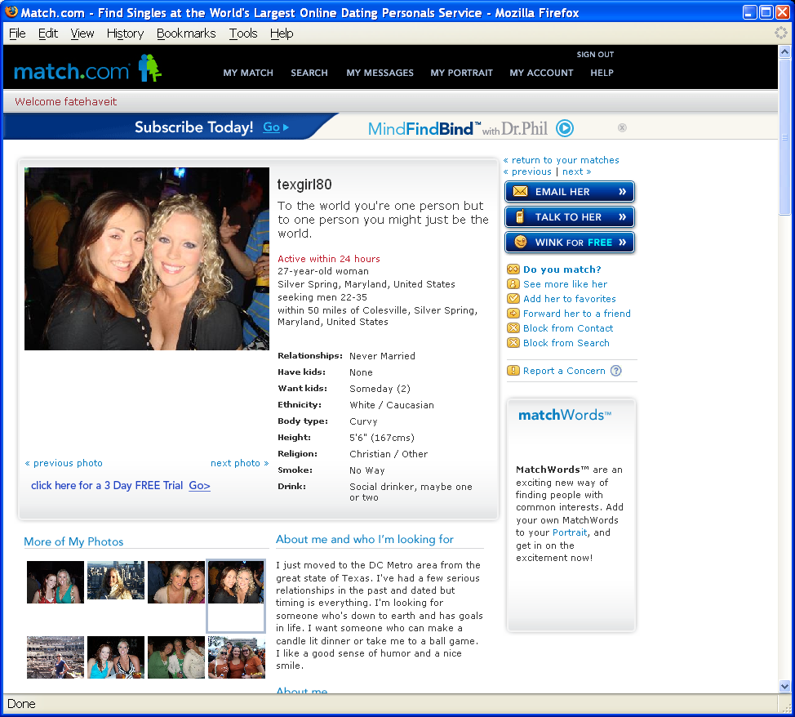
End Game
Users’ Needs
Organization
Systems
Navigation
Systems
Page Layout
and Design

Slide 35

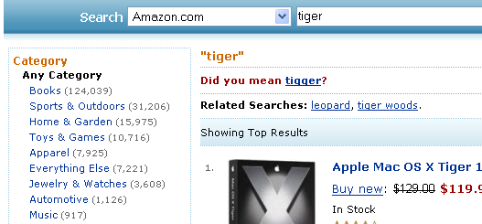
Middle Game
Users’ Needs
Organization
Systems
Navigation
Systems
Page Layout
and Design

Slide 36
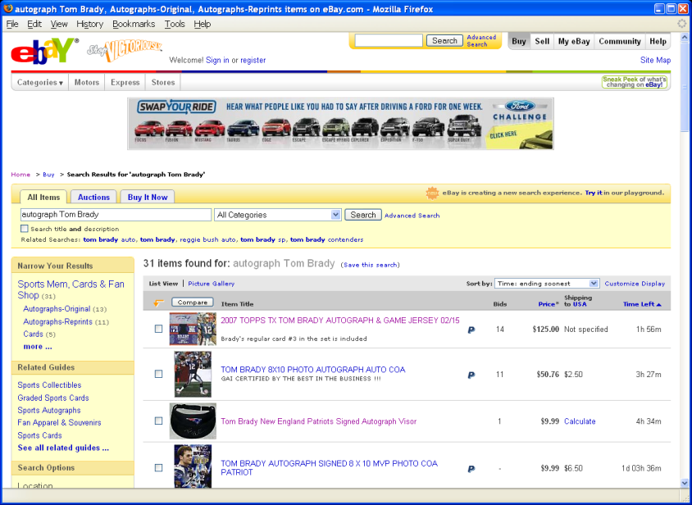
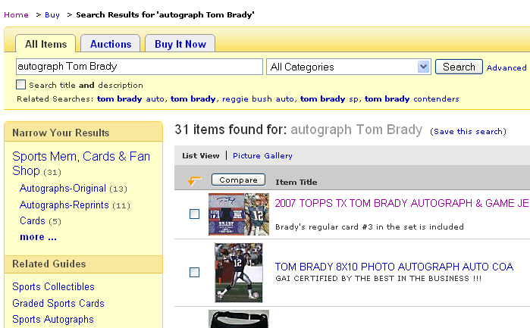
Middle Game
Users’ Needs
Organization
Systems
Navigation
Systems
Page Layout
and Design

Slide 37
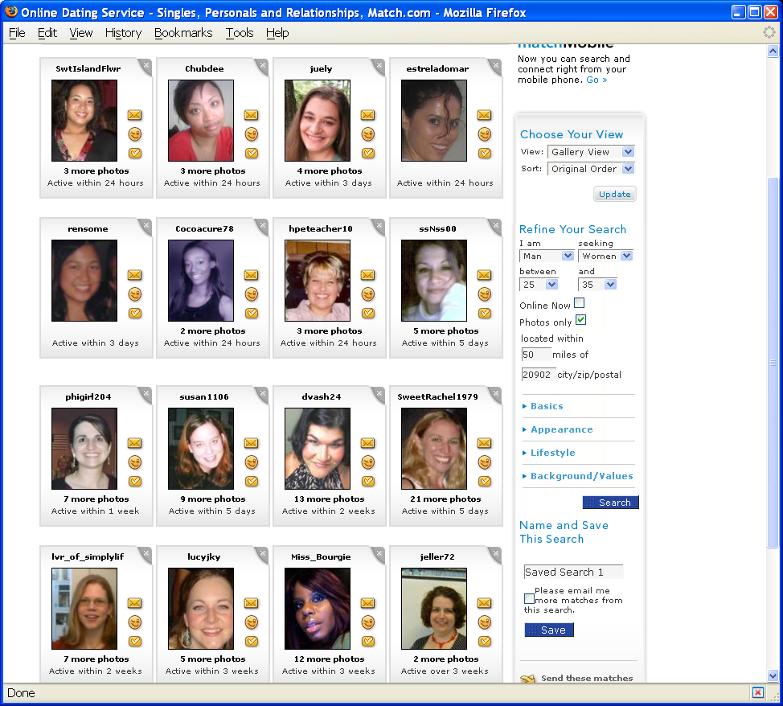
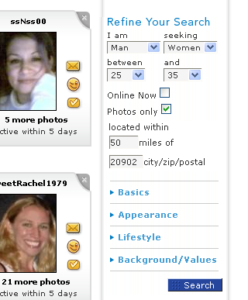
Middle Game
Users’ Needs
Organization
Systems
Navigation
Systems
Page Layout
and Design

Slide 38
Supporting the “Middle Game”
Navigation systems must support moves through the information space
Analogy: User views a projection of the information space
What the user sees
Users’ Needs
Organization
Systems
Navigation
Systems
Page Layout
and Design
Information Space
Possibly Relevant Information

Slide 39
Possible “Moves”
n₁
b₂
n₂
b₁
narrow
broaden
Users’ Needs
Organization
Systems
Navigation
Systems
Page Layout
and Design
s₁
s₂
j₁
j₂
shift
jump

Slide 40
Navigation Patterns
Movement in the organization hierarchy
  Move up a level
  Move down a level
  Move to sister
  Move to next (natural sequences)
  Move to sister of parent
Drive to content
Drive to advertisement
Jump to related
Jump to recommendations
Users’ Needs
Organization
Systems
Navigation
Systems
Page Layout
and Design

Slide 41
Navigation Patterns
$$
Users’ Needs
Organization
Systems
Navigation
Systems
Page Layout
and Design
Mostly navigation
Mostly content

Slide 42
Types of Navigation Systems
Global
  Shown everywhere
  Tells the user “what’s important”
Local
  Shown in specific parts of the site
  Tells the user “what’s nearby”
Contextual
  Shown only in specific situations
  Tells the user “what’s related”
Users’ Needs
Organization
Systems
Navigation
Systems
Page Layout
and Design

Slide 43
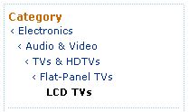

You are here
Remind users “where they are”
Not everyone starts from the front page
Don’t assume that the “back button” is meaningful
Example from Amazon
Example from IBM
Users’ Needs
Organization
Systems
Navigation
Systems
Page Layout
and Design

Slide 44
Designing CRAPy Pages
Contrast: make different things different
  to bring out dominant elements
  to mute lesser elements
Repetition: repeat design throughout the interface
  to create consistency
  to foster familiarity
Alignment: visually connect elements
  to create flow
  to convey organization
Proximity: make effective use of spacing
  to group related elements
  to separate unrelated elements
Users’ Needs
Organization
Systems
Navigation
Systems
Page Layout
and Design
From: Saul Greenberg

Slide 45
CRAPy Pages: Contrast
Important
Less important
Less important
Less important
Important
Less important
Less important
Less important
Important
Less important
Less important
Less important
Important
Less important
Less important
Less important
Users’ Needs
Organization
Systems
Navigation
Systems
Page Layout
and Design

Slide 46


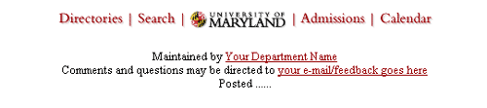
CRAPy Pages: Repetition
Block 1
  My points
  You points
  Their points
Block 2
  Blah
  Argh
  Shrug
Users’ Needs
Organization
Systems
Navigation
Systems
Page Layout
and Design
http://www.trademarks.umd.edu/trademarks/web.cfm

Slide 47
CRAPy Pages: Alignment
Major Bullets
  Secondary bullet
  Secondary bullet
Major Bullet
  Secondary bullet
  Secondary bullet
Users’ Needs
Organization
Systems
Navigation
Systems
Page Layout
and Design
Alignment denotes items “at the same level”

Slide 48
CRAPy Pages: Proximity
Important
Less important
Less important
Less important
Related
Important
Less important
Less important
Less important
Less Related
Important
Less important
Less important
Less important
Users’ Needs
Organization
Systems
Navigation
Systems
Page Layout
and Design
Important
Less important
Less important
Less important
Related

Slide 49
Page Layout: Conventions
Navigation
Navigation
Content
Content
Navigation (Global)
Navigation
(Contextual)
Users’ Needs
Organization
Systems
Navigation
Systems
Page Layout
and Design
Navigation
(Local)
Content
Content

Slide 50
It’s all about the grid!
Natural correspondence to organization hierarchy
Conveys structure
Easy to implement in tables
Easy to control alignment and proximity
Users’ Needs
Organization
Systems
Navigation
Systems
Page Layout
and Design

Slide 51
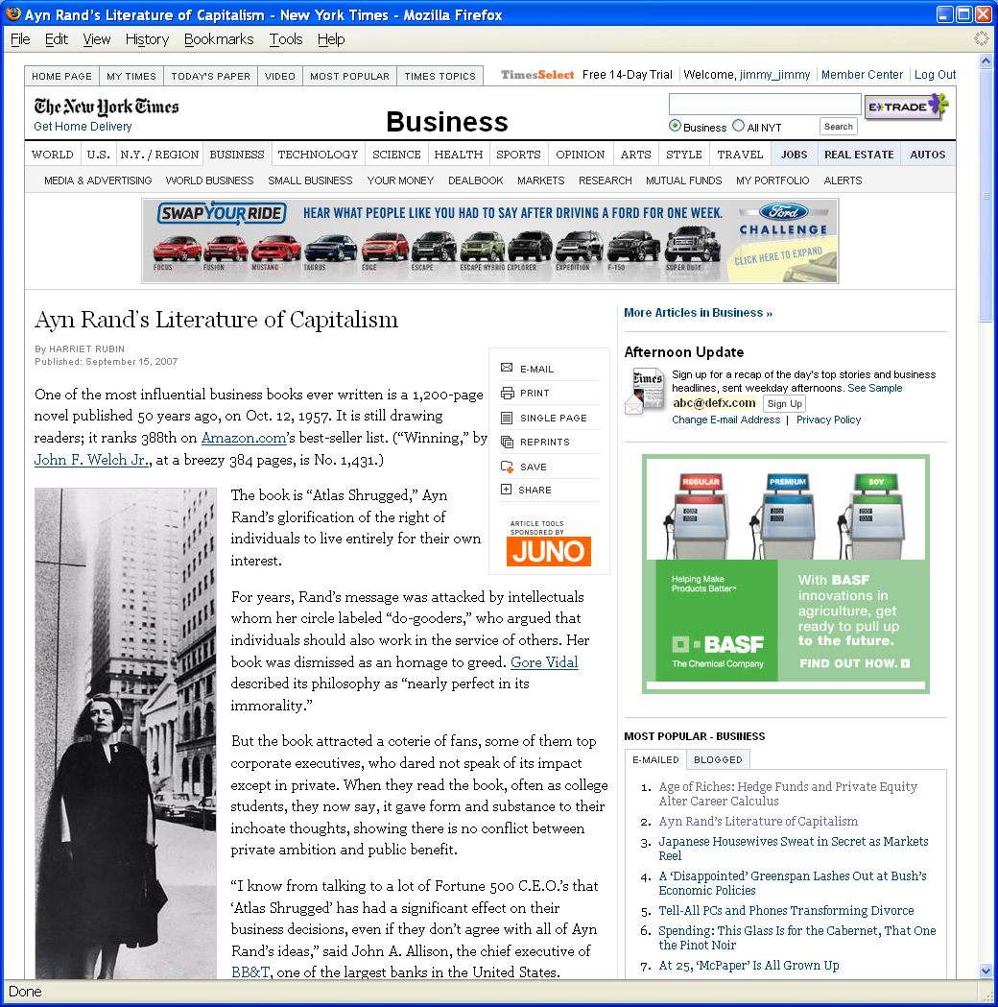
Grid Layout: NY Times
Users’ Needs
Organization
Systems
Navigation
Systems
Page Layout
and Design

Slide 52
Grid Layout: NY Times
Navigation (Global)
Banner Ad
Another Ad
Users’ Needs
Organization
Systems
Navigation
Systems
Page Layout
and Design
Content
Popular
Articles

Slide 53

Grid Layout: ebay
Users’ Needs
Organization
Systems
Navigation
Systems
Page Layout
and Design

Slide 54
Grid Layout: ebay
Navigation (Global)
Banner Ad
Navigation (Search)
Users’ Needs
Organization
Systems
Navigation
Systems
Page Layout
and Design
Navigation
(Local)
Search Results

Slide 55
Grid Layout: Amazon
Users’ Needs
Organization
Systems
Navigation
Systems
Page Layout
and Design

Slide 56
Grid Layout: Amazon
Navigation (Global)
Navigation (Contextual)
Navigation
(Contextual)
Users’ Needs
Organization
Systems
Navigation
Systems
Page Layout
and Design
Search Results

Slide 57
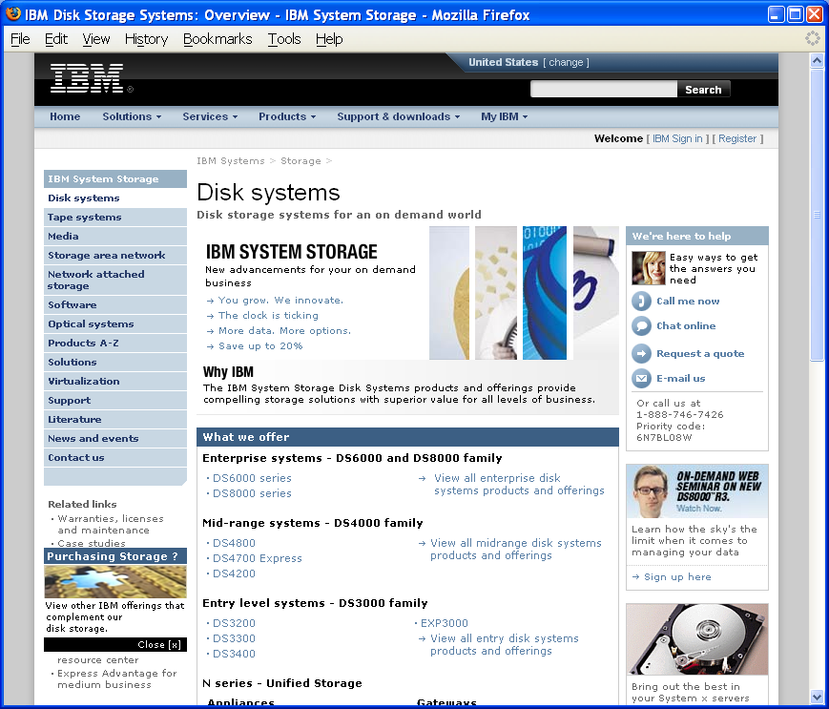
Navigation Overload
Users’ Needs
Organization
Systems
Navigation
Systems
Page Layout
and Design

Slide 58
Beware: Navigation Overload
Navigation
More Navigation
Content
Even More Navigation
Users’ Needs
Organization
Systems
Navigation
Systems
Page Layout
and Design

Slide 59
Labeling System
Direct manifestations of possible user actions
Mutually constrained by:
  Organization system
  Navigation system
  Page layout and design
Warning: poor labels can ruin a good organization and navigation system!
How so?
Users’ Needs
Organization
Systems
Navigation
Systems
Page Layout
and Design

Slide 60
Language of Labels
Different types of phrases:
  Nouns (“Flight reservations”)
  Verb phrases (“Book a flight”)
  Gerunds (“Giving to Maryland”)
  Prepositional phrases (“For applicants”)
  Questions (“How do I sign up?”)
  Idiomatic (“What’s new?”, “Guestbook”, “Shopping cart”)
  Icons
Natural affinity between label types and organization systems
Users’ Needs
Organization
Systems
Navigation
Systems
Page Layout
and Design

Slide 61
Hierarchy Structure → Links
Users’ Needs
Organization
Systems
Navigation
Systems
Page Layout
and Design
How do you fit so many links on a page?

Slide 62
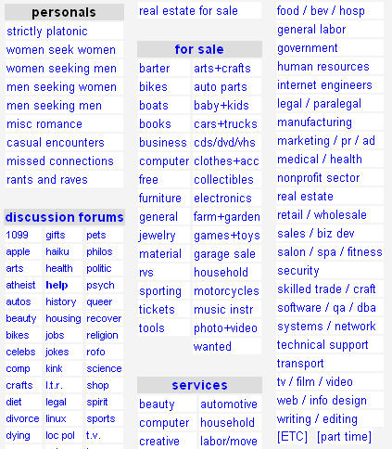
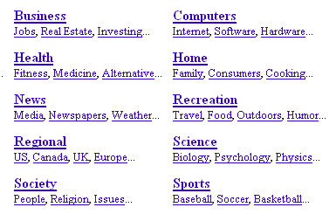
Link Organization
Craig’s List
Open Directory Project
Users’ Needs
Organization
Systems
Navigation
Systems
Page Layout
and Design

Slide 63

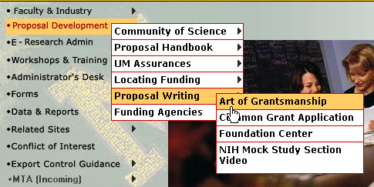
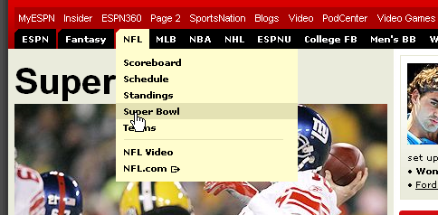
Menu Systems
Slashdot
ORAA UMD
Users’ Needs
Organization
Systems
Navigation
Systems
Page Layout
and Design
ESPN

Slide 64
Wireframes
Visual displays that define the layout and placement of fundamental design elements
My expectations for projects:
  Site prototypes with wireframes
  Basically, everything minus “pretty graphics”
  Of course, appropriate graphic design can certainly enhance the presentation
Users’ Needs
Organization
Systems
Navigation
Systems
Page Layout
and Design

Slide 65
Putting it all together…
Furnas’ Theory of Effective View Navigation
Definitions:
  Logical graph: underlying structure
  View graph: structure as visible from any given node
  Residue: indication of what lies at the target and beyond
Requirements:
  Small views: reasonable out-degree at each node
  Short paths: short distances between pairs of nodes
  Navigability: good out-link info
  Residue distribution: every node should have good residue at every other node
Users’ Needs
Organization
Systems
Navigation
Systems
Page Layout
and Design
George W. Furnas. (1997) Effective View Navigation. Proceedings of SIGCHI 1997 Conference on Human Factors in Computing Systems (CHI 1997).

Slide 66
Effective View Navigation
$$
Users’ Needs
Organization
Systems
Navigation
Systems
Page Layout
and Design

Slide 67
Recap of Today’s Topics
User’s information needs
  What do users want?
  How do users behave?
Organization Systems
  The structure of the information space
  Mostly static
Navigation Systems
  How users move through the information space
  Dynamic in nature
Page layout and design
Users’ Needs
Organization
Systems
Navigation
Systems
Page Layout
and Design

