Slide 1

INFM 700: Session 3
Structured Information
Jimmy Lin
The iSchool
University of Maryland
Monday, February 11, 2008
This work is licensed under a Creative Commons Attribution-Noncommercial-Share Alike 3.0 United States
See http://creativecommons.org/licenses/by-nc-sa/3.0/us/ for details

Slide 2
Today’s Topics
Separation of content from presentation
Relational databases
  Tables as the organizing principle
XML
  Graphs as the organizing principle
Introduction
Databases
XML

Slide 3
What we see…
Introduction
Databases
XML
Content as HTML pages arranged hierarchically…
is this really what’s going on?

Slide 4
The Reality
Content
Metadata
Introduction
Databases
XML

Slide 5

Site Organization
Presentation
Content
Introduction
Databases
XML
Metadata

Slide 6
Content vs. Presentation
Why separate the two?
Content
  Structured data: relational databases (tables)
  Semi-structured data: XML (graphs)
Presentation
  HTML/CSS
  Flash, multimedia, etc.
Introduction
Databases
XML
But wait… isn’t HTML a type of XML also?

Slide 7
Application Architectures
Database
Web
Server
Network
Two-Layer Architecture
Database
Web
Server
Application
Server
Network
Introduction
Databases
XML
Three-Layer Architecture

Slide 8
Database Basics
What is a database?
  Collection of data, organized to support access
  Models some aspects of reality
Components of a relational database:
  Field = an “atomic” unit of data
  Record (or Tuple) = a collection of related fields
    Each record defines a relation
  Table = a collection of related records
    Each record is one row in the table
    Each field is one column in the table
  Database = a collection of tables
Introduction
Databases
XML

Slide 9
Important Concepts
Primary Key:
  Field that uniquely identifies a record
Foreign Key:
  Field in a table that “links” to another table
  Must be primary key in the other table
Schema
  Specifies the name of the relation
  Specifies name and type of each field
Introduction
Databases
XML

Slide 10
A Simple Example
Field Name
Table
Name | DOB | SSN
John Doe | 04/15/1970 | 153-78-9082
Jane Smith | 08/31/1985 | 768-91-2376
Mary Adams | 11/05/1972 | 891-13-3057
Record/Tuple
Field
Primary Key
Introduction
Databases
XML

Slide 11
Registrar Example
What do we need to know (i.e., model)?
  Something about the students (e.g., first name, last name, email, department)
  Something about the courses (e.g., course ID, description, enrolled students, grades)
  Which students are in which courses
Introduction
Databases
XML

Slide 12
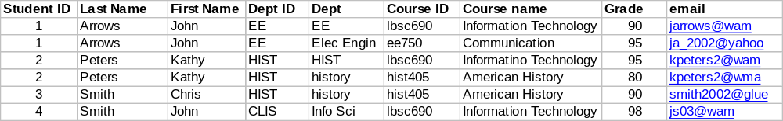
A First Try
Put everything in a big table…
Discussion: Why is this a bad idea?
Introduction
Databases
XML

Slide 13
Goals of “Normalization”
Save space
  Save each fact only once
More rapid updates
  Each fact only needs to be updated once
More rapid search
  Finding something once is good enough
Avoid inconsistency
  Changing data once changes it everywhere
Introduction
Databases
XML

Slide 14
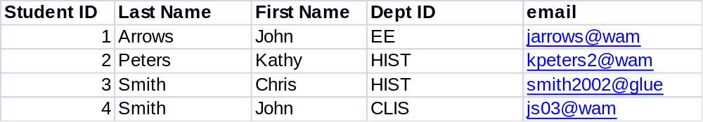
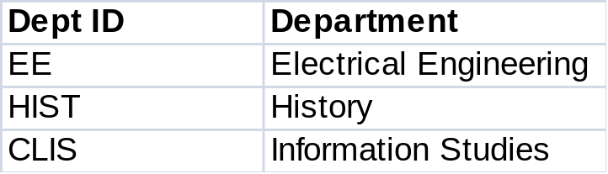
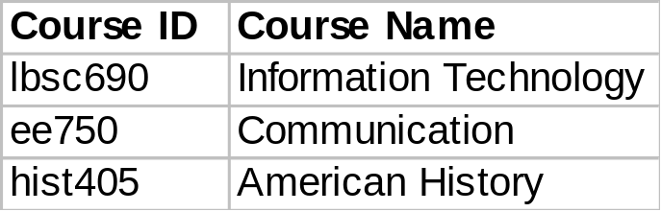
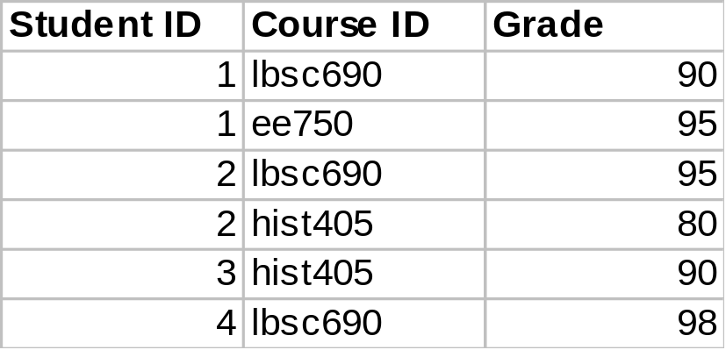
Another Try...
Student Table
Department Table
Course Table
Enrollment Table
Introduction
Databases
XML

Slide 15
Relational Operations
Joining tables
  Must specify join criteria
Selecting columns
  Based on their field name
Selecting rows
  Based on values of particular fields
  Can be arbitrarily complex Boolean expressions
Introduction
Databases
XML

Slide 16
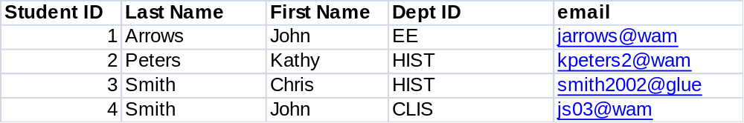
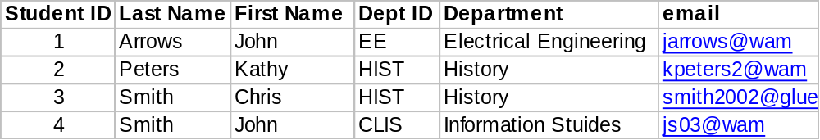
Joining Tables
Student Table
Department Table
…
FROM Student, Department
WHERE Student.Dept ID =
Department.Dept ID
“Joined” Table
Introduction
Databases
XML

Slide 17
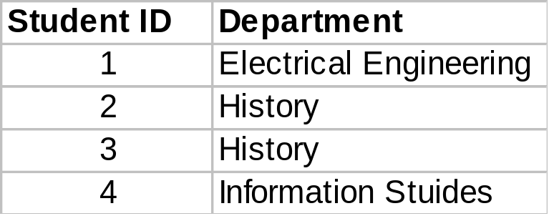
Selecting Columns
SELECT Student ID, Department
…
Introduction
Databases
XML

Slide 18
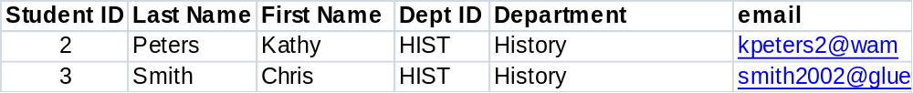
Selecting Rows
…
WHERE Department ID = “HIST”
Introduction
Databases
XML

Slide 19
SQL
SQL = language for querying relational databases
Basic components of a SQL statement
  SELECT field₁, field₂, …
  FROM table₁, table₂, …
  WHERE field₁=value₁, field₂=value₂, …
Selection of multiple tables implies a join
  Must specify join criteria
Introduction
Databases
XML

Slide 20
Database Design Process
Requirements Analysis
Conceptual Design
Conceptual Model
(e.g. ER)
Logical Design
Database Model
(e.g. RM)
Data Definition
Concrete implementation
(e.g., mySQL)
Physical Design
Introduction
Databases
XML
Implementation
How does this process relate to information architecture?

Slide 21
Registrar ER Diagram
Student
Student ID
First name
Last name
Department
E-mail
…
Enrollment
Student
Course
Grade
…
has
has
associated with
Course
Course ID
Course Name
…
Department
Department ID
Department Name
…
Introduction
Databases
XML

Slide 22
Conceptual Design
address
name
number
minit
location
fname
lname
works_for
Department
SSN
name
bdate
manages
Employee
salary
controls
sex
works_on
supervision
Project
dependent_of
name
number
location
Introduction
Databases
XML
relation
Dependent
name
bday
sex

Slide 23
Logical Design
Employee(ssn, fname, minit, lname, bdate, address,
sex, salary, superssn, dno)
Department(dname, dnumber, mgrssn )
Department_Locations(dnumber, dlocation)
Project(pname, pnumber, plocation, dnumber)
Works_on(essn, pnumber)
Introduction
Databases
XML
Dependent(essn, name, sex, bdate, relationship)

Slide 24
Semi-structured Data
Relational databases:
  Impose a relational model on data
  Must have schemas specified in advance
But what if:
  Schema is difficult to know in advance
  Schema evolves over time
  Users don’t follow the schema
  Data has missing, ambiguous, optional, or alternative elements
  Data types are unknown or unconstrained
We call this “semi-structured” data
  Structured data → relational model
  Semi-structured data → graph model
Introduction
Databases
XML

Slide 25
What’s a graph?
G = (V,E), where
  V represents the set of vertices (nodes)
  E represents the set of edges (links)
  Both vertices and edges may contain additional information
Different types of graphs:
  Directed vs. undirected edges
  Presence or absence of cycles
Graphs are everywhere:
  Hyperlink structure of the Web
  Interstate highway system
  Social networks
  XML data
Introduction
Databases
XML

Slide 26
Graphs vs. Tables
Family
Suffix
Person
Jr.
First
Last
First
Person
John
Middle
Middle
Last
First
Smith
John
Last
Bradley
Middle
Arthur
Smith
Smith
Linda
Hamilton
Person
First | Middle | Last
John | Arthur | Smith
Linda | Hamilton | Smith
Introduction
Databases
XML
??
First | Middle | Last | Suffix
John | Bradley | Smith | Jr.

Slide 27
Alternate Structures
Family
Suffix
Person
Jr.
First
Last
First
Person
John
Middle
Middle
Last
First
Smith
John
Last
Bradley
Middle
Arthur
Smith
Smith
Linda
Hamilton
Skype
Cell
Email
Introduction
Databases
XML
Smithmeister
Linda.Smith@gmail.com
(617) 213-8923

Slide 28
XML: Overview
XML = Extensible Markup Language
  Meta-language based on SGML
  What’s a meta-language?
DTD = Document Type Definition
  Specifies valid XML structure (optional)
Complementary technologies:
  XML Schema: more powerful than DTD
  XPath, XQuery: query languages
  XSLT: transformation language
  Lots more…
Introduction
Databases
XML

Slide 29
XML Building Blocks
Elements are denoted by tags:
Alternatively, elements can be empty:
Complex elements are built by nesting:
Criteria for XML documents
  Well-formed (obligatory): obeys basic XML rules
  Valid (optional) confirms to a specific DTD
<email>John.Smith@gmail.com</email>
<email/>
<person>
<first>John</first>
<middle>Arthur</middle>
<last>Smith</last>
</person>
Introduction
Databases
XML

Slide 30
XML, Graphs, and Trees
How does XML encode graphs?
What’s the difference between graphs and trees?
Person
<person>
<first>John</first>
<middle>Arthur</middle>
<last>Smith</last>
</person>
First
Middle
Last
John
Arthur
Smith
Introduction
Databases
XML

Slide 31
Attributes
XML tags can also have attributes
Element or attribute?
<email type="primary">John.Smith@gmail.com</email>
<email type="primary">John.Smith@gmail.com</email>
<email>
<type>primary</type>
<address>John.Smith@gmail.com</address>
</email>
<course id="INFM700">Information Architecture</course>
<course>
<id>INFM700</id>
<title>Information Architecture</title>
</course>
Introduction
Databases
XML

Slide 32
XPath
XPath is a language for selecting nodes in an XML document
Provides constructs for:
  Navigating the XML tree
  Selecting nodes based on various criteria
Think of it as a simple query language for XML
Introduction
Databases
XML

Slide 33
XPath Example (1)
XPath:
/wikimedia/projects/project/editions/*[2]
<?xml version="1.0" encoding="utf-8"?>
<wikimedia>
<projects>
<project name="Wikipedia" launch="2001-01-05">
<editions>
<edition language="English">en.wikipedia.org</edition>
<edition language="German">de.wikipedia.org</edition>
<edition language="French">fr.wikipedia.org</edition>
<edition language="Polish">pl.wikipedia.org</edition>
</editions>
</project>
<project name="Wiktionary" launch="2002-12-12">
<editions>
<edition language="English">en.wiktionary.org</edition>
<edition language="French">fr.wiktionary.org</edition>
<edition language="Vietnamese">vi.wiktionary.org</edition>
<edition language="Turkish">tr.wiktionary.org</edition>
</editions>
</project>
</projects>
</wikimedia>
Introduction
Databases
XML

Slide 34
XPath Example (2)
XPath:
/wikimedia/projects/project/@name
<?xml version="1.0" encoding="utf-8"?>
<wikimedia>
<projects>
<project name="Wikipedia" launch="2001-01-05">
<editions>
<edition language="English">en.wikipedia.org</edition>
<edition language="German">de.wikipedia.org</edition>
<edition language="French">fr.wikipedia.org</edition>
<edition language="Polish">pl.wikipedia.org</edition>
</editions>
</project>
<project name="Wiktionary" launch="2002-12-12">
<editions>
<edition language="English">en.wiktionary.org</edition>
<edition language="French">fr.wiktionary.org</edition>
<edition language="Vietnamese">vi.wiktionary.org</edition>
<edition language="Turkish">tr.wiktionary.org</edition>
</editions>
</project>
</projects>
</wikimedia>
Introduction
Databases
XML

Slide 35
XPath Example (3)
XPath:
/wikimedia/projects/project/editions/edition[@language="English"]/text()
<?xml version="1.0" encoding="utf-8"?>
<wikimedia>
<projects>
<project name="Wikipedia" launch="2001-01-05">
<editions>
<edition language="English">en.wikipedia.org</edition>
<edition language="German">de.wikipedia.org</edition>
<edition language="French">fr.wikipedia.org</edition>
<edition language="Polish">pl.wikipedia.org</edition>
</editions>
</project>
<project name="Wiktionary" launch="2002-12-12">
<editions>
<edition language="English">en.wiktionary.org</edition>
<edition language="French">fr.wiktionary.org</edition>
<edition language="Vietnamese">vi.wiktionary.org</edition>
<edition language="Turkish">tr.wiktionary.org</edition>
</editions>
</project>
</projects>
</wikimedia>
Introduction
Databases
XML

Slide 36
XPath Example (4)
XPath:
/wikimedia/projects/project[@name="Wikipedia"]/editions/edition/text()
<?xml version="1.0" encoding="utf-8"?>
<wikimedia>
<projects>
<project name="Wikipedia" launch="2001-01-05">
<editions>
<edition language="English">en.wikipedia.org</edition>
<edition language="German">de.wikipedia.org</edition>
<edition language="French">fr.wikipedia.org</edition>
<edition language="Polish">pl.wikipedia.org</edition>
</editions>
</project>
<project name="Wiktionary" launch="2002-12-12">
<editions>
<edition language="English">en.wiktionary.org</edition>
<edition language="French">fr.wiktionary.org</edition>
<edition language="Vietnamese">vi.wiktionary.org</edition>
<edition language="Turkish">tr.wiktionary.org</edition>
</editions>
</project>
</projects>
</wikimedia>
Introduction
Databases
XML

Slide 37
Important Points
XML is simply a convention for storing data
XML by itself doesn’t “do anything”
How does XML actually become useful?
  Case study: XHTML
  Case study: RSS
Introduction
Databases
XML

Slide 38
Manipulating XML
XPath: language for referencing XML elements
Beyond XPath: XQuery, XSLT, etc.
Common operations on XML documents
  Get an element’s parent
  Get an element’s children
  Iterate over a element’s children
  Filter by tag type
  Filter by attribute value
  … and “do something” with the result
Introduction
Databases
XML

Slide 39
XML Lifecycle
Programs
XML
XML
Processor
XML
XML
Presentation
Content
The beauty of it… everything’s XML!
Introduction
Databases
XML
How does this fit into application architectures?

Slide 40
Why is this so hard?
The three core technologies that drive dynamic Web sites have different underlying models
The “ROX triangle”
  Relational: databases
  Object-oriented: programming languages
  XML: presentation (i.e., HTML), content
“Impendence mismatch”
  Developers waste a lot of time bridging the three
Introduction
Databases
XML

Slide 41
Object-Oriented Design
Person
.getFirstName()
.getLastName()
.getGender()
Employee
Customer
.getEmployeeID()
…
.getCreditCard ()
Executive
Manager
Staff
Introduction
Databases
XML
.giveStockOption(double)
…
.giveBonus(float)
…
.giveBonus(int)
…

Slide 42
Objects vs. Relations
In OO design, encapsulation is a central tenant
In OO design, tight noun-verb coupling
In OO design, types and inheritance are central
In RM, normalization is a central tenant
In RM, everything is a tuple
Introduction
Databases
XML

Slide 43
Alternative Architectures
Web Server
Application Server
Object-Relational “Bridge”
XML-Relational “Bridge”
OO
Database
“Native” XML
Database
Introduction
Databases
XML
Relational Database

Slide 44
Today’s Topics
Separation of content from presentation
Relational databases
  Tables as the organizing principle
XML
  Graphs as the organizing principle
The ROX triangle
Introduction
Databases
XML

