Slide 1

INFM 700: Session 4
Metadata
Jimmy Lin
The iSchool
University of Maryland
Monday, February 18, 2008
This work is licensed under a Creative Commons Attribution-Noncommercial-Share Alike 3.0 United States
See http://creativecommons.org/licenses/by-nc-sa/3.0/us/ for details

Slide 2
Today’s Topics
What is metadata?
Taxonomies
Thesauri
Ontologies
Putting everything together
Metadata
Taxonomies
Thesauri
Ontologies
Integration

Slide 3
Metadata
Literally “data about data”
  “a set of data that describes and gives information about other data” ― Oxford English Dictionary
In practical terms:
  Metadata helps users interpret content
  Metadata helps in organization, navigation, etc.
Metadata
Taxonomies
Thesauri
Ontologies
Integration

Slide 4
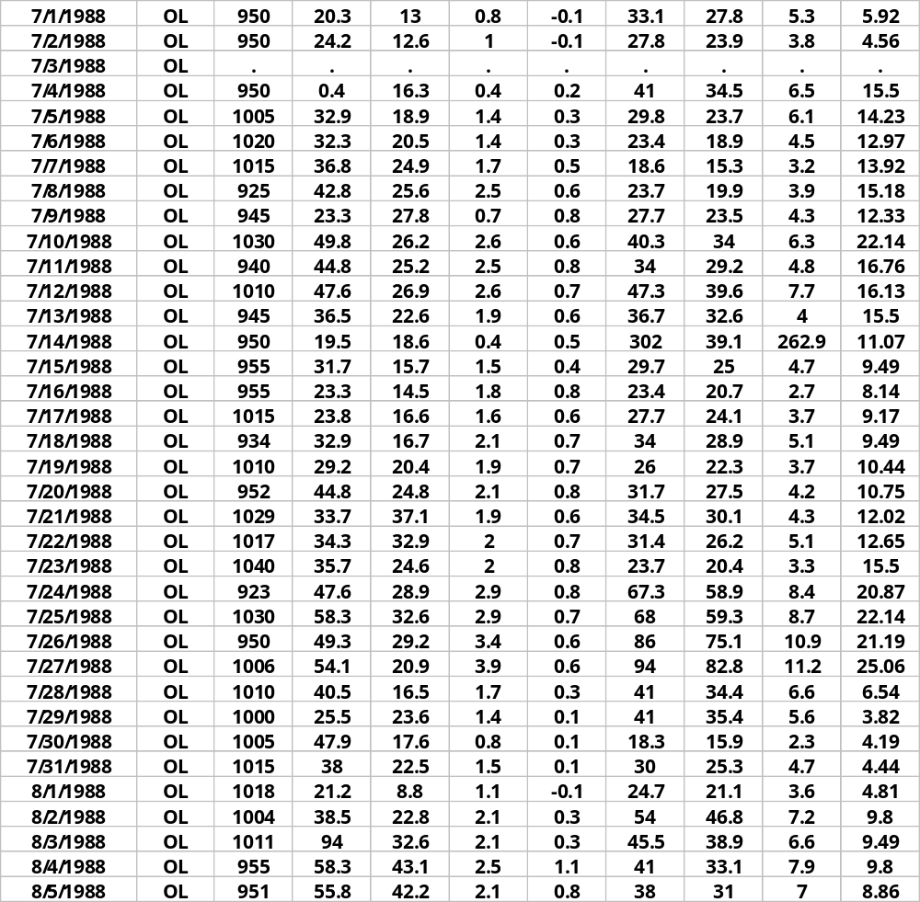
Data without Metadata…
Who:
authored it?
to contact about data?
What:
are contents of database?
When:
was it collected?
processed? finalized?
Where:
was the study done?
Why:
was the data collected?
How:
were data collected?
processed? Verified?
Metadata
Taxonomies
Thesauri
Ontologies
Integration
… can be pretty useless!

Slide 5
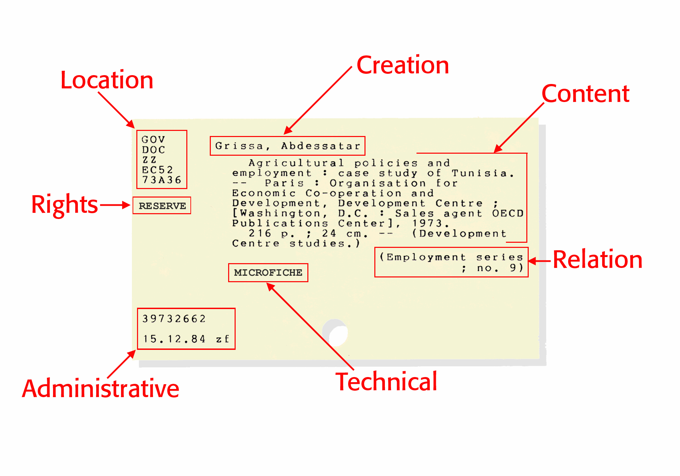
Early Example of Metadata
Metadata
Taxonomies
Thesauri
Ontologies
Integration

Slide 6
Types of Organizations
Taxonomies
  Anything organized in some sort of structure
Thesauri
  Addition of relations between terms
  Emergence of “concepts”
Ontologies
  Model of a domain
  Machine-readable
Metadata
Taxonomies
Thesauri
Ontologies
Integration
Increasing complexity and richness

Slide 7
Menagerie of Terms
Classification
Hierarchies
Directories
Controlled vocabularies
Knowledge representations
Metadata
Taxonomies
Thesauri
Ontologies
Integration
Let’s focus on significant differences.
Let’s focus on advantages/disadvantages.
Let’s focus on how each is useful.
Let’s not quibble over what to exactly call each.

Slide 8
Taxonomies
Organization of objects according to some principle
Familiar examples:
  Linnaean taxonomy (for living organisms)
  Web directories (e.g., Yahoo or ODP)
  Corporate directories
  Organization charts
  Organizational structures previously discussed
Metadata
Taxonomies
Thesauri
Ontologies
Integration

Slide 9

Thesauri: Motivation
“Semantic gap” between concepts and words
Words are used to evoke concepts
  Concrete objects: MacBook Pro, iPhone
  Abstract ideas: freedom, peace
Concepts
Ideas
Words
Meaning
Metadata
Taxonomies
Thesauri
Ontologies
Integration

Slide 10
To name that thing…
The semantic gap: What’s the problem?
  Synonymy
  Polysemy
Thesauri represent attempts to better organize mappings between words and concepts
Do these present precision or recall problems?
Metadata
Taxonomies
Thesauri
Ontologies
Integration

Slide 11
A slight detour…
What’s a concept?
Multiple perspectives
  Literature
  Philosophy
  Computer science (artificial intelligence)
  Cognitive science
Harder to define than you think!
  What’s a chair?
  What’s a bird?
  Who’s a mother?
Metadata
Taxonomies
Thesauri
Ontologies
Integration

Slide 12
Two Attempts
First try: necessary and sufficient conditions
Second try: prototypes
Metadata
Taxonomies
Thesauri
Ontologies
Integration

Slide 13
Radial Categories
A category with a central prototype…
  But has many cases deviating in different dimensions
Example: “Mother”
  Central case:
  Other cases:
A mother who is and always has been female, and who gave birth to the child, supplied her half of the child's genes, nurtured the child, is married to the father, is one generation older than the child, and is the child's legal guardian.
biological mother, birth mother, surrogate mother, genetic mother, stepmother, adoptive mother, foster mother, unwed mother, etc…
Metadata
Taxonomies
Thesauri
Ontologies
Integration
George Lakoff. (1987) Women, Fire and Dangerous Things: What Categories Reveal about the Mind. Chicago: University of Chicago Press.

Slide 14
Basic Level Categories
Two opposing principles in categorization
  Desire for rich structure, ability to discriminate differences
  Reduction of cognitive load
Basic level: the balance point
People learn basic level categories first
Superordinate
Basic Level
Subordinate
Furniture
Chair
Dining chair, lawn chair, armchair, etc.
Table
Dining table, folding table, kitchen table, etc.
Metadata
Taxonomies
Thesauri
Ontologies
Integration
Eleanor Rosch. (1977) Classification of Real-World Objects: Origins and Representation of Cognition. Johnson-Laird and Wason, eds., Thinking.

Slide 15
Relation to IA
Any organization system must be sensitive to users’ understanding of different concepts
Examples:
  What’s the difference between laptop, PDA, phone, and convergence device?
  What documents should the system retrieval when “mother” is the query?
  When a user browses a furniture catalog for chairs, do you show them ottomans and footstools?
Metadata
Taxonomies
Thesauri
Ontologies
Integration

Slide 16
Standard Thesaurus Structure
Broader
Terms
Computer
IS-A
Preferred
Notebook
Laptop
Synonyms (variants)
AKA
IS-A
Metadata
Taxonomies
Thesauri
Ontologies
Integration
Narrower
Terms
Desktop
Replacement
Ultraportable
Tablet PC

Slide 17
Other Thesaurus Concepts
Concepts vs. Instances
  ~ metadata vs. content
Various relations (formal names)
  Synonyms
  Hyponyms/Hypernyms
  Meronym/Holonym
  …
Metadata
Taxonomies
Thesauri
Ontologies
Integration

Slide 18
Uses of Thesauri
For organization
For navigation
For indexing content
For searching
Metadata
Taxonomies
Thesauri
Ontologies
Integration

Slide 19
Poly-Hierarchies
Concepts can have multiple parents
Example:
Cracow (Poland : Voivodship)
German death camps
Auschwitz II-Birkenau (Poland : Death Camp)
Metadata
Taxonomies
Thesauri
Ontologies
Integration
Block 25
(Auschwitz II-Birkenau)
Kanada
(Auschwitz II-Birkenau)
From Shoah Foundation’s thesaurus of holocaust terms

Slide 20
Poly-Hierarchies
What are the advantages and disadvantages?
What’s the relationship to polysemy?
Metadata
Taxonomies
Thesauri
Ontologies
Integration

Slide 21
Faceted Hierarchies
Alternative to single and poly-hierarchies
Basic idea:
  Describe objects along multiple facets
  Each facet has its associated hierarchy
Issues:
  What’s a facet?
  How do you navigate faceted hierarchies?
Metadata
Taxonomies
Thesauri
Ontologies
Integration

Slide 22
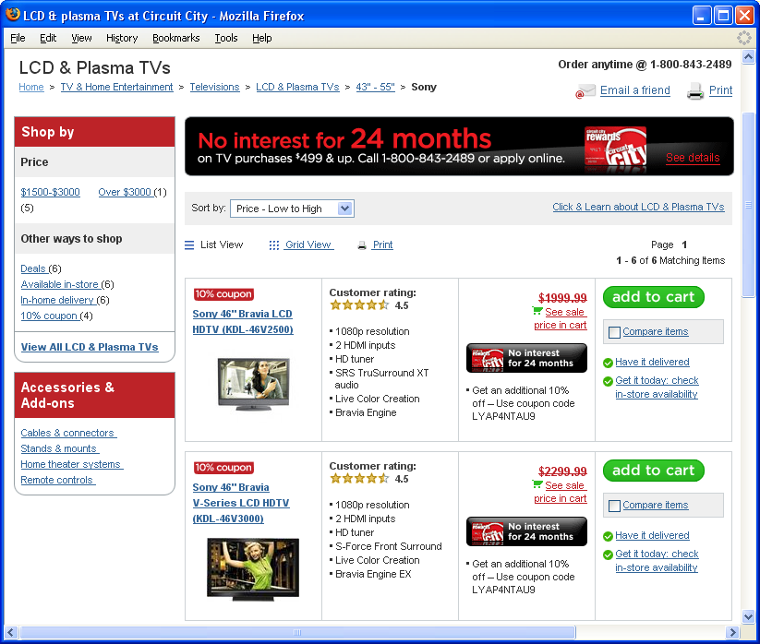
Faceted Browsing Example
Metadata
Taxonomies
Thesauri
Ontologies
Integration

Slide 23
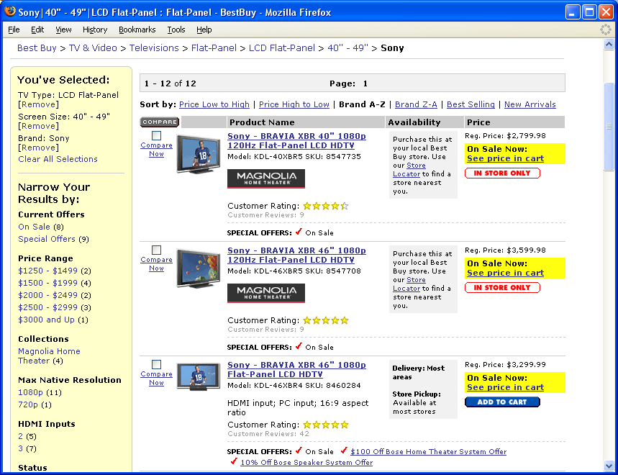
Faceted Browsing Example
Metadata
Taxonomies
Thesauri
Ontologies
Integration

Slide 24
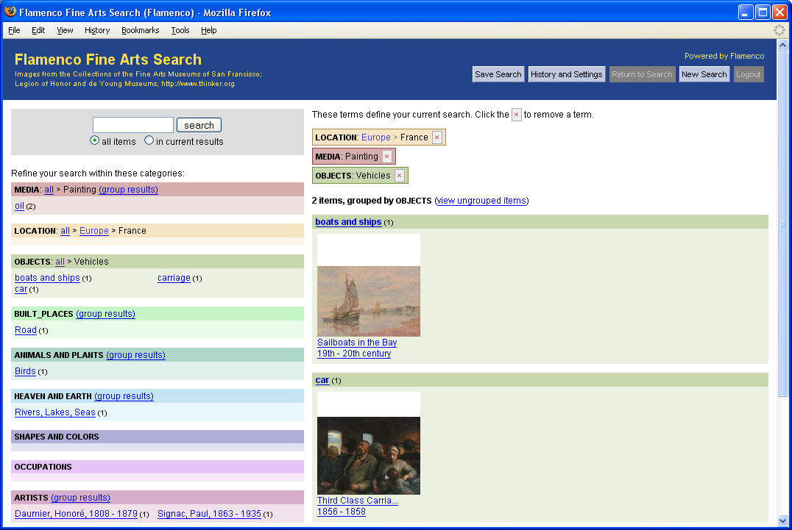
Faceted Browsing Example
Metadata
Taxonomies
Thesauri
Ontologies
Integration
Demo: http://flamenco.berkeley.edu/demos.html

Slide 25
Advantages of Facets
Integrates searching and browsing
Easy to build complex queries
Easy to narrow, broaden, shift focus
Helps users avoid getting lost
Helps to prevent “categorization wars”
Metadata
Taxonomies
Thesauri
Ontologies
Integration

Slide 26
Ontologies
First, a philosophical discipline:
  A branch of philosophy that deals with the nature and the organization of reality
  What characterizes being?
  What is being?
More recently, computer science perspective
  Arose out of desire to build smarter machines
  Related concepts: knowledge representation, knowledge engineering
Metadata
Taxonomies
Thesauri
Ontologies
Integration

Slide 27
What is an ontology?
An computational artifact:
  Symbols describing relevant concepts in a domain
  Explicit assumptions regarding the meaning and usage of the symbols
A formal specification of a particular domain:
  Represents shared understanding of that domain
  Must be capable of manipulation by a computer
Metadata
Taxonomies
Thesauri
Ontologies
Integration

Slide 28
What’s in an ontology?
Symbols representing concepts arranged according to relevant relations
Rules or constraints governing relations between concepts
Metadata
Taxonomies
Thesauri
Ontologies
Integration

Slide 29

Relationship to IA?
Database
Web
Server
Application
Server
Network
Ontologies are implicitly “hidden” here!!!
Trip
Airplane
Type:
Part-of
Capacity:
Flight
Equipment
Metadata
Taxonomies
Thesauri
Ontologies
Integration
From:
Departure Time:
Origin:
To:
Arrival Time:
Destination:
Rule: Arrival Time is always after Departure Time
Rule: Distance from Origin to Destination typical > 100 miles

Slide 30
Grand Vision
Ontology₁
General Purpose Reasoning Engine
Ontology₂
Really, really, really smart
machines!
Ontology₃
Metadata
Taxonomies
Thesauri
Ontologies
Integration
…

Slide 31
Putting it all together…
Apache
mySQL
Database
Web
Server
PHP
Network
Two-Layer Architecture
Database
Web
Server
Application
Server
Network
Metadata
Taxonomies
Thesauri
Ontologies
Integration
Three-Layer Architecture

Slide 32
Popular Implementation
Presentation
PHP/HTML
Metadata
Taxonomies
Thesauri
Ontologies
Integration
Content
Metadata
SQL Database

Slide 33
Encoding Hierarchies
A
Table: Hierarchy
Child | Parent
B | A
C | A
D | C
E | C
F | C
G | D
H | D
B
C
Store in RDBMS
D
E
F
G
H
Metadata
Taxonomies
Thesauri
Ontologies
Integration
Finding children of A:
Select child from Hierarchy where parent = ‘A’ → B, C
Finding parent of G:
Select parent from Hierarchy where child = ‘G’ → D
Finding siblings of D:
find parent, and then find its children

Slide 34
Encoding Metadata
A
Table: Items
ID | Attributes … | Label
0001 |  | B
0002 |  | B
0003 |  | C
0004 |  | D
0005 |  | D
0006 |  | E
… | …
B
C
D
E
F
G
H
Metadata
Taxonomies
Thesauri
Ontologies
Integration

Slide 35
Content ↔ Presentation
A
You are here: A > C > D
Related
- D
- E
B
C
Contents at D
D
E
F
G
H
Metadata
Taxonomies
Thesauri
Ontologies
Integration
Hierarchy(child, parent)
Content(id, attribute₁, attribute₂, attribute₃, …)

Slide 36
Faceted Browsing
Filter by
- Facet₁
(possible values)
- Facet₂
(possible values)
Matching
Results
Metadata
Taxonomies
Thesauri
Ontologies
Integration
Hierarchy(child, parent)
Content(id, attribute₁, attribute₂, attribute₃, …)

Slide 37
Today’s Topics
What is metadata?
Taxonomies
Thesauri
Ontologies
Putting everything together
Metadata
Taxonomies
Thesauri
Ontologies
Integration

