Slide 1

INFM 700: Session 6
Unstructured Information (Part I)
Jimmy Lin
The iSchool
University of Maryland
Monday, March 3, 2008
This work is licensed under a Creative Commons Attribution-Noncommercial-Share Alike 3.0 United States
See http://creativecommons.org/licenses/by-nc-sa/3.0/us/ for details

Slide 2
Today’s Topics
Introduction to Information Retrieval
Boolean retrieval
Ranked retrieval
Tokenization issues
IR Intro
Boolean
Vector Space
Tokenization

Slide 3
Levels of Structure
Different types of data
  Structured data
  Semi-structured data
  Unstructured data
How do you provide access to unstructured data?
  Manually develop an organization system
  Provide search capabilities
IR Intro
Boolean
Vector Space
Tokenization

Slide 4
What is search?
Search is query-based access
  How is this different from browsing?
Things one can search on:
  Content
  Metadata
  Organization systems
  Labels
  …
IR Intro
Boolean
Vector Space
Tokenization

Slide 5
The Information Retrieval Cycle
Source
Selection
Resource
Query
Formulation
Query
Today
Search
Results
Selection
Documents
System discovery
Vocabulary discovery
Concept discovery
Document discovery
Examination
IR Intro
Boolean
Vector Space
Tokenization
Information
source reselection
Delivery

Slide 6


The Central Problem in IR
Authors
Searcher
Concepts
Concepts
IR Intro
Boolean
Vector Space
Tokenization
Query
Documents
Do these represent the same concepts?
Notes:
Why is IR hard? Because language is hard!

Slide 7
Architecture of IR Systems
Documents
Query
online
offline
Representation
Function
Representation
Function
Query Representation
Document Representation
Index
Comparison
Function
IR Intro
Boolean
Vector Space
Tokenization
Hits

Slide 8
How do we represent text?
Remember: computers don’t “understand” documents or queries
Simple, yet effective approach: “bag of words”
  Treat all the words in a document as index terms
  Assign a “weight” to each term based on “importance”
  Disregard order, structure, meaning, etc. of the words
Assumptions
  Term occurrence is independent
  Document relevance is independent
  “Words” are well-defined
IR Intro
Boolean
Vector Space
Tokenization

Slide 9
What’s a word?
天主教教宗若望保祿二世因感冒再度住進醫院。這是他今年第二度因同樣的病因住院。
وقال مارك ريجيف - الناطق باسم
الخارجية الإسرائيلية - إن شارون قبل
الدعوة وسيقوم للمرة الأولى بزيارة
تونس، التي كانت لفترة طويلة المقر
الرسمي لمنظمة التحرير الفلسطينية بعد خروجها من لبنان عام 1982.
Выступая в Мещанском суде Москвы экс-глава ЮКОСа заявил не совершал ничего противозаконного, в чем обвиняет его генпрокуратура России.
भारत सरकार ने आर्थिक सर्वेक्षण में वित्तीय वर्ष 2005-06 में सात फ़ीसदी विकास दर हासिल करने का आकलन किया है और कर सुधार पर ज़ोर दिया है
IR Intro
Boolean
Vector Space
Tokenization
日米連合で台頭中国に対処…アーミテージ前副長官提言
조재영 기자= 서울시는 25일 이명박 시장이 `행정중심복합도시'' 건설안에 대해 `군대라도 동원해 막고싶은 심정''이라고 말했다는 일부 언론의 보도를 부인했다.

Slide 10
Sample Document
McDonald's slims down spuds
Fast-food chain to reduce certain types of fat in its french fries with new cooking oil.
NEW YORK (CNN/Money) - McDonald's Corp. is cutting the amount of "bad" fat in its french fries nearly in half, the fast-food chain said Tuesday as it moves to make all its fried menu items healthier.
But does that mean the popular shoestring fries won't taste the same? The company says no. "It's a win-win for our customers because they are getting the same great french-fry taste along with an even healthier nutrition profile," said Mike Roberts, president of McDonald's USA.
But others are not so sure. McDonald's will not specifically discuss the kind of oil it plans to use, but at least one nutrition expert says playing with the formula could mean a different taste.
Shares of Oak Brook, Ill.-based McDonald's (MCD: down $0.54 to $23.22, Research, Estimates) were lower Tuesday afternoon. It was unclear Tuesday whether competitors Burger King and Wendy's International (WEN: down $0.80 to $34.91, Research, Estimates) would follow suit. Neither company could immediately be reached for comment.
…
“Bag of Words”
14 × McDonald’s
12 × fat
11 × fries
8 × new
6 × company, french, nutrition
5 × food, oil, percent, reduce, taste, Tuesday
…
IR Intro
Boolean
Vector Space
Tokenization

Slide 11
What’s the point?
Retrieving relevant information is hard!
  Evolving, ambiguous user needs, context, etc.
  Complexities of language
To operationalize information retrieval, we must vastly simplify the picture
Bag-of-words approach:
  Information retrieval is all (and only) about matching words in documents with words in queries
  Obviously, not true…
  But it works pretty well!
IR Intro
Boolean
Vector Space
Tokenization

Slide 12
Why does “bag of words” work?
Words alone tell us a lot about content
It is relatively easy to come up with words that describe an information need
Random: beating takes points falling another Dow 355
Alphabetical: 355 another beating Dow falling points
“Interesting”: Dow points beating falling 355 another
Actual: Dow takes another beating, falling 355 points
IR Intro
Boolean
Vector Space
Tokenization

Slide 13
Boolean Retrieval
Users express queries as a Boolean expression
  AND, OR, NOT
  Can be arbitrarily nested
Retrieval is based on the notion of sets
  Any given query divides the collection into two sets: retrieved, not-retrieved (complement)
  Pure Boolean systems do not define an ordering of the results
IR Intro
Boolean
Vector Space
Tokenization

Slide 14
AND/OR/NOT
All documents
A
B
C
IR Intro
Boolean
Vector Space
Tokenization

Slide 15
Logic Tables
B
0
1
A
B
0
1
0
0
1
1
0
1
1
1
NOT B
A OR B
B
0
1
B
0
1
A
A
0
0
0
0
0
0
IR Intro
Boolean
Vector Space
Tokenization
1
0
1
1
1
0
A AND B
A NOT B
(= A AND NOT B)
Notes:
11
Start 1:45

Slide 16
Representing Documents
Document 1
Term
Document 1
Document 2
The quick brown
fox jumped over
the lazy dog’s
back.
aid
0
1
all
0
1
Stopword
List
back
1
0
brown
1
0
come
0
1
for
dog
1
0
is
fox
1
0
of
Document 2
good
0
1
the
jump
1
0
to
lazy
1
0
Now is the time
for all good men
to come to the
aid of their party.
men
0
1
now
0
1
IR Intro
Boolean
Vector Space
Tokenization
over
1
0
party
0
1
quick
1
0
their
0
1
time
0
1
Notes:
9

Slide 17
Boolean View of a Collection
Term
Doc 2
Doc 3
Doc 1
Doc 4
Doc 5
Doc 6
Doc 7
Doc 8
aid
0
0
0
1
0
0
0
1
Each column represents the view of a particular document: What terms are contained in this document?
all
0
1
0
1
0
1
0
0
back
1
0
1
0
0
0
1
0
brown
1
0
1
0
1
0
1
0
come
0
1
0
1
0
1
0
1
dog
0
0
1
0
1
0
0
0
Each row represents the view of a particular term: What documents contain this term?
fox
0
0
1
0
1
0
1
0
good
0
1
0
1
0
1
0
1
jump
0
0
1
0
0
0
0
0
lazy
1
0
1
0
1
0
1
0
To execute a query, pick out rows corresponding to query terms and then apply logic table of corresponding Boolean operator
men
0
1
0
1
0
0
0
1
now
0
1
0
0
0
1
0
1
IR Intro
Boolean
Vector Space
Tokenization
over
1
0
1
0
1
0
1
1
party
0
0
0
0
0
1
0
1
quick
1
0
1
0
0
0
0
0
their
1
0
0
0
1
0
1
0
time
0
1
0
1
0
1
0
0
Notes:
12

Slide 18
Sample Queries
Term
Doc 2
Doc 3
Doc 1
Doc 4
Doc 5
Doc 6
Doc 7
Doc 8
dog
0
0
1
0
1
0
0
0
fox
0
0
1
0
1
0
1
0
dog ∧ fox
0
0
1
0
1
0
0
0
dog AND fox → Doc 3, Doc 5
dog ∨ fox
0
0
1
0
1
0
1
0
dog OR fox → Doc 3, Doc 5, Doc 7
dog ¬ fox
0
0
0
0
0
0
0
0
dog NOT fox → empty
fox ¬ dog
0
0
0
0
0
0
1
0
fox NOT dog → Doc 7
Term
Doc 2
Doc 3
Doc 1
Doc 4
Doc 5
Doc 6
Doc 7
Doc 8
good
0
1
0
1
0
1
0
1
IR Intro
Boolean
Vector Space
Tokenization
party
0
0
0
0
0
1
0
1
g ∧ p
0
0
0
0
0
1
0
1
good AND party → Doc 6, Doc 8
over
1
0
1
0
1
0
1
1
g ∧ p ¬ o
0
0
0
0
0
1
0
0
good AND party NOT over → Doc 6

Slide 19
Inverted Index
Term
Doc 2
Term
Postings
Doc 3
Doc 1
Doc 4
Doc 5
Doc 6
Doc 7
Doc 8
aid
0
0
0
1
0
0
0
1
aid
4
8
all
0
1
0
1
0
1
0
0
all
2
4
6
back
1
0
1
0
0
0
1
0
back
1
3
7
brown
1
0
1
0
1
0
1
0
brown
1
3
5
7
come
0
1
0
1
0
1
0
1
come
2
4
6
8
dog
0
0
1
0
1
0
0
0
dog
3
5
fox
0
0
1
0
1
0
1
0
fox
3
5
7
good
0
1
0
1
0
1
0
1
good
2
4
6
8
jump
0
0
1
0
0
0
0
0
jump
3
lazy
1
0
1
0
1
0
1
0
lazy
1
3
5
7
men
0
1
0
1
0
0
0
1
men
2
4
8
now
0
1
0
0
0
1
0
1
now
2
6
8
IR Intro
Boolean
Vector Space
Tokenization
over
1
0
1
0
1
0
1
1
over
1
3
5
7
8
party
0
0
0
0
0
1
0
1
party
6
8
quick
1
0
1
0
0
0
0
0
quick
1
3
their
1
0
0
0
1
0
1
0
their
1
5
7
time
0
1
0
1
0
1
0
0
time
2
4
6
Notes:
12

Slide 20
Boolean Retrieval
To execute a Boolean query:
  Build query syntax tree
  For each clause, look up postings
  Traverse postings and apply Boolean operator
Efficiency analysis
  Postings traversal is linear (assuming sorted postings)
  Start with shortest posting first
AND
( fox or dog ) and quick
quick
OR
fox
dog
dog
3
5
fox
3
5
7
dog
3
5
OR = union
fox
3
5
7
3
5
7
IR Intro
Boolean
Vector Space
Tokenization

Slide 21
Proximity Operators
Simple implementation
  Store word offset in postings
  Treat proximity queries like “AND”, with additional constraints
Disadvantages:
  What happens to the index size?
  How can users select the proper threshold?
IR Intro
Boolean
Vector Space
Tokenization

Slide 22
Why Boolean Retrieval Works
Boolean operators approximate natural language
How so?
  AND can discover relationships between concepts
    (e.g., good party)
  OR can discover alternate terminology
    (e.g., excellent party, wild party, etc.)
  NOT can discover alternate meanings
    (e.g., Democratic party)
IR Intro
Boolean
Vector Space
Tokenization
Notes:
13

Slide 23
The Perfect Query Paradox
Every information need has a perfect set of documents
  If not, there would be no sense doing retrieval
Every document set has a perfect query
  AND every word in a document to get a query for it
  Repeat for each document in the set
  OR every document query to get the set query
But can users realistically be expected to formulate this perfect query?
  Boolean query formulation is hard!
IR Intro
Boolean
Vector Space
Tokenization
Notes:
14

Slide 24
Why Boolean Retrieval Fails
Natural language is way more complex
How so?
  AND “discovers” nonexistent relationships
    Terms in different sentences, paragraphs, …
  Guessing terminology for OR is hard
    good, nice, excellent, outstanding, awesome, …
  Guessing terms to exclude is even harder!
    Democratic party, party to a lawsuit, …
IR Intro
Boolean
Vector Space
Tokenization
Notes:
15

Slide 25
Strengths and Weaknesses
Strengths
  Precise, if you know the right strategies
  Precise, if you know what you’re looking for
  It’s fast
Weaknesses
  Users must learn Boolean logic
  Boolean logic insufficient to capture the richness of language
  No control over size of result set: either too many documents or none
  When do you stop reading? All documents in the result set are considered “equally good”
  What about partial matches? Documents that “don’t quite match” the query may be useful also
IR Intro
Boolean
Vector Space
Tokenization

Slide 26
Ranked Retrieval
Order documents by how likely they are to be relevant to the information need
  Estimate relevance(q, d_{i})
  Sort documents by relevance
  Display sorted results
User model
  Present results one screen at a time, best results first
  At any point, users can decide to stop looking
How do we estimate relevance?
  Assume that document d is relevant to query q if they share words in common
  Replace relevance(q, d_{i}) with sim(q, d_{i})
  Compute similarity of vector representations
IR Intro
Boolean
Vector Space
Tokenization

Slide 27
Vector Representation
“Bags of words” can be represented as vectors
  Why? Computational efficiency, ease of manipulation
  Geometric metaphor: “arrows”
A vector is a set of values recorded in any consistent order
“The quick brown fox jumped over the lazy dog’s back”
→ [ 1 1 1 1 1 1 1 1 2 ]
1st position corresponds to “back”
2nd position corresponds to “brown”
3rd position corresponds to “dog”
4th position corresponds to “fox”
5th position corresponds to “jump”
6th position corresponds to “lazy”
7th position corresponds to “over”
8th position corresponds to “quick”
9th position corresponds to “the”
IR Intro
Boolean
Vector Space
Tokenization
Notes:
8

Slide 28
Vector Space Model
t₃
d₂
d₃
d₁
θ
φ
t₁
d₅
t₂
d₄
IR Intro
Boolean
Vector Space
Tokenization
Assumption: Documents that are “close together” in vector space “talk about” the same things
Therefore, retrieve documents based on how close the document is to the query (i.e., similarity ~ “closeness”)

Slide 29
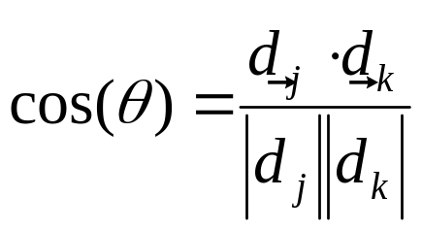
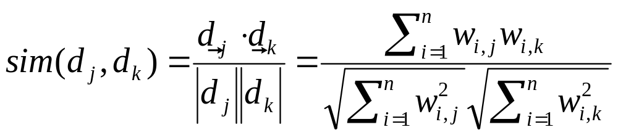
Similarity Metric
How about |d₁ – d₂|?
Instead of Euclidean distance, use “angle” between the vectors
  It all boils down to the inner product (dot product) of vectors
IR Intro
Boolean
Vector Space
Tokenization

Slide 30
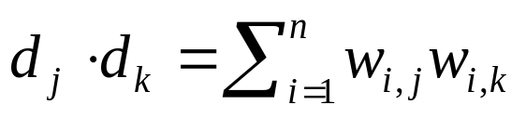
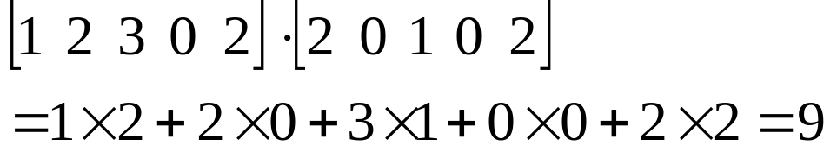
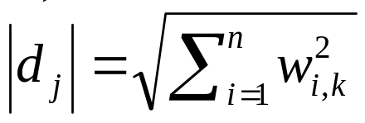
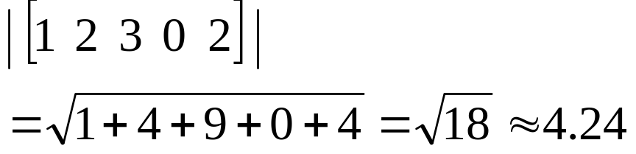
Components of Similarity
The “inner product” (aka dot product) is the key to the similarity function
The denominator handles document length normalization
Example:
IR Intro
Boolean
Vector Space
Tokenization
Example:

Slide 31
Term Weighting
Term weights consist of two components
  Local: how important is the term in this doc?
  Global: how important is the term in the collection?
Here’s the intuition:
  Terms that appear often in a document should get high weights
  Terms that appear in many documents should get low weights
How do we capture this mathematically?
  Term frequency (local)
  Inverse document frequency (global)
IR Intro
Boolean
Vector Space
Tokenization

Slide 32
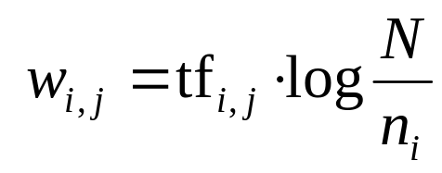
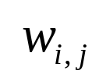
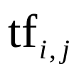


TF.IDF Term Weighting
weight assigned to term i in document j
number of occurrence of term i in document j
number of documents in entire collection
number of documents with term i
IR Intro
Boolean
Vector Space
Tokenization

Slide 33
TF.IDF Example
tf
1
2
3
4
idf
complicated
5
2
0.301
complicated
0.301
3,5
4,2
contaminated
4
1
3
0.125
contaminated
0.125
1,4
2,1
3,3
fallout
5
4
3
0.125
fallout
0.125
1,5
3,4
4,3
information
6
3
3
2
0.000
information
0.000
1,6
2,3
3,3
4,2
interesting
1
0.602
interesting
0.602
2,1
nuclear
3
7
0.301
nuclear
0.301
1,3
3,7
IR Intro
Boolean
Vector Space
Tokenization
retrieval
6
1
4
0.125
retrieval
0.125
2,6
3,1
4,4
siberia
2
0.602
siberia
0.602
1,2

Slide 34
Document Scoring Algorithm
Initialize accumulators to hold document scores
For each query term t in the user’s query
  Fetch t’s postings
  For each document, score_{doc} += w_{t,d} × w_{t,q}
Apply length normalization to the scores at end
Return top N documents
IR Intro
Boolean
Vector Space
Tokenization

Slide 35
Indexing: Performance Analysis
Inverted indexing is fundamental to all IR models
Fundamentally, a large sorting problem
  Terms usually fit in memory
  Postings usually don’t
Lots of clever optimizations…
How large is the inverted index?
  Size of vocabulary
  Size of postings
IR Intro
Boolean
Vector Space
Tokenization

Slide 36
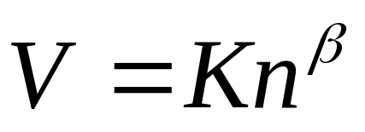
Vocabulary Size: Heaps’ Law
In other words:
  When adding new documents, the system is likely to have seen most terms already
  But the postings keep growing
V is vocabulary size
n is corpus size (number of documents)
K and β are constants
Typically, K is between 10 and 100, β is between 0.4 and 0.6
IR Intro
Boolean
Vector Space
Tokenization
Notes:
22

Slide 37
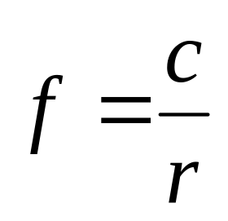
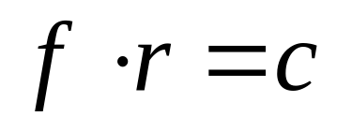
Postings Size: Zipf’s Law
George Kingsley Zipf (1902-1950) observed the following relation between the rth most frequent event and its frequency:
In other words:
  A few elements occur very frequently
  Many elements occur very infrequently
Zipfian Distributions
  English words
  Library book checkout patterns
  Website popularity (almost anything on the Web)
f = frequency
r = rank
c = constant
or
IR Intro
Boolean
Vector Space
Tokenization

Slide 38
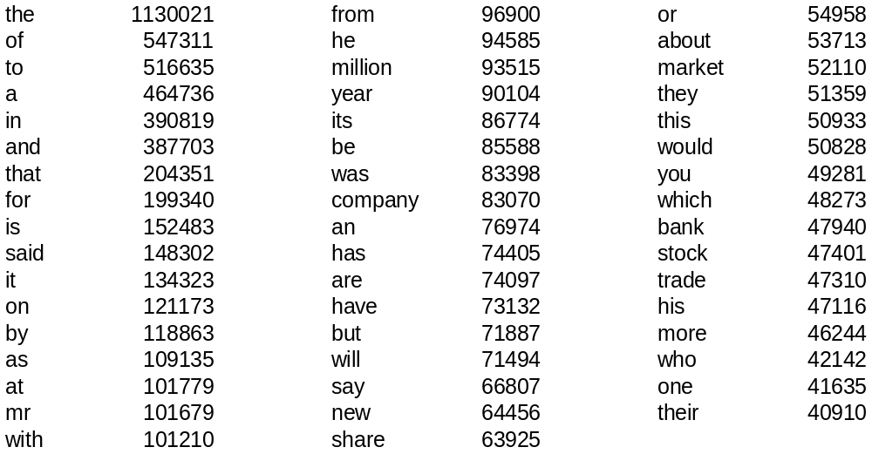
Word Frequency in English
Frequency of 50 most common words in English
(sample of 19 million words)
IR Intro
Boolean
Vector Space
Tokenization

Slide 39
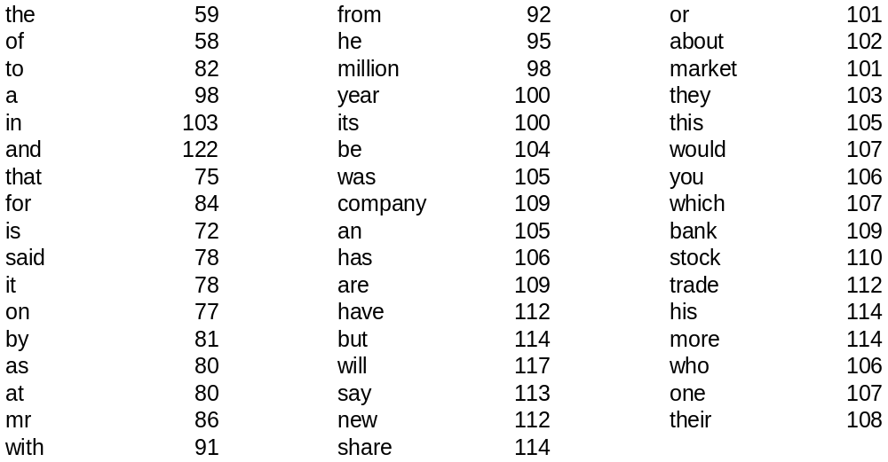
Does it fit Zipf’s Law?
The following shows rf×1000/n
r is the rank of word w in the sample
f is the frequency of word w in the sample
n is the total number of word occurrences in the sample
IR Intro
Boolean
Vector Space
Tokenization

Slide 40
Summary thus far…
Represent documents as “bags of words”
Reduce retrieval to a problem of matching words
Back to this question: what’s a word?
  First try: words are separated by spaces
  What about clitics?
The cat on the mat.
the, cat, on, the, mat
I’m not saying that I don’t want John’s input on this.
IR Intro
Boolean
Vector Space
Tokenization

Slide 41
What’s a word?
天主教教宗若望保祿二世因感冒再度住進醫院。這是他今年第二度因同樣的病因住院。
وقال مارك ريجيف - الناطق باسم
الخارجية الإسرائيلية - إن شارون قبل
الدعوة وسيقوم للمرة الأولى بزيارة
تونس، التي كانت لفترة طويلة المقر
الرسمي لمنظمة التحرير الفلسطينية بعد خروجها من لبنان عام 1982.
Выступая в Мещанском суде Москвы экс-глава ЮКОСа заявил не совершал ничего противозаконного, в чем обвиняет его генпрокуратура России.
भारत सरकार ने आर्थिक सर्वेक्षण में वित्तीय वर्ष 2005-06 में सात फ़ीसदी विकास दर हासिल करने का आकलन किया है और कर सुधार पर ज़ोर दिया है
IR Intro
Boolean
Vector Space
Tokenization
日米連合で台頭中国に対処…アーミテージ前副長官提言
조재영 기자= 서울시는 25일 이명박 시장이 `행정중심복합도시'' 건설안에 대해 `군대라도 동원해 막고싶은 심정''이라고 말했다는 일부 언론의 보도를 부인했다.

Slide 42
Tokenization Problem
In many languages, words are not separated by spaces…
Tokenization = separating a string into “words”
Simple greedy approach:
  Start with a list of every possible term (e.g., from a dictionary)
  Look for the longest word in the unsegmented string
  Take longest matching term as the next word and repeat
IR Intro
Boolean
Vector Space
Tokenization
Notes:
15

Slide 43
Indexing N-Grams
Consider a Chinese document: c₁ c₂ c₃ … c_{n}
Don’t segment (you could be wrong!)
Instead, treat every character bigram as a term
Break up queries the same way
Instead of bigrams, try also trigrams…
Works at least as well as trying to segment correctly!
c₁ c₂ c₃ c₄ c₅ … c_{n}
c₁ c₂ c₂ c₃ c₃ c₄ c₄ c₅ … c_{n-1} c_{n}
IR Intro
Boolean
Vector Space
Tokenization

Slide 44
Morphological Variation
Handling morphology: related concepts have different forms
  Inflectional morphology: same part of speech
  Derivational morphology: different parts of speech
Different morphological processes:
  Prefixing
  Suffixing
  Infixing
  Reduplication
dogs = dog + PLURAL
broke = break + PAST
destruction = destroy + ion
researcher = research + er
IR Intro
Boolean
Vector Space
Tokenization

Slide 45
Stemming
Dealing with morphological variation: index stems instead of words
  Stem: a word equivalence class that preserves the central concept
How much to stem?
  organization → organize → organ?
  resubmission → resubmit/submission → submit?
  reconstructionism?
IR Intro
Boolean
Vector Space
Tokenization

Slide 46
Stemmers
Porter stemmer is a commonly used stemmer
  Strips off common affixes
  Not perfect!
Many other stemming algorithms available
Errors of comission:
doe/doing
execute/executive
ignore/ignorant
Incorrectly lumps unrelated terms together
Errors of omission:
create/creation
europe/european
cylinder/cylindrical
Fails to lump related terms together
IR Intro
Boolean
Vector Space
Tokenization

Slide 47
Does Stemming Work?
Generally, yes! (in English)
  Helps more for longer queries
  Lots of work done in this area
Donna Harman (1991) How Effective is Suffixing? Journal of the American Society for Information Science, 42(1):7-15.
Robert Krovetz. (1993) Viewing Morphology as an Inference Process. Proceedings of SIGIR 1993.
David A. Hull. (1996) Stemming Algorithms: A Case Study for Detailed Evaluation. Journal of the American Society for Information Science, 47(1):70-84.
And others…
IR Intro
Boolean
Vector Space
Tokenization

Slide 48
Stemming in Other Languages
Arabic makes frequent use of infixes
What’s the most effective stemming strategy in Arabic? Open question…
maktab (office),
kitaab (book),
kutub (books),
kataba (he wrote),
naktubu (we write),
etc.
the root ktb
IR Intro
Boolean
Vector Space
Tokenization

Slide 49
Beyond Words…
Tokenization = specific instance of a general problem: what is it?
Other units of indexing
  Concepts (e.g., from WordNet)
  Named entities
  Relations
  …
IR Intro
Boolean
Vector Space
Tokenization

Slide 50
Today’s Topics
Introduction to Information Retrieval
Boolean retrieval
Ranked retrieval
Tokenization issues
IR Intro
Boolean
Vector Space
Tokenization

