Slide 1

INFM 700: Session 7
Unstructured Information (Part II)
Jimmy Lin
The iSchool
University of Maryland
Monday, March 10, 2008
This work is licensed under a Creative Commons Attribution-Noncommercial-Share Alike 3.0 United States
See http://creativecommons.org/licenses/by-nc-sa/3.0/us/ for details

Slide 2
The IR Black Box
Query
Search
Ranked List

Slide 3
The Role of Interfaces
Help users decide where to start
Source
Selection
Resource
Help users formulate queries
Query
Formulation
Query
Help users make sense of results and navigate the information space
Search
Ranked List
Selection
Documents
System discovery
Vocabulary discovery
Concept discovery
Document discovery
Examination
Documents
source reselection
Delivery

Slide 4
Today’s Topics
Source selection
  What should I search?
Query formulation
  What should my query be?
Result presentation
  What are the search results?
Browsing support
  How do I make sense of all these results?
Navigation support
  Where am I?
Source
Selection
Query
Formulation
Result
Presentation
Browsing
Support
Navigation
Support

Slide 5
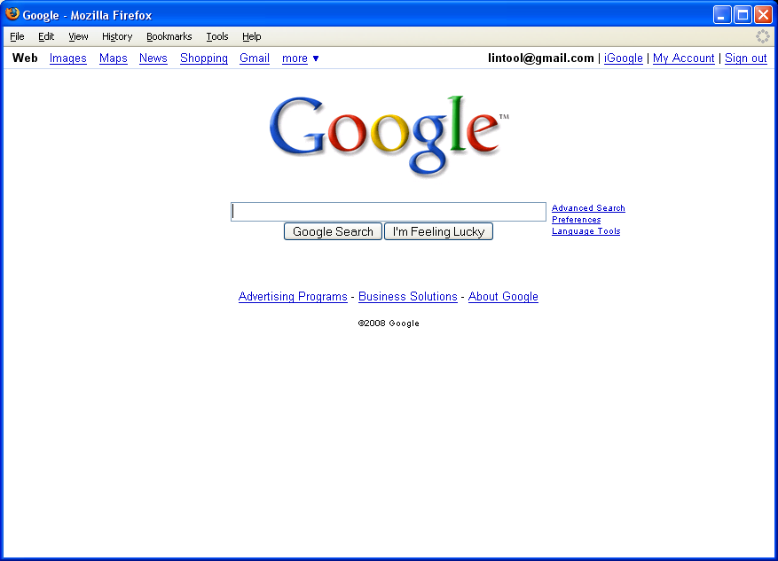
Source Selection: Google
Source
Selection
Query
Formulation
Result
Presentation
Browsing
Support
Navigation
Support

Slide 6
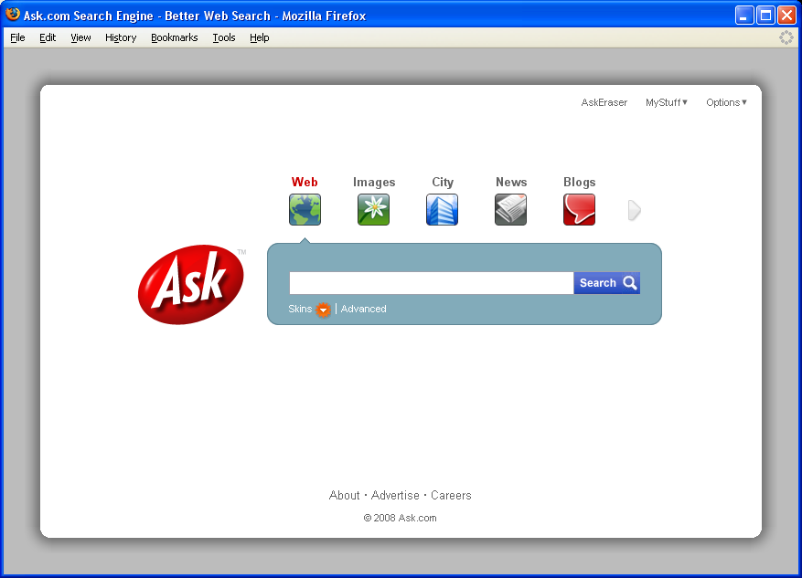
Source Selection: Ask
Source
Selection
Query
Formulation
Result
Presentation
Browsing
Support
Navigation
Support

Slide 7
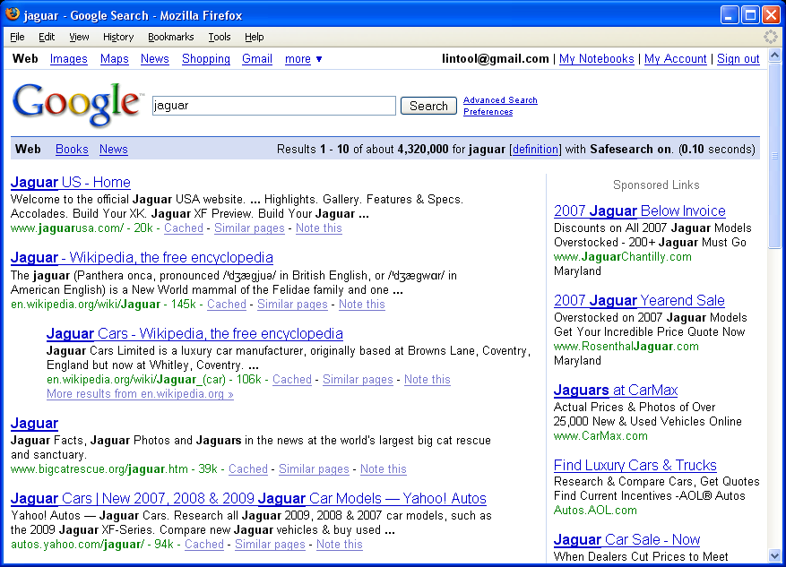
Source Reselection
Source
Selection
Query
Formulation
Result
Presentation
Browsing
Support
Navigation
Support

Slide 8
The Search Box
Source
Selection
Query
Formulation
Result
Presentation
Browsing
Support
Navigation
Support

Slide 9
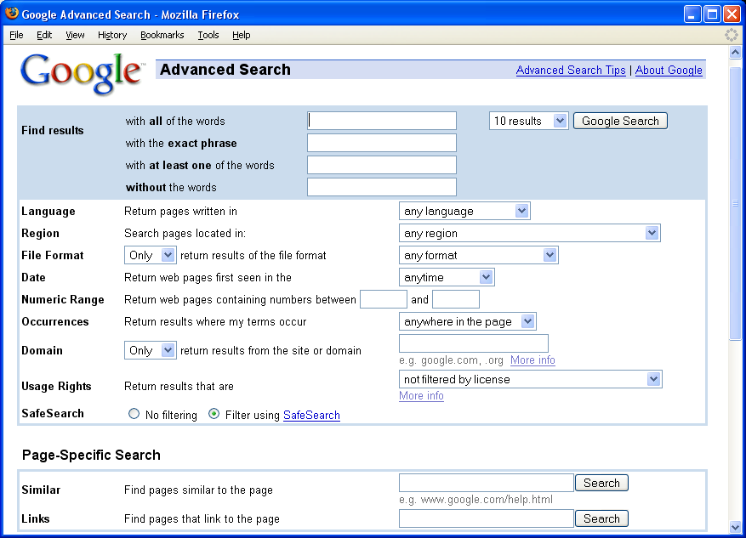
Advanced Search: Facets
Source
Selection
Query
Formulation
Result
Presentation
Browsing
Support
Navigation
Support

Slide 10
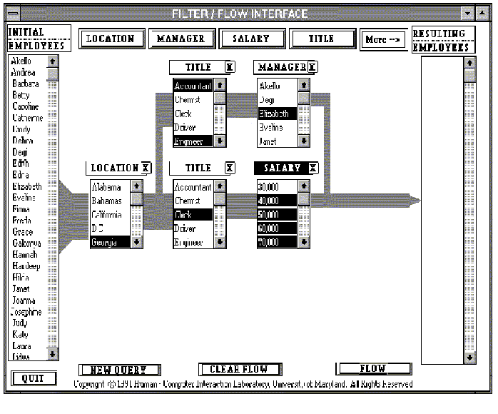
Filter/Flow Query Formulation
Source
Selection
Query
Formulation
Result
Presentation
Browsing
Support
Navigation
Support
Degi Young and Ben Shneiderman. (1993) A Graphical Filter/Flow Representation of Boolean Queries: A Prototype Implementation and Evaluation. JASIS, 44(6):327-339.

Slide 11
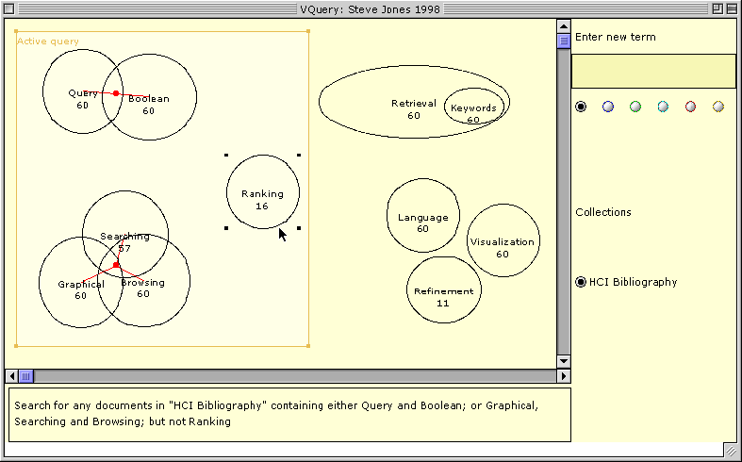
Direct Manipulation Queries
Source
Selection
Query
Formulation
Result
Presentation
Browsing
Support
Navigation
Support
Steve Jones. (1998) Graphical Query Specification and Dynamic Result Previews for a Digital Library. Proceedings of UIST 1998.

Slide 12
Result Presentation
How should the system present search results to the user?
The interface should:
  Provide hints about the roles terms play within the result set and within the collection
  Provide hints about the relationship between terms
  Show explicitly why documents are retrieved in response to the query
  Compactly summarize the result set
Source
Selection
Query
Formulation
Result
Presentation
Browsing
Support
Navigation
Support

Slide 13
Alternative Designs
One-dimensional lists
  Content: title, source, date, summary, ratings, ...
  Order: retrieval score, date, alphabetic, ...
  Size: scrolling, specified number, score threshold
More sophisticated multi-dimensional displays
Source
Selection
Query
Formulation
Result
Presentation
Browsing
Support
Navigation
Support

Slide 14
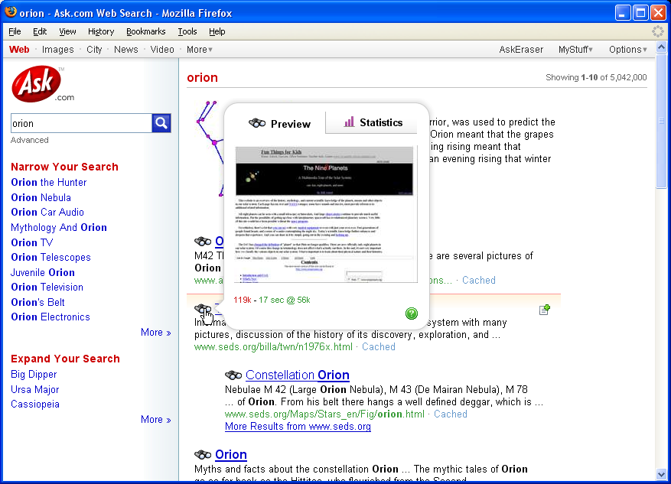
Binoculars
Source
Selection
Query
Formulation
Result
Presentation
Browsing
Support
Navigation
Support

Slide 15
TileBars
Graphical representation of term distribution and overlap in search results
Simultaneously Indicate:
  Relative document length
  Query term frequencies
  Query term distributions
  Query term overlap
Source
Selection
Query
Formulation
Result
Presentation
Browsing
Support
Navigation
Support
Marti Hearst (1995) TileBars: A Visualization of Term Distribution Information in Full Text Information Access. Proceedings of SIGCHI 1995.

Slide 16
Technique
Relative length of document
Search term 1
Search term 2
Source
Selection
Query
Formulation
Result
Presentation
Browsing
Support
Navigation
Support
Blocks indicate “chunks” of text, such as paragraphs
Blocks are darkened according to the frequency of the term in the document

Slide 17
Example
Topic: reliability of DBMS (database systems)
Query terms: DBMS, reliability
DBMS
Mainly about both DBMS and reliability
reliability
DBMS
Mainly about DBMS, discusses reliability
reliability
Source
Selection
Query
Formulation
Result
Presentation
Browsing
Support
Navigation
Support
DBMS
Mainly about, say, banking, with a subtopic discussion on DBMS/Reliability
reliability
DBMS
Mainly about high-tech layoffs
reliability

Slide 18
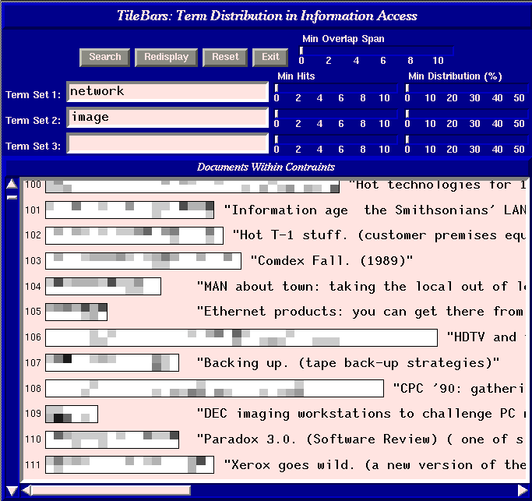
TileBars Screenshot
Source
Selection
Query
Formulation
Result
Presentation
Browsing
Support
Navigation
Support

Slide 19
TileBars Summary
Compact, graphical representation of term distribution in search results
  Simultaneously display term frequency, distribution, overlap, and doc length
  However, does not provide the context in which query terms are used
Do they help?
  Users intuitively understand them
  Lack of context sometimes causes problems in disambiguation
Source
Selection
Query
Formulation
Result
Presentation
Browsing
Support
Navigation
Support

Slide 20
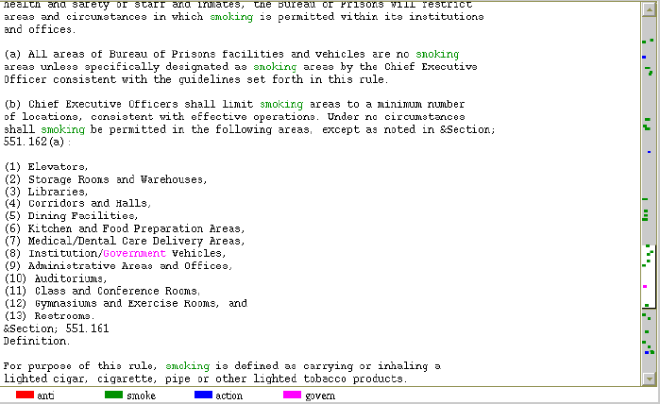
Scrollbar-Tilebar
Source
Selection
Query
Formulation
Result
Presentation
Browsing
Support
Navigation
Support
From U. Mass

Slide 21
Cat-a-Cone
Key Ideas:
  Separate documents from category labels
  Show both simultaneously
  Link the two for iterative feedback
  Integrate searching and browsing
Distinguish between:
  Searching for documents
  Searching for categories
Source
Selection
Query
Formulation
Result
Presentation
Browsing
Support
Navigation
Support
Marti A. Hearst and Chandu Karadi. (1997) Cat-a-Cone: An Interactive Interface for Specifying Searches and Viewing Retrieval Results using a Large Category Hierarchy. SIGIR 1997.

Slide 22
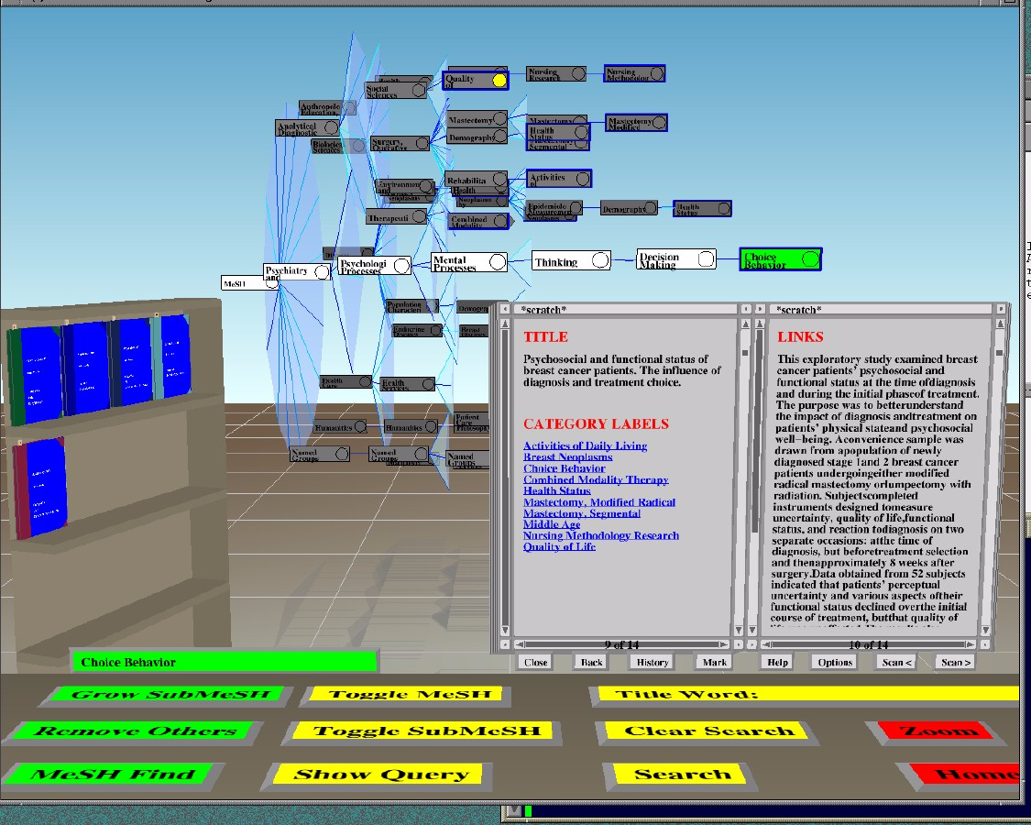
Cat-a-Cone Interface
Source
Selection
Query
Formulation
Result
Presentation
Browsing
Support
Navigation
Support

Slide 23
Cat-a-Cone Architecture
browse
search
query terms
Category
Hierarchy
Collection
Source
Selection
Query
Formulation
Result
Presentation
Browsing
Support
Navigation
Support
Retrieved
Documents

Slide 24
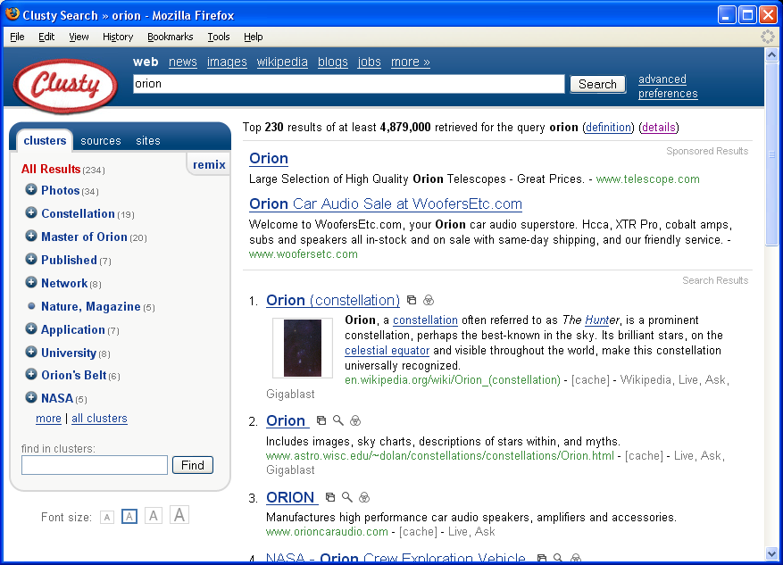
Clustering Search Results
Source
Selection
Query
Formulation
Result
Presentation
Browsing
Support
Navigation
Support

Slide 25
Vector Space Model
t₃
d₂
d₃
d₁
θ
φ
t₁
Source
Selection
Query
Formulation
Result
Presentation
Browsing
Support
Navigation
Support
d₅
t₂
d₄
Assumption: Documents that are “close together” in vector space “talk about” the same things

Slide 26
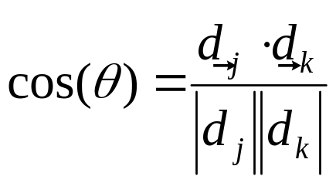
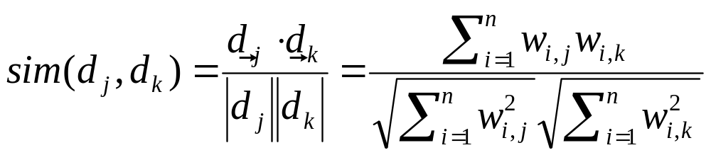
Similarity Metric
How about |d₁ – d₂|?
Instead of Euclidean distance, use “angle” between the vectors
  It all boils down to the inner product (dot product) of vectors
Source
Selection
Query
Formulation
Result
Presentation
Browsing
Support
Navigation
Support

Slide 27
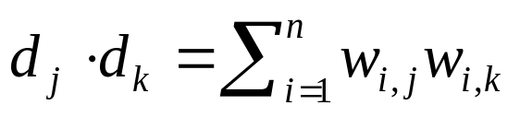
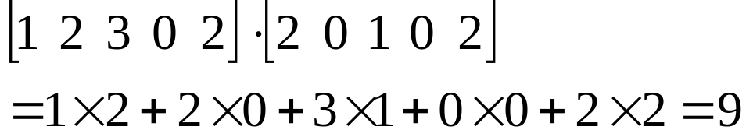
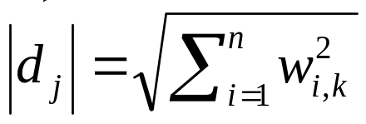
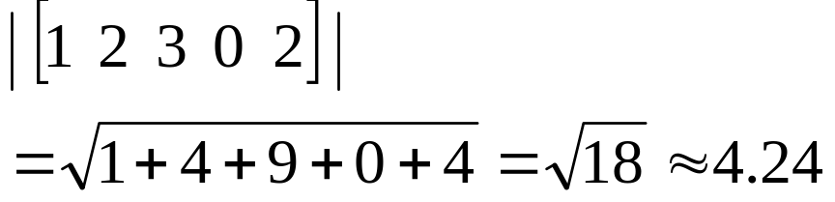
Components of Similarity
The “inner product” (aka dot product) is the key to the similarity function
The denominator handles document length normalization
Example:
Source
Selection
Query
Formulation
Result
Presentation
Browsing
Support
Navigation
Support
Example:

Slide 28
Text Clustering
What? Automatically partition documents into clusters based on content
  Documents within each cluster should be similar
  Documents in different clusters should be different
Why? Discover categories and topics in an unsupervised manner
  Help users make sense of the information space
  No sample category labels provided by humans
Source
Selection
Query
Formulation
Result
Presentation
Browsing
Support
Navigation
Support

Slide 29
The Cluster Hypothesis
“Closely associated documents tend to be
relevant to the same requests.”
van Rijsbergen 1979
“… I would claim that document clustering
can lead to more effective retrieval than linear
search [which] ignores the relationships that
exist between documents.”
van Rijsbergen 1979
Source
Selection
Query
Formulation
Result
Presentation
Browsing
Support
Navigation
Support

Slide 30
Visualizing Clusters
Source
Selection
Query
Formulation
Result
Presentation
Browsing
Support
Navigation
Support
Centroids

Slide 31
Two Strategies
Aglommerative (bottom-up) methods
  Start with each document in its own cluster
  Iteratively combine smaller clusters to form larger clusters
Divisive (partitional, top-down) methods
  Directly separate documents into clusters
Source
Selection
Query
Formulation
Result
Presentation
Browsing
Support
Navigation
Support

Slide 32
HAC
HAC = Hierarchical Agglomerative Clustering
Start with each document in its own cluster
Until there is only one cluster:
  Among the current clusters, determine the two clusters c_{i} and c_{j}, that are most similar
  Replace c_{i} and c_{j} with a single cluster c_{i} ∪ c_{j}
The history of merging forms the hierarchy
Source
Selection
Query
Formulation
Result
Presentation
Browsing
Support
Navigation
Support

Slide 33
HAC
Source
Selection
Query
Formulation
Result
Presentation
Browsing
Support
Navigation
Support
A B C D E F G H

Slide 34
What’s going on geometrically?
Source
Selection
Query
Formulation
Result
Presentation
Browsing
Support
Navigation
Support

Slide 35
Cluster Similarity
Assume a similarity function that determines the similarity of two instances: sim(x,y)
  What’s appropriate for documents?
What’s the similarity between two clusters?
  Single Link: similarity of two most similar members
  Complete Link: similarity of two least similar members
  Group Average: average similarity between members
Source
Selection
Query
Formulation
Result
Presentation
Browsing
Support
Navigation
Support

Slide 36
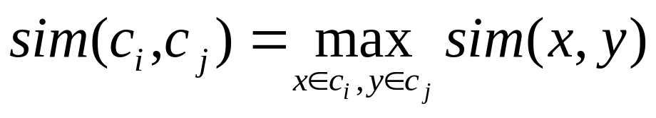
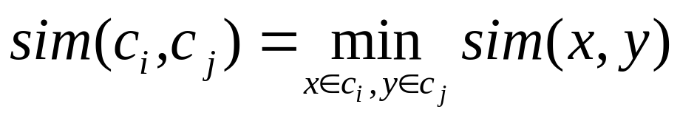
Different Similarity Functions
Single link:
  Uses maximum similarity of pairs:
  Can result in “straggly” (long and thin) clusters due to chaining effect
Complete link:
  Use minimum similarity of pairs:
  Makes more “tight” spherical clusters
Source
Selection
Query
Formulation
Result
Presentation
Browsing
Support
Navigation
Support

Slide 37
Non-Hierarchical Clustering
Typically, must provide the number of desired clusters, k
Randomly choose k instances as seeds, one per cluster
Form initial clusters based on these seeds
Iterate, repeatedly reallocating instances to different clusters to improve the overall clustering
Stop when clustering converges or after a fixed number of iterations
Source
Selection
Query
Formulation
Result
Presentation
Browsing
Support
Navigation
Support

Slide 38
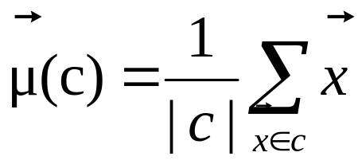
K-Means
Clusters are determined by centroids (center of gravity) of documents in a cluster:
Reassignment of documents to clusters is based on distance to the current cluster centroids
Source
Selection
Query
Formulation
Result
Presentation
Browsing
Support
Navigation
Support

Slide 39
K-Means Algorithm
Let d be the distance measure between documents
Select k random instances {s₁, s₂,… s_{k}} as seeds.
Until clustering converges or other stopping criterion:
  Assign each instance x_{i} to the cluster c_{j} such that
  d(x_{i}, s_{j}) is minimal
  Update the seeds to the centroid of each cluster
  For each cluster c_{j}, s_{j} = μ(c_{j})
Source
Selection
Query
Formulation
Result
Presentation
Browsing
Support
Navigation
Support

Slide 40
K-Means Clustering Example
Pick seeds
Reassign clusters
Compute centroids
Reasssign clusters
x
x
x
Compute centroids
Source
Selection
Query
Formulation
Result
Presentation
Browsing
Support
Navigation
Support
x
x
x
Reassign clusters
Converged!

Slide 41
K-Means: Discussion
How do you select k?
Issues:
  Results can vary based on random seed selection
  Possible consequences: poor convergence rate, convergence to sub-optimal clusters
Source
Selection
Query
Formulation
Result
Presentation
Browsing
Support
Navigation
Support

Slide 42
Why cluster for IR?
Cluster the collection
  Retrieve clusters instead of documents
Cluster the results
  Provide support for browsing
“Closely associated documents tend to be relevant to the same requests.”
“… I would claim that document clustering can lead to more effective retrieval than linear search [which] ignores the relationships that exist between documents.”
Source
Selection
Query
Formulation
Result
Presentation
Browsing
Support
Navigation
Support

Slide 43
From Clusters to Centroids
Source
Selection
Query
Formulation
Result
Presentation
Browsing
Support
Navigation
Support
Centroids

Slide 44
Clustering the Collection
Basic idea:
  Cluster the document collection
  Find the centroid of each cluster
  Search only on the centroids, but retrieve clusters
If the cluster hypothesis is true, then this should perform better
Why would you want to do this?
Why doesn’t it work?
Source
Selection
Query
Formulation
Result
Presentation
Browsing
Support
Navigation
Support

Slide 45
Clustering the Results
Commercial example: Clusty
Research example: Scatter/Gather
Source
Selection
Query
Formulation
Result
Presentation
Browsing
Support
Navigation
Support

Slide 46
Scatter/Gather
How it works:
  The system clusters documents into general “themes”
  The system displays the contents of the clusters by showing topical terms and typical titles
  User chooses a subset of the clusters
  The system automatically re-clusters documents within selected cluster
  The new clusters have more refined “themes”
Originally used to give collection overview
  Evidence suggests more appropriate for displaying retrieval results in context
Source
Selection
Query
Formulation
Result
Presentation
Browsing
Support
Navigation
Support
Marti A. Hearst and Jan O. Pedersen. (1996) Reexaming the Cluster Hypothesis: Scatter/Gather on Retrieval Results. Proceedings of SIGIR 1996.

Slide 47
Scatter/Gather Example
Query = “star” on encyclopedic text
sports 14 docs
film, tv 47 docs
music 7 docs
symbols 8 docs
film, tv 68 docs
astrophysics 97 docs
astronomy 67 docs
flora/fauna 10 docs
Source
Selection
Query
Formulation
Result
Presentation
Browsing
Support
Navigation
Support
stellar phenomena 12 docs
galaxies, stars 49 docs
constellations 29 docs
miscellaneous 7 docs
Clustering and re-clustering is entirely automated

Slide 48
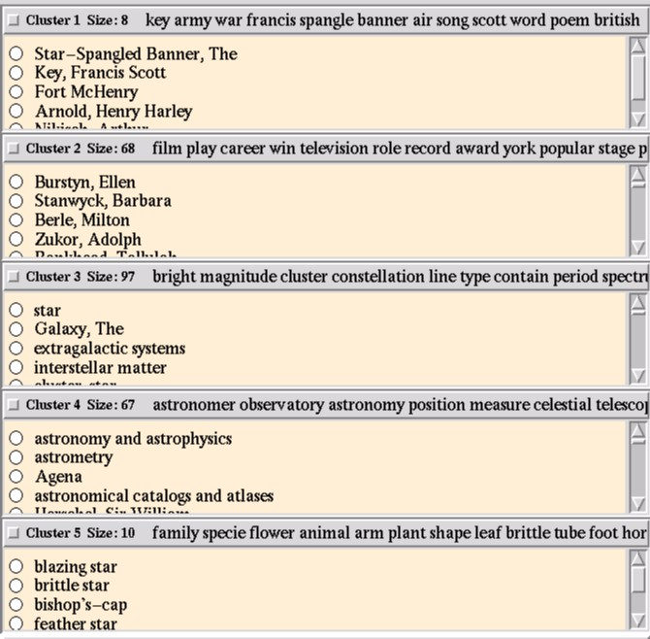
Source
Selection
Query
Formulation
Result
Presentation
Browsing
Support
Navigation
Support

Slide 49
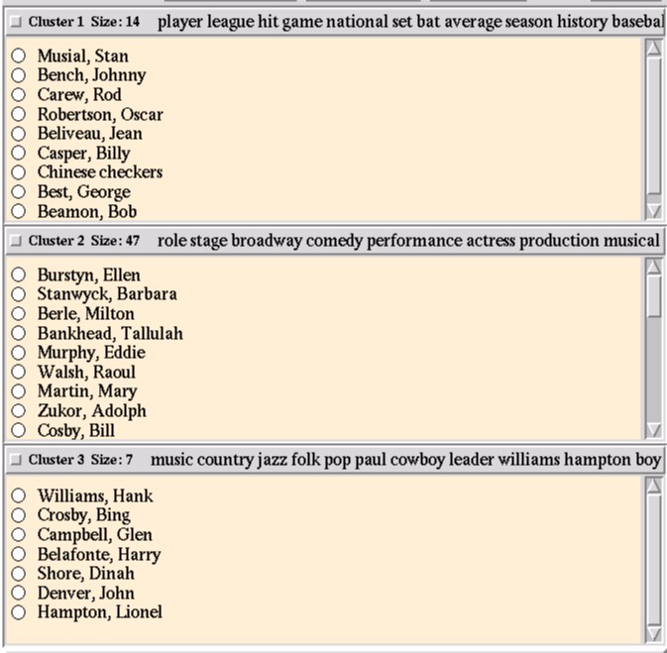
Source
Selection
Query
Formulation
Result
Presentation
Browsing
Support
Navigation
Support

Slide 50
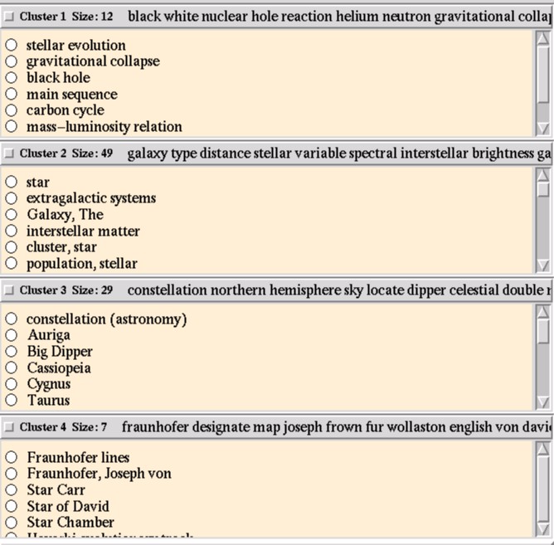
Source
Selection
Query
Formulation
Result
Presentation
Browsing
Support
Navigation
Support

Slide 51
Clustering Result Sets
Advantages:
  Topically coherent sets of documents are presented to the user together
  User gets a sense of topics in the result set
  Supports exploration and browsing of retrieved hits
Disadvantage:
  Clusters might not “make sense”
  May be difficult to understand the topic of a cluster based on summary terms
  Summary term might not describe the clusters
  Additional computational processing required
Source
Selection
Query
Formulation
Result
Presentation
Browsing
Support
Navigation
Support

Slide 52
Navigation Support
The “back” button isn’t enough!
Behavior is counterintuitive to many users
A
Source
Selection
Query
Formulation
Result
Presentation
Browsing
Support
Navigation
Support
B
You hit “back” twice from page D.
Where do you end up?
C
D

Slide 53
PadPrints
Tree-based history of recently visited Web pages
  History map placed to left of browser window
  Node = title + thumbnail
  Visually shows navigation history
Zoomable: ability to grow and shrink sub-trees
Source
Selection
Query
Formulation
Result
Presentation
Browsing
Support
Navigation
Support
Ron R. Hightower et al. (1998) PadPrints: Graphical Multiscale Web Histories. Proceedings of UIST 1998, GCHI 1995.

Slide 54
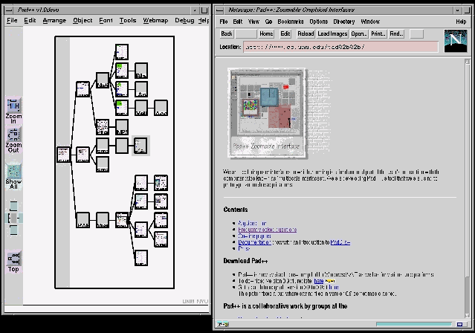
PadPrints Screenshot
Source
Selection
Query
Formulation
Result
Presentation
Browsing
Support
Navigation
Support

Slide 55
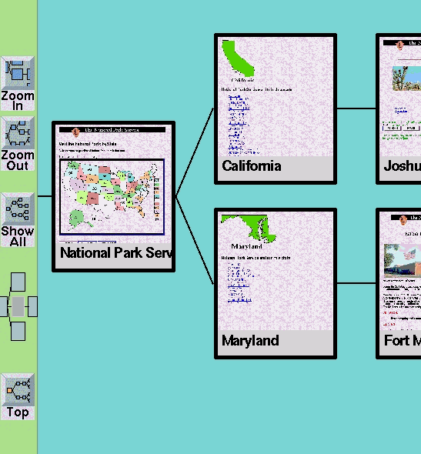
PadPrints Thumbnails
Source
Selection
Query
Formulation
Result
Presentation
Browsing
Support
Navigation
Support

Slide 56
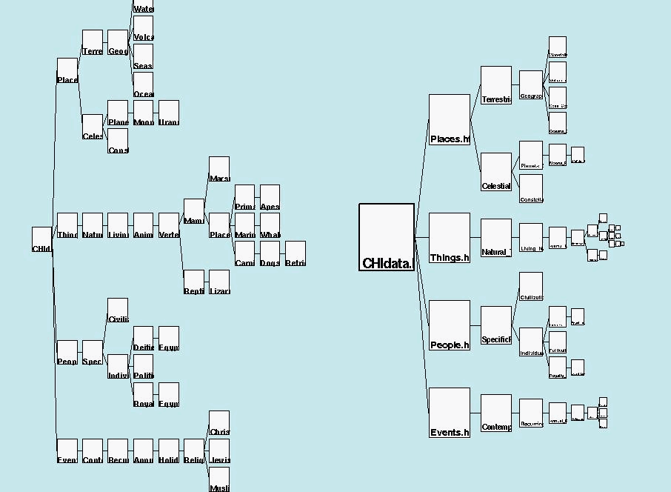
Zoomable History
Source
Selection
Query
Formulation
Result
Presentation
Browsing
Support
Navigation
Support

Slide 57
Does it work?
Study involved CHI database and National Park Service website
In tasks requiring return to prior pages, 40% savings in time when using PadPrints
Users more satisfied with PadPrints
Source
Selection
Query
Formulation
Result
Presentation
Browsing
Support
Navigation
Support

Slide 58
Today’s Topics
Source selection
  What should I search?
Query formulation
  What should my query be?
Result presentation
  What are the search results?
Browsing support
  How do I make sense of all these results?
Navigation support
  Where am I?
Source
Selection
Query
Formulation
Result
Presentation
Browsing
Support
Navigation
Support

