Slide 1
Medical Subject Headings (MeSH)
Rishi Anand
Todd Bailey
Sumit Gupta

Slide 2
Presentation Outline
Definition, Development, & Maintenance of MesH - Todd
Theory & Structure of Mesh - Rishi
Application & Relevance to Information Architecture - Sumit
Future Trends/Research - Sumit
Class Actitivity - Team
Q&As - Team

Slide 3
MeSH - What Is It?
A controlled vocabulary thesaurus developed by the National Library of Medicine for indexing bio-medical literature.
  used by the MEDLINE/PubMed article database and by NLM's catalog of books
  takes guesswork out of choosing terms one needs to enter into a search; identifies the appropriate (preferred) term to use when looking for information

Slide 4
How Was MeSH Created?
1874 - John Shaw Billings produces the Index Catalogue of the
Library of the Surgeon-General
1879 - Index Medicus is published as a monthly comprehensive
index of medical journal articles
1927 - Index Medicus is merged with the American Medical
Association's competing bibliography and renamed
Quarterly Cummulative Index Medicus
1951 - Colonel Frank Rogers produces Current List of Medical Literature, a
standardized list of subject headings
1960 - Medical Literature Analysis and Retrieval System (MEDLARS) is developed, as part of this effort a MeSH database is also developed
with a new and thoroughly revised list of subject headings
1963 - MeSH database is updated with "Tree Structure"

Slide 5
MeSH - How Is It Maintained?
Medical Subject Headings staff continually revise and update the MeSH vocabulary
  staff collects new terms as they appear in the scientific literature or in emerging areas of research
  staff defines terms within the context of existing vocabulary; and recommend their addition to MeSH
  consultants also advise and offer recommendations

Slide 6
MeSH- How it can be applied to organize information? - I
The 17,000 word MeSH vocabulary is divided into complex hierarchical tree structure.
There are 16 main top level categories in the hierarchical structure which further give rise to branch like tree structure sub categories in order of their increasing specificity.
The MeSH tree structure allows to find relevant MeSH terms and corresponding articles in PubMed even when only general concept areas are known.

Slide 7
MeSH- How it can be applied to organize information? - II
The MeSH hierarchical tree structure allows to
have a control on both precision and recall.
  Recall- The MeSH allows to broaden the domain and increase the recall by fetching the related articles as well.
  Precision- The MeSH tree structure leads to specificity and hence increases precision.
For a proficient MEDLINE searcher - Right balance needed between precision and recall.

Slide 8
MeSH- How it can be applied to organize information? - III
Descriptors- Also known as Main Headings, Descriptors are used to index citations in NLM's MEDLINE database, for cataloging of publications, and other databases.
Publication Characteristics- Although MeSH Descriptors, these records are unlike other MeSH Descriptors in that they indicate what the indexed item is, i.e., its type, rather than what it is about, for example, Historical Article, Editorial
Geographics- Descriptors which include continents, regions, countries, states, and other geographic subdivisions.
Qualifiers- There are 83 topical Qualifiers (also known as Subheadings) used for indexing and cataloging in conjunction with Descriptors. Qualifiers afford a convenient means of grouping together those citations which are concerned with a particular aspect of a subject. For example- Liver/Drug effects

Slide 9
MeSH- What is the relevance to Information Architecture? - I
MeSH Tree structures successfully incorporate the following four major IA components:
Organization System
Whole tree organized into 16 main categories
Further organized into sub-categories
Each heading is labeled in a decreasing order of spectrum (range)
Labeling System
Labels contain terms which are directly/indirectly related
Poor labels can ruin a good organization or navigation system

Slide 10
MeSH- What is the relevance to Information Architecture? - II
Navigation System
Global (what’s important)
Local (what’s nearby)
Contextual (related)
Searching System
Returns the corresponding MeSH heading
Presents the exact tree structure of the subject

Slide 11
Problem of Language
It is the problem faced by inexperienced MEDLINE user while looking for appropriate MeSH terms in order to execute a query.
Many biomedical terms point to the single canonical MeSH term.
    Example- Heart Failure, Congestive is the only MeSH
    term to represent all types of cardiac failures
Solutions-
Use of entry terms- used to map non MeSH terms to MeSH terms.
Use MeSH hierarchies to traverse to the articles.

Slide 12
Future Trends / Research
NLM's Indexing Initiative (IND) *
Human indexing is an expensive and labor-intensive activity
IND project involves investigating automated methods to substitute for current indexing practices
More stress is being given to improve the current retrieval performance
New approaches like Machine Learning algorithms viz. Naïve
Bayes, Adaptive Boosting and Support Vector Machines are being tested
* Aronson A. R.; Bodenreider O.; Chang H. F.; Humphrey S. M.; Mork J.G.; Nelson S. J.; Rindflesch T. C.; and Wilbur W. J., “The NLM Indexing Initiative”, AMIA Annual Fall Symposium, 17-21, 2000

Slide 13
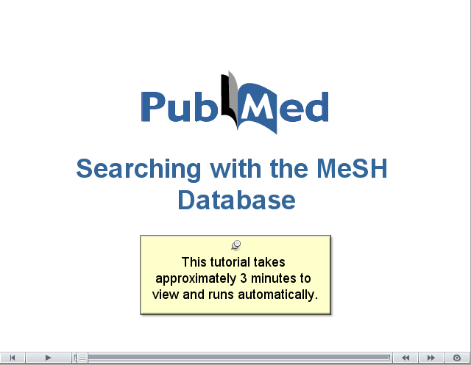
Class Activity - Let's Perform a Search in Pub Med

Slide 14
Questions & Answers

