Slide 1

Jennie Ning Zheng
Linda Melchor
Ferhat Omur

Slide 2
Contents
Introduction
WordNet
  Application – WordNet
  Data Structure - WordNet
FrameNet
  Application – FrameNet
  Data Structure – FrameNet
Relevance with IA
Q & A

Slide 3
WordNet
A semantic lexicon for the English language
Purpose:
  A combination of dictionary and thesaurus
  to support automatic text analysis and artificial intelligence applications

Slide 4
WordNet
Groups the meanings of English words into five categories
  Nouns
  Verbs
  Adjectives
  Adverbs
  Function words(prepositions, pronouns, determiners)

Slide 5
WordNet
Meanings are related by
  Synonymy (Pipe, Tube)
  Antonymy (Wet, Dry)
  Hyponymy (Tree, Plant)
  Meronymy (Ship, Fleet)
  Morphological relations

Slide 6
Contents
Introduction
WordNet
  Application – WordNet
  Data Structure - WordNet
FrameNet
  Application – FrameNet
  Data Structure – FrameNet
Relevance with IA
Q & A

Slide 7
Application - WordNet
WordNet’s hierarchical structure can help in the creation faceted categories, which are essential for faceted metadata and search functions.
Words from a structured collection are compared to high-level category labels of WordNet’s lexicon.
  Subsets of the most frequently occurring categories are retained.
  Categories related to ambiguous words are discarded.
  High-level hierarchy labels that are to general or broad are discarded as well.

Slide 8
Application - WordNet
Reason for using WordNet?
  Allows for efficient navigation within and across lexical data due the rigorous structure of its semantic tagging
  Hypernym (IS A) relations are most commonly used and easiest to integrate into Information Extraction and browsing/search systems, making it easier to find synonyms and near synonyms of words.
  Currently, there has been a movement to create multilingual WordNets with the goal of enhancing cross-lingual information retrieval systems. WN provides a platform for representing the lexical knowledge between different languages.

Slide 9
Contents
Introduction
WordNet
  Application – WordNet
  Data Structure - WordNet
FrameNet
  Application – FrameNet
  Data Structure – FrameNet
Relevance with IA
Q & A

Slide 10
Data Structure & Maintenance
WordNet was created and is being maintained at the Cognitive Science Laboratory of Princeton University under the direction of psychology professor George A. Miller
Development began in 1985
Q: Where do they get the definitions for WordNet?
A: Their Lexicographers write them
  However, many different dictionaries and sources were used and many others are still being used to expand the WordNet library.
The database contains about 150,000 words organized in over 115,000 synsets for a total of 207,000 word-sense pairs

Slide 11
Data Structure & Maintenance
It has its own database structure and library but there are three versions;
  Windows (Plain files, queries done by Binary Search)
  Unix
  Prolog
However, there are different API’s exist to use WordNet database which are written in Java or C#, and different types of databases exist such as XML, MySQL, PostgreSQL and many others as well to store WordNet data.

Slide 12
Contents
Introduction
WordNet
  Application – WordNet
  Data Structure - WordNet
FrameNet
  Application – FrameNet
  Data Structure – FrameNet
Relevance with IA
Q & A

Slide 13
FrameNet
A project housed at the International Computer Science Institute in Berkeley, California which produces an electronic resource based on semantic frames
Scope of the project
  FrameNet Database : Lexicon, Frame Database, Annotated Example Sentences
  Associated Software Tools

Slide 14
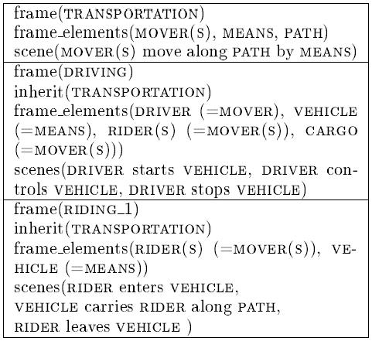
FrameNet

Slide 15
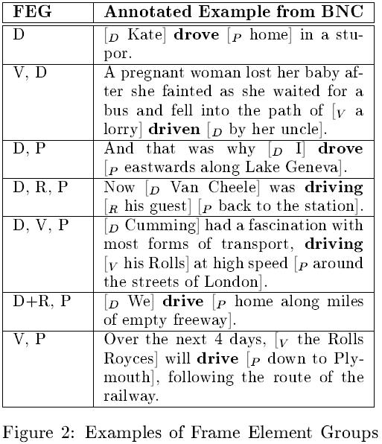
FrameNet

Slide 16
FrameNet
Comparison with WordNet and Ontology
  Lexical units comes with definition
  Multiple annotated example
  Examples from natural corpora
  Frame by frame
  A network relations between frames
  Not readily usable as ontology of things

Slide 17
Contents
Introduction
WordNet
  Application – WordNet
  Data Structure - WordNet
FrameNet
  Application – FrameNet
  Data Structure – FrameNet
Relevance with IA
Q & A

Slide 18
Application - FrameNet
Organize information in terms of case-roles, which helps determine the lexical meaning by the use of conceptual structure provided by FN.
Can be applied to NLP systems because of its potential to find the arguments of a collection through the use of word sense and sentence examples.
FrameNet annotated data sets are compared against Information extraction patterns. All non-relevant terms of the frames are discarded.

Slide 19
Application - FrameNet
Reason for using FrameNet?
  The lexicon and pattern sets provided by FN make it possible for natural language processing systems to generate more precise results than those allowed by WordNet.
  FN consists of machine readable terms that provide sentence examples extracted from natural corpora, which make it possible to provide meaning to terms related to frames.

Slide 20
Contents
Introduction
WordNet
  Application – WordNet
  Data Structure - WordNet
FrameNet
  Application – FrameNet
  Data Structure – FrameNet
Relevance with IA
Q & A

Slide 21
Data Structure
The development of the theory of Frame Semantics began more than 25 years ago, however until 1997 there were no implementations
British National Corpus and Linguistic Data Consortium were used to create the database and they plan to add American National Corpus data as well
Frames are added by FrameNet Staff

Slide 22
Data Structure
Data structures were initially implemented in SGML
Currently uses XML and MySQL
Frame information kept in a MySQL database such as frame elements, lemmas or lexical units
It has a Java GUI to use MySQL Database
It has also its own query language, namely FrameSQL
  ie “ﬁnd all example sentences containing verbs in the Communication frame whose Addressees are expressed as direct objects”

Slide 23
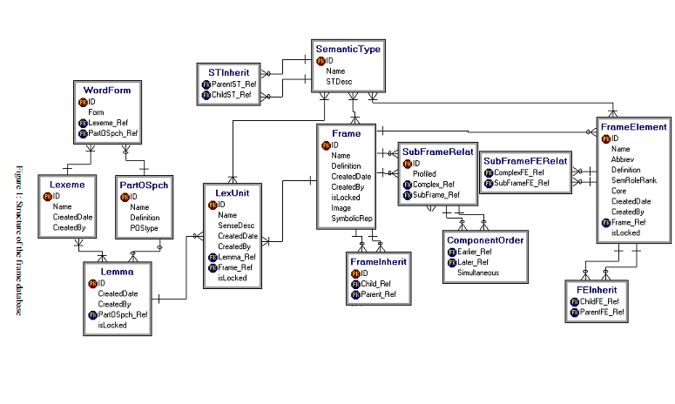

Slide 24
Contents
Introduction
WordNet
  Application – WordNet
  Data Structure - WordNet
FrameNet
  Application – FrameNet
  Data Structure – FrameNet
Relevance with IA
Q & A

Slide 25
Relevance with IA
FN and WN are essential resources for Natural Language Processing applications and Information Exaction systems.
FN and WN have been used for information retrieval, word sense disambiguation, machine translation, conceptual indexing, and text and document classification, among other applications/systems.

Slide 26
Relevance with IA
Together they can greatly enhance the middle-game of IA, particularly through the use of Faceted Metadata.
FN helps increase precision with a trade-off in recall. However, using WN can address this trade off since it will increase recall.
A balance between the two can lead to the creation of efficient information systems.

Slide 27
Discussion
Which do you prefer WordNet or FrameNet?
Have you ever used either?

Slide 28


