Slide 1
Automatic Clustering & Classification
Team: Yang
Priyanka
Jithesh
Arun.

Slide 2
Agenda
Introduction to Clustering and Categorization.
  Types of Clustering
  Application of Clustering
  Application of Categorization
  Example (Quintara, NCSU Libraries)
Clustering Categorization and Information Architecture.
Future works
Questions ???

Slide 3
Clustering
It is a process of partitioning a set of data in a set of meaningful subclasses. Every data in the subclass shares a common trait.
It helps a user understand the natural grouping or structure in a data set.
Categorization
Classification is a technique used to predict group membership for data instances. For example, you may wish to use classification to predict whether the weather on a particular day will be “sunny”, “rainy” or “cloudy”.

Slide 4
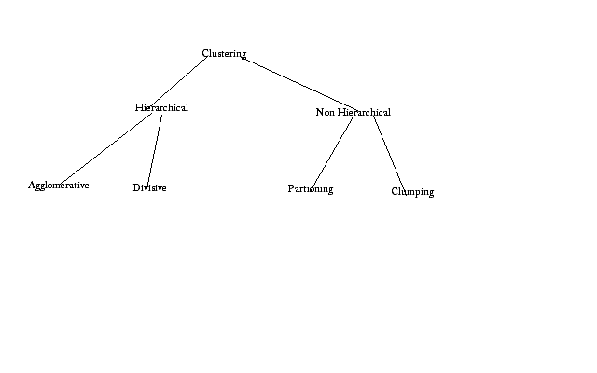
Types of Clustering Methods

Slide 5
How does Clusters Organize Documents?
The Scatter Gather approach is used for Text Clustering.
The user scatters documents into clusters, gathers the contents of 1 or more clusters & re-scatters them to form new clusters.
In text clustering, the documents are represented as Vectors where each entry in the vector corresponds to a weighted feature.
Features that do not appear are represented as zero.
Feature space is reduced by eliminating rare features.
Similarity between 2 documents is the measure of word overlap between them.
The similarity measure results in the collection of documents being clustered.
The Scatter gather thus shows only a few large clusters allowing the user to refine the cluster dynamically.

Slide 6
K Means Clustering
In this K seeds are chosen to represent the centers of the k resulting clusters.
Each document is assigned to the cluster with the most similar seed.
It is a iterative process. Once every document has been assigned to a cluster, new seeds can be computed.
The assignment process is repeated with these new seeds.

Slide 7
Applications of Clustering
Document retrieval and text mining
Web Snippet
Pattern classification
Image segmentation/spatial data analysis
  GIS
  Medical Image Database
Data mining
  Economic science (e.g. marketing)
  Scientific data exploration (e.g. bioinformatics)
  Tools: SAS, MATHLAB
Windows NT

Slide 8
Review of Clustering Search Engines
A9 http://www.a9.com/ Accumo http://www.accumo.com/ All 4 One MetaSearch http://all4one.searchallinone.com/ AlltheWeb http://livesearch.alltheweb.com/ BizNetic http://www.biznetic.com/ BoardReader.com http://www.boardreader.com/ Clush http://www.clush.com/ Clusty http://www.clusty.com/ Collarity http://www.collarity.com/ Curry Guide http://www.curryguide.com/ Deepor http://www.deepor.com/ Exalead http://www.exalead.com/ Find.com http://www.find.com/ | FyberSearch http://www.fybersearch.com/ iBoogie ttp://www.iboogie.com/ Infonetware http://www.infonetware.com/ lyGo http://www.lygo.com/ mnemo http://www.mnemo.org/ Mooter http://www.mooter.com/ Oxide http://www.oxide.com/ PolyMeta http://www.polymeta.com/ Qksearch http://www.qksearch.com/ Query Server http://www.queryserver.com/ Quintura http://www.quintura.com/ SearchNet.com http://www.searchnet.com/ | Seekport http://www.seekport.de/ Snap http://www.snap.com/ Teoma http://www.teoma.com/ Ujiko http://www.ujiko.com/ WebBrain.com http://www.webbrain.com/ WindSeek http://www.windseek.com/ WiseNut http://www.wisenut.com/ Wotbox http://www.wotbox.com/ Yahoo http://mindset.research.yahoo.com/ Zevarti http://www.zevarti.com/ / Carrot Search http://www.carrot-search.com/ Clusterizer Solution Provider http://www.clusterizer.com/

Slide 9
Applied Algorithms
Name | Single terms as Labels | Sentences as Labels | Single terms as Labels | Sentences as Labels | on-line
 | Flat Clusters | Flat Clusters | Hierarchy of Clusters | Hierarchy of Clusters
WebCat | + |  |  |  | +
Retriever | +
Scatter/Gather | +
Wang et al. | +
Grouper |  | +
Carrot |  | + |  |  | +
Lingo |  | + |  |  | +
Microsoft |  | +
FICH |  |  | + |  | +
Credo |  |  | + |  | +
IBM |  |  | +
SHOC |  |  |  | +
CIIRarchies |  |  |  | + | +
LA |  |  |  | +
Highlight |  |  |  | + | +
WhatsOnWeb |  |  |  | + | +
SnakeT |  |  |  | + | +
Mooter |  |  | + |  | +
Vivisimo |  |  |  | + | +

Slide 10
Example – Quintura
(http://www.quintura.com/)
A super-cool UI allows Users to dynamically move between the various clusters
Interactive clustering is more interesting than Clusty clustering.
Refining Results are faster and more customize.
The font size of the terms indicates how relevant and important Quintura considers the word or phrase

Slide 11
Classification
The goal of data classification is to organize and categorize data into distinct classes
  A model is first created based on the data distribution
  The model is then used to classify new data
  Given the model, a class can be predicted for new data
Classification Process
  Model Construction
  Model Evaluation
  Model Use

Slide 12
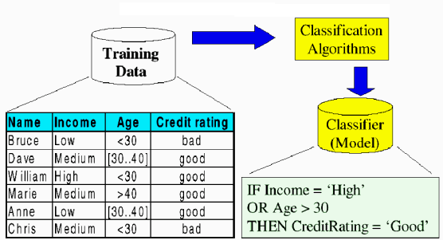
Model Construction - Learning
  Each record is assumed to belong to a pre-defined class, as determined by one of the attributes, called the class label
  The set of all records used for construction of the model is called training set
  The model is usually presented in the form of classification rules, (IF-Then statements) or decision trees.

Slide 13
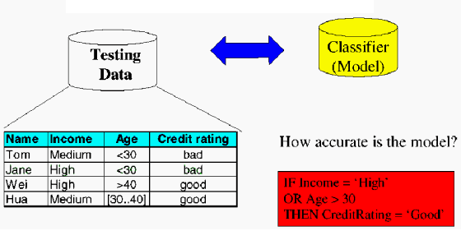
Model Evaluation - Accuracy
Estimate accuracy rate of the model based on a test set
The known label of test sample is compared with the classified result from the model
Accuracy rate: percentage of test set samples correctly classified by the model
Caution: Test set is independent of training set otherwise over fitting will occur

Slide 14
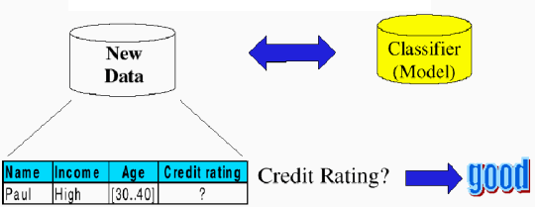
Model use - Classification
Model is used to classify unseen instances (assigning class labels)
Predict the value of an actual attribute

Slide 15
Applications of Classification
Document classification
  BLISS in Libraries
E-commerce interfaces
  Amazon, eBay
Medical Domain
  MeSH
Geodemographic classifications
  ACORN
Data Mining

Slide 16
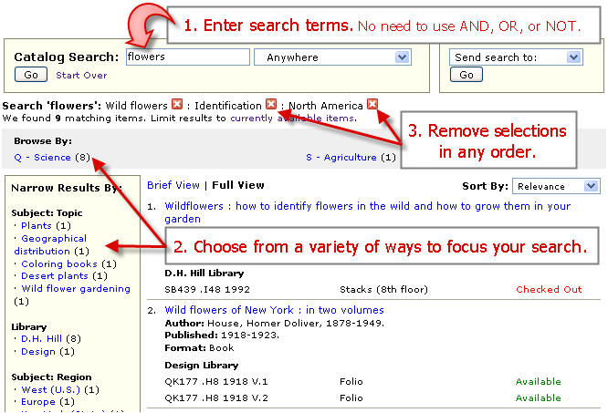
Example – Hierarchical Faceted Categories
(http://www.lib.ncsu.edu/catalog/)

Slide 17
Conclusion for Applications
Both clustering and classification are boutique search interfaces
Applied and used primarily in domain-specific collections
It is an open question whether these will eventually be widely and regularly used on the open-domain Web

Slide 18
Relevance to Information Architecture
Well defined Information Architecture must answer the below mentioned questions
  Locating Search: Where is it?
  Query Entry: How can a user search it?
  Retrieval Results: What did the user find based on the query?
  Query Refinement: How efficiently can user navigate from broad to specific query?
  Interaction with other IA components: Besides searching, components available for users?
This section will provide answers to these question using clustering based search website.

Slide 19
Automatic labeling patterns for clusters
Two promising methods to create labeling
  X² Test
  Frequent and Predictive Method
X² Test
  This test is implemented in hierarchical clustering.
  It identifies the set of words that are equally likely to occur in children nodes of a current node.
  Such nodes are general for all sub trees of a current node and labeling of current node are made based on these nodes.
  Bag of nodes used in this implementation excludes stop words
Frequent and Predictive Method
  This method depends on the frequency and predictive ness attribute of words. Words are selected for labeling based on product of local frequency and predictive ness.
p (word | class) * (p (word | class)/ p (word))
p (word | class) is the frequency of the word in a given cluster
p (word) is the frequency in a general category or in the whole collection

Slide 20
Quintura – Example (http://www.quintura.com)
Qunintura is clustering based Search Website. It provides a visual user experience by creating cluster cloud
Features
  Visual Mapping
  In-depth Search
  Great Flexibility
  Faster Results
Design
Query
Cloud
Refined Query
Result

Slide 21
Quintura – Continued…(http://www.quintura.com/)
User Interface features of Clustering Website
  Context Management
    It analyses the relationship or associations between words and keywords, and defines the keyword context or key word meaning
  Dynamic Clustering
    Clusters are built as the fly based on user input
  Visual Semantic Web for Context Management
    Allowing user to add or delete keyword. Changing the context based on user mouse click
  All in one approach
    Visualization, Content Management and clustering are provided in single search.
User Friendly Navigation techniques

Slide 22
Quintura – Continued…(http://www.quintura.com/)
User can change the cluster cloud size in Quintura. Depending on the user requirement, cloud size can be adjusted to any number of keywords between 10 to 50.
Besides entering search keyword, Users are can save their search or share it with their friends.
Users are provided with a long tail of keywords, thereby enabling users to navigate from broad vision to specific idea.
Quintura supports visual semantic on web by allowing users to add/ delete keywords in cluster clod.
Mouse over the keyword will display the search results.

Slide 23
Pro. & Cons
Clustering | Classification
Identifies meaningful themes that might not otherwise be discovered Themes are data driven Differentiate well in heterogeneous collections Scale well semantically Domain independent | Interpretable Can describe multiple facets of a document’s content Domain dependent, descriptive
High variability in quality of results Only one view of the many possible meaningful organizations Not effective at differentiating homogeneous documents Require interpretation Might not align with a user’s interests | Do not scale well Domain dependent, costly to acquire Might not align with a user’s interests

Slide 24
Future
A new type of decision tree, called an oblique tree, will soon be available that generates splits based on compound relationships between independent variables, rather than the one-variable-at-a-time approach used today.
Many data mining tools still require a significant level of expertise from users.
Tool vendors must design better user interfaces if they hope to gain wider acceptance of their products.
Easier interfaces will allow end users with limited technical skills to achieve good results, yet let experts tweak models in any number of ways, and rush users at any level of expertise quickly through their learning curves.

Slide 25
Discussion.
Thank you.

