Slide 1
Folksonomies and
Community-built directories
INFM700 Information Architecture
Sujatha Dissanayake
Ahmad Ladhani
Rhett McCarty

Slide 2
Overview
Folksonomies
Community-built directories
Compare and contrast technologies
Questions?
Discussion
Introduction
Folksonomies
Community-built directories
Conclusion
Discussion

Slide 3
What is a folksonomy?
The practice and method of collaboratively creating and managing tags to annotate and categorize content.
Bottom-up approach to organization
Folks = People , -onomy = Management
Folksonomy is tagging that works - Thomas Vander Wal
Introduction
Folksonomies
Community-built directories
Conclusion
Discussion

Slide 4
What is the underlying theory?
Easy to search, discover and navigate over time.
No hierarchy, no parent-child relationship; each tag at same level.
No disconnect between users’ words and words on the site.
Lower time and effort costs.
Introduction
Folksonomies
Community-built directories
Conclusion
Discussion

Slide 5
How was it created?
How is it maintained?
Created by:
  Web-Developers/Programmers.
  Web users
Maintained by:
  Web users
Let users add “tags” to information.
Introduction
Folksonomies
Community-built directories
Conclusion
Discussion

Slide 6
How can it be applied to organize information?
Deals with the user’s perspective of information.
Helps alleviate some of the challenges of taxonomies.
Organizes based on tags. Links tags.
Like a desktop space/folder.
Introduction
Folksonomies
Community-built directories
Conclusion
Discussion

Slide 7
What is its relevance to information architecture?
Little IA.
Its not all about ‘classification of living things’.
Boon to information architects.
Each website = unique information = unique classification.
Helps architects understand how (how often) users refer to specific resources.
Introduction
Folksonomies
Community-built directories
Conclusion
Discussion

Slide 8
Limitations of folksonomies
Plurals : Eg. Cat and Cats
Polysemy
Synonymy
Depth (Specificity) : How specific should the user be in translating a concept to a tag?
Browsing vs. Finding
Introduction
Folksonomies
Community-built directories
Conclusion
Discussion

Slide 9
What is a community-built directory?
Directory
  Categorization
  Web interface
  Internet or intranet
Community-built
  Built by volunteer editors, subject specialists, the “masses”
Introduction
Folksonomies
Community-built directories
Conclusion
Discussion

Slide 10
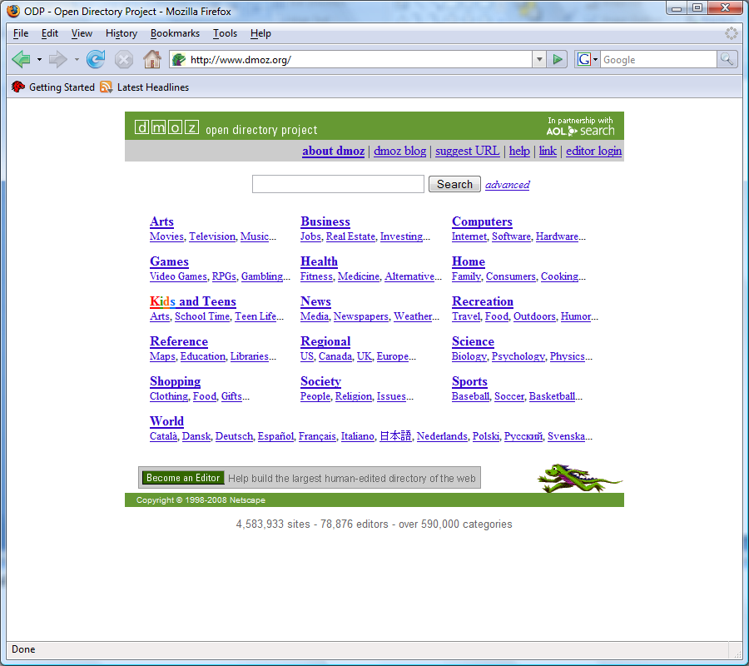
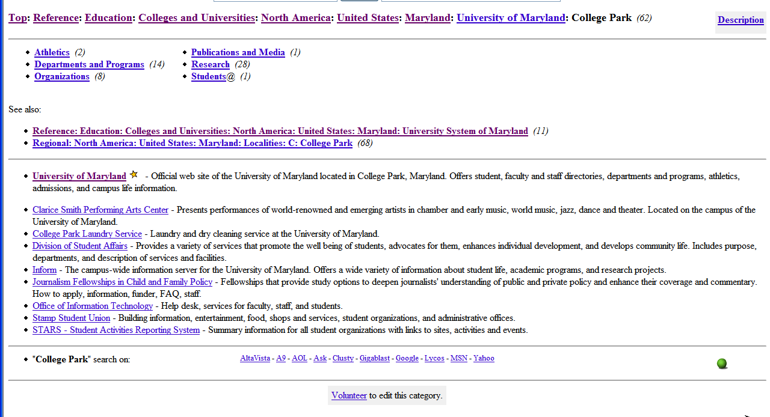
Open Directory Project (ODP or DMOZ) www.dmoz.org
Introduction
Folksonomies
Community-built directories
Conclusion
Discussion

Slide 11
What is the underlying theory?
Thousands > few
  Many specialists are better than a few generalist
  Many can handle Internet and information growth
No commercial interest
  Information is categorized in the most appropriate directories
  No over posting
Introduction
Folksonomies
Community-built directories
Conclusion
Discussion

Slide 12
How was it created?
How is it maintained?
Created by:
  Volunteer editors
  Web users
Maintained by:
  Supervising editors
  Co-editors
  Web users
Introduction
Folksonomies
Community-built directories
Conclusion
Discussion

Slide 13
How can it be applied to organize information?
Directory
  Taxonomy of information, websites, and other media
Community-built
  Thousands of regular, volunteer specialist make the decisions on categorization
Introduction
Folksonomies
Community-built directories
Conclusion
Discussion

Slide 14
What is its relevance to information architecture?
Big IA model
Taxonomy
Encourages correctness and reliability because of mass of editors
Introduction
Folksonomies
Community-built directories
Conclusion
Discussion

Slide 15
Limitations of community-built directories
Taxonomic structure
Organized by amateurs
Outdated listings
Missing listings
Too ambitious for the Internet
Introduction
Folksonomies
Community-built directories
Conclusion
Discussion

Slide 16
Folksonomies vs. Community-built directories
Folksonomies
  Categorization done by users
  Bottom up
  No Hierarchies, all categorization at the same level
Introduction
Folksonomies
Community-built directories
Conclusion
Discussion

Slide 17
Folksonomies vs. Community-built directories
Community-built directories
  Categorization done by registered editors
  Top Down
  Consists of Hierarchies designed by the editors
Introduction
Folksonomies
Community-built directories
Conclusion
Discussion

Slide 18
Folksonomy vs. Taxonomy
Folksonomy | Taxonomy
Flexible | Brittle
Less reliable | Accurate (if done well)
Rewards but doesn’t force compliance | Compliance must be forced
Easy to add to | Hard to add to
Democratically controlled | Centrally controlled
Organic | Predictable
Introduction
Folksonomies
Community-built directories
Conclusion
Discussion

Slide 19
Discussion
Have you used either technology?
Which approach do you prefer?
Which approach do you find to provide better information organization?
Would a combination application be useful? Would it be functional?
Do you trust the expertise of an amateur over a professional? Do you like collaborative technology? Would you give more trust to one of the technologies over the other?
Introduction
Folksonomies
Community-built directories
Conclusion
Discussion

Slide 20
Folksonomy References
Folksonomy. (n.d.). Wikipedia. Retrieved February 18, 2008, from http://en.wikipedia.org/wiki/Folksonomy.
Mathes, A. (2004, Dec.). Folksonomies: Cooperative classification and communication through shared metadata. Retrieved February 18, 2008, from http://www.adammathes.com/academic/computer-mediated-communication/folksonomies.html.
Noruzi, A. (2007, June). Folksonomies: Why do we need controlled vocabulary? [Editorial]. Webology. Retrieved February 18, 2008, from http://www.webology.ir/2007/v4n2/editorial12.html.
Porter, J. (2005, April 26). Folksonomies: A user-driven approach to organizing content. User Interface Engineering. Retrieved February 18, 2008, from http://www.uie.com/articles/folksonomies/.
Sturtz, D. (2004, Dec. 16). Communal Categorization: The Folksonomy [Lecture]. INFO622: Content Representation.
Vander Wal, T. (2007, Feb. 2). Folksonomy. Retrieved February 18, 2008, from http://www.vanderwal.net/folksonomy.html.
What is a folksonomy? (n.d.). Wise Geek. Retrieved February 18, 2008, from http://www.wisegeek.com/what-is-a-folksonomy.htm.

Slide 21
Community-built directory References
About DMOZ. (n.d.). Open Directory Project. Retrieved February 16, 2008, from http://www.dmoz.org/about.html.
Dufour, M., Ha, J., de Haan, M. G., and van der Meer, K. (2000). Kascade: a new Open directory way of access to Internet information. Information Services & Use 20(2/3), 63-72.
Jacsó, P. (2007). Vivísimo, Central Search, TIME Magazine, and the Open Directory Project. Online 31(1), 58-60.
Skrenta, R. (2003, Jan. 21). Genesis of the Open Directory Project. Retrieved February 18, 2008, from http://www.inetdevgrp.org/20030121/.
United States Patent Application 20040019584.

