Slide 1
Mining Query Logs
Team and Topic Introduction
Recapitulation / Pre-requisites to understanding the Topic
  TF-IDF
  Term weighting
  Similarity Calculation
  Document Normalization
What is it?
How does it work?
Is it used today and in what context?
  Relevance with Query Classification
  Relevance with Query Expansion
Relevance with Information Architecture
Main applications and future advancements
Questions?
Notes:
Isn’t this supposed to be the first slide?

Slide 2
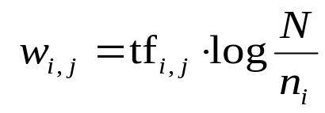
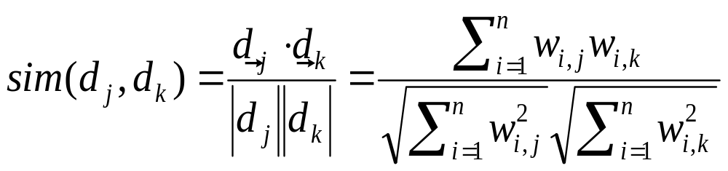
Recapitulation / Pre-requisites to understanding Mining Query Logs
tf
TF-iDF definition
Significance of TF-iDF
Term Weighting definition
Significance of Term Weighting
Similarity Calculation (relevant documents)‏
1
2
3
4
idf
complicated
5
2
0.301
contaminated
4
1
3
0.125
fallout
5
4
3
0.125
information
6
3
3
2
0.000
interesting
1
0.602
nuclear
3
7
0.301
retrieval
6
1
4
0.125
siberia
2
0.602

Slide 3
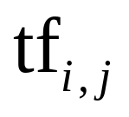
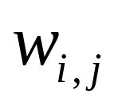
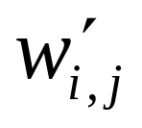
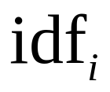
Recap (contd..)
Document Normalization & why use it?
1
2
3
4
1
2
3
4
1
2
3
4
complicated
5
2
0.301
1.51
0.60
0.13
0.57
0.69
contaminated
4
1
3
0.125
0.50
0.13
0.38
0.29
0.14
fallout
5
4
3
0.125
0.63
0.50
0.38
0.37
0.19
0.44
information
6
3
3
2
0.000
interesting
1
0.602
0.60
0.62
nuclear
3
7
0.301
0.90
2.11
0.53
0.79
retrieval
6
1
4
0.125
0.75
0.13
0.50
0.77
0.05
0.57
siberia
2
0.602
1.20
0.71
Length
1.70
0.97
2.67
0.87
Unweighted query: contaminated retrieval, Result: 2, 4, 1, 3 (compare to 2, 3, 1, 4)‏

Slide 4
What is Web Mining?
A Definition: Discovering interesting patterns and useful information from the Web by sorting through large amounts of data – data mining.
Examples:
Web search: e.g. Google, Yahoo, MSN, AOL, …
Specialized search: e.g. Froogle (comparison shopping)
Ecommerce : e.g. Recommendations: e.g. Netflix, Amazon
Advertising: e.g. Google (ads around results)

Slide 5
Web Mining
Web Usage Mining:
  Records logs of user behaviors – browsing patterns and transaction data.
  New advanced tools to analyze this data:
    Pattern Discovery Tools
    Pattern Analysis Tools
Web Content Mining:
  Mines information from the content of a web page. (text, images, audio, or video data.)
Web Structure Mining:
  Uses graph theory to analyze the structure of a website.

Slide 6
Query Log –An Example
[10/09 06:39:25] Query: holiday decorations [1-10]
[10/09 06:39:35] Query: [web]holiday decorations [11-20]
[10/09 06:39:54] Query: [web]holiday decorations [21-30]
[10/09 06:39:59] Click: [webresult][q=holiday decorations][21]
http://www.stretcher.com/stories/99/991129b.cfm
[10/09 06:40:45] Query: [web]halloween decorations [1-10]
[10/09 06:41:17] Query: [web]home made halloween decorations [1-10]
[10/09 06:41:31] Click: [webresult][q=home made halloween decorations][6]
http://www.rats2u.com/halloween/halloween_crafts.htm
[10/09 06:52:18] Click: [webresult][q=home made halloween decorations][8]
http://www.rpmwebworx.com/halloweenhouse/index.html
[10/09 06:53:01] Query: [web]home made halloween decorations [11-20]
[10/09 06:53:30] Click: [webresult][q=home made halloween decorations][20]
http://www.halloween-magazine.com/
collected on October 9, 2000 for 24 hours from excite.com users who accepted cookies.

Slide 7
Uses for Query Logs
Improving web search
  Guide automatic spelling correction
  Associated queries
  Recently viewed items
Sell advertising
  Indicators of current trends in user interests
Research purposes

Slide 8
In the news…
Google lawsuit of 2005-6
  Child Protection act, USA Patriot Act
  Google refusal to release query logs based on invasion of privacy
  Google forced to comply
Other search engines that complied: AOL, Verizon, MSN, Yahoo etc…

Slide 9
In the news…cont’d
AOL release of query logs in 2006
  Launched AOL Research
  Public outcry
  Removal of AOL Research
  Identification of user from Query logs
From what I have read, you can still find and download the released query logs if you know where to search…

Slide 10
Is Mining Query Logs used today?
Very much – Google, Yahoo search, AOL, Amazon, Netflix,…‏
How and what for – advertisements, spell check and making suggestions, User Modelling etc
Relevance with Query Classification

Slide 11
Query Classification
What is Query Classification?
  Task of assigning web search queries to one or more predefined categories based on its topic
How does it help / Significance of Query Classification
  Importance cannot be undermined because of obvious reasons. Some reasons:
    Better search results in terms of efficiency,accuracy (eg. Apple can be a search related to the fruit or a company product)‏
    Benefits to advertisement companies
Is it hard or easy? Why?
  Harder compared to document classification
  Because user queries are short & noisy, ambiguous, & evolving over time (queries mean different things over time)‏

Slide 12
Query Classification (contd..)‏
How to overcome the difficulties and achieve Query Classification?
  short & noisy, ambiguous queries:
    Query-enrichment based methods
      Queries become pseudo-documents containing snippets of top ranked documents from search engines
      Then the text documents are categorized using synonym based classifiers or statistical classifiers (eg. Naïve Bayes, Support Vector Machines, etc)‏
  Evolving queries:
    Intermediate taxonomy based method
      Builds a bridging classifier based on Intermediate taxonomy in an offline mode
      Uses this bridging classifier in an online mode to map user queries to target categories via intermediate taxonomy
      The bridging classifier needs to be trained only once and it adapts itself to new set of categories and queries

Slide 13
Prior work in classification
Manual classification
  Drawbacks: expensive, tedious, time consuming, vast nature of work involved, no solution for evolving queries
Automatic classification
  Broder's[2002] - categorization by informational,navigational,transactional taxonomy
  Gravano et al.[2003] – categorization by geographical locality
  Exact-Matching using labeled data
  N-gram matching using labeled data
  Supervised machine learning (Statistical classifiers)‏
  Selectional Preferences in Computational Linguistics
    Verb-Object relationship – pairs(x,y) and (x,u)‏
  Selectional Preferences in Queries (Semantic classifiers)‏
  Tuning and combining classifiers
    Order of preference: exact,n-gram,selectional preferences

Slide 14
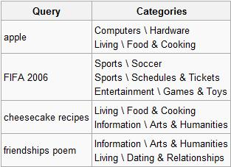
KDD Cup 2005
The objective of this competition is to classify 800,000 real user queries into 67 target categories. Each query can belong to more than one target category. As an example of a QC task, given the query “apple”, it should be classified into ranked categories: “Computers \ Hardware; Living \ Food & Cooking”.

Slide 15
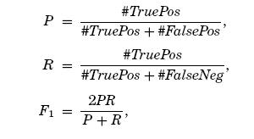
KDD Cup 2005 (contd..)‏
Each participant was to classify all queries into as many as five categories.
An evaluation set was created by having three human assessors independently judge 800 queries that were randomly selected from the sample of 800,000.
In all, there were 37 classification runs submitted by 32 individual teams.
Winner - Shen et al. [2005] (Why?)
http://www.sigkdd.org/kdd2005/kddcup.html

Slide 16
Applying Data Mining
Problems regarding search queries:
  User queries are short and vague
  Keyword-matching is simply inefficient
  Mismatches in the document and query space
Any obvious solutions?

Slide 17
Query Expansion (QE)
What is QE?
Types of QE
  Manual: user-driven
  Automatic: based on global and local analysis

Slide 18
Automatic Query Expansion
Global analysis:
  Synonyms
  Stemming
Local analysis:
  Formulate expansion terms based on top-ranked results
QE by mining query logs
  Introduces implicit relevance
  Attempts to solve the problem of Mismatching

Slide 19
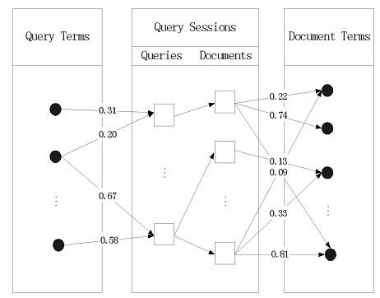
QE by Mining Query Logs
The General Idea:
Hang Cui, Ji-Rong Wen, Jian-Yun Nie, and Wei-Ying Ma. Query Expansion by Mining User Logs. IEEE Transactions on Knowledge and Data Engineering, 15(4):829-839, 2003.

Slide 20
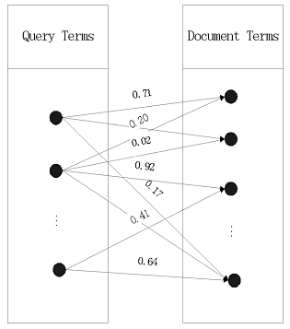
QE by Mining Query Logs
Spatial Correlations:
Hang Cui, Ji-Rong Wen, Jian-Yun Nie, and Wei-Ying Ma. Query Expansion by Mining User Logs. IEEE Transactions on Knowledge and Data Engineering, 15(4):829-839, 2003.

Slide 21
MATH ON!!!

Slide 22
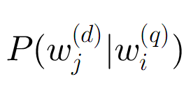
Defining Term Correlation
The Fundamental Property

Slide 23



Defining Term Correlation

Slide 24


Defining Term Correlation
Assumption:
Therefore,

Slide 25

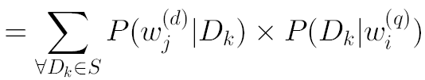
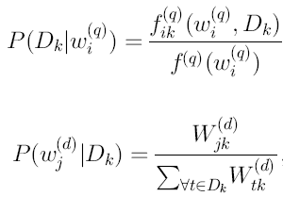
Defining Term Correlation
Final Formula
We have that:

Slide 26
Query log applications – web usage mining
Pattern discovery tool
  The emerging tools for user pattern discovery to mine for knowledge from collected data. (WEBMINER)
  Pattern analysis tool
  Once access patterns have been discovered, analysts need the appropriate tools and techniques to understand, visualize, and interpret these patterns.

Slide 27
Query log applications – user modeling
Adapt different infrastructure according to specific user’s needs.
  short term vs. long term
  group vs. single
  by user vs. user’s behavior
Privacy issues: release these data to third parties. Making the wealth of information available raises serious concerns about the privacy of individuals.

Slide 28
Query log applications – user modeling & query log
Search engine
  Keep improving, adding new query to usage table
  Getting closer to user’s requirement
Advertisements
  Cutting cost, more efficient
  Improving user’s satisfaction level

Slide 29
Query log applications – user modeling & query log
Query corrections
  exploits indicators of the input query’s returning results
  Using both search results of input query and top-ranked candidate
Web-based Intelligent Tutoring Systems
  Locate user knowledge level
  Compare

Slide 30
Query log applications – user modeling & query log
E-business
  locate user’s interests
  compare function, properties, and prices
  track user interests development

Slide 31
Questions
Any other applications might be developed by query log?
Despite conveniences, is there any more potential problems regarding to mining query log?

Slide 32
Privacy Issues
The concept of web mining raises many concerns over privacy. How much do you reveal about yourself online without even realizing it?
What about web applications like Google Calendar which allow you to upload even more personal information just for the convenience of wider access?

