Slide 1
Recommender Systems
March 31, 2008
Aalap Kohojkar
Yang Liu
Zhan Shi

Slide 2
Agenda
What are recommender systems
Why are they useful
What are different types of them
Relation with information architecture
Limitations and possible improvements
Relation with Social Networking
Class Exercise!
Q&A

Slide 3
What are they and Why are they
RS – problem of information filtering
RS – problem of machine learning
Enhance user experience
  Assist users in finding information
  Reduce search and navigation time
Increase productivity
Increase credibility
Mutually beneficial proposition

Slide 4
Types of RS
Three broad types:
Content based RS
Collaborative RS
Hybrid RS

Slide 5
Types of RS – Content based RS
Content based RS highlights
  Recommend items similar to those users preferred in the past
  User profiling is the key
  Items/content usually denoted by keywords
  Matching “user preferences” with “item characteristics” … works for textual information
  Vector Space Model widely used

Slide 6
Types of RS – Content based RS
Content based RS - Limitations
  Not all content is well represented by keywords, e.g. images
  Items represented by same set of features are indistinguishable
  Overspecialization: unrated items not shown
  Users with thousands of purchases is a problem
  New user: No history available
  Shouldn’t show items that are too different, or too similar

Slide 7
Types of RS – Collaborative RS
Collaborative RS highlights
  Use other users recommendations (ratings) to judge item’s utility
  Key is to find users/user groups whose interests match with the current user
  Vector Space model widely used (directions of vectors are user specified ratings)
  More users, more ratings: better results
  Can account for items dissimilar to the ones seen in the past too
  Example: Movielens.org

Slide 8
Types of RS – Collaborative RS
Collaborative RS - Limitations
  Different users might use different scales. Possible solution: weighted ratings, i.e. deviations from average rating
  Finding similar users/user groups isn’t very easy
  New user: No preferences available
  New item: No ratings available
  Demographic filtering is required
  Multi-criteria ratings is required

Slide 9
Other Variations of RS
Cluster Models
  Create clusters or groups
  Put a customer into a category
  Classification simplifies the task of user matching
  More scalability and performance
  Lesser accuracy than normal collaborative filtering method

Slide 10
Other Variations of RS
Item to item collaboration (one that Amazon.com uses)
  Compute similarity between item pairs
  Combine the similar items into recommendation list
  Vector corresponds to an item, and directions correspond to customers who have purchased them
  “Similar items” table built offline
  Example: Amazon.com Example

Slide 11
Other Variations of RS
Algorithm for Amazon’s item to item collaborative
filtering
For each item in product catalog, I1
For each customer C who purchased I1
For each item I2 purchased by customer C
Record that a customer purchased I1
and I2
For each item I2
Compute the similarity between I1 and I2
Similarity between two items depends on number of
customers who bought them both

Slide 12
Other Variations of RS
Knowledge based RS
  Use knowledge of users and items
  Conversational Interaction used to establish current user preferences
  i.e. “more like this”, “less like that”, “none of those” …
  No user profiles maintained, preferences drawn through manual interaction
  Query by example … tweaking the source example to fetch results

Slide 13
Popular RS techniques in E-Commerce
Browsing
Similar Item/s
Email
Text Comments
Average Rating
Top-N results
Ordered search results

Slide 14
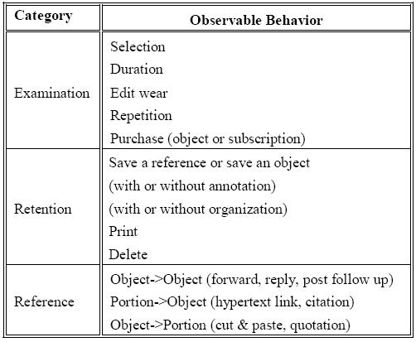
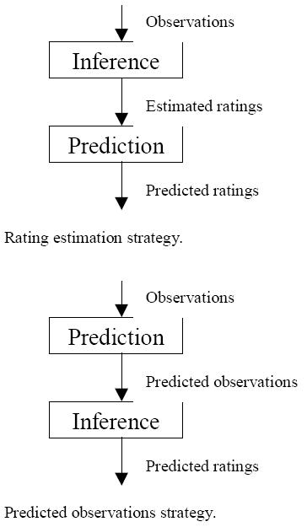
Implicit Feedback in RS
Observable behavior for implicit feedback

Slide 15
Relevance to information architecture
Increase findability
Reduce searching efforts
Improve organizational systems
Enhance browsing
Provide more useful “local navigation” options
“Targeted Advertising” a much better substitute to common advertisements that are often irrelevant

Slide 16
Some general considerations in RS
Difficult to Set Up
  Lot of development required for setup
  Moving to RS takes time, energy and long-term commitment
They could be wrong
  RS not just a technical challenge, but also a social challenge
  Amazon took some heat when it started cross-promoting its new Clothing site by recommending clean underwear to people who were shopping for DVD
Maintenance

Slide 17
Some general considerations in RS
Context is important in “user X items” space
Similarity is a non-uniform concept, is highly contextual and task-oriented
Users sometimes need motivation to rate items

Slide 18
Possible Improvement in RS
Better understanding of users and items
Social network (social RS)
User level
  Highlighting interests, hobbies, and keywords people have in common
Item level
  link the keywords to eCommerce (by RS algorithms)

Slide 19
Possible Improvement in RS
System transparency
Help users understand how the RS works
Example:
http://www.pandora.com/
Amazon.com
Result:
  Generate trust
  Convince users

Slide 20
Possible Improvement in RS
Multidimensionality of Recommendations
Take into consideration the contextual information
Examples:
Movie
Travel

Slide 21
Possible Improvement in RS
Randomness

Slide 22
Possible Improvement in RS
Other
Gift
Amazon
Privacy (CF methods)
One-way hash: easily computed one direction, impossible in the other
Malicious use (recommendation spam)
Probabilistic techniques to determine the honesty of a score (unusual pattern)

Slide 23
Possible Improvement in RS
Common business models adapted:
  Charge recipient of recommendations
  Provide incentives for giving ratings
  Targeted advertisements
  Charge owners of the items

Slide 24
Possible Improvement in RS
Complicated Problems
People might change minds afterwards
Study: The variations of an individual’s own opinion

Slide 25
Exercise
Is imdb.com a recommender system?
Compare and contrast implicit and explicit feedback methods for RS
If I start a company that sells only one type of product, or product line, would I prefer content based RS or collaborative RS?
New item is a problem in Content based or collaborative RS?

Slide 26
THANK YOU !!!
Questions??

