Slide 1
Cloud Computing Lecture #2
Introduction to MapReduce
Jimmy Lin
The iSchool
University of Maryland
Monday, September 8, 2008
Some material adapted from slides by Christophe Bisciglia, Aaron Kimball, & Sierra Michels-Slettvet, Google Distributed Computing Seminar, 2007 (licensed under Creation Commons Attribution 3.0 License)
This work is licensed under a Creative Commons Attribution-Noncommercial-Share Alike 3.0 United States
See http://creativecommons.org/licenses/by-nc-sa/3.0/us/ for details

Slide 2
Today’s Topics
Functional programming
MapReduce
Distributed file system

Slide 3
Functional Programming
MapReduce = functional programming meets distributed processing on steroids
  Not a new idea… dates back to the 50’s (or even 30’s)
What is functional programming?
  Computation as application of functions
  Theoretical foundation provided by lambda calculus
How is it different?
  Traditional notions of “data” and “instructions” are not applicable
  Data flows are implicit in program
  Different orders of execution are possible
Exemplified by LISP and ML

Slide 4
Overview of Lisp
Lisp ≠ Lost In Silly Parentheses
We’ll focus on particular a dialect: “Scheme”
Lists are primitive data types
Functions written in prefix notation
'(1 2 3 4 5)
'((a 1) (b 2) (c 3))
(+ 1 2) → 3
(* 3 4) → 12
(sqrt (+ (* 3 3) (* 4 4))) → 5
(define x 3) → x
(* x 5) → 15

Slide 5
Functions
Functions = lambda expressions bound to variables
Syntactic sugar for defining functions
  Above expressions is equivalent to:
Once defined, function can be applied:
(define foo
(lambda (x y)
(sqrt (+ (* x x) (* y y)))))
(define (foo x y)
(sqrt (+ (* x x) (* y y))))
(foo 3 4) → 5

Slide 6
Other Features
In Scheme, everything is an s-expression
  No distinction between “data” and “code”
  Easy to write self-modifying code
Higher-order functions
  Functions that take other functions as arguments
(define (bar f x) (f (f x)))
Doesn’t matter what f is, just apply it twice.
(define (baz x) (* x x))
(bar baz 2) → 16

Slide 7
Recursion is your friend
Simple factorial example
Even iteration is written with recursive calls!
(define (factorial n)
(if (= n 1)
1
(* n (factorial (- n 1)))))
(factorial 6) → 720
(define (factorial-iter n)
(define (aux n top product)
(if (= n top)
(* n product)
(aux (+ n 1) top (* n product))))
(aux 1 n 1))
(factorial-iter 6) → 720

Slide 8
Lisp → MapReduce?
What does this have to do with MapReduce?
After all, Lisp is about processing lists
Two important concepts in functional programming
  Map: do something to everything in a list
  Fold: combine results of a list in some way

Slide 9
Map
Map is a higher-order function
How map works:
  Function is applied to every element in a list
  Result is a new list
f
f
f
f
f

Slide 10
Fold
Fold is also a higher-order function
How fold works:
  Accumulator set to initial value
  Function applied to list element and the accumulator
  Result stored in the accumulator
  Repeated for every item in the list
  Result is the final value in the accumulator
f
f
f
f
f
final value
Initial value

Slide 11
Map/Fold in Action
Simple map example:
Fold examples:
Sum of squares:
(map (lambda (x) (* x x))
'(1 2 3 4 5))
→ '(1 4 9 16 25)
(fold + 0 '(1 2 3 4 5)) → 15
(fold * 1 '(1 2 3 4 5)) → 120
(define (sum-of-squares v)
(fold + 0 (map (lambda (x) (* x x)) v)))
(sum-of-squares '(1 2 3 4 5)) → 55

Slide 12
Lisp → MapReduce
Let’s assume a long list of records: imagine if...
  We can parallelize map operations
  We have a mechanism for bringing map results back together in the fold operation
That’s MapReduce! (and Hadoop)
Observations:
  No limit to map parallelization since maps are indepedent
  We can reorder folding if the fold function is commutative and associative

Slide 13
Typical Problem
Iterate over a large number of records
Extract something of interest from each
Shuffle and sort intermediate results
Aggregate intermediate results
Generate final output
Map
Reduce
Key idea: provide an abstraction at the point of these two operations

Slide 14
MapReduce
Programmers specify two functions:
  map (k, v) → <k’, v’>*
  reduce (k’, v’) → <k’, v’>*
  All v’ with the same k’ are reduced together
Usually, programmers also specify:
  partition (k’, number of partitions ) → partition for k’
  Often a simple hash of the key, e.g. hash(k’) mod n
  Allows reduce operations for different keys in parallel
Implementations:
  Google has a proprietary implementation in C++
  Hadoop is an open source implementation in Java (lead by Yahoo)

Slide 15
It’s just divide and conquer!
Data Store
Initial kv pairs
Initial kv pairs
Initial kv pairs
Initial kv pairs
map
map
map
map
k₁, values…
k₃, values…
k₁, values…
k₃, values…
k₁, values…
k₃, values…
k₁, values…
k₃, values…
k₂, values…
k₂, values…
k₂, values…
k₂, values…
Barrier: aggregate values by keys
k₁, values…
k₂, values…
k₃, values…
reduce
reduce
reduce
final k₁ values
final k₂ values
final k₃ values

Slide 16
Recall these problems?
How do we assign work units to workers?
What if we have more work units than workers?
What if workers need to share partial results?
How do we aggregate partial results?
How do we know all the workers have finished?
What if workers die?

Slide 17
MapReduce Runtime
Handles scheduling
  Assigns workers to map and reduce tasks
Handles “data distribution”
  Moves the process to the data
Handles synchronization
  Gathers, sorts, and shuffles intermediate data
Handles faults
  Detects worker failures and restarts
Everything happens on top of a distributed FS (later)

Slide 18
“Hello World”: Word Count
Map(String input_key, String input_value):
// input_key: document name
// input_value: document contents
for each word w in input_values:
EmitIntermediate(w, "1");
Reduce(String key, Iterator intermediate_values):
// key: a word, same for input and output
// intermediate_values: a list of counts
int result = 0;
for each v in intermediate_values:
result += ParseInt(v);
Emit(AsString(result));

Slide 19
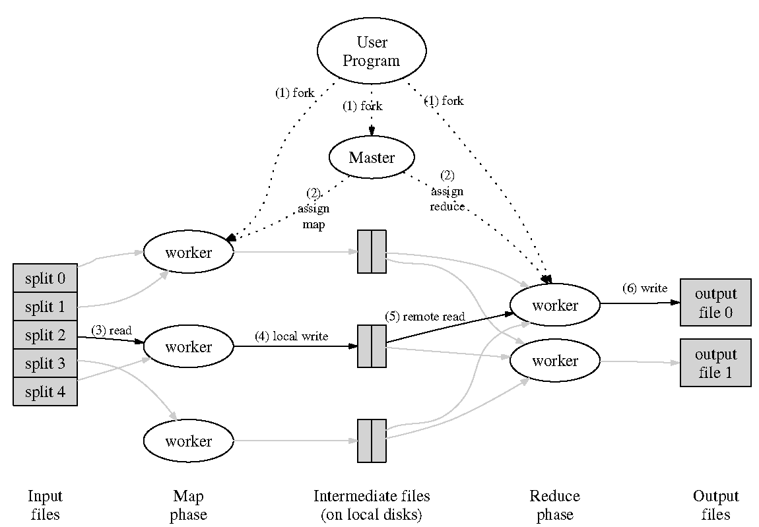
Source: Dean and Ghemawat (OSDI 2004)

Slide 20
Bandwidth Optimization
Issue: large number of key-value pairs
Solution: use “Combiner” functions
  Executed on same machine as mapper
  Results in a “mini-reduce” right after the map phase
  Reduces key-value pairs to save bandwidth

Slide 21
Skew Problem
Issue: reduce is only as fast as the slowest map
Solution: redundantly execute map operations, use results of first to finish
  Addresses hardware problems...
  But not issues related to inherent distribution of data

Slide 22

How do we get data to the workers?
NAS
SAN
Compute Nodes
What’s the problem here?

Slide 23
Distributed File System
Don’t move data to workers… Move workers to the data!
  Store data on the local disks for nodes in the cluster
  Start up the workers on the node that has the data local
Why?
  Not enough RAM to hold all the data in memory
  Disk access is slow, disk throughput is good
A distributed file system is the answer
  GFS (Google File System)
  HDFS for Hadoop

Slide 24
GFS: Assumptions
Commodity hardware over “exotic” hardware
High component failure rates
  Inexpensive commodity components fail all the time
“Modest” number of HUGE files
Files are write-once, mostly appended to
  Perhaps concurrently
Large streaming reads over random access
High sustained throughput over low latency
GFS slides adapted from material by Dean et al.

Slide 25
GFS: Design Decisions
Files stored as chunks
  Fixed size (64MB)
Reliability through replication
  Each chunk replicated across 3+ chunkservers
Single master to coordinate access, keep metadata
  Simple centralized management
No data caching
  Little benefit due to large data sets, streaming reads
Simplify the API
  Push some of the issues onto the client

Slide 26

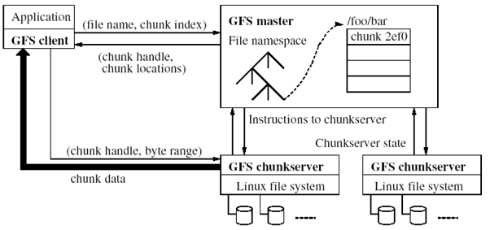
Source: Ghemawat et al. (SOSP 2003)

Slide 27
Single Master
We know this is a:
  Single point of failure
  Scalability bottleneck
GFS solutions:
  Shadow masters
  Minimize master involvement
    Never move data through it, use only for metadata (and cache metadata at clients)
    Large chunk size
    Master delegates authority to primary replicas in data mutations (chunk leases)
Simple, and good enough!

Slide 28
Master’s Responsibilities (1/2)
Metadata storage
Namespace management/locking
Periodic communication with chunkservers
  Give instructions, collect state, track cluster health
Chunk creation, re-replication, rebalancing
  Balance space utilization and access speed
  Spread replicas across racks to reduce correlated failures
  Re-replicate data if redundancy falls below threshold
  Rebalance data to smooth out storage and request load

Slide 29
Master’s Responsibilities (2/2)
Garbage Collection
  Simpler, more reliable than traditional file delete
  Master logs the deletion, renames the file to a hidden name
  Lazily garbage collects hidden files
Stale replica deletion
  Detect “stale” replicas using chunk version numbers

Slide 30
Metadata
Global metadata is stored on the master
  File and chunk namespaces
  Mapping from files to chunks
  Locations of each chunk’s replicas
All in memory (64 bytes / chunk)
  Fast
  Easily accessible
Master has an operation log for persistent logging of critical metadata updates
  Persistent on local disk
  Replicated
  Checkpoints for faster recovery

Slide 31
Mutations
Mutation = write or append
  Must be done for all replicas
Goal: minimize master involvement
Lease mechanism:
  Master picks one replica as primary; gives it a “lease” for mutations
  Primary defines a serial order of mutations
  All replicas follow this order
  Data flow decoupled from control flow

Slide 32
Parallelization Problems
How do we assign work units to workers?
What if we have more work units than workers?
What if workers need to share partial results?
How do we aggregate partial results?
How do we know all the workers have finished?
What if workers die?
How is MapReduce different?

Slide 33

From Theory to Practice
1. Scp data to cluster
2. Move data into HDFS
3. Develop code locally
4. Submit MapReduce job
4a. Go back to Step 3
Hadoop Cluster
You
5. Move data out of HDFS
6. Scp data from cluster

Slide 34
On Amazon: With EC2
0. Allocate Hadoop cluster
1. Scp data to cluster
2. Move data into HDFS
EC2
3. Develop code locally
4. Submit MapReduce job
4a. Go back to Step 3
You
Your Hadoop Cluster
5. Move data out of HDFS
6. Scp data from cluster
7. Clean up!
Uh oh. Where did the data go?

Slide 35
On Amazon: EC2 and S3
Copy from S3 to HDFS
EC2
(The Cloud)
S3
(Persistent Store)
Your Hadoop Cluster
Copy from HFDS to S3

Slide 36
Questions?

