Slide 1
Cloud Computing Lecture #3
More MapReduce
Jimmy Lin
The iSchool
University of Maryland
Wednesday, September 10, 2008
Material adapted from: Jimmy Lin. Scalable Language Processing Algorithms for the Masses: A Case Study in Computing Word Co-occurrence Matrices with MapReduce. Proceedings of EMNLP 2008.
This work is licensed under a Creative Commons Attribution-Noncommercial-Share Alike 3.0 United States
See http://creativecommons.org/licenses/by-nc-sa/3.0/us/ for details

Slide 2
Today’s Topics
Synchronization and coordinating partial results
Use of complex keys and values

Slide 3
Managing Dependencies
Remember: Mappers run in isolation
  You have no idea in what order the mappers run
  You have no idea on what node the mappers run
  You have no idea when each mapper finishes
Tools for synchronization:
  Ability to hold state in reducer across multiple key-value pairs
  Sorting function for keys
  Partitioner
  Cleverly-constructed data structures

Slide 4
Motivating Example
Term co-occurrence matrix for a text collection
  M = N x N matrix (N = vocabulary size)
  M_{ij}: number of times i and j co-occur in some context
  (for concreteness, let’s say context = sentence)
Why?
  Distributional profiles as a way of measuring semantic distance
  Semantic distance useful for many language processing tasks
“You shall know a word by the company it keeps” (Firth, 1957)
e.g., Mohammad and Hirst (EMNLP, 2006)

Slide 5
MapReduce: Large Counting Problems
Term co-occurrence matrix for a text collection
= specific instance of a large counting problem
  A large event space (number of terms)
  A large number of events (the collection itself)
  Goal: keep track of interesting statistics about the events
Basic approach
  Mappers generate partial counts
  Reducers aggregate partial counts
How do we aggregate partial counts efficiently?

Slide 6
First Try: “Pairs”
Each mapper takes a sentence:
  Generate all co-occurring term pairs
  For all pairs, emit (a, b) → count
Reducers sums up counts associated with these pairs
Use combiners!
Note: in all my slides, I denote a key-value pair as k → v

Slide 7
“Pairs” Analysis
Advantages
  Easy to implement, easy to understand
Disadvantages
  Lots of pairs to sort and shuffle around (upper bound?)

Slide 8
Another Try: “Stripes”
Idea: group together pairs into an associative array
Each mapper takes a sentence:
  Generate all co-occurring term pairs
  For each term, emit a → { b: count_{b}, c: count_{c}, d: count_{d} … }
Reducers perform element-wise sum of associative arrays
(a, b) → 1
(a, c) → 2
(a, d) → 5
(a, e) → 3
(a, f) → 2
a → { b: 1, c: 2, d: 5, e: 3, f: 2 }
a → { b: 1, d: 5, e: 3 }
a → { b: 1, c: 2, d: 2, f: 2 }
a → { b: 2, c: 2, d: 7, e: 3, f: 2 }
+

Slide 9
“Stripes” Analysis
Advantages
  Far less sorting and shuffling of key-value pairs
  Can make better use of combiners
Disadvantages
  More difficult to implement
  Underlying object is more heavyweight
  Fundamental limitation in terms of size of event space

Slide 10
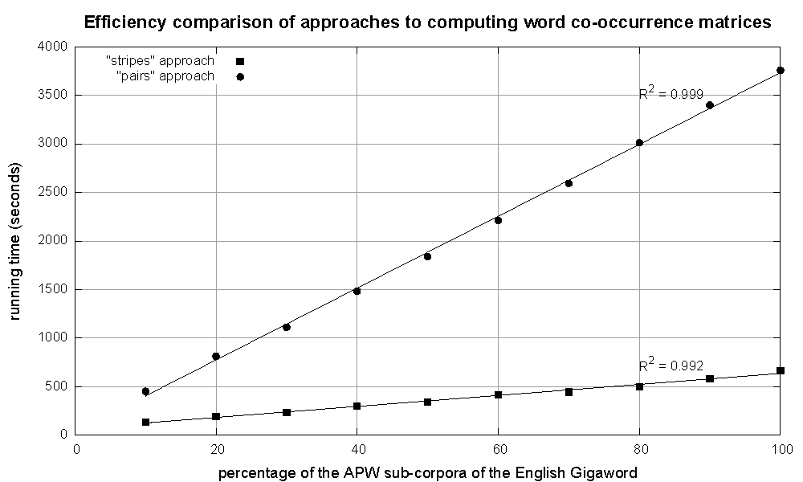
Cluster size: 38 cores
Data Source: Associated Press Worldstream (APW) of the English Gigaword Corpus (v3), which contains 2.27 million documents (1.8 GB compressed, 5.7 GB uncompressed)

Slide 11
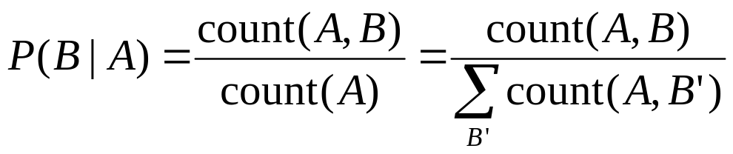
Conditional Probabilities
How do we compute conditional probabilities from counts?
Why do we want to do this?
How do we do this with MapReduce?

Slide 12
P(B|A): “Pairs”
For this to work:
  Must emit extra (a, *) for every b_{n} in mapper
  Must make sure all a’s get sent to same reducer (use Partitioner)
  Must make sure (a, *) comes first (define sort order)
(a, *) → 32
Reducer holds this value in memory
(a, b₁) → 3
(a, b₂) → 12
(a, b₃) → 7
(a, b₄) → 1
…
(a, b₁) → 3 / 32
(a, b₂) → 12 / 32
(a, b₃) → 7 / 32
(a, b₄) → 1 / 32
…

Slide 13
P(B|A): “Stripes”
Easy!
  One pass to compute (a, *)
  Another pass to directly compute P(B|A)
a → {b₁:3, b₂ :12, b₃ :7, b₄ :1, … }

Slide 14
Synchronization in Hadoop
Approach 1: turn synchronization into an ordering problem
  Sort keys into correct order of computation
  Partition key space so that each reducer gets the appropriate set of partial results
  Hold state in reducer across multiple key-value pairs to perform computation
  Illustrated by the “pairs” approach
Approach 2: construct data structures that “bring the pieces together”
  Each reducer receives all the data it needs to complete the computation
  Illustrated by the “stripes” approach

Slide 15
Issues and Tradeoffs
Number of key-value pairs
  Object creation overhead
  Time for sorting and shuffling pairs across the network
Size of each key-value pair
  De/serialization overhead
Combiners make a big difference!
  RAM vs. disk and network
  Arrange data to maximize opportunities to aggregate partial results

Slide 16
Data Types in Hadoop
Writable
Defines a de/serialization protocol. Every data type in Hadoop is a Writable.
WritableComprable
Defines a sort order. All keys must be of this type (but not values).
IntWritable
LongWritable
Text
…
Concrete classes for different data types.

Slide 17
Complex Data Types in Hadoop
How do you implement complex data types?
The easiest way:
  Encoded it as Text, e.g., (a, b) = “a:b”
  Use regular expressions to parse and extract data
  Works, but pretty hack-ish
The hard way:
  Define a custom implementation of WritableComprable
  Must implement: readFields, write, compareTo
  Computationally efficient, but slow for rapid prototyping
Alternatives:
  Cloud⁹ offers two other choices: Tuple and JSON

Slide 18
Questions?

