Slide 1
Cloud Computing Lecture #4
Information Retrieval with MapReduce
Jimmy Lin
The iSchool
University of Maryland
Wednesday, September 17, 2008
This work is licensed under a Creative Commons Attribution-Noncommercial-Share Alike 3.0 United States
See http://creativecommons.org/licenses/by-nc-sa/3.0/us/ for details

Slide 2
Today’s Topics
Introduction to IR
Boolean retrieval
Ranked retrieval
IR with MapReduce

Slide 3
The Information Retrieval Cycle
Source
Selection
Resource
Query
Formulation
Query
Search
Results
Selection
Documents
System discovery
Vocabulary discovery
Concept discovery
Document discovery
Examination
Information
source reselection
Delivery

Slide 4


The Central Problem in Search
Author
Searcher
Concepts
Concepts
Query Terms
Document Terms
“tragic love story”
“fateful star-crossed romance”
Do these represent the same concepts?
Notes:
Why is IR hard? Because language is hard!

Slide 5
Architecture of IR Systems
Documents
Query
online
offline
Representation
Function
Representation
Function
Query Representation
Document Representation
Index
Comparison
Function
Hits

Slide 6
How do we represent text?
Remember: computers don’t “understand” anything!
“Bag of words”
  Treat all the words in a document as index terms for that document
  Assign a “weight” to each term based on “importance”
  Disregard order, structure, meaning, etc. of the words
  Simple, yet effective!
Assumptions
  Term occurrence is independent
  Document relevance is independent
  “Words” are well-defined

Slide 7
What’s a word?
天主教教宗若望保祿二世因感冒再度住進醫院。這是他今年第二度因同樣的病因住院。
وقال مارك ريجيف - الناطق باسم
الخارجية الإسرائيلية - إن شارون قبل
الدعوة وسيقوم للمرة الأولى بزيارة
تونس، التي كانت لفترة طويلة المقر
الرسمي لمنظمة التحرير الفلسطينية بعد خروجها من لبنان عام 1982.
Выступая в Мещанском суде Москвы экс-глава ЮКОСа заявил не совершал ничего противозаконного, в чем обвиняет его генпрокуратура России.
भारत सरकार ने आर्थिक सर्वेक्षण में वित्तीय वर्ष 2005-06 में सात फ़ीसदी विकास दर हासिल करने का आकलन किया है और कर सुधार पर ज़ोर दिया है
日米連合で台頭中国に対処…アーミテージ前副長官提言
조재영 기자= 서울시는 25일 이명박 시장이 `행정중심복합도시'' 건설안에 대해 `군대라도 동원해 막고싶은 심정''이라고 말했다는 일부 언론의 보도를 부인했다.

Slide 8
Sample Document
McDonald's slims down spuds
Fast-food chain to reduce certain types of fat in its french fries with new cooking oil.
NEW YORK (CNN/Money) - McDonald's Corp. is cutting the amount of "bad" fat in its french fries nearly in half, the fast-food chain said Tuesday as it moves to make all its fried menu items healthier.
But does that mean the popular shoestring fries won't taste the same? The company says no. "It's a win-win for our customers because they are getting the same great french-fry taste along with an even healthier nutrition profile," said Mike Roberts, president of McDonald's USA.
But others are not so sure. McDonald's will not specifically discuss the kind of oil it plans to use, but at least one nutrition expert says playing with the formula could mean a different taste.
Shares of Oak Brook, Ill.-based McDonald's (MCD: down $0.54 to $23.22, Research, Estimates) were lower Tuesday afternoon. It was unclear Tuesday whether competitors Burger King and Wendy's International (WEN: down $0.80 to $34.91, Research, Estimates) would follow suit. Neither company could immediately be reached for comment.
…
“Bag of Words”
16 × said
14 × McDonalds
12 × fat
11 × fries
8 × new
6 × company, french, nutrition
5 × food, oil, percent, reduce, taste, Tuesday
…

Slide 9
Boolean Retrieval
Users express queries as a Boolean expression
  AND, OR, NOT
  Can be arbitrarily nested
Retrieval is based on the notion of sets
  Any given query divides the collection into two sets:
  retrieved, not-retrieved
  Pure Boolean systems do not define an ordering of the results

Slide 10
Representing Documents
Document 1
Term
Document 1
Document 2
The quick brown
fox jumped over
the lazy dog’s
back.
aid
0
1
all
0
1
Stopword
List
back
1
0
brown
1
0
come
0
1
for
dog
1
0
is
fox
1
0
of
Document 2
good
0
1
the
jump
1
0
to
lazy
1
0
Now is the time
for all good men
to come to the
aid of their party.
men
0
1
now
0
1
over
1
0
party
0
1
quick
1
0
their
0
1
time
0
1
Notes:
9

Slide 11
Inverted Index
Term
Doc 2
Term
Postings
Doc 3
Doc 1
Doc 4
Doc 5
Doc 6
Doc 7
Doc 8
aid
0
0
0
1
0
0
0
1
aid
4
8
all
0
1
0
1
0
1
0
0
all
2
4
6
back
1
0
1
0
0
0
1
0
back
1
3
7
brown
1
0
1
0
1
0
1
0
brown
1
3
5
7
come
0
1
0
1
0
1
0
1
come
2
4
6
8
dog
0
0
1
0
1
0
0
0
dog
3
5
fox
0
0
1
0
1
0
1
0
fox
3
5
7
good
0
1
0
1
0
1
0
1
good
2
4
6
8
jump
0
0
1
0
0
0
0
0
jump
3
lazy
1
0
1
0
1
0
1
0
lazy
1
3
5
7
men
0
1
0
1
0
0
0
1
men
2
4
8
now
0
1
0
0
0
1
0
1
now
2
6
8
over
1
0
1
0
1
0
1
1
over
1
3
5
7
8
party
0
0
0
0
0
1
0
1
party
6
8
quick
1
0
1
0
0
0
0
0
quick
1
3
their
1
0
0
0
1
0
1
0
their
1
5
7
time
0
1
0
1
0
1
0
0
time
2
4
6
Notes:
12

Slide 12
Boolean Retrieval
To execute a Boolean query:
  Build query syntax tree
  For each clause, look up postings
  Traverse postings and apply Boolean operator
Efficiency analysis
  Postings traversal is linear (assuming sorted postings)
  Start with shortest posting first
AND
( fox or dog ) and quick
quick
OR
fox
dog
dog
3
5
fox
3
5
7
dog
3
5
OR = union
fox
3
5
7
3
5
7

Slide 13
Extensions
Implementing proximity operators
  Store word offset in postings
Handling term variations
  Stem words: love, loving, loves … → lov

Slide 14
Strengths and Weaknesses
Strengths
  Precise, if you know the right strategies
  Precise, if you have an idea of what you’re looking for
  Implementations are fast and efficient
Weaknesses
  Users must learn Boolean logic
  Boolean logic insufficient to capture the richness of language
  No control over size of result set: either too many hits or none
  When do you stop reading? All documents in the result set are considered “equally good”
  What about partial matches? Documents that “don’t quite match” the query may be useful also

Slide 15
Ranked Retrieval
Order documents by how likely they are to be relevant to the information need
  Estimate relevance(q, d_{i})
  Sort documents by relevance
  Display sorted results
User model
  Present hits one screen at a time, best results first
  At any point, users can decide to stop looking
How do we estimate relevance?
  Assume document is relevant if it has a lot of query terms
  Replace relevance (q, d_{i}) with sim(q, d_{i})
  Compute similarity of vector representations

Slide 16
Vector Space Model
t₃
d₂
d₃
d₁
θ
φ
t₁
d₅
t₂
d₄
Assumption: Documents that are “close together” in vector space “talk about” the same things
Therefore, retrieve documents based on how close the document is to the query (i.e., similarity ~ “closeness”)

Slide 17
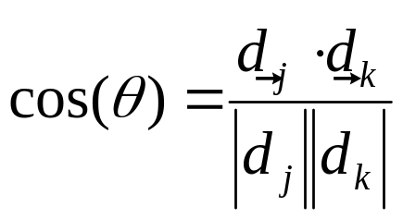
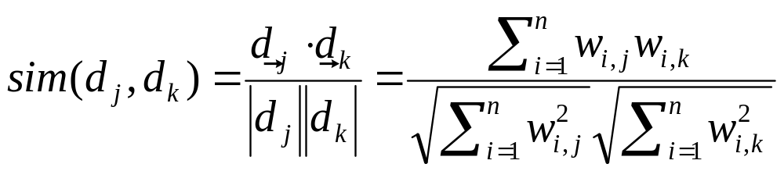
Similarity Metric
How about |d₁ – d₂|?
Instead of Euclidean distance, use “angle” between the vectors
  It all boils down to the inner product (dot product) of vectors

Slide 18
Term Weighting
Term weights consist of two components
  Local: how important is the term in this document?
  Global: how important is the term in the collection?
Here’s the intuition:
  Terms that appear often in a document should get high weights
  Terms that appear in many documents should get low weights
How do we capture this mathematically?
  Term frequency (local)
  Inverse document frequency (global)

Slide 19
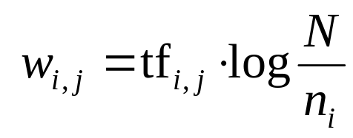
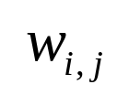
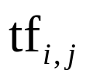


TF.IDF Term Weighting
weight assigned to term i in document j
number of occurrence of term i in document j
number of documents in entire collection
number of documents with term i

Slide 20
TF.IDF Example
tf
1
2
3
4
idf
complicated
5
2
0.301
complicated
0.301
3,5
4,2
contaminated
4
1
3
0.125
contaminated
0.125
1,4
2,1
3,3
fallout
5
4
3
0.125
fallout
0.125
1,5
3,4
4,3
information
6
3
3
2
0.000
information
0.000
1,6
2,3
3,3
4,2
interesting
1
0.602
interesting
0.602
2,1
nuclear
3
7
0.301
nuclear
0.301
1,3
3,7
retrieval
6
1
4
0.125
retrieval
0.125
2,6
3,1
4,4
siberia
2
0.602
siberia
0.602
1,2

Slide 21
Sketch: Scoring Algorithm
Initialize accumulators to hold document scores
For each query term t in the user’s query
  Fetch t’s postings
  For each document, score_{doc} += w_{t,d} × w_{t,q}
Apply length normalization to the scores at end
Return top N documents

Slide 22
MapReduce it?
The indexing problem
  Must be relatively fast, but need not be real time
  For Web, incremental updates are important
The retrieval problem
  Must have sub-second response
  For Web, only need relatively few results

Slide 23
Indexing: Performance Analysis
Inverted indexing is fundamental to all IR models
Fundamentally, a large sorting problem
  Terms usually fit in memory
  Postings usually don’t
How is it done on a single machine?
How large is the inverted index?
  Size of vocabulary
  Size of postings

Slide 24
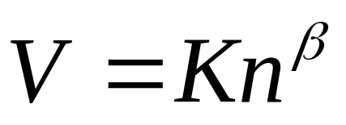
Vocabulary Size: Heaps’ Law
V is vocabulary size
n is corpus size (number of documents)
K and β are constants
Typically, K is between 10 and 100, β is between 0.4 and 0.6
When adding new documents, the system is likely to have seen most terms already… but the postings keep growing
Notes:
22

Slide 25
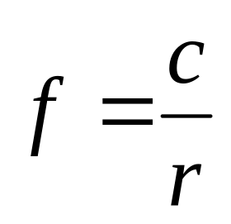
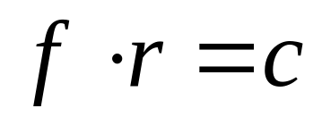
Postings Size: Zipf’s Law
George Kingsley Zipf (1902-1950) observed the following relation between frequency and rank
In other words:
  A few elements occur very frequently
  Many elements occur very infrequently
Zipfian distributions:
  English words
  Library book checkout patterns
  Website popularity (almost anything on the Web)
f = frequency
r = rank
c = constant
or

Slide 26
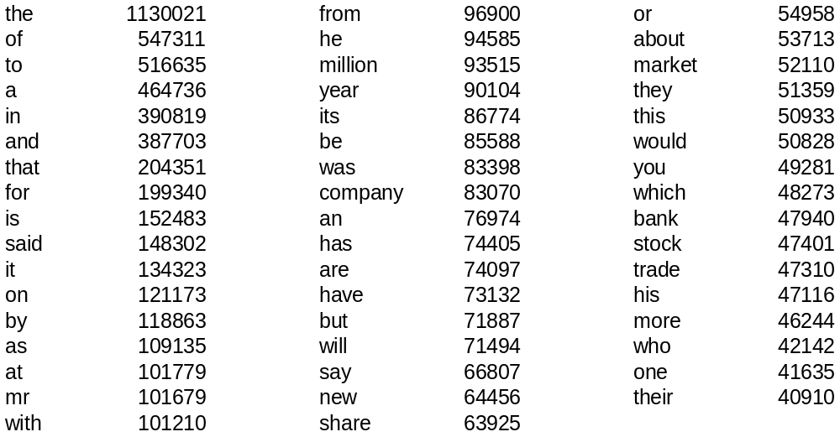
Word Frequency in English
Frequency of 50 most common words in English
(sample of 19 million words)

Slide 27
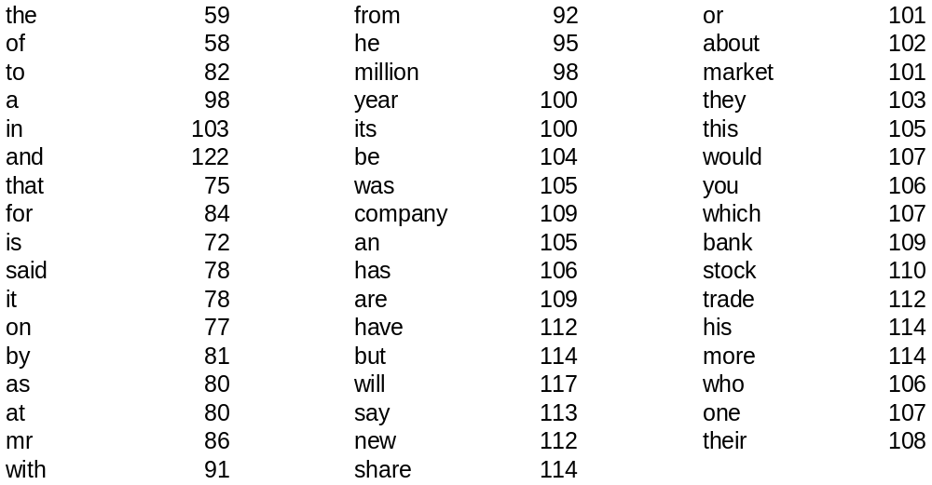
Does it fit Zipf’s Law?
The following shows rf×1000
r is the rank of word w in the sample
f is the frequency of word w in the sample

Slide 28
MapReduce: Index Construction
Map over all documents
  Emit term as key, (docid, tf) as value
  Emit other information as necessary (e.g., term position)
Reduce
  Trivial: each value represents a posting!
  Might want to sort the postings (e.g., by docid or tf)
MapReduce does all the heavy lifting!

Slide 29
Query Execution
MapReduce is meant for large-data batch processing
  Not suitable for lots of real time operations requiring low latency
The solution: “the secret sauce”
  Most likely involves document partitioning
  Lots of system engineering: e.g., caching, load balancing, etc.

Slide 30
MapReduce: Query Execution
High-throughput batch query execution:
  Instead of sequentially accumulating scores per query term:
  Have mappers traverse postings in parallel, emitting partial score components
  Reducers serve as the accumulators, summing contributions for each query term
MapReduce does all the heavy lifting
  Replace random access with sequential reads
  Amortize over lots of queries
  Examine multiple postings in parallel

Slide 31
Questions?

