Slide 1
Cloud Computing Lecture #7
Introduction to Ajax
Jimmy Lin
The iSchool
University of Maryland
Wednesday, October 15, 2008
Material adopted from slides by Ian Graham: http://www.iangraham.org/talks/
This work is licensed under a Creative Commons Attribution-Noncommercial-Share Alike 3.0 United States
See http://creativecommons.org/licenses/by-nc-sa/3.0/us/ for details

Slide 2
What is Cloud Computing?
Web-scale problems
Large data centers
Different models of computing
Highly-interactive Web applications

Slide 3
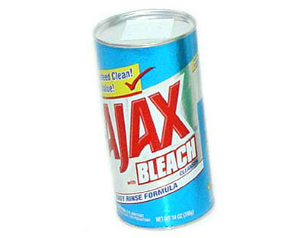
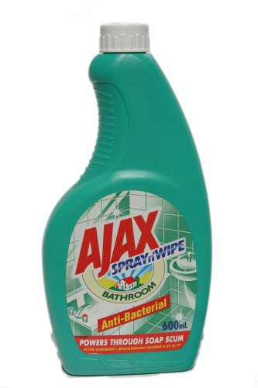

Slide 4
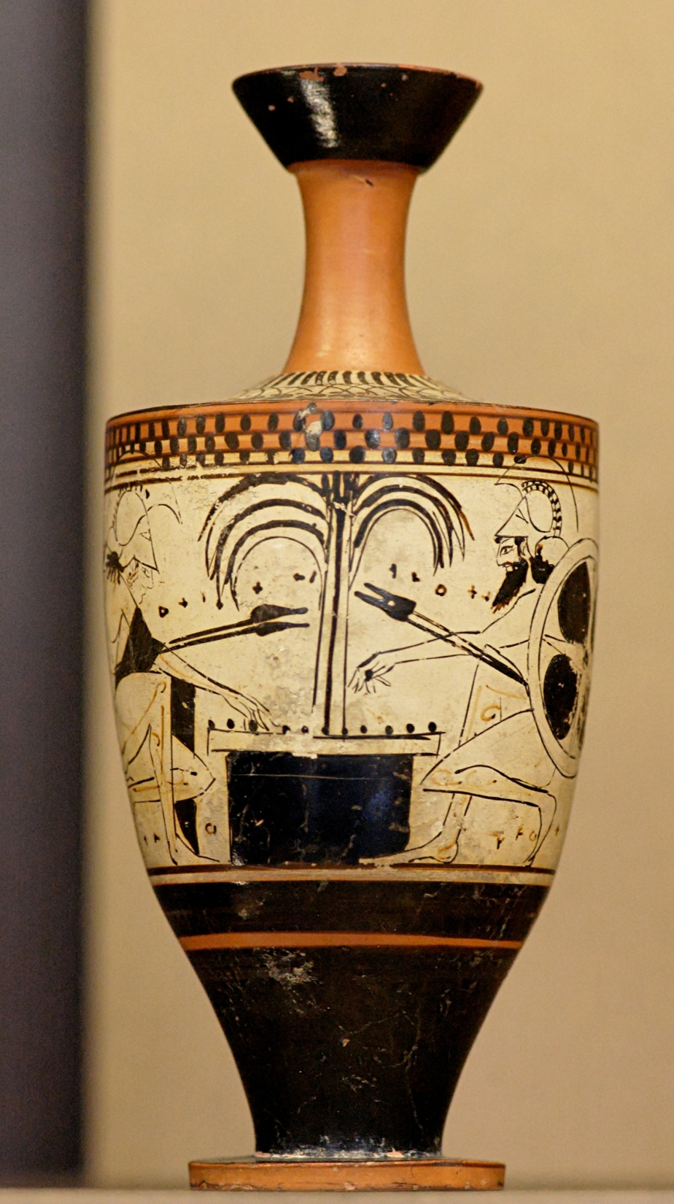
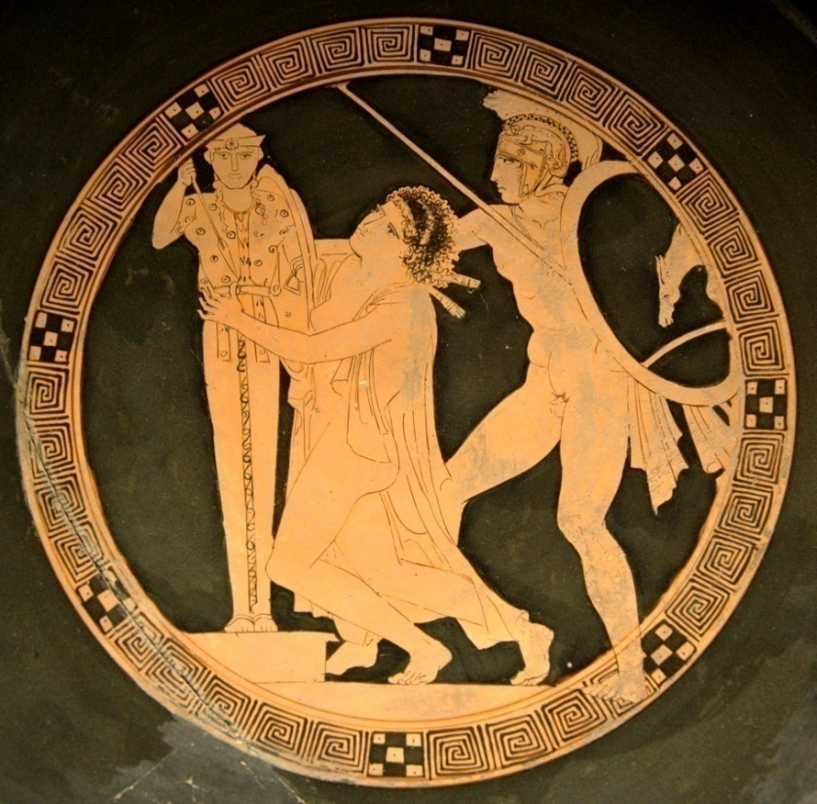
Source: Wikipedia

Slide 5
Ajax
Asynchronous JavaScript and XML: an approach for building interactive Web applications
Ajax refers to a number of technologies:
  XHTML/CSS for presentation
  XML for data exchange (or JSON)
  XMLHttpRequest object for asynchronous communication
  JavaScript to tie everything together
From “old-school” Web applications to Ajax…

Slide 6
“Old-School” Web Applications
browser sends request to server
server generates Web page as a response to the request
user does something
server-side systems
1
3
browser
2
Web
server
backend database
HTTP request
Interface
HTTP response
4
5
data is returned in response to the request
browser replaces view with data sent from server

Slide 7
Characteristics
User-driven: Things only happen when the user does something (e.g., clicks on a link or button)
Views defined by URLs: You can bookmark something and come back to it; use the forward/backward button
Simple user interaction model: Not that many things you can do in browser
Synchronous Interaction: System responses are synchronized with user-driven events

Slide 8
Synchronous Interactions
browser
user activity
user activity
user activity
1
5
2
Request →
Response →
Request →
Response →
Time
4
server-side
3
server processing
server-side systems
server processing
1
browser
HTTP request
2
5
4
HTTP response
3

Slide 9
So what do you run on the server side?
L
A
M
P
Linux
Apache
MySQL
PHP/Python/Perl

Slide 10
From “Old-School” to Ajax
Ajax intermediates between the interface and the server.
browser
server-side systems
Ajax
“engine”
Web
server
backend database
request
Interface
response
data
management
interaction management

Slide 11
Inside the Browser
browser
HTTP request
HTML / CSS
data
Rendering Engine
Interface
other data
(e.g. images)
HTTP response

Slide 12
Enter JavaScript
browser
JavaScript Engine
HTTP request
HTML / CSS
data
JavaScript
code
Rendering Engine
Interface
other data
(e.g. images)
HTTP response

Slide 13
Enter Ajax
browser
HTTP request
XMLHttpRequest
JavaScript Engine
HTTP request
HTML / CSS
data
XML
data
JavaScript
code
Rendering Engine
Interface
other data
(e.g. images)
HTTP response

Slide 14
From Synchronous Interactions…
browser
user activity
user activity
user activity
Request →
Response →
Request →
Response →
Time
server-side
server processing
server processing

Slide 15
To asynchronous Interactions
browser
user activity
client-side processing
Request →
Response →
Request →
Response →
Time
server-side
server processing
server processing

Slide 16
Components of an Ajax Interaction
A client event occurs (captured by JavaScript event handlers)
An XMLHttpRequest object is created and configured
An asynchronous request is made to the server via the XMLHttpRequest object
Server processes request and returns data, executing a callback in the XMLHttpRequest object
The HTML DOM is updated based on response data

Slide 17
DOM
Document Object Model: platform- and language-independent way to represent XML
  Adopts a tree-based representation
  W3C standard, supported by modern browsers
JavaScript uses DOM to manipulate content
  To process user events
  To process server responses (via XMLHttpRequest)

Slide 18
Ajax: Things to watch out for!
Hype
  Best thing since sliced bread?
Application development/maintenance cost
  Brower incompatibilities
  Many different approaches and tools
  For many things, lack of agreed-on best practices
Behavior is not ‘Web-like’
  Standard things often don’t work correctly (e.g., browser ‘back’ button, bookmarks)
  Usability issues for users with disabilities
Security issues
  Whole new class of cross-site scripting (XSS) exploits

Slide 19
Making your life easier…
Dojo: really cool set of interface widgets
http://www.dojotoolkit.org/
Direct Web Remoting: RPC library for calling server-side Java from client-side JavaScript.
http://directwebremoting.org/
jQuery: supports chaining of expressions for more concise code.
http://jquery.com/
Prototype: provides support for more traditional object-oriented programming
http://www.prototypejs.org/

Slide 20
Learning Ajax
Bewildering options:
  PHP vs. Python vs. Perl vs. ASP vs. JSP …
  XML vs. JSON
  Countless toolkits, frameworks, libraries, etc.
Amazing amount of information online:
  Numerous Web tutorials
  Learn by example
  Learn by building

Slide 21
The next frontier?
server-side systems
Interactive Web applications
browser
Apache
MySQL
HTTP request
Interface
HTTP response
Hadoop cluster
MapReduce
HDFS
Backend batch processing

Slide 22
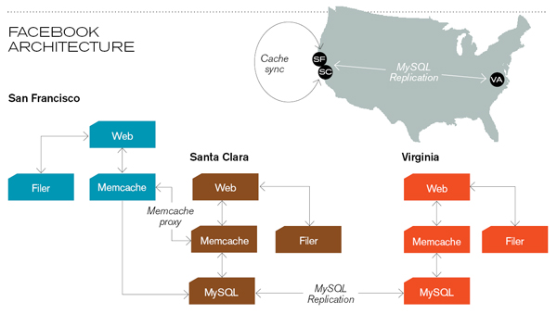
Caching servers: 15 million requests per second, 95% handled by memcache (15 TB of RAM)
Database layer: 800 eight-core Linux servers running MySQL (40 TB user data)
Source: Technology Review (July/August, 2008)

