Slide 1
AJAX:
"The Next Generation of Web Applications”
Who: Ian Graham / IT Strategy and Planning
Email: <ian . graham [at] bmo . com>
Date: 22 June 2007
Talk: http://www.iangraham.org/ian/talks/

Slide 2
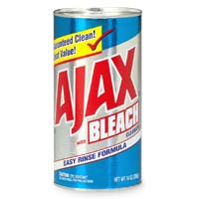
Ajax: The Next Generation of Web Applications? what this talk is about
Ajax
    Asynchronous JavaScript and XML
    A way of – or design pattern for -- building a new style of highly interactive Web application
what will I talk about?
    How browsers traditionally work – the “classic” web
    How Ajax arose – how browsers’ evolved -- and how this makes things different
    What Ajax lets you do – with examples
    Things to think/worry about if building stuff using AJAX
    And if there is time …
      Web 2.0 – what is it and how does AJAX fit in?

Slide 3
Ajax: The Next Generation of Web Applications?
“classic” web applications
browser sends request to server (e.g. for a web page)
server generates web page (html + css) as a response to the request
user does something
server-side systems
1
3
browser
2
web
server
data stores backend etc.
http request
UI
html + css data
4
5
five stages of
each interaction.
Will unpack how this
actually works later on.
data is returned in response to the request
browser replaces view with data sent from server

Slide 4
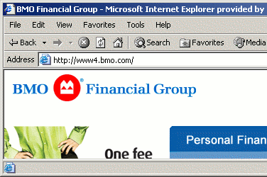
Ajax: The Next Generation of Web Applications? characteristics of “classic”
user-driven. Things only happen when the user clicks on a link, pushes a button, etc.
views defined by address / link. You can bookmark something and come back to it - e.g. http://www.bmo.com -- or use forward/backward button.
simple user interaction.
The user – browser
interaction is very simple:
not like the complex UIs in
apps like Word, PowerPoint
(of course, that is often
a good thing!)

Slide 5
Ajax: The Next Generation of Web Applications? characteristics (cont.)
synchronous. Things happen / are synchronized with user-driven events.
browser
user activity
user activity
User activity
1
5
2
Request →
Response →
Request →
Response →
time
4
server-side
3
server processing
server-side systems
server processing
browser
1
http request
2
4
html + css data
3
5

Slide 6
Ajax: The Next Generation of Web Applications? from “classic” to “Ajax”
Ajax adds an extra layer of functionality on the browser, which helps manage the desktop / user interaction, and intermediates between what the user sees/does and the functionality of – and data sent out by – the server.
browser
server-side systems
browser
UI
JavaScript
calls
Ajax
“engine”
web
server
data stores backend etc.
request
UI
html + css
+ xml data
data mgmt
Desktop UI
“session” management
How does this work? The next slides explain what’s happing under the “browser hood” to support the Ajax approach.

Slide 7
Ajax: The Next Generation of Web Applications? what’s inside a browser so this works?
rendering engine -- takes HTML/CSS data and images, and ‘knows’ how to format and display it.
What really happens “under the
hood” of a “classic” browser.
browser
UI
request
browser
UI
HTML / CSS
data
HTML rendering engine
data
other
data (e.g.
images)
data stores. Browser knows how to save and manage data it downloads.

Slide 8
Ajax: The Next Generation of Web Applications? how it all works --
User clicks on a link: rendering engine / browser sends of a request for
a document.
Data comes back
Browser knows what
to do with it and where
to put it
HTML and CSS go to
the rendering engine,
which starts painting
the screen. This
engine also knows
to send out more
requests for images,
needed in the page.
E.g. http://www.bmo.com; http://www.flickr.com
1
2
browser
3
UI
request
4
1
1
2
4
5
HTML / CSS
data
HTML rendering engine
3
5
data
other
data (e.g.
images)

Slide 9
Ajax: The Next Generation of Web Applications? enter JavaScript (1996-8)
browser
Javascript engine – can run programs downloaded alongside the HTML, CSS and images.
JavaScript programs can detect UI events (clicks, etc.) and run code when the user does something: interactivity is programmable.
UI
JavaScript Engine
HTML / CSS
data
JavaScript
programs
HTML rendering engine
data
other
data (e.g.
images)
JavaScript programs, via the engine, can access and modify the HTML / CSS data, dynamically changing the UI that’s displayed.

Slide 10
Ajax: The Next Generation of Web Applications? simple JavaScript examples
Javascript calculator -- http://www.area48.com/calculator.html
  JavaScript programs monitor the buttons in a form, and read from / write data to the form.
happy faces -- http://www.mozilla.org/docs/dom/samples/dom-css-fonts/bouncingsmile.html
  Uses JavaScript to move characters around on the screen.
interactivity with HTML -- http://www.mozilla.org/docs/dom/samples/dynatable-light/index.html
  Uses JavaScript to edit / modify the data being displayed. Can also grab things and move them on the screen
It took a while for all this to mature. Browsers didn’t support this well, or in the same way, and it was often slow, or buggy.

Slide 11
Ajax: The Next Generation of Web Applications?
Ajax: XML data, and a new tool
browser
a new JavaScript function.. This lets JavaScript programs send out requests for data (images, XML, whatever) on their own, without waiting for a user click.
JavaScript programs can now go off and “do their own thing,” including getting data from elsewhere, without waiting for the user to do something!
XMLHttpRequest()
request
UI
JavaScript Engine
HTML / CSS
data
XML
data
JavaScript
code
HTML rendering engine
data
other
data (e.g.
images)
XML data support. Browsers can now store XML data, and access / manipulate from JavaScript programs via the JavaScript engine.

Slide 12
Ajax: The Next Generation of Web Applications? which brings us to Ajax
browser
XMLHttpRequest()
Ajax is a pattern for building
applications on the browser.
The pattern is:
  Use JavaScript to control the show.
  Use it to asynchronously
  request and retrieve data from
  remote servers, whenever the
  program thinks this is a good
  idea (i.e. not just when the
  user does something),
  Use XML to send numerical or text-style data to the browser. Then use JavaScript to extract data from the XML,
  Use HTML and CSS for display: manipulate this using JavaScript.
UI
JavaScript Engine
A
A
C
HTML / CSS
data
XML
data
JavaScript
Code –
the Ajax
“engine”
HTML rendering engine
B
other
data (e.g.
images)
B
C
A
B
C
control
data
display
JavaScript
XML, other formats
(e.g. images)
HTML and CSS

Slide 13
Ajax: The Next Generation of Web Applications? from “classic” to “Ajax” redux
The Ajax
“engine”
browser
server-side systems
browser
browser
html + css
XMLHttpRequest()
UI
JavaScript Engine
UI
JavaScript
calls
Ajax
“engine”
web
server
data stores backend etc.
request
HTML / CSS
data
XML
data
JavaScript
Code –
Ajax
engine
HTML rendering engine
UI
other
data (e.g.
images)
html + css
+ xml data
data mgmt
Desktop UI
“session” management
Desktop UI
“session” management

Slide 14
Ajax: The Next Generation of Web Applications? before and after Ajax
After:
Before:
Browser
UI:
browser
user activity
user activity
User activity
Ajax:
Request →
Response →
Request →
Response →
time
server-side
time
server processing
server processing
server-side
server processing

Slide 15
Ajax: The Next Generation of Web Applications? example Ajax sites:
http://www.google.com/webhp?complete=1&hl=en
  Google web help – provides hints as you search
http://weboggle.shackworks.com/
  Web-based version of the game ‘boggle’
http://www.kayak.com/, http://www.sidestep.com
  Travel information aggregator – uses Ajax to aggregate to the browser
http:/docs.google.com
  Google docs and spreadsheets --- Group spreadsheet and word processing applications (more services coming)
  More on this when I talk about Web 2.0

Slide 16
Ajax: The Next Generation of Web Applications? how to build Ajax?
Can do it custom, but there are libraries that help, by:
  providing a JavaScript toolkit that perform common functions / behaviors
  supporting multiple browsers (i.e. have built-in workarounds for differences between Internet Explorer 5/6/7, Firefox 1.0/1.5/2.0, others ...)
There are application ‘frameworks’ that support Ajax within a server/application building environment. For example:
  ATLAS (for .NET)
  AJAX-JSF (Java)
  Cajax (PHP)
  Some being provides as part of commercial vendor packages ….
  .... (geeks see: ajaxpatterns.org/Ajax_Frameworks, ajaxpatterns.org/Frameworks_Matrix; en.wikipedia.org/wiki/Ajax_framework
  or search for ‘Open ajax initiative’ or ‘Ajax Framework’ on Google, etc.)

Slide 17
Ajax: The Next Generation of Web Applications? things to worry about?
But of course! Concerns fall into four main categories:
Application development / maintenance cost
  Ajax Libraries are new, and browsers are, well, ‘idiosyncratic’
  No one ideal library
  Not part of most commercial toolsets (i.e. bleeding edge / open source)
  Skills gap: need web-savvy developers (not Java coders)
Behavior is not ‘web-like’
  Standard things (browser ‘back’ button, bookmarks) often don’t work.
  Can confuse users if not careful
  Often have usability problems with the UI (for users with disabilities)
Over-enthusiasm
  Ajax isn’t always the right choice. Many things work fine, if not better, without it!
Security issues
  Whole new avenues to cross-site scripting (XSS) – have to be careful!

Slide 18
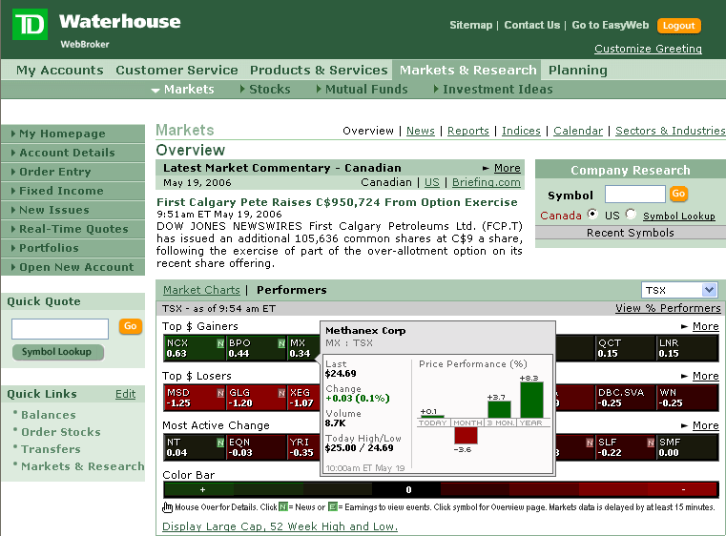

Ajax: The Next Generation of Web Applications? our competitors are using these new technologies to meet growing customer needs
Scotiabank – Market Summary
JP Morgan Chase Investment
Yahoo stock tracker
http://finance.yahoo.com
(Slide courtesy of Simon Zhang, Enterprise Architecture)

Slide 19
Ajax: The Next Generation of Web Applications? ajax is core to Web 2.0
Web 2.0 is about the culture of web applications, not technology. It is about user participation, collaboration, sharing, and community. It’s about the user, a community of users, rather than the producer. It changes how ‘solutions’ are used, and delivered.
Here are some example of ‘traditional’ Web concepts/apps and Web 2.0 ones
All the examples from this talk fall in the Web 2.0 category. Ajax is a key underpinning of Web 2.0
Web 1.0 |  | Web 2.0
Netscape | ➔ | Google
Mp3.com | ➔ | Napster
Britannica Online | ➔ | Wikipedia
Personal websites | ➔ | blogging
Double Click | ➔ | Google AdSense
Akamai | ➔ | BitTorrent
Publishing | ➔ | Participation
….. | ➔ | …..

Slide 20
Ajax: The Next Generation of Web Applications? example of Web 2.0: Google Apps
Google offers an ‘enterprise’ suite of Web 2.0 services (search always included)
  Google Mail (10 GB mailbox)
  Google Calendar
  Personal start page
  Google talk (Free text and voice calling / messaging around the world)
  Google Docs (like Word) and Google Spreadsheets – collaborative tools
  Wiki (coming soon)
  Web Page creator / publisher
  Extensibility APIs (for customization, SSO, etc.)
  Control panels (for domain, user admin)
  24 / 7 support
And costs are….
  Circa $50 per year for one user…..
  $1.7 Million / year for all staff at BMO.

Slide 21
Ajax: The Next Generation of Web Applications? summary and conclusions
Ajax is a pattern for building a new style of web applications using JavaScript, XML, and new browser features as core technical underpinnings
Ajax can lead to really neat stuff!
Ajax has it’s costs, and is not a panacea for all Web site / application ‘problems’
We need to know and experiment with it, to keep up with the neighbors
Web 2.0 is more about the cultural wave that Ajax is a part of
Need to keep track of Web 2.0 too, as it may change how our customers expect us to offer services

Slide 22

Ajax: The Next Generation of Web Applications?
Questions and Answers
Thanks!
Presenter: Ian Graham
Date: June 22, 2007
Location: PES 2007
Talk: http://www.iangraham.org/ian/talks/

