Slide 1
Distributed Computing Seminar
Lecture 4: Clustering – an Overview and Sample MapReduce Implementation
Christophe Bisciglia, Aaron Kimball, & Sierra Michels-Slettvet
Summer 2007
Except as otherwise noted, the content of this presentation is © 2007 Google Inc. and licensed under the Creative Commons Attribution 2.5 License.

Slide 2
Outline
Clustering
  Intuition
  Clustering Algorithms
    The Distance Measure
    Hierarchical vs. Partitional
    K-Means Clustering
  Complexity
  Canopy Clustering
  MapReducing a large data set with K-Means and Canopy Clustering

Slide 3
Clustering
What is clustering?

Slide 4
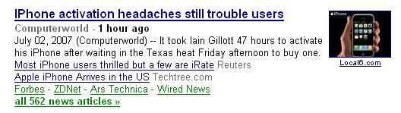

Google News
They didn’t pick all 3,400,217 related articles by hand…
Or Amazon.com
Or Netflix…

Slide 5
Other less glamorous things...
Hospital Records
Scientific Imaging
  Related genes, related stars, related sequences
Market Research
  Segmenting markets, product positioning
Social Network Analysis
Data mining
Image segmentation…

Slide 6
The Distance Measure
How the similarity of two elements in a set is determined, e.g.
  Euclidean Distance
  Manhattan Distance
  Inner Product Space
  Maximum Norm
  Or any metric you define over the space…

Slide 7
Types of Algorithms
Hierarchical Clustering vs.
Partitional Clustering

Slide 8
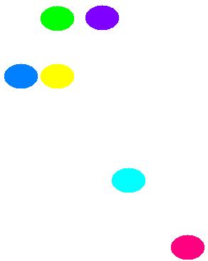
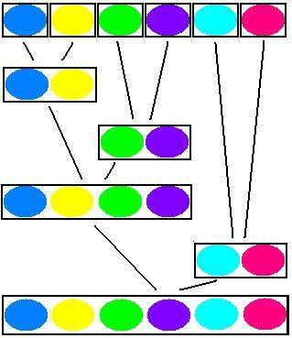
Hierarchical Clustering
Builds or breaks up a hierarchy of clusters.

Slide 9
Partitional Clustering
Partitions set into all clusters simultaneously.

Slide 10
Partitional Clustering
Partitions set into all clusters simultaneously.

Slide 11
K-Means Clustering
Super simple Partitional Clustering
Choose the number of clusters, k
Choose k points to be cluster centers
Then…

Slide 12
K-Means Clustering
iterate {
Compute distance from all points to all k-
centers
Assign each point to the nearest k-center
Compute the average of all points assigned to
all specific k-centers
Replace the k-centers with the new averages
}

Slide 13
But!
The complexity is pretty high:
  k * n * O ( distance metric ) * num (iterations)
Moreover, it can be necessary to send tons of data to each Mapper Node. Depending on your bandwidth and memory available, this could be impossible.

Slide 14
Furthermore
There are three big ways a data set can be large:
  There are a large number of elements in the set.
  Each element can have many features.
  There can be many clusters to discover
Conclusion – Clustering can be huge, even when you distribute it.

Slide 15
Canopy Clustering
Preliminary step to help parallelize computation.
Clusters data into overlapping Canopies using super cheap distance metric.
Efficient
Accurate

Slide 16
Canopy Clustering
While there are unmarked points {
pick a point which is not strongly marked
call it a canopy center
mark all points within some threshold of
it as in it’s canopy
strongly mark all points within some
stronger threshold
}

Slide 17
After the canopy clustering…
Resume hierarchical or partitional clustering as usual.
Treat objects in separate clusters as being at infinite distances.

Slide 18
MapReduce Implementation:
Problem – Efficiently partition a large data set (say… movies with user ratings!) into a fixed number of clusters using Canopy Clustering, K-Means Clustering, and a Euclidean distance measure.

Slide 19
The Distance Metric
The Canopy Metric ($)
The K-Means Metric ($$$)

Slide 20
Steps!
Get Data into a form you can use (MR)
Picking Canopy Centers (MR)
Assign Data Points to Canopies (MR)
Pick K-Means Cluster Centers
K-Means algorithm (MR)
  Iterate!

Slide 21
Data Massage
This isn’t interesting, but it has to be done.

Slide 22
Selecting Canopy Centers

Slide 23
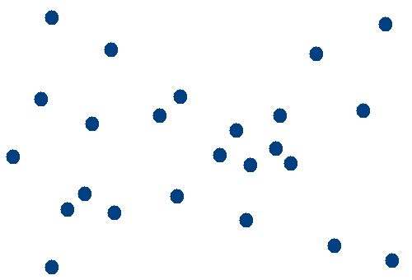

Slide 24
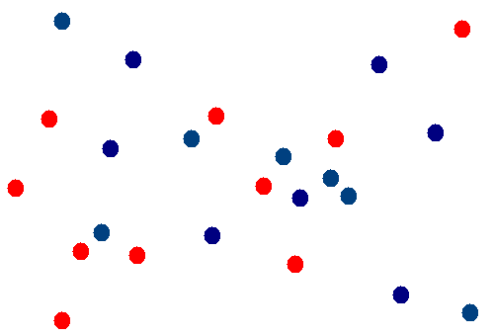

Slide 25
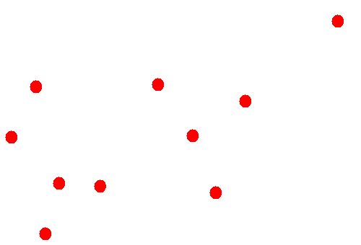

Slide 26
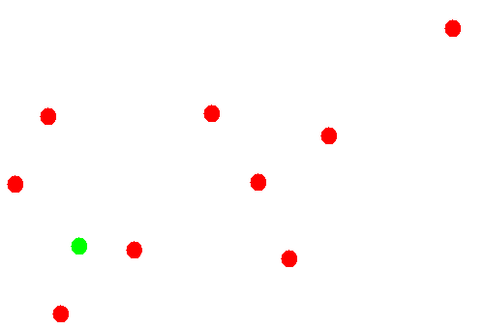

Slide 27
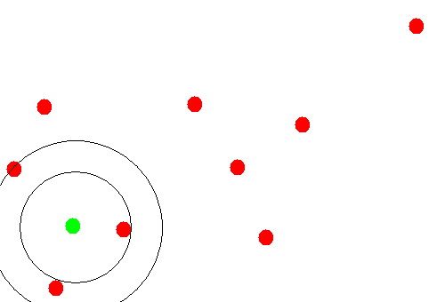

Slide 28
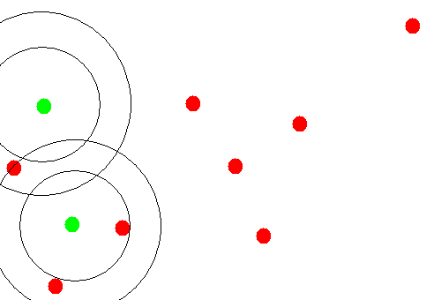

Slide 29
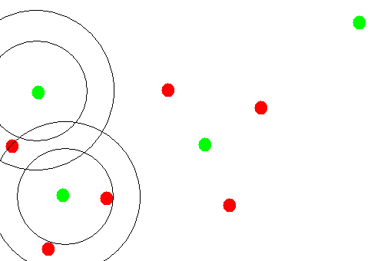

Slide 30
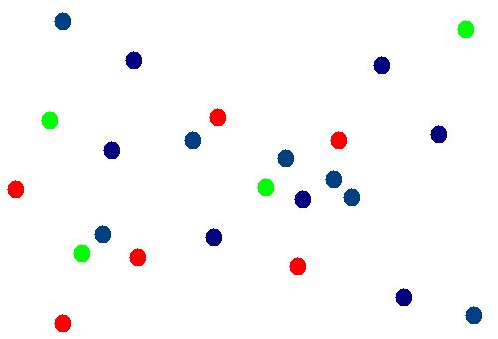

Slide 31
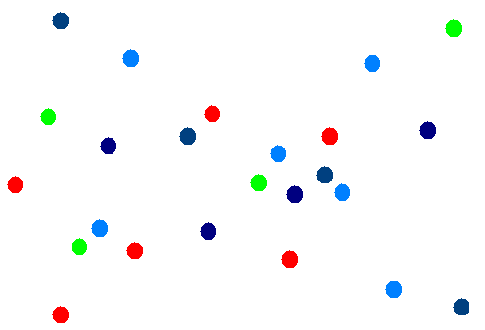

Slide 32
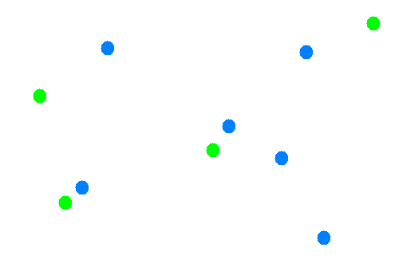

Slide 33
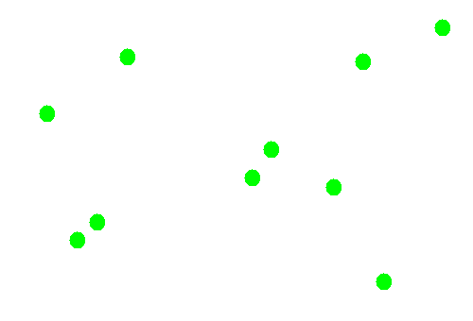

Slide 34
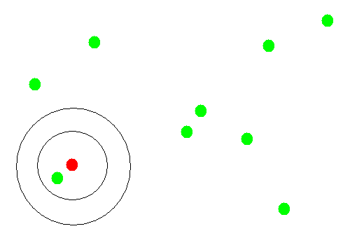

Slide 35
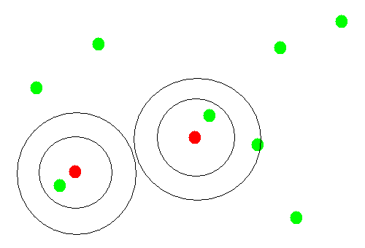

Slide 36
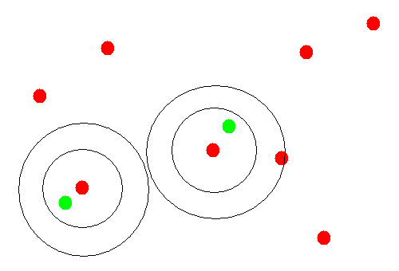

Slide 37
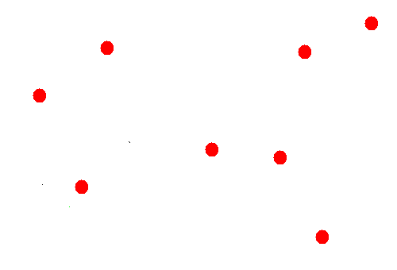

Slide 38
Assigning Points to Canopies

Slide 41
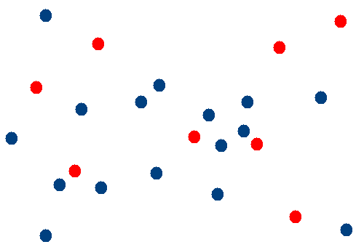

Slide 42
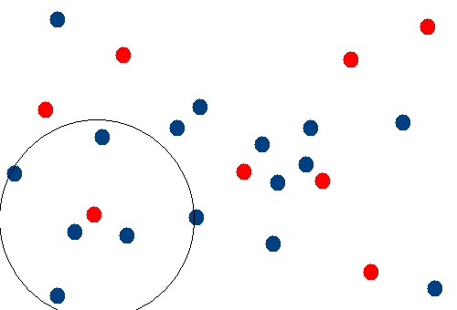

Slide 43
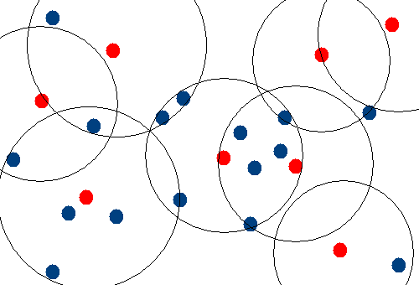

Slide 44
K-Means Map

Slide 45
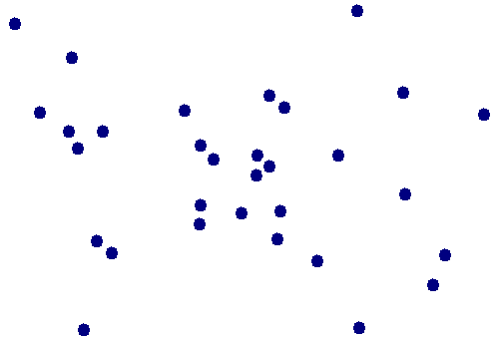

Slide 46
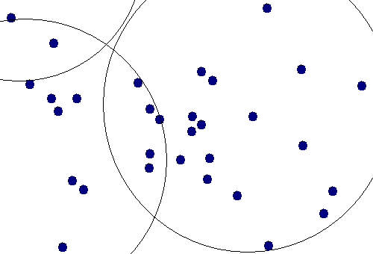

Slide 47
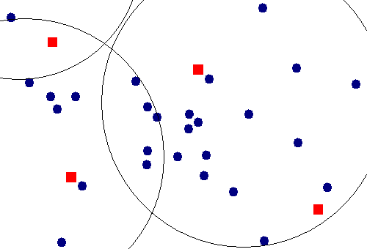

Slide 48
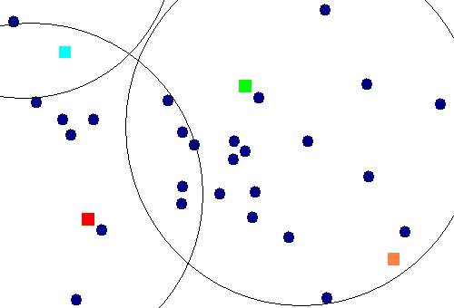

Slide 49
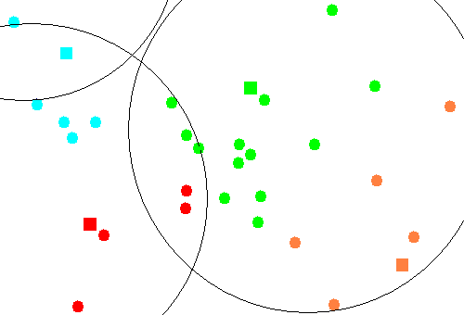

Slide 50
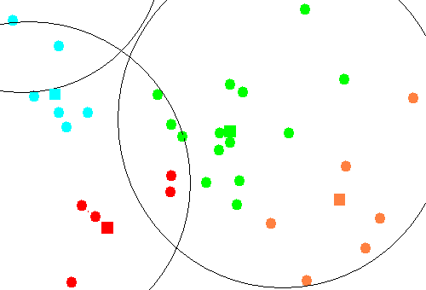

Slide 51


Slide 52
Elbow Criterion
Choose a number of clusters s.t. adding a cluster doesn’t add interesting information.
Rule of thumb to determine what number of Clusters should be chosen.
Initial assignment of cluster seeds has bearing on final model performance.
Often required to run clustering several times to get maximal performance

Slide 53
Conclusions
Clustering is slick
And it can be done super efficiently
And in lots of different ways
Tomorrow! Graph algorithms.

