Slide 1

Computing Pairwise Document
Similarity in Large Collections:
A MapReduce Perspective
Tamer Elsayed, Jimmy Lin, and Douglas W. Oard
Notes:
Today, I will talk about How we use MapReduce framework to efficiently do pairwise similarity in large collections
And this a joint work with ……
--------
Using MapReduce to solve
The aspect of the problem I’m going to talk so I will focus today on scalability
Is not a new problem but our goal here is to do that effeciently

Slide 2
Overview
Abstract Problem
Trivial Solution
MapReduce Solution
Efficiency Tricks
Identity Resolution in Email

Slide 3
Abstract Problem
0.20
0.30
0.54
0.21
0.00
0.34
0.34
0.13
0.74
~~~~~~~~~~~~~~~~~~~~~~~~~~~~~~~~~~~~~~~~
0.20
0.30
0.54
0.21
0.00
0.34
0.34
0.13
0.74
0.20
0.30
0.54
0.21
0.00
0.34
0.34
0.13
0.74
~~~~~~~~~~~~~~~~~~~~~~~~~~~~~~~~~~~~~~~~
~~~~~~~~~~~~~~~~~~~~~~~~~~~~~~~~~~~~~~~~
0.20
0.30
0.54
0.21
0.00
0.34
0.34
0.13
0.74
0.20
0.30
0.54
0.21
0.00
0.34
0.34
0.13
0.74
~~~~~~~~~~~~~~~~~~~~~~~~~~~~~~~~~~~~~~~~
~~~~~~~~~~~~~~~~~~~~~~~~~~~~~~~~~~~~~~~~
Applications:
  Clustering
  Coreference resolution
  “more-like-that” queries
Notes:
Here is the abstract problem
We have a set of docs in a coll, each doc is represented by a vector of term wts
And we want to compute the similarity between every pair of docs in the coll
So clearly it’s a quadratic problem
This appears in different applications. For example: cl, coref, and the kind of “mlt” queries when the user likes a resulted doc and would like to see more like it
-----
There r many applications for this problem: for example clustering, coreference resolution, the kind of “more like this” queries when the user wants to see similar documents to a particular result
A trivial solution to that problem is to take each vector and compute its similarity (dot product) with all other documents
This is not efficient
But that’s not gonna work for large collections, so Our goal is to have a scalable and effiecient solution
U can see that goes up quadratic
Large Collection of documents
Bag of words ➔ vectors
Why we should do that on disk
Rate of growth is N
# of similarities is o(n^2) to compute
If I try to solve this in memory, I will run out
I ultimately have to go to disk in large scale problem
Let me show u how to do that in disk
The key insight is first compute the partial products, then we need to use the partial products
Applications:
“More like that” queries
Clustering: co-reference resolution

Slide 4
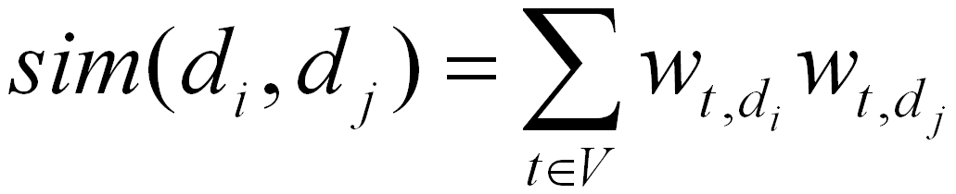
Similarity of Documents
Simple inner product
Cosine similarity
Term weights
  Standard problem in IR
  tf-idf, BM25, etc.
d_{i}
d_{j}

Slide 5
Trivial Solution
load each vector o(N) times
load each term o(df_{t}²) times
Goal
scalable and efficient solution
for large collections
Notes:
A trivial sol is to take each vector and compute its similarity (dot prod) with every other vector in the coll, which means that we will oad each vector o(n) times
This will work for small coll, but our goal is to have a scalable and efficient sol for large colls

Slide 6
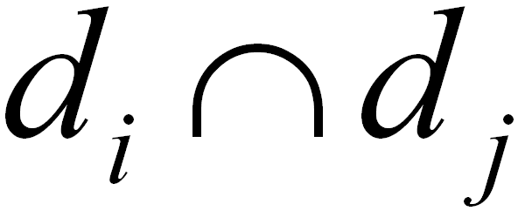
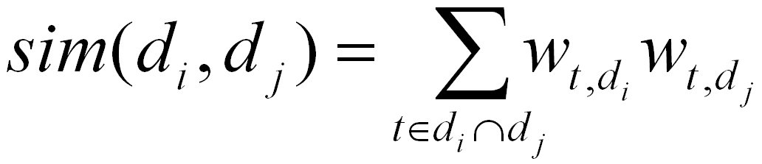
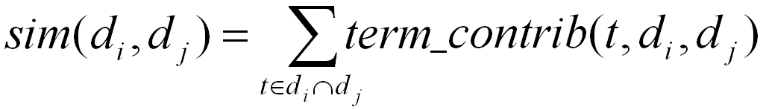
Better Solution
Each term contributes only if appears in
Load weights for each term once
Each term contributes o(df_{t}²) partial scores
Allows efficiency tricks
Notes:
We can have a better solution if we notice that each term contributes to a pair only if it appears in both

Slide 7
Decomposition ➔ MapReduce
Each term contributes only if appears in
reduce
index
map
Load weights for each term once
Each term contributes o(df_{t}²) partial scores
Notes:
This maps well to the mapreduce framework

Slide 8
MapReduce Framework
(a) Map
(b) Shuffle
(c) Reduce
(k₁, v₁)
[k₂, v₂]
Shuffling
group values by: [keys]
input
map
(k₂, [v₂])
[(k₃, v₃)]
reduce
output
input
map
reduce
output
input
map
reduce
output
input
map
handles low-level details transparently
Notes:
So, let me introduce the MapReduce framework here.
MR framework provides a very simple platform to do distributed processing across multiple machines.
It requires the user to define 4 things:
The input processing unit in terms of key, value pairs
Define the map fn that will process each individual input record and produce a list of key-value pairs, possibly of diff types
[each of these pairs will be processed by a user-defined map function to produce a list of key-value pairs]
3) All the will be grouped by keys and each key with the associated list of values will be processed by a second user-defined function: the “reduce” fn
Which finally produces the o/p in list of a possibly third type of key-valuer pairs
So in general we have to define a //le processing data unit, and to decompose the process into two operations: map and reduce
And the framework will handle all the low level details transparently for us, like Scheduling, f tol, data transfer, synch, load balancing
But in turn, we have to be very careful to control/minimize the shuffling phase as we will discuss later
The design has to minimize the shuffling
U do have to pay attention to sperabilty of map and reduce + getting the shuffling right (very easy
U have to define 4 things: specify i/p structure, map, what u suppose to sort on: u have to control the shuffling fn, and reduce
If u have to do this on disk, then there are 3 things to do
Compute partial products/results (the product stage pf the inner prod) We can do that efficiently on disk by working with this data structure (standard IR inverted index) that tells me for a term where it appears
And here is how to do that for ………. Example
and store them on disk,
2) On disk, we must sort the partial products/results so that we can now access them by pairs of document
3) then we do the final computation which is very simple: summation
We have taken the problem and reduced it to 3 steps:
1) Initial processing: Partial prod
2) Sort on disk
3) Produce our results: summation
This is the general framework of MapReduce
A real problem that maps to MapReduce
Morph it
Requires that I define these 4 steps
Setup: Structure of i/p
Processing/ computation
Structure of intermediate
Processing
Mapreduce handle everything: balance the date across macahines/ sorting done for me
So I save time by not having to spend time on thinking about handling those details

Slide 9
Standard Indexing
(a) Map
(b) Shuffle
(c) Reduce
Shuffling
group values by: terms
doc
tokenize
combine
posting list
doc
tokenize
combine
posting list
doc
tokenize
combine
posting list
doc
tokenize
Notes:
Let me show u an example of using mapreduce
It turns out that this what we need ….
U have to compute
indexing
If u have to do this on disk, then there are 3 things to do
Compute partial products/results (the product stage pf the inner prod) We can do that efficiently on disk by working with this data structure (standard IR inverted index) that tells me for a term where it appears
And here is how to do that for ………. Example
and store them on disk,
2) On disk, we must sort the partial products/results so that we can now access them by pairs of document
3) then we do the final computation which is very simple: summation
We have taken the problem and reduced it to 3 steps:
1) Initial processing: Partial prod
2) Sort on disk
3) Produce our results: summation
This is the general framework of MapReduce
A real problem that maps to MapReduce
Morph it
Requires that I define these 4 steps
Setup: Structure of i/p
Processing/ computation
Structure of intermediate
Processing
Mapreduce handle everything: balance the date across macahines/ sorting done for me
So I save time by not having to spend time on thinking about handling those details

Slide 10
Indexing (3-doc toy collection)
Clinton
Obama
Clinton
Clinton
Obama
Clinton
Clinton
Indexing
2
1
1
Clinton
Cheney
Cheney
Clinton
Cheney
1
Barack
1
Clinton
Barack
Obama
Clinton
Barack
Obama
Obama
1
1
Notes:
For simplicity I will use symbols here, so the first one will be a triangle, ….

Slide 11
Pairwise Similarity
(a) Generate pairs
(b) Group pairs
(c) Sum pairs
Clinton
2
2
2
1
2
2
1
2
1
Cheney
1
2
1
3
1
Barack
1
1
Obama
1
1
1
1
Notes:
U have to compute
indexing
If u have to do this on disk, then there are 3 things to do
Compute partial products/results (the product stage pf the inner prod) We can do that efficiently on disk by working with this data structure (standard IR inverted index) that tells me for a term where it appears
And here is how to do that for ………. Example
and store them on disk,
2) On disk, we must sort the partial products/results so that we can now access them by pairs of document
3) then we do the final computation which is very simple: summation
We have taken the problem and reduced it to 3 steps:
1) Initial processing: Partial prod
2) Sort on disk
3) Produce our results: summation
This is the general framework of MapReduce
A real problem that maps to MapReduce
Morph it
Requires that I define these 4 steps
Setup: Structure of i/p
Processing/ computation
Structure of intermediate
Processing
Mapreduce handle everything: balance the date across macahines/ sorting done for me
So I save time by not having to spend time on thinking about handling those details

Slide 12
Pairwise Similarity (abstract)
(a) Generate pairs
(b) Group pairs
(c) Sum pairs
Shuffling
group values by: pairs
term postings
multiply
sum
similarity
term postings
multiply
sum
similarity
term postings
multiply
sum
similarity
term postings
multiply
Notes:
U have to compute
indexing
If u have to do this on disk, then there are 3 things to do
Compute partial products/results (the product stage pf the inner prod) We can do that efficiently on disk by working with this data structure (standard IR inverted index) that tells me for a term where it appears
And here is how to do that for ………. Example
and store them on disk,
2) On disk, we must sort the partial products/results so that we can now access them by pairs of document
3) then we do the final computation which is very simple: summation
We have taken the problem and reduced it to 3 steps:
1) Initial processing: Partial prod
2) Sort on disk
3) Produce our results: summation
This is the general framework of MapReduce
A real problem that maps to MapReduce
Morph it
Requires that I define these 4 steps
Setup: Structure of i/p
Processing/ computation
Structure of intermediate
Processing
Mapreduce handle everything: balance the date across macahines/ sorting done for me
So I save time by not having to spend time on thinking about handling those details

Slide 13

Experimental Setup
Elsayed, Lin, and Oard, ACL 2008
0.16.0
  Open source MapReduce implementation
Cluster of 19 machines
  Each w/ two processors (single core)
Aquaint-2 collection
  906K documents
Okapi BM25
Subsets of collection

Slide 14
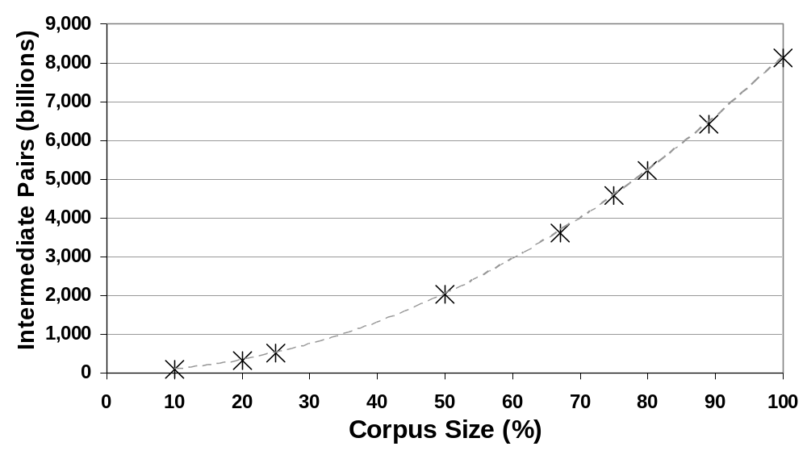
Efficiency (disk space)
Aquaint-2 Collection, ~ 906k docs
8 trillion intermediate pairs
Hadoop, 19 PCs, each: 2 single-core processors, 4GB memory, 100GB disk
Notes:
If we use all the terms, we get 8 trillion pairs and we will have to cut it down so that it fits in memory
As u can see the process is quadratic
And prodcue more pair than what we can store on commodity hw
We hav to cut down on space

Slide 15
Terms: Zipfian Distribution
each term t contributes o(df_{t}²) partial results
very few terms dominate the computations
most frequent term (“said”) ➔ 3%
most frequent 10 terms ➔ 15%
most frequent 100 terms ➔ 57%
most frequent 1000 terms ➔ 95%
doc freq (df)
~0.1% of total terms
(99.9% df-cut)
term rank
Notes:
we know that term frequencies in a collections follows a power law
And that in our problem, each term
Df falls off very quickly
So, df² falls off even more quickly
Freq is inversely proportional to rank

Slide 16
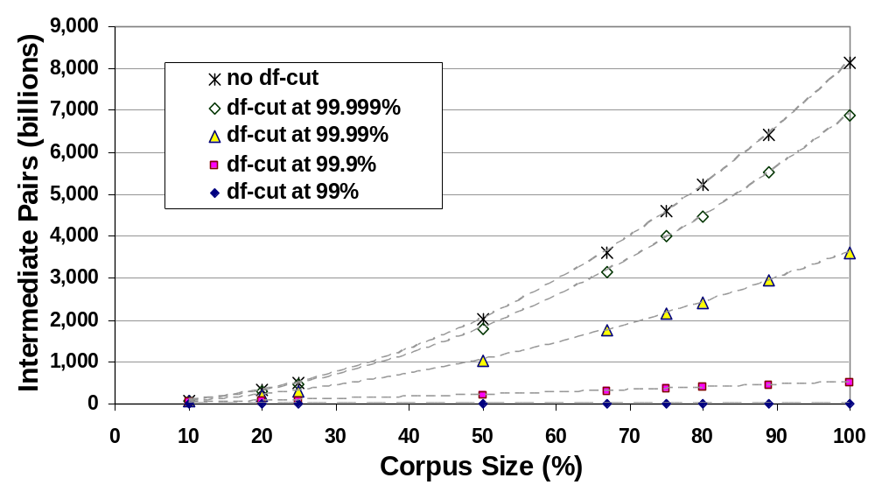
Efficiency (disk space)
Aquaint-2 Collection, ~ 906k doc
8 trillion
intermediate pairs
0.5 trillion intermediate pairs
Hadoop, 19 PCs, each w/: 2 single-core processors, 4GB memory, 100GB disk

Slide 17
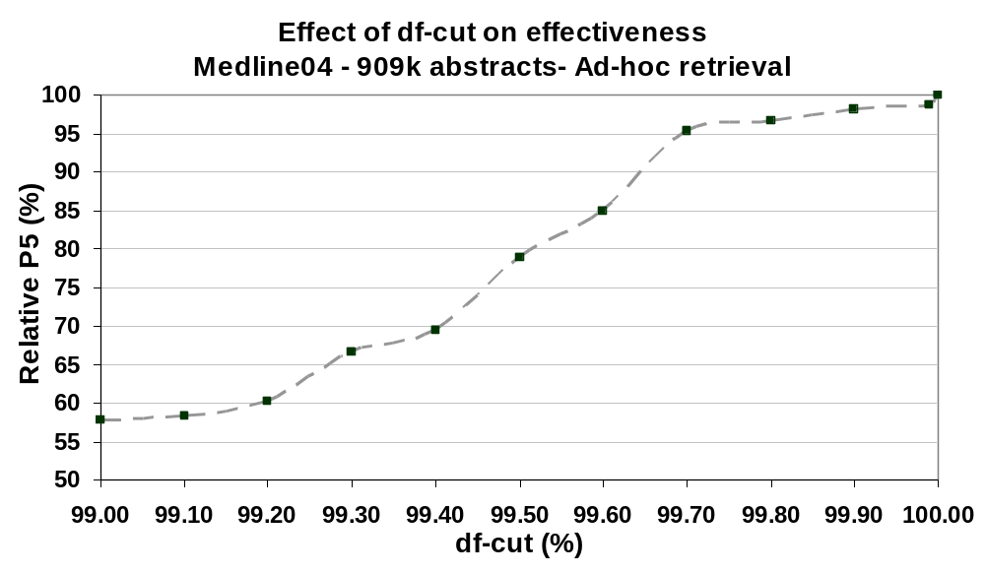
Effectiveness (recent work)
Drop 0.1% of terms
“Near-Linear” Growth
Fit on disk
Cost 2% in Effectiveness
Hadoop, 19 PCs, each w/: 2 single-core processors, 4GB memory, 100GB disk
Notes:
I gave up 2%

Slide 18
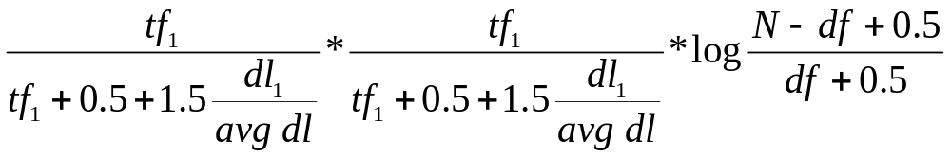
Implementation Issues
BM25s Similarity Model
  TF, IDF
  Document length
DF-Cut
  Build a histogram
  Pick the absolute df for the % df-cut

Slide 19
Other Approximation Techniques ?

Slide 20
Other Approximation Techniques
(2) Absolute df
Consider only terms that appear in at least n (or %) documents
  An absolute lower bound on df, instead of just removing the % most-frequent terms

Slide 21
Other Approximation Techniques
(3) tf-Cut
Consider only documents (in posting list)
with tf > T ; T=1 or 2
OR: Consider only the top N documents based on tf for each term

Slide 22
Other Approximation Techniques
(4) Similarity Threshold
Consider only partial scores > Sim_{T}

Slide 23
Other Approximation Techniques:
(5) Ranked List
Keep only the most similar N documents
  In the reduce phase
Good for ad-hoc retrieval and “more-like this” queries

Slide 24
Space-Saving Tricks
(1) Stripes
  Stripes instead of pairs
  Group by doc-id not pairs
1
1
2
2

Slide 25
Space-Saving Tricks
(2) Blocking
  No need to generate the whole matrix at once
  Generate different blocks of the matrix at different steps ➔ limit the max space required for intermediate results
Similarity Matrix

Slide 26
Identity Resolution in Email
Topical Similarity
Social Similarity
Joint Resolution of Mentions

Slide 27
Basic Problem
Date: Wed Dec 20 08:57:00 EST 2000
From: Kay Mann <kay.mann@enron.com>
To: Suzanne Adams <suzanne.adams@enron.com>
Subject: Re: GE Conference Call has be rescheduled
Did Sheila want Scott to participate? Looks like the
call will be too late for him.
Sheila
WHO?
Notes:
And one of the task those searaches may is what we call identity resolution
So given an email and a mention to person in that email, u wann disambiguate it, or resolve it to a full name or at least to an email address.
Let’s see an example from an organizational collection.
Let’s say a historian is exploring this collection and found that email.
And there are other specific problems we could work one but we picked one specific and one general
Who is being talked about or mentioned
Resolve “named” reference NOT “nay” reference
The first question indicates on side of the problem which is : ,and the second indicates/flags the other side of the problem which is content res.
And we work on both problems.
The first is concerned with modeling and resolving the identity of the involved participants
(i.e., who sent email, received email, or were mentioned in email), and the second is concerned
with expanding the email content based on its context, hence helping user to pose queries
that match emails effectively.
-------
By resolving identity, we aim to determine the true referent of a given reference or
mention in the collection.
By resolving content, we seek to efficiently retrieve emails that are on-topic but may not
match the query terms.

Slide 28
Enron Collection
55 Sheila’s !!
Message-ID: <1494.1584620.JavaMail.evans@thyme>
Date: Mon, 30 Jul 2001 12:40:48 -0700 (PDT)
From: elizabeth.sager@enron.com
To: sstack@reliant.com
Subject: RE: Shhhh.... it's a SURPRISE !
X-From: Sager, Elizabeth </O=ENRON/OU=NA/CN=RECIPIENTS/CN=ESAGER>
X-To: 'SStack@reliant.com@ENRON'
weisman
pardo
glover
rich
jones
breeden
huckaby
tweed
mcintyre
chadwick
birmingham
kahanek
foraker
tasman
fisher
petitt
Dombo
Robbins
chang
maynes
nacey
ferrarini
dey
macleod
howard
darling
watson
perlick
advani
hester
kenner
lewis
walton
whitman
berggren
osowski
kelly
jarnot
kirby
knudsen
boehringer
lutz
glover
wollam
jortner
neylon
whanger
nagel
graves
mclaughlin
venville
rappazzo
miller
swatek
hollis
Hi Shari
Hope all is well.
Count me in for the group present.
See ya next week if not earlier
Rank Candidates
Liza
Elizabeth Sager
713-853-6349
-----Original Message-----
From: SStack@reliant.com@ENRON
Sent: Monday, July 30, 2001 2:24 PM
To: Sager, Elizabeth; Murphy, Harlan; jcrespo@hess.com; wfhenze@jonesday.com
Cc: ntillett@reliant.com
Subject: Shhhh.... it's a SURPRISE !
Please call me (713) 207-5233
Thanks!
Shari
Notes:
We use Enron collection which has 150 mailboxes and about 250,000.
RFC-822 emails usually have names and addresses together in the same header.
recursively
We consider the Enron collection as a representative collection of large informal communication media.
A typical email message from the Enron collection is shown in figure 1.
The message header comprises the basic metadata part of the email.
In this collection, the typical fields that represent the parties communicating in the email consist only of email address without names. The names then come in separate fields, sometimes unsynchronized with the email addresses in the corresponding RFC-822 fields.
The rest of the message is considered the message body, which may include quoted text if the original was a reply or forward of another. The quoted text may start with a system generated quoted header that acts as the metadata part of a quoted message.
The body of the quoted message, “the quoted body,” may in turn include another quoted message and so on.
We can further classify the lines of the message main body (excluding any quoted text) into salutation, free text, and signature block. The salutation could appear inline or in a separate line. The free text is considered the actual message that the sender intends to express to the recipients. The signature block may consist of a manually-typed signature (which we call a “free signature”) and a relatively static set of system-generated signature lines.

Slide 29

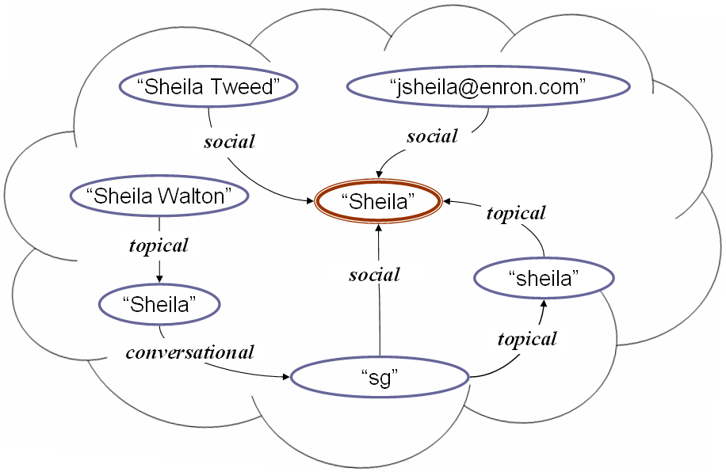
Generative Model
Choose “person” c to mention
  p(c)
Choose appropriate “context” X to mention c
  p(X | c)
Choose a “mention” l
  p(l | X, c)
GE
conference
call
“sheila”
Notes:
Here is the generative story
I want to mention this “Sue”
I want tp mention sue to YOU
Here is a bunch of emails in which this sue has been mentioned and I will pick one of thes that I think it’s of ashared context betwenn me and
u. if we previously refer to her suzy I would call her suzy, but we called her sue so I wull call her sue
So, what I will do is to pick a person, then I pick a shared context that will help u resolve the person, then I use that context
Which will not not be ambigous to the recipients

Slide 30
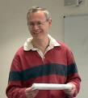









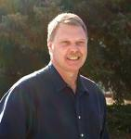


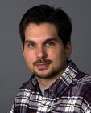

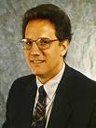



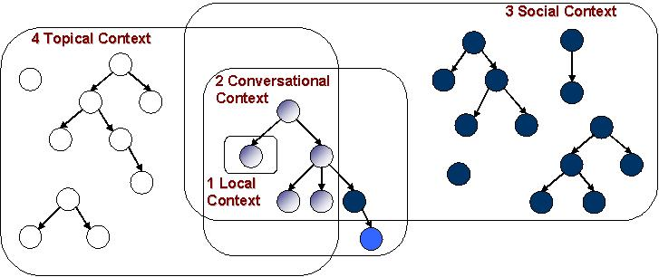
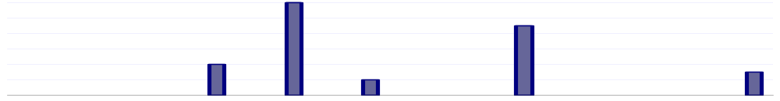
3-Step Solution
(1) Identity Modeling
(2) Context Reconstruction
(3) Mention Resolution
Posterior Distribution
Notes:
Estimate prior
Compute posterior
A solution for that problem could be of two steps:
Identify (or model) the identities/people. And thus have a prior distribution given the mention to be resolved. Of course this step we
Resolve that mention and thus have a posterior distribution that can answer many questions like: who is the most likely referent, who are the top N potential candidates, and so on.
We r not going to talk about identity models, we will just assume that we have built them.

Slide 31
Contextual Space
Topical Context
Conversational
Context
Local
Context
Notes:
We model the topical context by “Bag of word similarity” tf-idf
We could look in the local,
We could look at
Here, let me show u for example how we look in the social context.
Diff places to get evidence
Combination of evidence
What is unique of what I did:
-

Slide 32
Topical Context
Date: Wed Dec 20 08:57:00 EST 2000
From: Kay Mann <kay.mann@enron.com>
To: Suzanne Adams <suzanne.adams@enron.com>
Subject: Re: GE Conference Call has be rescheduled
Did Sheila want Scott to participate? Looks like the call will be too late for
him.
GE
Sheila
call
Date: Fri Dec 15 05:33:00 EST 2000
From: david.oxley@enron.com
To: vince j kaminski <vince.kaminski@enron.com>
Cc: sheila walton <sheila.walton@enron.com>
Subject: Re: Grant Masson
Great news. Lets get this moving along. Sheila, can you work out GE letter?
Vince, I am in London Monday/Tuesday, back Weds late. I'll ask Sheila to fix
this for you and if you need me call me on my cell phone.
sheila.walton@enron.com
Sheila
GE
call

Slide 33
Contextual Space
Social Context
Topical Context
Conversational
Context
Local
Context
Notes:
We model the topical context by “Bag of word similarity” tf-idf
We could look in the local,
We could look at
Here, let me show u for example how we look in the social context.
Diff places to get evidence
Combination of evidence
What is unique of what I did:
-

Slide 34
Social Context
Date: Wed Dec 20 08:57:00 EST 2000
From: Kay Mann <kay.mann@enron.com>
To: Suzanne Adams <suzanne.adams@enron.com>
Subject: Re: GE Conference Call has be rescheduled
Did Sheila want Scott to participate? Looks like the call will be too late for
him.
kay.mann@enron.com
Date: Tue, 19 Dec 2000 07:07:00 -0800 (PST)
From: rebecca.walker@enron.com
To: kay.mann@enron.com
Subject: ESA Option Execution
Kay
Can you initial the ESA assignment and assumption agreement or should I ask
Sheila Tweed to do it? I believe she is currently en route from Portland.
Thanks,
Rebecca
kay.mann@enron.com
Sheila Tweed

Slide 35
Contextual Space (mentions)
“Sheila Tweed”
“jsheila@enron.com”
social
social
“Sheila Walton”
“Sheila”
topical
topical
social
“sheila”
“Sheila”
topical
conversational
“sg”
Joint Resolution of Mentions

Slide 36
Topical Expansion
Each email is a document
Index all (bodies of) emails
  remove all signature and salutation lines
  Use temporal constraints
    Need an email-to-date/time mapping
    Check for each pair of documents

Slide 37
Social Expansion
Can we use the same technique?
  For each email: list of participating email addresses comprises the document
MessageID: 3563
Date: Wed Dec 20 08:57:00 EST 2000
From: Kay Mann <kay.mann@enron.com>
To: Suzanne Adams <suzanne.adams@enron.com>
Subject: Re: GE Conference Call has be rescheduled
Did Sheila want Scott to participate? Looks like the call will be too late for
him.
2563
kay.mann@enron.com suzanne.adams@enron.com
Index the new “social documents” and apply same topical expansion process

Slide 38
Social Similarity Models
Intersection size
Jaccard Coefficent
Boolean
All given temporal constraints

Slide 39
Joint Resolution
“Sheila Tweed”
“jsheila@enron.com”
social
social
“Sheila Walton”
“Sheila”
topical
topical
social
“sheila”
“Sheila”
topical
conversational
“sg”

Slide 40
Joint Resolution
Mention
Graph
Spread
Current Resolution
Combine
Context Info
Update
Resolution

Slide 41
Joint Resolution
Mention
Graph
Work in Progress!
map
shuffle
reduce
MapReduce!

Slide 42

System Design
Threads
Emails
Identity Models
Mention Recognition
Conv. Expansion
Local Expansion
Topical Expansion
Social Expansion
Context-Free Resolution
Mentions
Conv.
Context
Local
Context
Topical
Context
Social Context
Context-Free Resolution
Merging Contexts
Prior Resolution
Joint Resolution
Posterior Resolution

Slide 43
Iterative Joint Resolution
Input: Context Graph + Prior Resolution
Mapper
  Consider one mention
  Takes:
    out-edges and context info
    prior resolution
  Spread context info and prior resolution to all mentions in context
Reducer
  Consider one mention
  Takes:
    in-edges and context info
    prior resolution
  Compute posterior resolution
Multiple Iterations

Slide 44
Conclusion
Simple and efficient MapReduce solution
  applied to both topical and social expansion in “Identity Resolution in Email”
  different tricks for approximation
Shuffling is critical
  df-cut controls efficiency vs. effectiveness tradeoff
  99.9% df-cut achieves 98% relative accuracy
Notes:
We had a nice decomposition
If we don’t pay attention to shuffle, it will not work
Parrlization is not just a matter of decompoistion/parra;izable, it’s also a matter to get eff/effec tradeoff
It’s

Slide 45
Thank You!

Slide 46
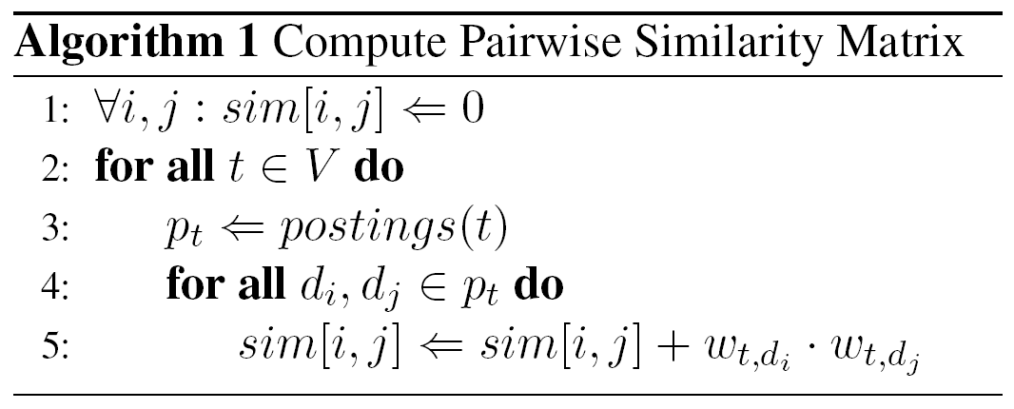
Algorithm
Matrix must fit in memory
  Works for small collections
Otherwise: disk access optimization
Notes:
Generate ½ df*(df-1) /term

