Slide 1

Cloud Computing Lecture #2
From Lisp to MapReduce and GFS
Jimmy Lin
The iSchool
University of Maryland
Wednesday, January 30, 2008
Material adapted from slides by Christophe Bisciglia, Aaron Kimball, & Sierra Michels-Slettvet, Google Distributed Computing Seminar, 2007 (licensed under Creation Commons Attribution 3.0 License)
This work is licensed under a Creative Commons Attribution-Noncommercial-Share Alike 3.0 United States
See http://creativecommons.org/licenses/by-nc-sa/3.0/us/ for details

Slide 2
Today’s Topics
Functional Programming
MapReduce
Google File System (GFS)
Lisp
MapReduce
GFS

Slide 3
Functional Programming
MapReduce = functional programming meets distributed processing on steroids
  Not a new idea… dates back to the 50’s (or even 30’s)
What is functional programming?
  Computation as application of functions
  Theoretical foundation provided by lambda calculus
How is it different?
  Traditional notions of “data” and “instructions” are not applicable
  Data flows are implicit in program
  Different orders of execution are possible
Exemplified by LISP and ML
Lisp
MapReduce
GFS

Slide 4
Overview of Lisp
Lisp ≠ Lost In Silly Parentheses
We’ll focus on particular a dialect: “Scheme”
Lists are primitive data types
Functions written in prefix notation
'(1 2 3 4 5)
'((a 1) (b 2) (c 3))
(+ 1 2) → 3
(* 3 4) → 12
(sqrt (+ (* 3 3) (* 4 4))) → 5
(define x 3) → x
(* x 5) → 15
Lisp
MapReduce
GFS

Slide 5
Functions
Functions are defined by binding lambda expressions to variables
Syntactic sugar for defining functions
  Above expressions is equivalent to:
Once defined, function can be applied:
(define foo
(lambda (x y)
(sqrt (+ (* x x) (* y y)))))
(define (foo x y)
(sqrt (+ (* x x) (* y y))))
Lisp
MapReduce
GFS
(foo 3 4) → 5

Slide 6
Other Features
In Scheme, everything is an s-expression
  No distinction between “data” and “code”
  Easy to write self-modifying code
Higher-order functions
  Functions that take other functions as arguments
(define (bar f x) (f (f x)))
Doesn’t matter what f is, just apply it twice.
(define (baz x) (* x x))
(bar baz 2) → 16
Lisp
MapReduce
GFS

Slide 7
Recursion is your friend
Simple factorial example
Even iteration is written with recursive calls!
(define (factorial n)
(if (= n 1)
1
(* n (factorial (- n 1)))))
(factorial 6) → 720
(define (factorial-iter n)
(define (aux n top product)
(if (= n top)
(* n product)
(aux (+ n 1) top (* n product))))
(aux 1 n 1))
(factorial-iter 6) → 720
Lisp
MapReduce
GFS

Slide 8
Lisp → MapReduce?
What does this have to do with MapReduce?
After all, Lisp is about processing lists
Two important concepts in functional programming
  Map: do something to everything in a list
  Fold: combine results of a list in some way
Lisp
MapReduce
GFS

Slide 9
Map
Map is a higher-order function
How map works:
  Function is applied to every element in a list
  Result is a new list
f
f
f
f
f
Lisp
MapReduce
GFS

Slide 10
Fold
Fold is also a higher-order function
How fold works:
  Accumulator set to initial value
  Function applied to list element and the accumulator
  Result stored in the accumulator
  Repeated for every item in the list
  Result is the final value in the accumulator
f
f
f
f
f
final value
Lisp
MapReduce
GFS
Initial value

Slide 11
Map/Fold in Action
Simple map example:
Fold examples:
Sum of squares:
(map (lambda (x) (* x x))
'(1 2 3 4 5))
→ '(1 4 9 16 25)
(fold + 0 '(1 2 3 4 5)) → 15
(fold * 1 '(1 2 3 4 5)) → 120
(define (sum-of-squares v)
(fold + 0 (map (lambda (x) (* x x)) v)))
(sum-of-squares '(1 2 3 4 5)) → 55
Lisp
MapReduce
GFS

Slide 12
Lisp → MapReduce
Let’s assume a long list of records: imagine if...
  We can distribute the execution of map operations to multiple nodes
  We have a mechanism for bringing map results back together in the fold operation
That’s MapReduce! (and Hadoop)
Implicit parallelism:
  We can parallelize execution of map operations since they are isolated
  We can reorder folding if the fold function is commutative and associative
Lisp
MapReduce
GFS

Slide 13
Typical Problem
Iterate over a large number of records
Map: extract something of interest from each
Shuffle and sort intermediate results
Reduce: aggregate intermediate results
Generate final output
Key idea: provide an abstraction at the point of these two operations
Lisp
MapReduce
GFS

Slide 14
MapReduce
Programmers specify two functions:
  map (k, v) → <k’, v’>*
  reduce (k’, v’) → <k’, v’>*
  All v’ with the same k’ are reduced together
Usually, programmers also specify:
  partition (k’, number of partitions ) → partition for k’
  Often a simple hash of the key, e.g. hash(k’) mod n
  Allows reduce operations for different keys in parallel
Lisp
MapReduce
GFS

Slide 15
It’s just divide and conquer!
Data Store
Initial kv pairs
Initial kv pairs
Initial kv pairs
Initial kv pairs
map
map
map
map
k₁, values…
k₃, values…
k₁, values…
k₃, values…
k₁, values…
k₃, values…
k₁, values…
k₃, values…
k₂, values…
k₂, values…
k₂, values…
k₂, values…
Barrier: aggregate values by keys
k₁, values…
k₂, values…
k₃, values…
Lisp
MapReduce
GFS
reduce
reduce
reduce
final k₁ values
final k₂ values
final k₃ values

Slide 16
Recall these problems?
How do we assign work units to workers?
What if we have more work units than workers?
What if workers need to share partial results?
How do we aggregate partial results?
How do we know all the workers have finished?
What if workers die?
Lisp
MapReduce
GFS

Slide 17
MapReduce Runtime
Handles data distribution
  Gets initial data to map workers
  Shuffles intermediate key-value pairs to reduce workers
  Optimizes for locality whenever possible
Handles scheduling
  Assigns workers to map and reduce tasks
Handles faults
  Detects worker failures and restarts
Everything happens on top of GFS (later)
Lisp
MapReduce
GFS

Slide 18
“Hello World”: Word Count
Map(String input_key, String input_value):
// input_key: document name
// input_value: document contents
for each word w in input_values:
EmitIntermediate(w, "1");
Reduce(String key, Iterator intermediate_values):
// key: a word, same for input and output
// intermediate_values: a list of counts
int result = 0;
for each v in intermediate_values:
result += ParseInt(v);
Emit(AsString(result));
Lisp
MapReduce
GFS

Slide 19
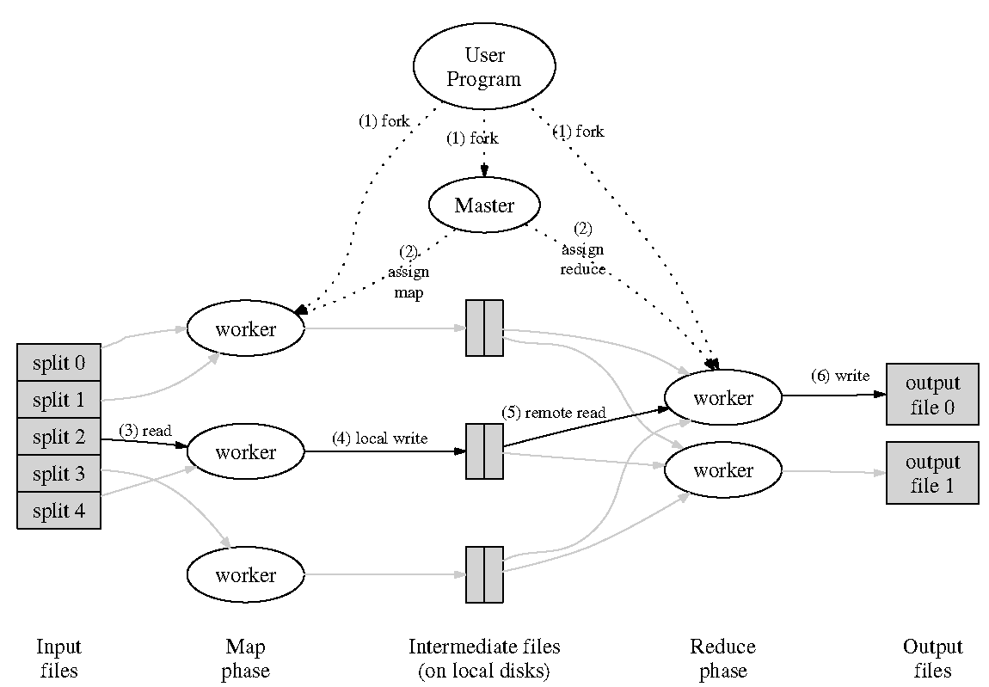
Behind the scenes…
Lisp
MapReduce
GFS

Slide 20
Bandwidth Optimizations
Take advantage of locality
  Move the process to where the data is!
Use “Combiner” functions
  Executed on same machine as mapper
  Results in a “mini-reduce” right after the map phase
  Reduces key-value pairs to save bandwidth
When can you use combiners?
Lisp
MapReduce
GFS

Slide 21
Skew Problem
Issue: reduce is only as fast as the slowest map
Solution: redundantly execute map operations, use results of first to finish
  Addresses hardware problems...
  But not issues related to inherent distribution of data
Lisp
MapReduce
GFS

Slide 22
Data, Data, More Data
All of this depends on a storage system for managing all the data…
That’s where GFS (Google File System), and by extension HDFS in Hadoop
Lisp
MapReduce
GFS

Slide 23
Assumptions
High component failure rates
  Inexpensive commodity components fail all the time
“Modest” number of HUGE files
  Just a few million (!!!)
  Each is 100MB or larger; multi-GB files typical
Files are write-once, mostly appended to
  Perhaps concurrently
Large streaming reads
High sustained throughput favored over low latency
Lisp
MapReduce
GFS

Slide 24
GFS Design Decisions
Files stored as chunks
  Fixed size (64MB)
Reliability through replication
  Each chunk replicated across 3+ chunkservers
Single master to coordinate access, keep metadata
  Simple centralized management
No data caching
  Little benefit due to large data sets, streaming reads
Familiar interface, but customize the API
  Simplify the problem; focus on Google apps
  Add snapshot and record append operations
Lisp
MapReduce
GFS

Slide 25

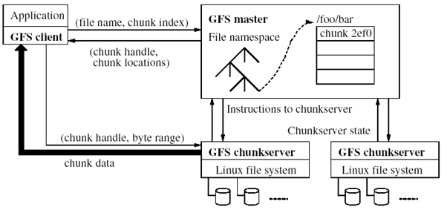
GFS Architecture
Single master
Mutiple chunkservers
Lisp
MapReduce
GFS
Can anyone see a potential weakness in this design?

Slide 26
Single master
From distributed systems we know this is a
  Single point of failure
  Scalability bottleneck
GFS solutions:
  Shadow masters
  Minimize master involvement
    Never move data through it, use only for metadata (and cache metadata at clients)
    Large chunk size
    Master delegates authority to primary replicas in data mutations (chunk leases)
Simple, and good enough!
Lisp
MapReduce
GFS

Slide 27
Metadata
Global metadata is stored on the master
  File and chunk namespaces
  Mapping from files to chunks
  Locations of each chunk’s replicas
All in memory (64 bytes / chunk)
  Fast
  Easily accessible
Master has an operation log for persistent logging of critical metadata updates
  Persistent on local disk
  Replicated
  Checkpoints for faster recovery
Lisp
MapReduce
GFS

Slide 28
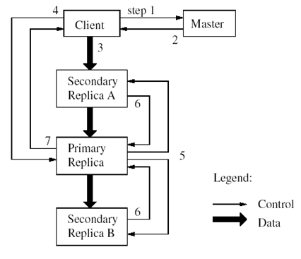
Mutations
Mutation = write or append
  Must be done for all replicas
Goal: minimize master involvement
Lease mechanism:
  Master picks one replica
  as primary; gives it a
  “lease” for mutations
  Primary defines a serial
  order of mutations
  All replicas follow this order
  Data flow decoupled from
  control flow
Lisp
MapReduce
GFS

Slide 29
Atomic Record Append
Client specifies data
GFS appends it to the file atomically at least once
  GFS picks the offset
  Works for concurrent writers
Used heavily by Google apps
  E.g., for files that serve as multiple-producer/single-consumer queues
Lisp
MapReduce
GFS

Slide 30
Relaxed Consistency Model
“Consistent” = all replicas have the same value
“Defined” = replica reflects the mutation, consistent
Some properties:
  Concurrent writes leave region consistent, but possibly undefined
  Failed writes leave the region inconsistent
Some work has moved into the applications:
  E.g., self-validating, self-identifying records
  Google apps can live with it
  What about other apps?
Lisp
MapReduce
GFS

Slide 31
Master’s Responsibilities (1/2)
Metadata storage
Namespace management/locking
Periodic communication with chunkservers
  Give instructions, collect state, track cluster health
Chunk creation, re-replication, rebalancing
  Balance space utilization and access speed
  Spread replicas across racks to reduce correlated failures
  Re-replicate data if redundancy falls below threshold
  Rebalance data to smooth out storage and request load
Lisp
MapReduce
GFS

Slide 32
Master’s Responsibilities (2/2)
Garbage Collection
  Simpler, more reliable than traditional file delete
  Master logs the deletion, renames the file to a hidden name
  Lazily garbage collects hidden files
Stale replica deletion
  Detect “stale” replicas using chunk version numbers
Lisp
MapReduce
GFS

Slide 33
Fault Tolerance
High availability
  Fast recovery: master and chunkservers restartable in a few seconds
  Chunk replication: default 3 replicas
  Shadow masters
Data integrity
  Checksum every 64KB block in each chunk
Lisp
MapReduce
GFS

Slide 34
Parallelization Problems
How do we assign work units to workers?
What if we have more work units than workers?
What if workers need to share partial results?
How do we aggregate partial results?
How do we know all the workers have finished?
What if workers die?
How do we assign work units to workers?
What if we have more work units than workers?
What if workers need to share partial results?
How do we aggregate partial results?
How do we know all the workers have finished?
What if workers die?

Slide 35
Managing Dependencies
Remember: Mappers run in isolation
  You have no idea in what order the mappers run
  You have no idea on what node the mappers run
  You have no idea when each mapper finishes
Question: what if your computation is a non-commutative operation on mapper results?
Answer: Cleverly “hide” dependencies in the reduce stage
  The reducer can hold state across multiple map operations
  Careful choice of partition function
  Careful choice of sorting function
Example: computing conditional probabilities

Slide 36
Other things to beware of…
Object creation overhead
Reading in external resources is tricky
  Possibility of creating hotspots in underlying file system

