Slide 1
Translating in the Clouds
Large-Scale Statistical Translation Model Estimation Using MapReduce on Apache Hadoop
Chris Dyer
October 17, 2007

Slide 2
Overview
Phrase-based statistical machine translation
Using Hadoop to estimate translation models
Future work

Slide 3
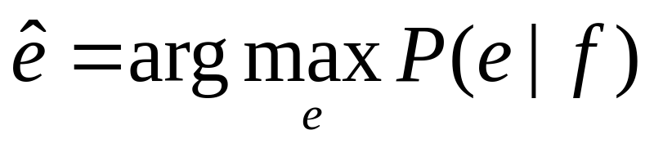
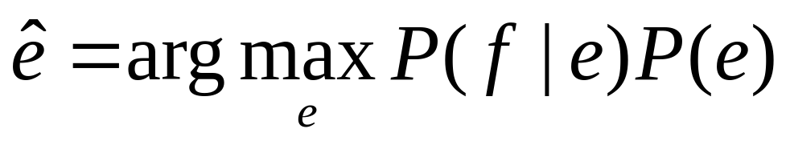
Statistical Machine Translation
Statistical machine translation is conceptually simple:

Slide 4
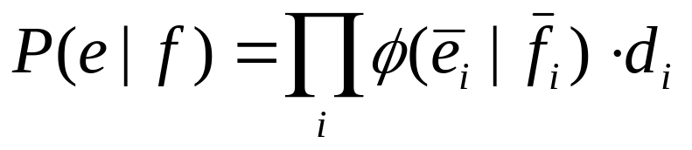
Phrase-Based Machine Translation
How to estimate P(e|f)?
One solution: divide and conquer (Koehn et al. (2003)
  Break up the source sentence into phrases which are treated independently
  Translate the phrases

Slide 5
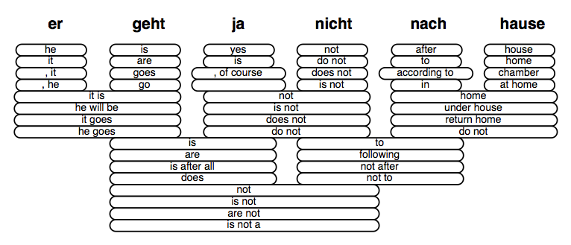
Phrasal Decomposition
Example from Callison-Burch (2007)

Slide 6
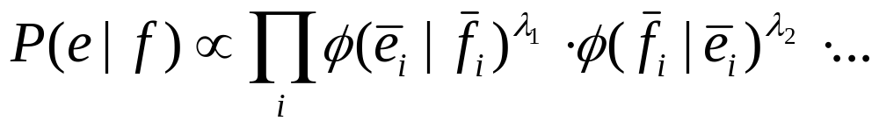
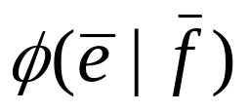
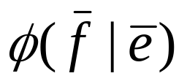
Phrase-Based Machine Translation
In practice, a log-linear combination of the phrase probabilities is used:
Our problem: how do we estimate
and ?

Slide 7
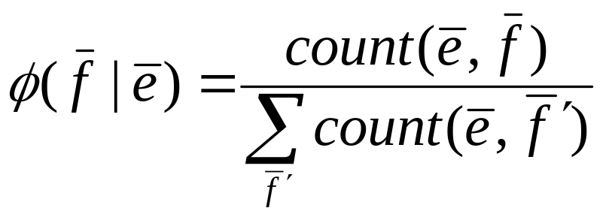
Phrase-Based Machine Translation
Start with a word-aligned corpus
Extract consistent phrase pairs (Och et al., 1999), use MLE for the probability estimates (Koehn et al., 2003):

Slide 8
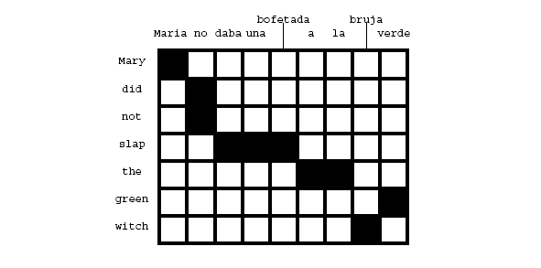
Phrase Extraction
Sample word alignment:
A consistent phrase alignment must contain all alignment points for all words it covers.
Example from Koehn & Knight (2002).

Slide 9
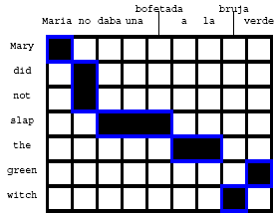
Phrase Extraction
6 phrases: (Maria, Mary),(no, did not), (slap, daba una bofetada), (a la, the), (bruja, witch), (verde, green)

Slide 10
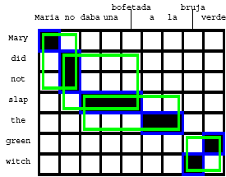
Phrase Extraction
4 phrases (Maria no, Mary did not), (no daba una bofetada, did not slap), (daba una bofetada a la, slap the), (bruja verde, green witch)

Slide 11
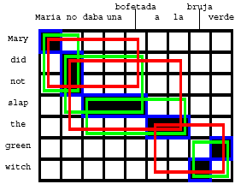
Phrase Extraction
3 phrases: (Maria no daba una bofetada, Mary did not slap), (no daba una bofetada a la, did not slap the), (a la bruja verde, the green witch)

Slide 12
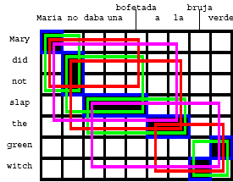
Phrase Extraction
2 phrases: (Maria no daba una bofetada a la, Mary did not slap the), (daba una bofetada a la bruja verde, slap the green witch)

Slide 13
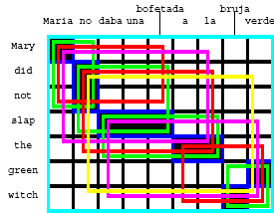
Phrase Extraction
1 phrase: (no daba una bofetada a la bruja verde, did not slap the green witch)
1 phrase: (Maria no daba una bofetada a la bruja verde, Mary did not slap the green witch)

Slide 14
Phrase Extraction
6+4+3+2+1+1 = 17 phrase pairs from one (short) sentence
Challenge: The number of phrase pairs that must be counted is a high multiple of the number of sentences in the training corpus!

Slide 15
Phrase Extraction Statistics
Entity | Count
Parallel segments | 0.9M
Phrase pairs (tokens) | 110M
Phrase pairs (types) | 64M
Marginals (types) | 46M

Slide 16
Model Estimation
Phrase translation probability estimation can be done in three steps:
  Counting phrase pair occurrence: C(e,f)
  Computing marginals: C(e), C(f)
  Computing conditional frequencies:
    C(e,f)/C(e)
    C(e,f)/C(f)
Current standard toolset (http://www.statmt.org/moses/) does this serially on a single processor.

Slide 17
Model Estimation with MapReduce
Three MapReduce operations:
  Count
  Marginalize
  Normalize
Comments about notation:
  e = a target language phrase (~English)
  f = a source language phrase (~French)

Slide 18
MR1: Count
Map
  Input: aligned sentence pairs
  Output: <(e,f), 1> for each consistent phrase pair (e,f)
Reduce
  Sort: by key [ie, (e,f)]
  Aggregation: sum values
  Result: <(e,f), Count(e,f)>

Slide 19
MR1: Sample output
Key[e,f] |  | Value[Count(e,f)]
the | el | 14561
the | la | 16529
the | los | 8426
the | las | 7519
the | al | 1345
the | a la | 982

Slide 20
MR2: Marginalize
Map
  Input: Output counts from MR1
  Output:
  <(e,f), Count(e,f)> → <e, Count(e,f)>
  <f, Count(e,f)>
Reduce
  Sort: by key
  Aggregation: sum values
  Output: <e, Count(e,*)>
  <f, Count(f,*)>

Slide 21
MR2: Sample output
Key[x] | Value[Count(x)]
the | 14561
el | 16529
la | 8426
las | 7519
la | 1345

Slide 22
MR3: Normalize (I)
Map
  Input: Outputs from MR1 and MR2
  Output:
  <(e,f), Count(e,f)> → <(e,f), Count(e,f)> <(f,e), Count(e,f)>
  <e, Count(e,*)> → <(e,*), Count(e,*)>
  <f, Count(f,*)> → <(f,*), Count(f,*)>

Slide 23
MR3: Normalize (II)
Reduce
  Sort: sort such that:
    All <(e,*),C> precede all <(e,f),C>
    All <(f,*),C> precede all <(f,e),C>
    Ensure that all keys matching <x,•> for any x are passed to a single reduce process.
  Aggregation:
    The first set of values for each key will be the marginal, the following values will be counts for phrases. Normalize.
  Output:
  <(e,f), φ(f|e)>
  <(f,e), φ(e|f)>

Slide 24
MR3: Sorted input to reduce
Key[x,y] | Value[Count(x)]
(the,*) | 33819
(the,el) | 16529
(the,la) | 8426
(the,los) | 7519
(the,las) | 1345
(these,*) | 360
(these,estos) | 183
(these,estas) | 177
Key group
Key group

Slide 25
MR3: Sample output
Key[x,y] | Value[φ(y|x)]
(the,el) | 0.4887
(the,la) | 0.2491
(the,los) | 0.2223
(the,las) | 0.0399
(these,estos) | 0.508
(these,estas) | 0.492

Slide 26
Performance Comparison
Model estimation with serial tools takes ~ 18 hours on a corpus of 1M sentences
With Hadoop with this configuration:
Compute nodes | 76
MR1 – Map tasks | 100
MR1 – Reduce tasks | 200
MR2 – Map tasks | 100
MR2 – Reduce tasks | 200
MR3 – Map tasks | 331
MR3 – Reduce tasks | 73
~20 minutes! ☺

Slide 27
Future MT Work
MT benefits considerably from more data
Existing serial tools, such as GIZA, are at the limits of being able to make use of the amount of data available
Areas for exploration
  Parallel computation of word alignment models
  System optimization (tuning)
  Discriminative translation models

Slide 28
Acknowledgements
This work and talk would not have been possible without contributions from:
  Jimmy Lin, UMD
  Eugene Hung, IBM
  Chris Callison-Burch, JHU
  Philipp Koehn, U Edinburgh
  Owen O’Malley, Yahoo

