Slide 1

Computing in the Clouds:
Applications of MapReduce in "Web-Scale" Information Processing
Chris Dyer and Jimmy Lin
University of Maryland
Wednesday, October 17, 2007
CLIP Colloquium
Chris Dyer, a graduate student in the Department of Linguistics, has already been “programming in the clouds.” He says, “I'm using it to estimate phrase-based translation models. What normally takes a day or so with my normal single-process script, I can now do in about 20 minutes on the cluster.” “Very cool. Very fast”, concurs Tamer Elsayed, a graduate student in the Department of Computer Science, who just returned from an internship at Google, and Tim Hawes, another graduate student who's been working with the cluster.
University of Maryland Press Release, October 8, 2007

Slide 2
Talk Outline
What is MapReduce and Hadoop?
Outline of collaboration with IBM
Quick Demo (Chris)
What we’ve been doing so far (Chris)
Discussion: What’s next?
Material in this talk adapted from the following sources: (Dean, 2006; Bisciglia et al., 2007)

Slide 3
Thinking at “Web Scale”
Data is the lifeblood of information processing applications
Thought experiment:
  Q1: If you had all the data in the world, what interesting problems could you tackle that you couldn’t now?
  Q2: If you got your hands on that data, how would you crunch it?
MB →
GB →
TB →
PB →
XB …
“Web Scale”
We supply the answer here…
… IBM/Google takes care of this part

Slide 4
Data-Crunching at “Web Scale”
Q2: Even if you had all the data you could ever want, how would you crunch it?
Answer: use lots of machines…
Sure, but, what about
  Communication, coordination
  Fault tolerance
  Load distribution
  …
Google has ~450,000 active machines…
…they’ve figured this out
MapReduce Google’s programming paradigm
Hadoop is an open source implementation

Slide 5
Typical Problem
Iterate over a large number of records
Map: extract something of interest from each
Shuffle and sort intermediate results
Reduce: aggregate intermediate results
Generate final output
Key idea: provide an abstraction at the point of these two operations

Slide 6
MapReduce
Programmers specify two functions:
  map (k, v) → <k’, v’>*
  reduce (k’, v’) → <k’, v’>*
  All v’ with the same k’ are reduced together
Usually, programmers also specify:
  partition (k’, number of partitions ) → partition for k’
  Often a simple hash of the key, e.g. hash(k’) mod n
  Allows reduce operations for different keys in parallel
MapReduce infrastructure handles
  Data distribution
  Scheduling
  Fault tolerance

Slide 7
“Hello World”: Word Count
Map(String input_key, String input_value):
// input_key: document name
// input_value: document contents
for each word w in input_values:
EmitIntermediate(w, "1");
Reduce(String key, Iterator intermediate_values):
// key: a word, same for input and output
// intermediate_values: a list of counts
int result = 0;
for each v in intermediate_values:
result += ParseInt(v);
Emit(AsString(result));
Total 80 lines of C++ code including comments

Slide 8
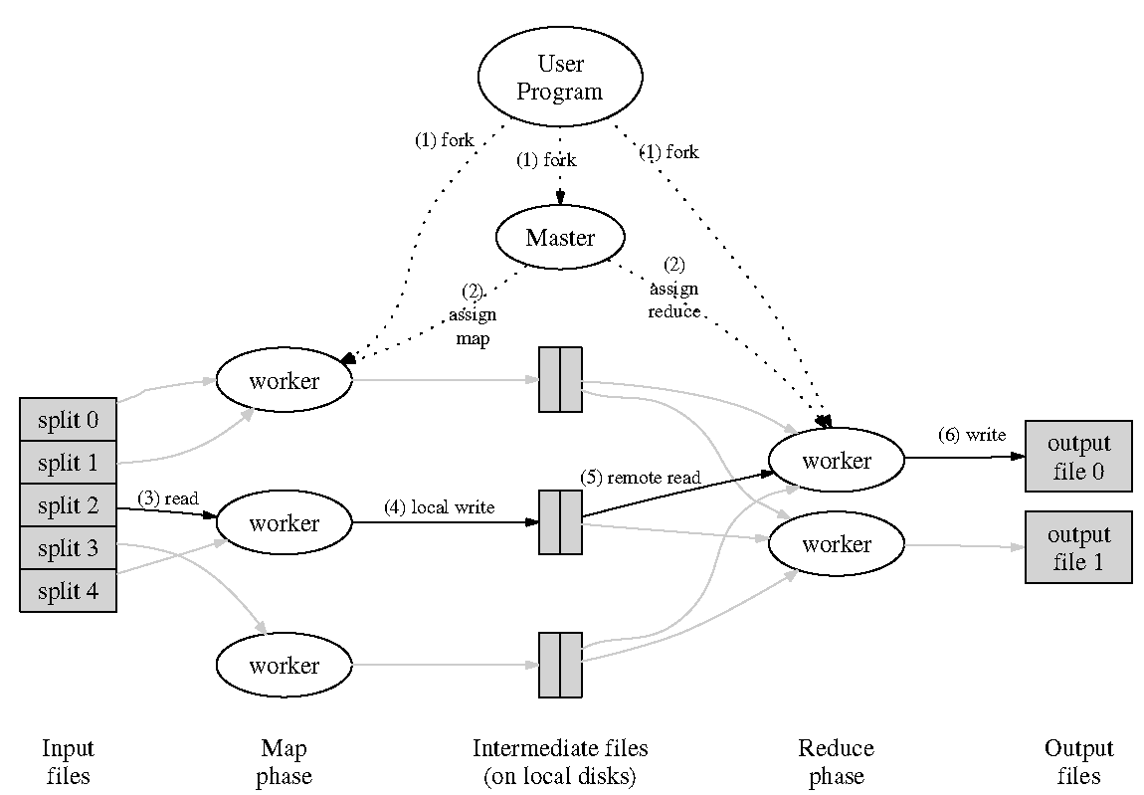
Behind the scenes…

Slide 9
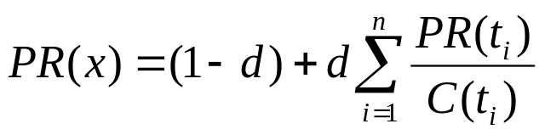
PageRank
Random walk: What is the probability a surfer clicking on links randomly will arrive at a page?
PageRank can be defined as follows:
  Given page x and in-bound links t₁…t_{n}
  Where C(t) is the out-degree of t, and (1-d) is a damping factor (random jump)
t_{i}
X
t₁
…
t_{n}

Slide 10
Computing PageRank
Properties of PageRank
  Can be computed iteratively
  Effects at each iteration is local
Sketch of algorithm:
  Start with seed PR_{i} values
  Each page distributes PR_{i} “credit” to all pages it links to
  Each target page adds up “credit” from multiple in-bound links to compute PR_{i+1}
  Iterate until values converge

Slide 11
PageRank in MapReduce
Map: distribute PageRank “credit” to link targets
Reduce: gather up PageRank “credit” from multiple sources to compute new PageRank value
Iterate until
convergence
...

Slide 12
Scope of Collaboration
Hadoop is an open-source implementation of MapReduce in Java
IBM provides a Hadoop cluster
  40-80 nodes
  Couple of TB storage
  Associated infrastructure support
Maryland does good work with the cluster
  Use it to tackle open research problems
  Use it for classroom instruction
ha·doop·i·fy (verb, -fies, -fied) ― to recast a problem into the Hadoop framework

Slide 13
Demo time!
“Hello World” in Hadoop
Also, preliminary experiments in machine translation

Slide 14
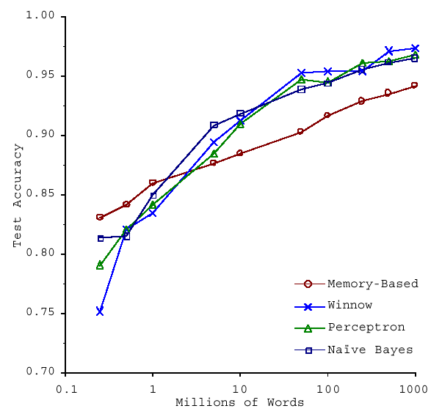
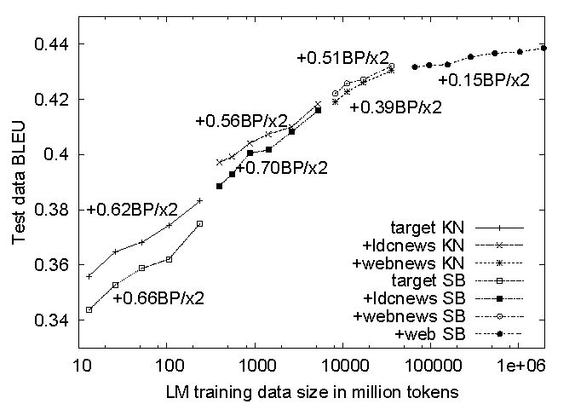
What to do with more data?
s/inspiration/data/g;
  When in doubt, throw more data at the problem…
Brants et al., EMNLP 2007
Banko and Brill, ACL 2001

Slide 15
What about smarter ideas?
Lots of machine translation applications
  Crawling the Web to find bitext
  Large language models
Web-scale social network analysis
  Realistic models of community formation and evolution
Blogsphere-level sentiment analysis
  Web-scale clustering to detect “topics”
…
Problems beyond information processing?

Slide 16
Hadoop in the Classroom
I’m creating a brand new “projects course”
  First offering: Spring 2008, MW 10:00-12:15
  Basic idea: assemble small teams to tackle interesting research problems with Hadoop
  Team leaders: graduate students (1 per group)
  Team members: undergraduate students (2 per group)
  Target: 6 groups
Logistic details:
  Tentative name: “Web-Scale” Information Processing Applications
  LBSC 878*/CMSC 828* (for graduates)
  CMSC 498* (for undergraduates)
* Pending final approval

Slide 17
Course Flow
Team Leaders
Team Members
Week 1
Project Management
“Boot Camp”
Hadoop
“Boot Camp”
Week 2
Prep work on
research problem
Week 3
Getting up to speed on
research problem
Week 4
Project work,
informal group presentations
…
Week 13
Final presentations

Slide 18
Weekly Cycle
Monday
Team project meetings
  Review deliverables
  Plan next steps
  As necessary: whiteboard sessions, discussion of readings, pair programming, etc.
Informal group presentations
Wednesday
Guest speakers
  Research presentation
  Discussion
Students write responses based on discussion

Slide 19
I’m looking for…
Problems
Data
People
  Team leaders
  Team members
Other help
Please contact me!
jimmylin@umd.edu

