Slide 1

LBSC 690: Session 1
Computers and Networks
Jimmy Lin
College of Information Studies
University of Maryland
Monday, September 10, 2007

Slide 2
Goals
By the end of this class, you will…
  Have a basic understanding of computers and networks
  Know how to think about “space”, “time”, and “speed”
  Understand of how computers store data and move data around
  Be able to evaluate tradeoffs between different technologies

Slide 3
A Very Brief History of Computing
Computer = “a person who computes” (< 1940’s)
Hardware: all developed for the government
  Mechanical: essentially a big adding machine
  Analog: designed for calculus, limited accuracy
  Digital: early machines filled a room
  Microchips: designed for missile guidance
Software: initial applications were military
  Numeric: computing gun angles
  Symbolic: code-breaking

Slide 4
Commercial Developments
Mainframes (1960’s)
Minicomputers (1970’s)
Personal computers (1980’s)
Networked computers (1990’s)
Ubiquitous and embedded computers (2000’s)

Slide 5
The Processing Cycle
Input comes from somewhere
  Keyboard, mouse, microphone, camera, …
  Fetch data from memory
The system does something with it
  Add, subtract, multiply, etc.
Output goes somewhere
  Monitor, speaker, printer, robot controls, …
  Store data back into memory

Slide 6
Today’s Focus
Storing and moving around data
  Within a computer
  Between computers
Inside a single computer: connecting the processor with the memory
Between multiple computers: computer networks

Slide 7
Thinking about Size
What’s a bit?
How much information can n bits represent?
What’s the difference between decimal and binary?
And octal?
And hexadecimal?
18,446,744,073,709,551,615 grains of wheat

Slide 8
Units of Size
Unit | Abbreviation | Size (bytes)
bit | b | 1/8
byte | B | 1
kilobyte | KB | 2¹⁰ = 1024
megabyte | MB | 2²⁰ = 1,048,576
gigabyte | GB | 2³⁰ = 1,073,741,824
terabyte | TB | 2⁴⁰ = 1,099,511,627,776
petabyte | PB | 2⁵⁰ = 1,125,899,906,842,624
How do hard drive manufactures “cheat” you?

Slide 9
Thinking About Time
Total “transfer time” is what counts
  Time for first bit + time between first and last bits
For long distances, the first factor is important
  California: 1/80 of a second (by optical fiber)
  London: 1/4 of a second (by satellite)
For large files, the second factor dominates
  Number of bits per second is limited by physics
Latency: the amount of time it takes data to travel from source to destination
Bandwidth: the amount of data that can be transmitted in a fixed amount of time

Slide 10
Discussion Point
What are the latency and bandwidth requirements for the following applications:
  Streaming audio (e.g., NPR broadcast over Web)
  Streaming video (e.g., CNN broadcast over Web)
  Audio chat
  Video conferencing

Slide 11
Thinking About Speed
Speed can be expressed two ways:
  How long to do something once?
    Memory speed measured as “access time”
  How many things can you do in one second?
    Processor speed measured in “clock cycles per second”
    Bandwidth measured in “bits per second”
Convenient units are typically used
  “10 microseconds” rather than “0.00001 seconds”
When comparing speeds, convert units first!

Slide 12
Units of Time
Unit | Abbreviation | Duration (seconds)
second | sec/s | 1
millisecond | ms | 10⁻³ = 1/1,000
microsecond | μs | 10⁻⁶ = 1/1,000,000
nanosecond | ns | 10⁻⁹ = 1/1,000,000,000
picosecond | ps | 10⁻¹² = 1/1,000,000,000,000
femtosecond | fs | 10⁻¹⁵ = 1/1,000,000,000,000,000

Slide 13
Units of Frequency
Unit | Abbreviation | Cycles per second
hertz | Hz | 1
kilohertz | KHz | 10³ = 1,000
megahertz | MHz | 10⁶ = 1,000,000
gigahertz | GHz | 10⁹ = 1,000,000,000

Slide 14
Trends in Technology: #1

Slide 15
Trends in Technology: #2

Slide 16
Trends in Technology: #3

Slide 17
Moore’s Law
What is it?
  Gordon E. Moore, co-founder of Intel: number of components on an integrated circuit will double every 18 months (1965)
Why is it important?

Slide 18
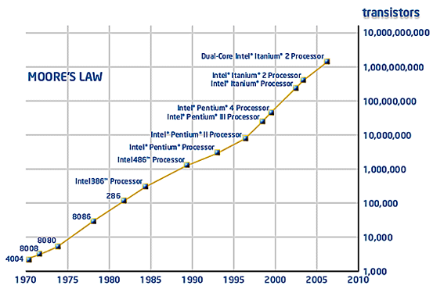
Illustration of Moore’s Law

Slide 19
Aside: The Gigahertz Race
Intel Pentium 4: 3.80 GHz
Intel Core Duo: 2.33 GHz
What does it mean?
Which is actually faster?
Why is this important for consumers?

Slide 20
The CPU and the Memory
CPU (Central Processor Unit) – where actual computation is performed
Memory – location of data on which computation is performed
Bus – moves data from memory to and from CPU
Desiderata for memory:
  Large
  Fast
  Cheap

Slide 21


Large, Fast, and Cheap Memory
Impossible! (Why?)
Engineering is all about compromise!
Small, but fast…
Large, but slow…

Slide 22
Best of Both Worlds?
Small, but fast…
+
=
Large and fast?!
Large, but slow…
Think about your bookshelf and the library…

Slide 23
Locality
Spatial locality: If the system fetched x, it is likely to fetch data located near x (Why?)
Temporal locality: If the system fetched x, it is likely to fetch x again (Why?)
Insight behind the storage hierarchy: move important data from slow, large memory to fast, small memory
Cache: a place for concealment and safekeeping, as of valuables. (American Heritage Dict.)
Caching strategies: what’s the most effective strategy for moving data around?

Slide 24
The Storage Hierarchy
Type | Speed | Size | Cost
Registers | < 1 ns | 512 bytes | Very expensive
Cache | 10 ns | 2 MB | Very expensive
RAM | 50 ns | 1 GB | Cheap
Hard drive | 10 ms | 100 GB | Very Cheap

Slide 25
Trading Speed for Space
Hard disk is larger than RAM but much slower
  10 ms access time and 100 GB is typical
    200,000x slower/100x bigger than RAM!
    > 10 million times slower than the CPU!
The initial access is the slow part
  Subsequent bytes sent at 30 MB/sec (33 ns/byte)
The importance of caching…
What’s typical cache miss rate?
What happens if the data doesn’t all fit into RAM?

Slide 26
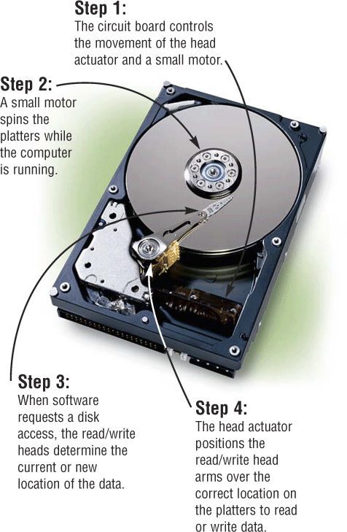
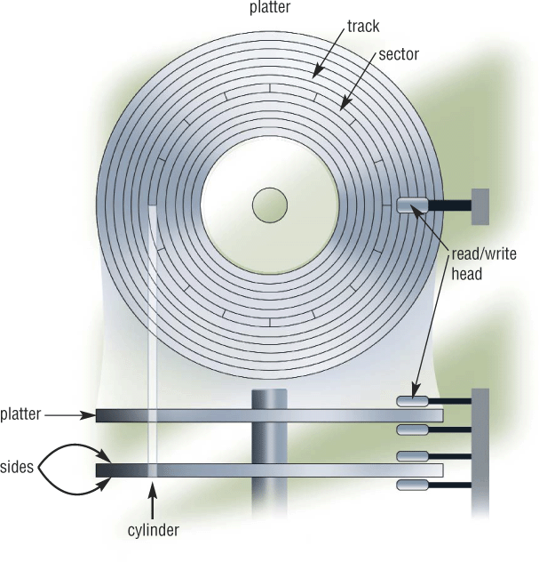
How Hard Drives Work
from Shelly, Cashman, Vermaatt’s Discovering Computers 2004

Slide 27
Summary So Far…
For computation to occur, data must be moved to and from memory
Different type of memories represent different tradeoffs
Caching strategies and the storage hierarchy give us the best of both worlds

Slide 28
Why Networking?
Sharing data
Sharing hardware
Sharing software
Increasing robustness
Facilitating communications
Facilitating commerce

Slide 29
Packet vs. Circuit Networks
Telephone system (“circuit-switched”)
  Fixed connection between caller and called
  High network load results in busy signals
Internet (“packet-switched”)
  Each transmission is broken up into pieces and routed separately
  High network load results in long delays

Slide 30
Packet Switching
Break long messages into short “packets”
  Keeps one user from hogging a line
  Each packet is tagged with where it’s going
Route each packet separately
  Each packet often takes a different route
  Packets often arrive out of order
  Receiver must reconstruct original message
  How do packet-switched networks deal with continuous data?
Request retransmission for lost packets
  Unless the first packet is lost!

Slide 31
Different Networks Types
Local Area Networks (LANs)
  Connections within a building or a small area
Metropolitan Area Networks (MANs)
  Connections across a city or a larger geographic area
Wide Area Networks (WANs)
  Connections between multiple LANs/MANs
  May cover thousands of square miles
The Internet
  Collection of WANs across multiple organizations

Slide 32
Local Area Networks
Usually covering a small area
  Short-distance lines are fast and cheap
  Fast communications makes routing simple
Ethernet is a common LAN technology
  All computers are connected to the same cable
  Ordinary lines can carry 10 Mb/sec
  Every host broadcasts everything to all others
  Collisions limit throughput to about 50% utilization
Network type vs. network typology

Slide 33
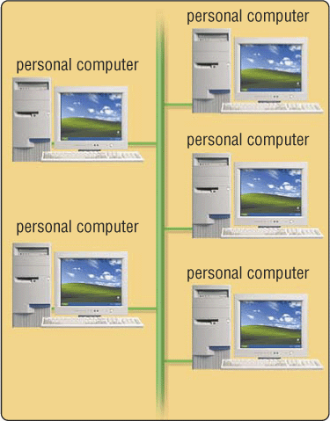
Network Typology: Bus
All attach to the same cable
Transmit anytime
  Collision detection
  Automatic retransmission
Inexpensive and flexible
  Easy to add new machines
  Robust to computer failure
Practical for short distances
  Half the bandwidth is wasted

Slide 34
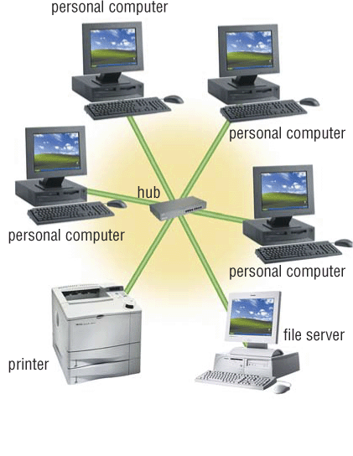
Network Typology: Star
All attach directly to a hub
Higher cost
  Line from hub to each machine
  Hub must handle every packet
  Hub requires backup power
Much higher bandwidth
  No sharing, no collisions
  Allows disks to be centralized

Slide 35
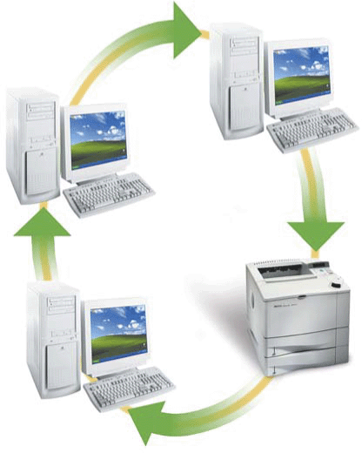
Network Typology: Ring
Unidirectional transmission
  Used mostly for larger networks
Very high bandwidth
  No collisions
  Simple routing policies
Complex management
  Changes must be coordinated

Slide 36
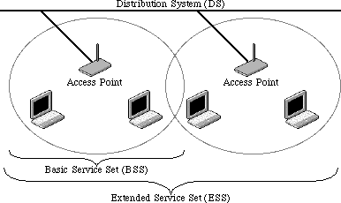
Wireless Networks
Radio-based Ethernet
  Effective for a few rooms within buildings
“Access Point” gateways to wired networks
  Available throughout most of the Maryland campus
  Commercial providers offer “hot spots” in airports, etc.
Available in two speeds
  IEEE 802.11b: 10Mbps
  IEEE 802.11g: 54Mbps

Slide 37
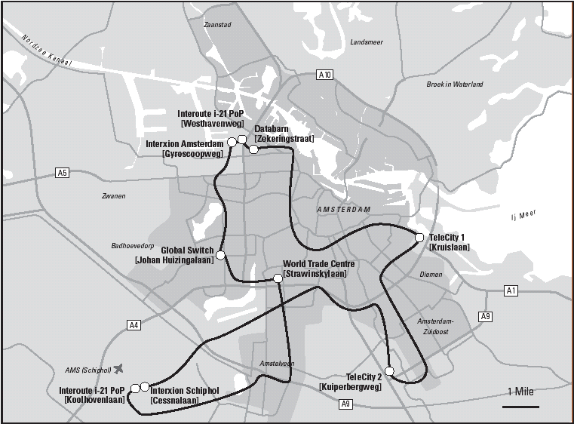
Metropolitan Area Networks
Span entire cities (often arranged as rings)

Slide 38
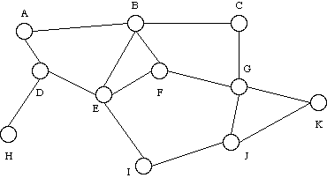
Wide Area Networks
Connect multiple LANs (or MANs) across a large geographic area
Often employ a “mesh” typology
The Internet is the largest WAN in existence

Slide 39
The Internet
Global collection of public networks
  Private networks are often called “intranets”
  Each organization maintains its own network
Use of shared protocols
  TCP/IP (Transmission Control Protocol/Internet Protocol): basis for communication
  DNS (Domain Name Service): basis for naming hosts
  HTTP (HyperText Transfer Protocol): World Wide Web
Next week: how does all of this work?

Slide 40
A Short History of the Internet
1969: Origins in government research
  Advanced Research Projects Agency (ARPAnet)
1983: Design adopted by other agencies
  Expansion from educational institutions to corporations
1991: World Wide Web added point-and-click capabilities

Slide 41
Now You Know About…
Size, time, and speed
Different types of memories and their tradeoffs
The storage hierarchy: large and fast!
Circuit-switched vs. packet-switched networks
Networks of different sizes: LANs, WANs, etc.
Network typologies: bus, star, ring, etc.

