Slide 1

LBSC 690: Session 13
Security and Privacy
Jimmy Lin
College of Information Studies
University of Maryland
Monday, December 3, 2007
Contributing sources: David Evans (UVA)

Slide 2
Agenda
Encryption
Identity, privacy, and anonymity
Security

Slide 3
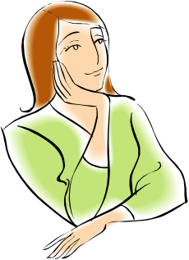
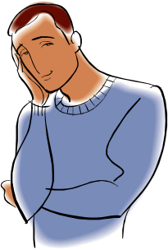
Encryption Concepts
encryption
Alice
Bob
Encrypt
Cipher text
Decrypt
Plain text
Plain text
Insecure channel
eavesdropper
eavesdropper
eavesdropper

Slide 4
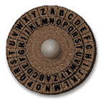
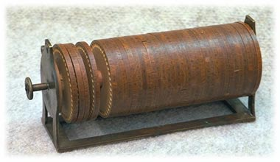
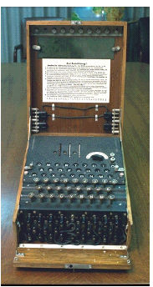
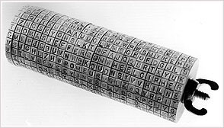
Early Forms of Encryption
encryption
Caesar Cipher
Jefferson Cipher Wheel
German Enigma Machine

Slide 5
Symmetric Key Encryption
encryption
Same key used both for encryption and decryption
key
key
Alice
Bob
Encrypt
Cipher text
Decrypt
Plain text
Plain text
Insecure channel
eavesdropper
eavesdropper
eavesdropper

Slide 6
Symmetric Key Encryption
encryption
What’s the fatal flaw?

Slide 7
Asymmetric Key Encryption
encryption
Different keys used for encryption and decryption
Bob’s public key
Bob’s private key
Alice
Bob
Encrypt
Cipher text
Decrypt
Plain text
Plain text
Insecure channel
eavesdropper
eavesdropper
eavesdropper

Slide 8
Asymmetric Key Encryption
encryption
Key = a large number (> 1024 bits)
  Public key – known by others, for encryption
  Private key – known only by self, for decryption
Alice and Bob don’t have to exchange keys

Slide 9
How does encryption work?
encryption
One-way mathematical functions
  “trapdoor functions”
  Large numbers are easy to multiply, but hard to factor
  Like mixing paint: easy to do, hard to undo
Want more security? Pick longer keys
  Keys less than 256 bits can be cracked within a few hours by a personal computer
  Keys greater than 1024 bits practically unbreakable

Slide 10
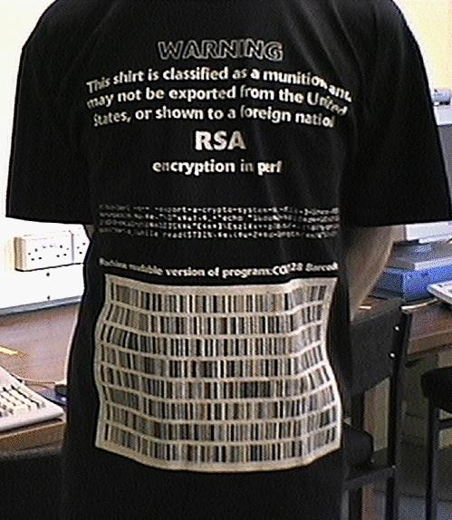
RSA in Perl
encryption
First and most famous asymmetric key encryption algorithm
Until 1997 – Illegal to show this slide to non-US citizens!
print pack"C*", split/\D+/,
`echo "16iII*o\U@{$/=$z; [(pop,pop,unpack"H*",<>)]} \EsMsKsN0[lN*1lK[d2%Sa2/d0 <X+d*lMLa^*lN%0]dsXx++lMlN /dsM0<J]dsJxp"|dc`

Slide 11
Digital Signatures
encryption
Public key cryptography in reverse
Alice “signs” (encrypts) with her private key, Bob checks (decrypts) with her public key
Bob knows it was from Alice, since only Alice knows Alice’s Private Key
Non-repudiation: Alice can’t deny signing message
  Except by claiming her key was stolen!
Integrity: Bob can’t change message
  Doesn’t know Alice’s Private Key

Slide 12
Key Management
encryption
Meet secretly
  Alice and Bob meet and swap public keys
  Not practical!
Publish announcement
  For example, Bob appends his public key to the end of his email
If you can arrange to meet, might as well use symmetric keys.
Defeats the point of asymmetric key encryption.
Easy for someone to pretend to be Bob!

Slide 13
Certificate
encryption
Combination of identity and public key digitally signed by a trusted third party
  Certificate authorities
“Web of trust”

Slide 14

Certificate Authority
encryption
Certificate Authority
Bob’s public key
Bob’s public key
Bob’s private key
Alice
Bob
Encrypt
Cipher text
Decrypt
Plain text
Plain text
Insecure channel
eavesdropper
eavesdropper
eavesdropper

Slide 15
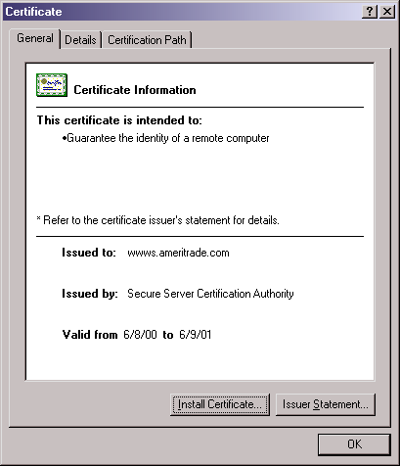
Certificates: Example
encryption

Slide 16
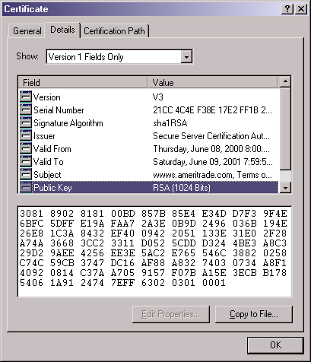
Certificates: In Detail
encryption

Slide 17
Different Types of Attacks
encryption
Brute force
False identity
Social attacks
  “Phishing”

Slide 18
The Dark Side of Encryption
encryption
Encryption is a double-edged sword
  The ability to keep secrets facilitates secure commercial transactions
  But bad guys can use encryption to keep secrets…
Can be cracked by the government?

Slide 19
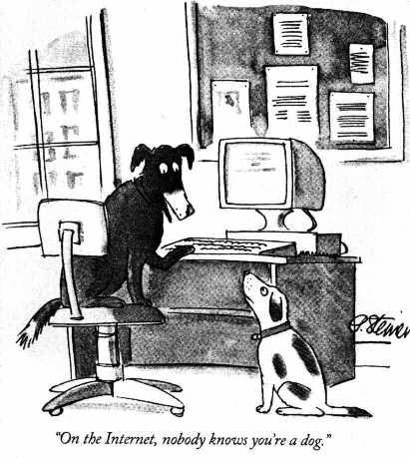
Identity, Privacy, Anonymity
identity, privacy, and anonymity
Or do they?

Slide 20
Ideals in Tension
identity, privacy, and anonymity
Establishing identity permits access control
Yet people don’t want to be tracked
How do you provide accountability?
  People’s behavior change when no one is watching
Whenever a conflict arises between privacy and accountability, people demand the former for themselves and the latter for everybody else.
The Transparent Society by David Brin

Slide 21
Authentication
identity, privacy, and anonymity
Used to establish identity
Two types
  Physical (Keys, badges, cardkeys, thumbprints)
  Electronic (Passwords, digital signatures)
Protected with social structures
  Report lost keys
  Don’t tell anyone your password
Susceptible to social engineering

Slide 22
Good Passwords
identity, privacy, and anonymity
Long enough not to be guessed
  Programs can try every combination of 4 letters
Not in the dictionary
  Programs can try every word in a dictionary
  And every date, and every proper name, ...
  And even every pair of words
Mix upper case, lower case, numbers, etc.
Change it often and use one for each account
Tension between security and convenience

Slide 23
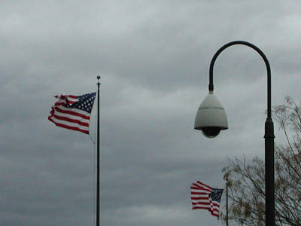
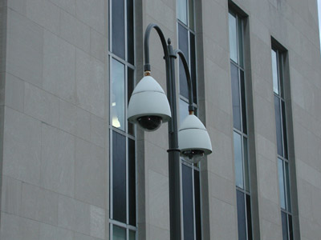
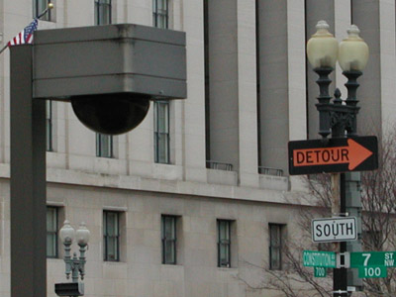
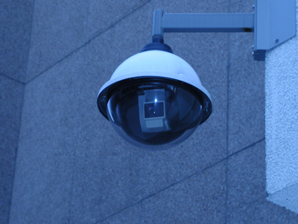
Is Privacy an Illusion?
identity, privacy, and anonymity

Slide 24
Are you being watched?
identity, privacy, and anonymity
Where?
  At home?
  At work?
  In a shopping mall?
  In a parking garage?
  In the library?
Do they have the right?

Slide 25
Tracking Internet Activity
identity, privacy, and anonymity
ISP logs
IP address
Firewalls
Cookies
Browser history
Spyware
Packet sniffing
Intercepting e-mails
Monitoring news groups
Monitoring chat rooms
Booby-trapped web sites
Wiretaps

Slide 26
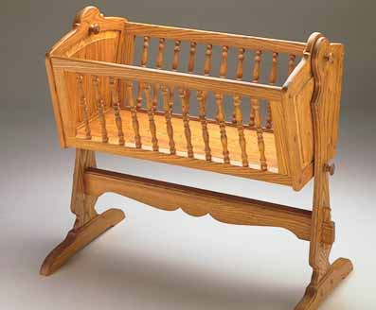
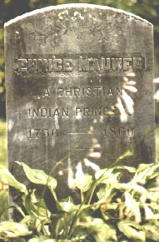
The Government Knows
identity, privacy, and anonymity
The government stores a lot of information about life events:
  Birth
  Getting your driver license
  Getting married
  Getting divorced
  Buying a house
  Paying taxes
  Dying

Slide 27
Practical Obscurity
identity, privacy, and anonymity
A lot of government-collected information is public record
Previously shielded by “practical obscurity”
  Records were hard to access
Not so with the Internet

Slide 28
Businesses Know
identity, privacy, and anonymity
Business know a lot about you:
  How you commute to work
  What cereal you eat
  Where you like to go for vacation
  What hobbies you have
And they sell each other this information

Slide 29
Databases
identity, privacy, and anonymity
Many organizations collect information about different facets of your life
What happens when they start piecing the facets together?
  Is anonymity even possible?
  “They” are already doing this!

Slide 30
The Post 9/11 World
identity, privacy, and anonymity
The public (?) will choose security over privacy
The Patriot Act gives the government broad powers
The Professional Association of Diving Instructors (PADI), which certifies about 65 percent of the nation's divers, gave the FBI a computer file containing the names of more than 2 million certified divers in May 2002.
Airlines have handed large amounts of passenger data over to the government (most voluntarily).
Etc.

Slide 31
Continual Erosion of Privacy
identity, privacy, and anonymity
Slippery slope into Big Brother?
What can you do?

Slide 32
Security
security
Used to be simple…
Not so in a networked environment
Viruses and other nasty stuff
  1988: Less than 10 known viruses
  1990: New virus found every day
  1993: 10-30 new viruses per week
  1999: 45,000 viruses and variants
  Today: ??

Slide 33

Viruses
security
Fragments of computer programs capable of attaching to disks or other files
  Replicates itself repeatedly, typically without user knowledge or permission
  Often does nothing, but sometimes actively performs malicious acts

Slide 34
Worms
security
A self-reproducing programs that travels independently across networks
Reproduction differences:
  A virus is dependent upon the transfer of files between machines to spread
  A worm can run completely independently and spread of by itself through network connections
Famous example:
  SQL slammer worm (January 25, 2003) claimed 75,000 victims within 10 minutes: Internet brought to a halt

Slide 35
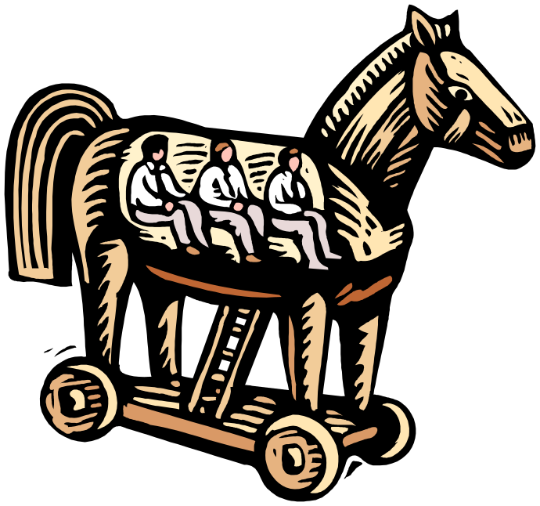
Trojan Horse
security
A malicious program that pretends to be a benign application
  Examples: logs key strokes and sends somewhere; creates a “back door”
  Usually doesn’t replicate

Slide 36
Spyware and Adware
security
Spyware: software that sits on your machine and reports information about your activity to a third party without your knowledge
  How does spyware get onto your computer?
Adware: software that display annoying advertisement

Slide 37
Denial of Service Attacks
security
An attack on a computer network that causes a loss of service to users
Typical perpetrated by flooding the host with an overwhelming number of packets
  Consumption of resources: CPU, bandwidth, etc.

Slide 38
Practical Tips
security
Be wary of anything free
Always have updated anti-virus software
Change default settings
Choose good passwords
Keep software patched

Slide 39
The Grand Plan
final review
Intellectual property, security, privacy, and social issues
Building and deploying systems
Databases
Multimedia
Programming
Search
XML: substrate for managing and communicating content
Interacting with computers
Computers, Networks, the Web

Slide 40
Computer and Networks
final review
Computers and networks as devices for transferring, storing, and manipulating data
Concepts of speed, time, and size
Computer hardware
  Managing time: storage hierarchy and caching
Computer networks
  Packet-switched networks: routers, routing tables, etc.

Slide 41
The Web
final review
HTML, HTTP, URLs
How does a Web page get from the server to your Web browser?

Slide 42
Interacting with Computers
final review
User Interfaces: arguably the most important component of software!
Interface design principles
  Consistency, alignment, flow, etc.
User’s mental model of software

Slide 43
XML
final review
Substrate for storing, managing, and communicating content
What XML is and what XML isn’t
  Cutting through the hype
Future promise and potential of XML
  Semantic Web
  Interoperability

Slide 44
Relational Databases
final review
Tables and relations
  Primary keys, foreign keys
  Normalization
Database operations
  Join (select x, y)
  Project (select…)
  Restrict (where...)
ACID Properties
Web sites that are really databases
  Deep vs. surface Web

Slide 45
Multimedia
final review
Tricking the human senses
  Pixels to images
  Images to movies
  Sampling for audio
Compressions, compression, compression
Streaming delivery

Slide 46
Programming
final review
Like cooking!
Built from individual instructions grouped into three types of control structures:
  Sequential
  Conditional
  Iteration
Functions “bundle together” common operations
Javascript

Slide 47
Search and IR
final review
Why is IR hard?
The interaction cycle
Boolean queries and index structure
Evaluating systems: precision vs. recall

Slide 48
System Life Cycle
final review
Building and deploying systems
  System analysis
  Software development models
  Managing complex systems
Open Source
The “chilling effects” of DRM, DMCA, etc.

Slide 49
The Grand Plan
final review
Intellectual property, security, privacy, and social issues
Building and deploying systems
Databases
Multimedia
Programming
Search
XML: substrate for managing and communicating content
Interacting with computers
Computers, Networks, the Web

