Slide 1

LBSC 690: Session 7
Relational Databases
Jimmy Lin
College of Information Studies
University of Maryland
Monday, October 22, 2007
Some content borrowed from slides by Michael Franklin, UC Berkeley

Slide 2
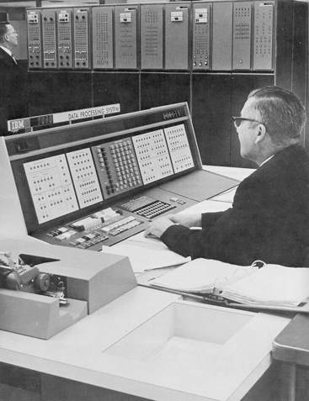
Databases Then…

Slide 3


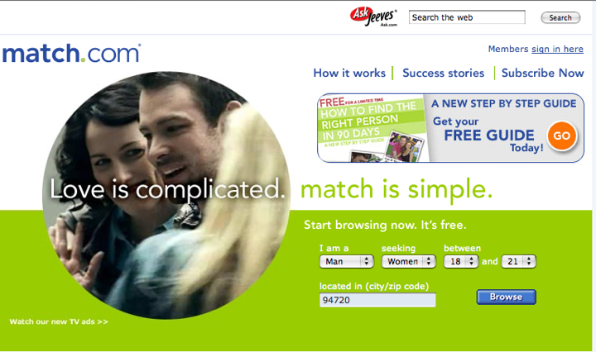

Databases Now…

Slide 4
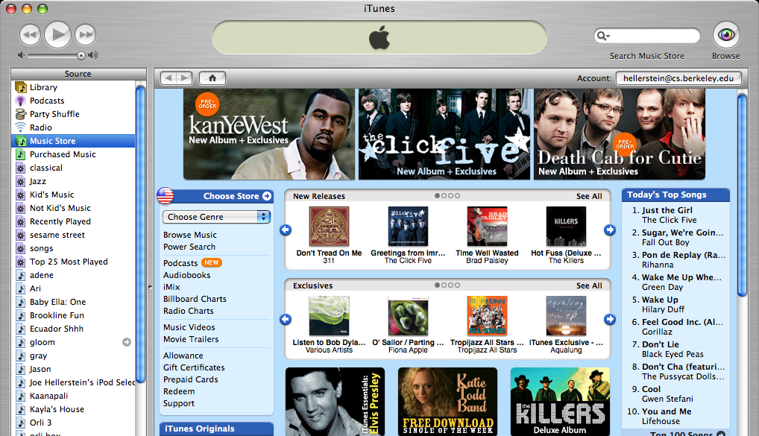
And here…

Slide 5
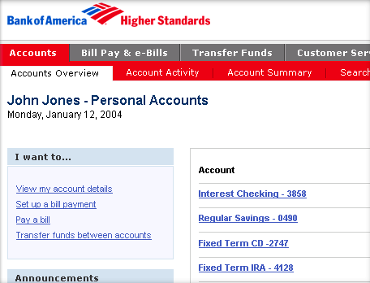
And here…

Slide 6

What is a database system?
Database:
  a large, integrated collection of data
Models something about the real world
  Entities (e.g., teams, games)
  Relationships (e.g., the Red Sox won the World Series)
  More recently, also includes active components, often called “business logic” (e.g., the playoff system)
A Database Management System (DBMS) is a software system designed to store, manage, and facilitate access to databases
  Today’s focus on relational databases

Slide 7
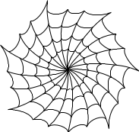

Is the WWW a DBMS?
=
Fairly sophisticated search available
  Crawler indexes pages on the Web
  Keyword-based search for pages
But, currently
  Data is mostly unstructured and untyped
  Can’t modify the data
  Can’t get summaries, complex combinations of data
  Few guarantees provided for freshness of data, consistency across data items, fault tolerance, …
The picture is changing
  New standards, e.g., XML, Semantic Web, etc., can provide richer models of data

Slide 8
Discussion Point
What is the difference between searching and querying?

Slide 9
Database Basics
What is a database?
  Collection of data, organized to support access
  Models some aspects of reality
Components of a relational database:
  Field = an “atomic” unit of data
  Record = a collection of related fields
  Table = a collection of related records
    Each record is one row in the table
    Each field is one column in the table
  Primary Key = the field that uniquely identifies a record
  Database = a collection of tables

Slide 10
A Simple Example
Field Name
Table
Name | DOB | SSN
John Doe | 04/15/1970 | 153-78-9082
Jane Smith | 08/31/1985 | 768-91-2376
Mary Adams | 11/05/1972 | 891-13-3057
Record
Field
Primary Key

Slide 11
Why “Relational”?
Databases model some aspects of reality
A relational database views the world in terms of entities and relations between them:
  Tables represent “relations”
  Named fields represent “attributes”
  Each row in the table is called a “tuple”

Slide 12
The Registrar Example
What do we need to know (i.e., model)?
  Something about the students (e.g., first name, last name, email, department)
  Something about the courses (e.g., course ID, description, enrolled students, grades)
  Which students are in which courses

Slide 13
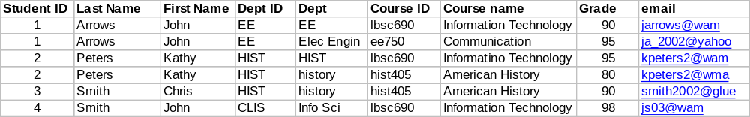
A First Try
Put everything in a big table…
Discussion: Why is this a bad idea?

Slide 14
Goals of “Normalization”
Save space
  Save each fact only once
More rapid updates
  Every fact only needs to be updated once
More rapid search
  Finding something once is good enough
Avoid inconsistency
  Changing data once changes it everywhere

Slide 15
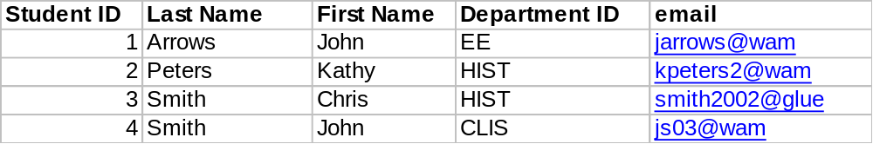
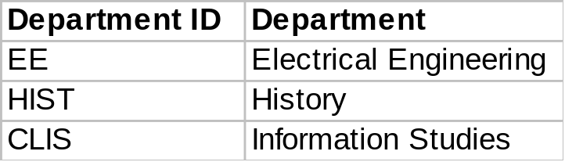
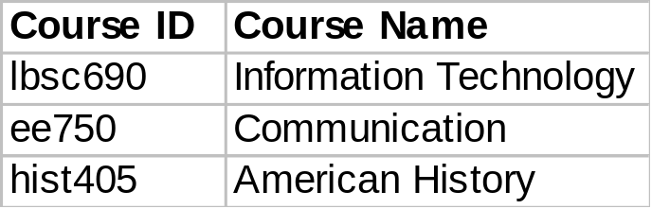
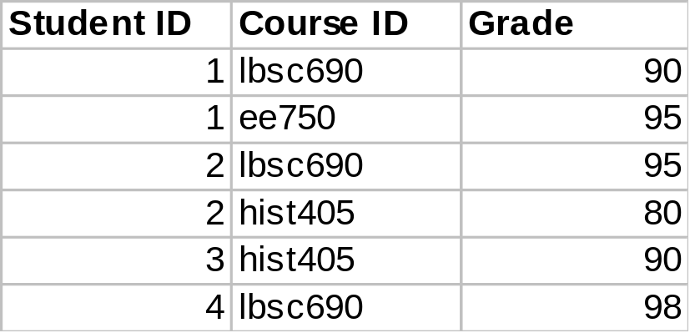
Another Try...
Student Table
Department Table
Course Table
Enrollment Table

Slide 16
Approaches to Normalization
For simple problems (like the homework):
  Start with “binary relationships”: pairs of fields that are related
  Group together wherever possible
  Add keys where necessary
For more complicated problems:
  Entity relationship modeling (LBSC 670)

Slide 17
Some Lingo
“Primary Key” uniquely identifies a record
  e.g., student ID in the student table
“Foreign Key” is primary key in the other table
  It need not be unique in this table

Slide 18
The Data Model
Student Table
Department Table
Course Table
Enrollment Table

Slide 19
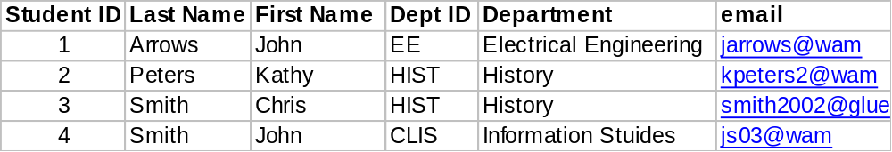
Join
Student Table
Department Table
“Joined” Table

Slide 20
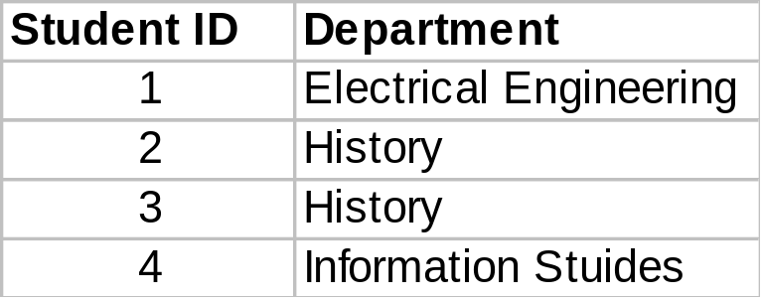
Project
SELECT Student ID, Department

Slide 21
Restrict
WHERE Department ID = “HIST”

Slide 22
Relational Operations
Joining tables: JOIN
Choosing columns: SELECT
  Based on their label
Choosing rows: WHERE
  Based on their contents
These can be specified together
department ID = “HIST”
SELECT Student ID, Dept WHERE Dept = “History”

Slide 23
Database Integrity
Registrar database must be internally consistent
  All enrolled students must have an entry in the student table
  All courses must have a name
  …
What happens:
  When a student withdraws from the university?
  When a course is taken off the books?

Slide 24
Integrity Constraints
Conditions that must be true of the database at any time
  Specified when the database is designed
  Checked when the database is modified
RDBMS ensures that integrity constraints are always kept
  So that database contents remain faithful to the real world
  Helps avoid data entry errors
Where do integrity constraints come from?

Slide 25
Discussion Point
How is a relational database different from a spreadsheet?

Slide 26



Database Architectures
two vs. three-tiered architectures
Application
Application
Client
network
network
Server
“Middleware”
Database System

Slide 27
Heavy-duty Demands
Typical database applications:
  Banking (e.g., saving/checking accounts)
  Trading (e.g., stocks)
  Airline reservations
  …
Characteristics:
  Lots of data
  Lots of concurrent access
  Must have fast access
  “Mission critical”

Slide 28
Reliability
Thought experiment: the power goes out when…
  You’re editing a file
  You’re in the middle of opening a file
  You’re in the middle of saving a file
How do you build systems under such circumstances?
Very carefully!
What happens?
Notes:
4

Slide 29
Concurrency
Thought experiment: You and your project partner are editing the same file…
  Scenario 1: you both save it at the same time
  Scenario 2: you save first, but before it’s done saving, your partner saves
How do you build systems under such circumstances?
Very carefully
Whose changes survive?
A) Yours B) Partner’s C) neither D) both E) ???
Notes:
4

Slide 30
Concurrency Example
Possible actions on a checking account
  Deposit check (read balance, write new balance)
  Cash check (read balance, write new balance)
Scenario:
  Current balance: $500
  You try to deposit a $50 check and someone tries to cash a $100 check at the same time
  Possible sequences: (what happens in each case?)
Deposit: read balance
Deposit: write balance
Cash: read balance
Cash: write balance
Deposit: read balance
Cash: read balance
Cash: write balance
Deposit: write balance
Deposit: read balance
Cash: read balance
Deposit: write balance
Cash: write balance

Slide 31
Database Transactions
Transaction = sequence of database actions grouped together
  e.g., transfer $500 from checking to savings
ACID properties:
  Atomicity: all-or-nothing
  Consistency: each transaction must take the DB between consistent states.
  Isolation: concurrent transactions must appear to run in isolation
  Durability: results of transactions must survive even if systems crash

Slide 32

Making Transactions
Idea: keep a log (history) of all actions carried out while executing transactions
  Before a change is made to the database, the corresponding log entry is forced to a safe location
Recovering from a crash:
  Effects of partially executed transactions are undone
  Effects of committed transactions are redone
  Trickier than it sounds!
the log

Slide 33
Entity-Relationship Diagrams
A database models some aspect of reality…
  ER diagrams are a way for graphically visualizing this
Entities are captured in boxes
Relationships are captured using arrows

Slide 34
The Data Model
Student Table
Department Table
Course Table
Enrollment Table

Slide 35
Registrar ER Diagram
Student
Student ID
First name
Last name
Department
E-mail
…
Enrollment
Student
Course
Grade
…
has
has
associated with
Course
Course ID
Course Name
…
Department
Department ID
Department Name
…

Slide 36
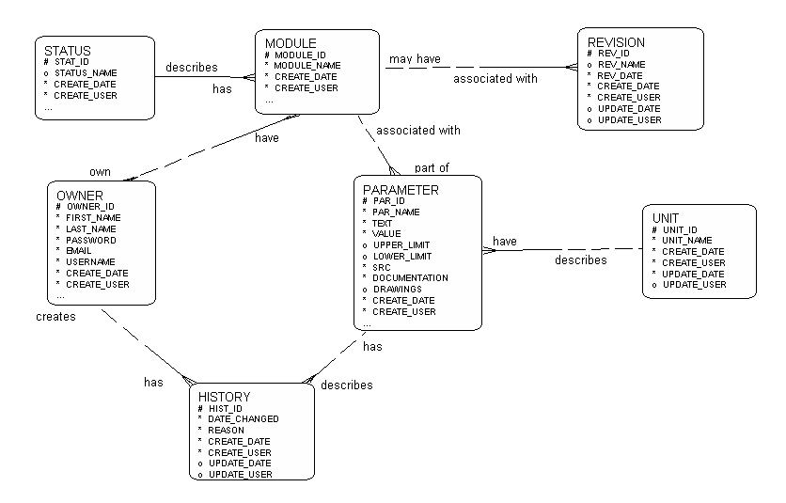
Example ER Diagram

Slide 37
Types of Relationships
Many-to-Many
1-to-Many
1-to-1

Slide 38
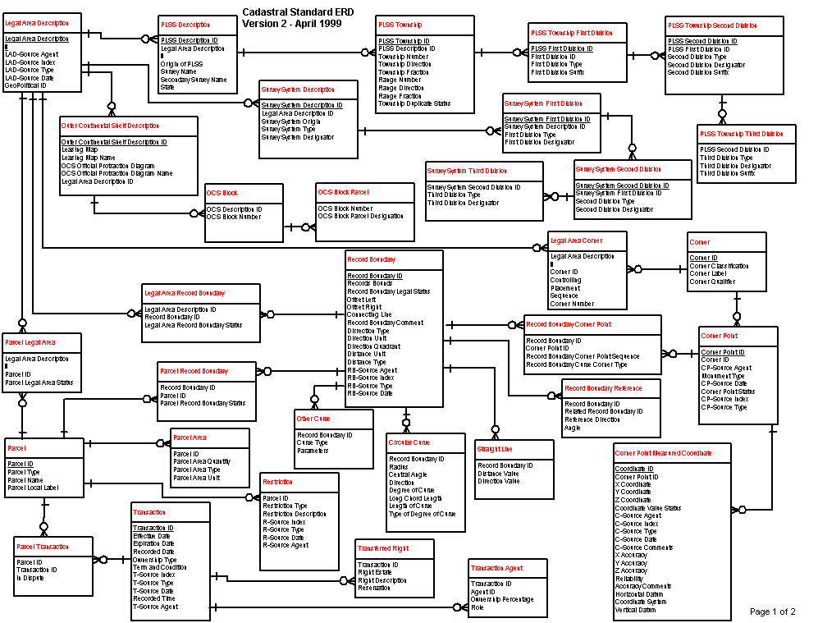
More Complex ER Diagram
cadastral: a public record, survey, or map of the value, extent, and ownership of land as a basis of taxation.
Source: US Dept. Interior Bureau of Land Management,
Federal Geographic Data Committee Cadastral Subcommittee
http://www.fairview-industries.com/standardmodule/cad-erd.htm

Slide 39
Steps in Database Design
Requirements Analysis: what must database do?
Conceptual Design: high level description (often done with ER model)
Logical Design: translate ER into DBMS data model
Schema Refinement: consistency, normalization
Physical Design: indexes, disk layout
Security Design: who accesses what, and how

Slide 40
RideFinder Exercise
Design a database to match drivers with passengers (e.g., for road trips):
  Drivers post available seats; they want to know about interested passengers
  Passengers call up looking for rides: they want to know about available rides (they don’t get to post “rides wanted” ads)
  These things happen in no particular order

Slide 41
Exercise Goals
Identify the tables you will need
  First decide what data you will save: What questions will be asked?
  Then decide how to group/split it into tables
Design queries (using join, project, and restrict)
  What happens when a passenger comes looking for a ride?
  What happens when a driver comes to find out who his passengers are?

