Slide 1

LBSC 690: Session 9
Multimedia
Jimmy Lin
College of Information Studies
University of Maryland
Monday, November 5, 2007

Slide 2
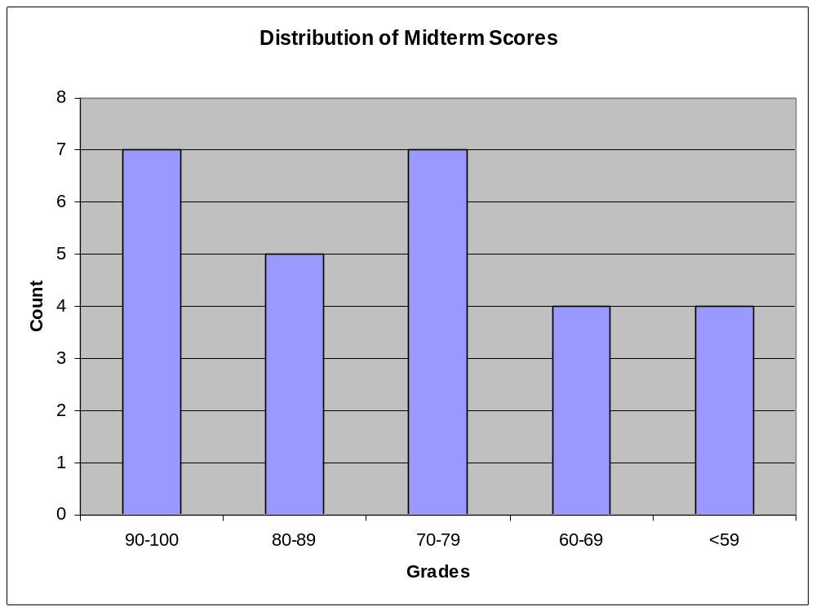
Midterm Grades

Slide 3
The Gullibility of Human Senses
Three simple tricks for producing
  Images
  Video
  Audio
But how do you move the bits around fast enough?
  Remove redundancy
  Throw away stuff that doesn’t matter
Synchronizing different media to create multimedia

Slide 4
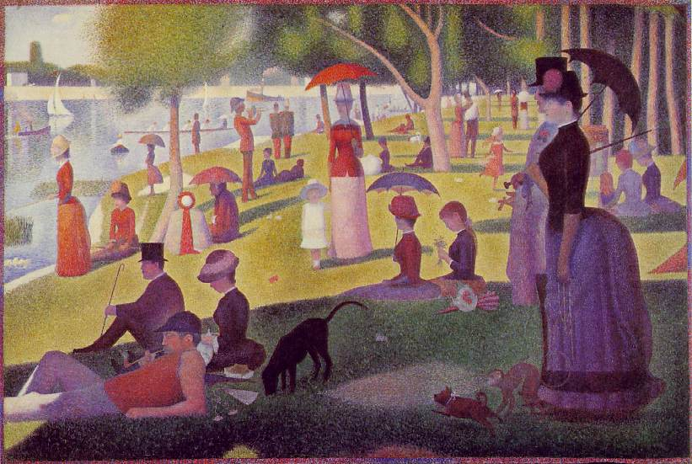
Nothing new…
Seurat, Georges, A Sunday Afternoon on the Island of La Grande Jatte

Slide 5
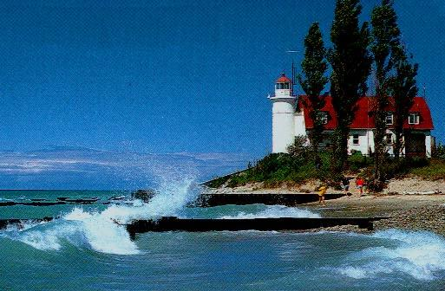
A Picture…

Slide 6
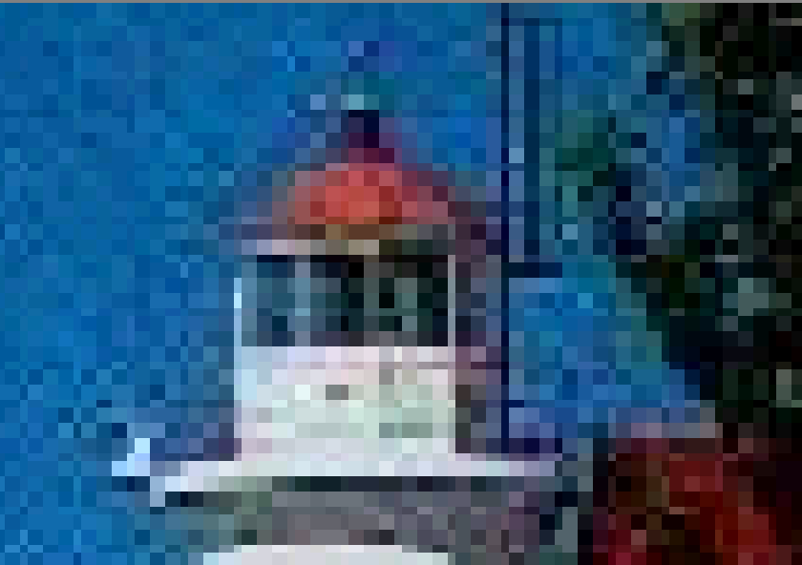
… close up

Slide 7
Visual Perception
Closely spaced dots appear solid
  But irregularities in diagonal lines can stand out
Any color can be produced from just three
  Red, Blue and Green: “additive” primary colors
High frame rates produce apparent motion
  Smooth motion requires about 24 frames/sec
Visual acuity varies markedly across features
  Discontinuities easily seen, absolutes less crucial
Notes:
http://www.yorku.ca/eye/thejoy.htm, radiating lines, brightness & color, kanizsa illusion
http://www.aber.ac.uk/media/Modules/MC10220/visper01.html (two images at the bottom)
visper03

Slide 8
Basic Image Coding
An image = a collection of picture elements (pixels)
  Each pixel has a “color”
Different types of pixels
  Binary (1 bit): black/white
  Grayscale (8 bits)
  Color (3 colors, 8 bits each): red, green, blue
A 1024x768 image requires 2.4 MB
  So a picture is worth 400,000 words!

Slide 9
Some Questions
How many images can a 64 MB flash card store?
  But mine holds 120. How?
How long will it take to send an image at 64kb/s?
  But my Web page loads faster than that. How?
But in reality images don’t have these problems
  How do we get around these problems?

Slide 10
Monitor Characteristics
Technology (CRT, flat panel)
Size
  15, 17, 19, 21 inch, or even bigger!
  Measured diagonally
Resolution
  Measured in pixels: 640x480, 800x600, 1024x768, 1280x1024, etc.
Dot pitch (0.26, 0.28)
Refresh rate (60, 72, 80 Hz)

Slide 11
Compression
Goal: send the same information using fewer bits
Originally developed for fax transmission
  Send high quality documents in short calls
Two basic types of data compression:
  Lossless: can reconstruct exactly
  Lossy: can’t reconstruct, but looks the same
Two basic strategies:
  Reduce redundancy
  Throw away stuff that doesn’t matter

Slide 12
Run-Length Encoding
Opportunity:
  Large regions of a single color are common
Approach:
  Record # of consecutive pixels for each color
An example with text:
Sheep go baaaaaaaaaa and cows go moooooooooo
→ Sheep go ba<10> and cows go mo<10>
Notes:
Run Length Encoding (RLE)
Pixels are organized into lines
Most pixels are the same as the one before
That can be coded in 1 bit (1/24 the space)
Smaller files take less time to transmit

Slide 13
Using Dictionaries
Opportunity:
  Data often has shared substructure, e.g., patterns
Approach:
  Create a dictionary of commonly seen patterns
  Replace patterns with shorthand code
An example with text:
The rain in Spain falls mainly in the plain
→ The r* ^ Sp* falls m*ly ^ the pl* (*=ain,^=in)

Slide 14
Using “Back Pointers”
Opportunity:
  Data often has shared substructure, e.g., patterns
Approach:
  Replace commonly seen patterns with “pointers” to previous location in data stream
An example with text:
The rain in Spain falls mainly in the plain
→ The rain <3,3>Sp<9,4>falls m<11,3>ly <16,3><34,4>pl<15,3>
<x, y> = go back x characters and take y characters

Slide 15
Huffman Coding
Opportunity:
  Common colors are sent more often
Approach:
  Use fewer bits to represent common colors
    1 Blue 75% 75x1 = 75 75x2 =150
    01 White 20% 20x2 = 40 20x2 = 40
    001 Red 5% 5x3 = 15 5x2 = 10
    130 200
Notes:
Graphic Interchange Format (GIF)
(.GIF file extension) There have been raging debates about the pronunciation. The designers of GIF say it is correctly pronounced to sound like Jiff. But that seems counter-intuitive, and up in my hills, we say it sounding like Gift (without the t).
GIF was developed by CompuServe to show images online (in 1987 for 8 bit video boards, before JPG and 24 bit color was in use). GIF uses indexed color, which is limited to a palette of only 256 colors (next page). GIF was a great match for the old 8 bit 256 color video boards, but is inappropriate for today's 24 bit photo images.
GIF files do NOT store the image's scaled resolution ppi number, so scaling is necessary every time one is printed. This is of no importance for screen or web images. GIF file format was designed for CompuServe screens, and screens don't use ppi for any purpose. Our printers didn't print images in 1987, so it was useless information, and CompuServe simply didn't bother to store the printing resolution in GIF files.
GIF is still an excellent format for graphics, and this is its purpose today, especially on the web. Graphic images (like logos or dialog boxes) use few colors. Being limited to 256 colors is not important for a 3 color logo. A 16 color GIF is a very small file, much smaller, and more clear than any JPG, and ideal for graphics on the web.
Graphics generally use solid colors instead of graduated shades, which limits their color count drastically, which is ideal for GIF's indexed color. GIF uses lossless LZW compression for relatively small file size, as compared to uncompressed data. GIF files offer optimum compression (smallest files) for solid color graphics, because objects of one exact color compress very efficiently in LZW. The LZW compression is lossless, but of course the conversion to only 256 colors may be a great loss. JPG is much better for 24 bit photographic images on the web. For those continuous tone images, the JPG file is also very much smaller (although lossy). But for graphics, GIF files will be smaller, and better quality, and (assuming no dithering) pure and clear without JPG artifacts.
If GIF is used for continuous tone photo images, the limited color can be poor, and the 256 color file is quite large as compared to JPG compression, even though it is 8 bit data instead of 24 bits. Photos might typically contain 100,000 different color values, so the image quality of photos is normally rather poor when limited to 256 colors. 24 bit JPG is a much better choice today. The GIF format may not even be offered as a save choice until you have reduced the image to 256 colors or less.
So for graphic art or screen captures or line art, GIF is the format of choice for graphic images on the web. Images like a company logo or screen shots of a dialog box should be reduced to 16 colors if possible and saved as a GIF for smallest size on the web. A complex graphics image that may look bad at 16 colors might look very good at say 48 colors (or it may require 256 colors if photo-like). But often 16 colors is fine for graphics, with the significance that the fewer number of colors, the smaller the file, which is extremely important for web pages.
GIF optionally offers transparent backgrounds, where one palette color is declared transparent, so that the background can show through it. The GIF File - Save As dialog box usually has an Option Button to specify which one GIF palette index color is to be transparent.
Interlacing is an option that quickly shows the entire image in low quality, and the quality sharpens as the file download completes. Good for web images, but it makes the file slightly larger.
GIF files use a palette of indexed colors, and if you thought 24 bit RGB color was kinda complicated, then you ain't seen nuthin' yet (next page).
For GIF files, a 24 bit RGB image requires conversion to indexed color. More specifically, this means conversion to 256 colors, or less. Indexed Color can only have 256 colors maximum. There are however selections of different ways to convert to 256 colors.

Slide 16
Palette Selection
Opportunity:
  No picture uses all 16 million colors
  Human eye does not see small differences
Approach:
  Select a palette of 256 colors
  Indicate which palette entry to use for each pixel
  Look up each color in the palette
What happens if there are more than 256 colors?
This is GIF!

Slide 17
Tricking Human Senses
Opportunity:
  Eye sees sharp lines better than subtle shading
  Eye more sensitive to small changes in brightness than in color
Approach:
  Retain detail only for the most important parts
  Approximate changes in image with mathematical curves: Discrete Cosine Transform
    Efficiently captures smooth transitions and shading
    Not as good at capturing sharp edges
This is JPEG!
Notes:
Jpeg vs gif
http://hotwired.lycos.com/webmonkey/geektalk/97/30/index3a.html?tw=design
JPEG is designed to exploit known limitations of the human eye, notably the fact that small color changes are perceived less accurately than small changes in brightness. Thus, JPEG is intended for compressing images that will be looked at by humans. If you plan to machine-analyze your images, the small errors introduced by JPEG may be a problem for you, even if they are invisible to the eye.
JPEG is that it stores full color information: 24 bits/pixel (16 million colors). GIF, the other image format widely used on the net, can only store 8 bits/pixel (256 or fewer colors).
What is color quantization? Many people don't have full-color (24 bit per pixel) display hardware. Inexpensive display hardware stores 8 bits per pixel, so it can display at most 256 distinct colors at a time. To display a full-color image, the computer must choose an appropriate set of representative colors and map the image into these colors. This process is called "color quantization". (This is something of a misnomer; "color selection" or "color reduction" would be a better term. But we're stuck with the standard usage.)
Making a good color quantization method is a black art, and no single algorithm is best for all images.
http://www.faqs.org/faqs/jpeg-faq/part1/

Slide 18
Mixing and Matching
Image encoding formats mix and match techniques described above
  GIF: palette selection, LZW compression
  JPEG: takes advantage of human visual system using DCT
  PNG: replacement for GIF (no patent restrictions)
  etc.
Notes:
Jpeg vs gif
http://hotwired.lycos.com/webmonkey/geektalk/97/30/index3a.html?tw=design
JPEG is designed to exploit known limitations of the human eye, notably the fact that small color changes are perceived less accurately than small changes in brightness. Thus, JPEG is intended for compressing images that will be looked at by humans. If you plan to machine-analyze your images, the small errors introduced by JPEG may be a problem for you, even if they are invisible to the eye.
JPEG is that it stores full color information: 24 bits/pixel (16 million colors). GIF, the other image format widely used on the net, can only store 8 bits/pixel (256 or fewer colors).
What is color quantization? Many people don't have full-color (24 bit per pixel) display hardware. Inexpensive display hardware stores 8 bits per pixel, so it can display at most 256 distinct colors at a time. To display a full-color image, the computer must choose an appropriate set of representative colors and map the image into these colors. This process is called "color quantization". (This is something of a misnomer; "color selection" or "color reduction" would be a better term. But we're stuck with the standard usage.)
Making a good color quantization method is a black art, and no single algorithm is best for all images.
http://www.faqs.org/faqs/jpeg-faq/part1/

Slide 19
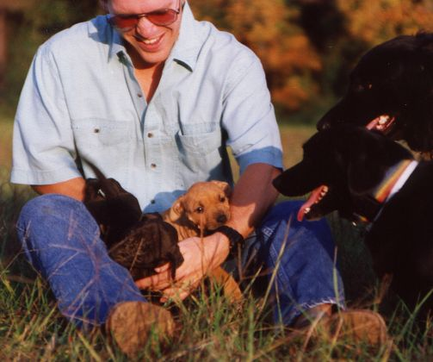
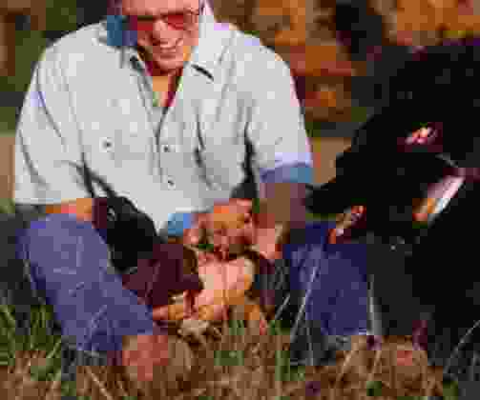
Variable JPEG Compression
37 kB (20%)
4 kB (95%)
Notes:
Good examples about jpeg and gif
http://www.wpdfd.com/wpdgraph.htm

Slide 20
Hands-on Exercise
Comparing JPEG and GIF formats
Load and save two images
  http://www.umiacs.umd.edu/~jimmylin/LBSC690-2007-Fall/Week9-images/image1.jpg
  http://www.umiacs.umd.edu/~jimmylin/LBSC690-2007-Fall/Week9-images/image2.gif
Download the two images:
  Use MS photo editor to convert each to the other format, and compare the quality and the size
  Vary the compression rate for the JPEG image, and compare the quality
Notes:
Good examples about jpeg and gif
http://www.wpdfd.com/wpdgraph.htm

Slide 21
Discussion Point
JPEG vs. GIF
Which format should I use for images in my Web pages?
  photos
  text images
  drawings

Slide 22
Discussion Point
When is Lossless Compression Important?
  For images?
  For text?
  For sound?
  For video?

Slide 23
Raster vs. Vector Graphics
Raster images = bitmaps
  Actually describe the contents of the image
Vector images = composed of mathematical curves
  Describe how to draw the image
What happens when you scale vector images?
What happens when you scale raster images?

Slide 24

Example of Vector Images

Slide 25
Basic Video Coding
Display a sequence of images
  Fast enough for smooth motion and no flicker
NTSC Video
  60 “interlaced” half-frames/sec, 720x486
HDTV
  30 “progressive” full-frames/sec, 1280x720

Slide 26
Complexity Example
“NTSC” Quality Computer Display
  640 X 480 pixel image
  3 bytes per pixel (red, green, blue)
  30 Frames per Second
Bandwidth
  26.4 MB/second: corresponds to 180X CD-ROM
  Exceeds bandwidth of almost all disk drives
Storage
  CD-ROM would hold 25 seconds worth
  30 minutes would require 46.3 GB
Some form of compression required!

Slide 27
Video Compression
Opportunity:
  One frame looks very much like the next
Approach:
  Record only the pixels that change
Standards:
  MPEG-1: Web video (file download)
  MPEG-2: HDTV and DVD
  MPEG-4: Web video (streaming)

Slide 28
MPEG Encoding
• • •
• • •
I₁
B₁
B₂
B₃
P₁
B₄
B₅
B₆
P₂
B₇
B₈
B₉
I₂
Frame Types
  I Intra Encode complete image, similar to JPEG
  P Forward Predicted Motion relative to previous I and P’s
  B Backward Predicted Motion relative to previous & future I’s & P’s

Slide 29
Frame Reconstruction
I₁
I₁+P₁
I₁+P₁+P₂
I₂
• • •
• • •
updates
  I frames provide complete image
  P frames provide series of updates to most recent I frame
P₁
P₂

Slide 30
Frame Reconstruction
I₁
I₁+P₁
I₁+P₁+P₂
I₂
• • •
• • •
Interpolations
B frames interpolate between frames represented by I’s & P’s
B₁
B₂
B₃
B₄
B₅
B₆
B₇
B₈
B₉

Slide 31
Basic Audio Coding
Sample at twice the highest frequency
  8 bits or 16 bits per sample
Speech (0-4 kHz) requires 8 kB/s
  Standard telephone channel (8-bit samples)
Music (0-22kHz) requires 172 kB/s
  Standard for CD-quality audio (16 bit samples)
Sampler

Slide 32
Compact Disk Recording
Parameters
  44,100 samples per second
    Sufficient for frequency response of 22KHz
  Each sample 16 bits
    48 dB range
  Two independent channels: stereo sound
    Dolby surround-sound uses tricks to pack 5 sound channels + subwoofer effects
Bit Rate
  44.1K samples/sec x 2 channels x 2 bytes = 172 KB/sec
Capacity
  74 Minutes maximum playing time
  747 MB total

Slide 33
Speech Compression
Opportunity:
  Human voices vary in predictable ways
Approach:
  Predict what’s next, then send only any corrections
Standards:
  Real audio can code speech in 6.5 kb/sec
Demo at http://www.data-compression.com/speech.html
Notes:
http://www.data-compression.com/speech.html

Slide 34
How do MP3s work?
Opportunity:
  The human ear cannot hear all frequencies at once, all the time
Approach:
  Don’t represent things that the human ear cannot hear

Slide 35
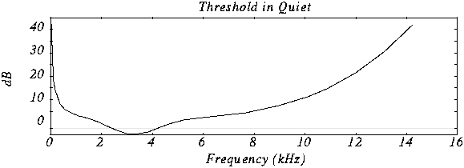
Human Hearing Response
Experiment: Put a person in a quiet room. Raise level of 1kHz tone until just barely audible. Vary the frequency and plot the results.

Slide 36
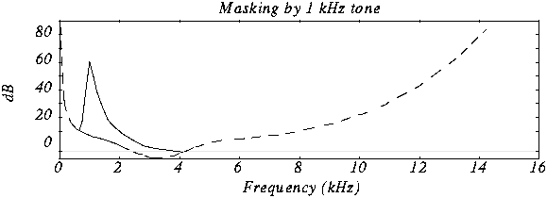
Frequency Masking
Experiment: Play 1kHz tone (masking tone) at fixed level (60db). Play test tone at a different level and raise level until just distinguishable. Vary the frequency of the test tone and plot the threshold when it becomes audible.

Slide 37
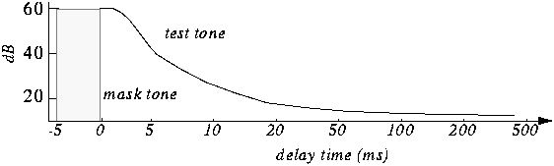
Temporal Masking
If we hear a loud sound, then it stops, it takes a while until we can hear a soft tone at about the same frequency.

Slide 38
Putting it all together…
Psychoacoustic compression:
  Eliminate sounds below threshold of hearing
  Eliminate sounds that are frequency masked
  Eliminate sounds that are temporally masked
  Eliminate stereo information for low frequencies

Slide 39
Multimedia: Take One
Object stored in a file
File transferred as an HTTP object:
  Received entirely at the client
  Passed to media player
Web
Browser
Web
Server
Media
Player

Slide 40
Multimedia: Take Two
Browser gets metafile over HTTP
  Launches media player to interpret the metafile
Media player contacts streaming server
Web
Browser
Web
Server
Media
Player
Streaming
Server

Slide 41

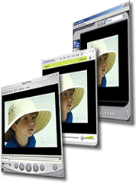
Streaming Audio and Video
Buffering a portion of audio/video
Playing along with receiving
Analogy: filling and draining a basin concurrently
Media Sever
Internet
Buffer
Notes:
Understanding streaming media
Streaming media is a technology for delivering audio, video, or multimedia files across a network without waiting for the entire file to download. When you click an Internet link to open a streaming media file, the file is partially downloaded and stored in a buffer; this is called buffering. The file then begins to play. As more information in the file is streamed to Windows Media Player, it continues to buffer information before playing it. Windows Media Player does this so that if traffic on the Internet interrupts the flow of information, there will be no breaks or interference with the file as it plays. You will notice a break in play when the data in the buffer runs out.
Windows Media Player alerts you when information is buffering. All streaming Windows Media files buffer before they begin playing. Unlike a downloaded file, data is not saved to the hard disk drive when streaming files are done playing.
Windows Media Player also supports intelligent streaming; it monitors network conditions and automatically makes adjustments to ensure the best reception and playback.
When you play streamed media or CD tracks, you can view statistics and information about the quality of the connection and the performance of the playback. The information in the Statistics dialog box can help you determine whether you are receiving a quality data transmission.
To view statistics about content
On the View menu, click Statistics.
If you want more specific information, click the Advanced tab.
To view details about a file
On the File menu, click Properties. –or-
In Media Library, right-click the file in the right pane, and then click Properties.

Slide 42
Client Buffering
Client-side buffering: playout delay compensate for network-added delay
constant bit
rate video
transmission
client video
reception
constant bit
rate video
playout at client
Cumulative data
variable
network
delay
buffered
video
client playout
delay
time

Slide 43





Multiple Client Rates
1.5 Mbps encoding
28.8 Kbps encoding
Q: how to handle different client receive rate capabilities?
  28.8 Kbps dialup
  100Mbps Ethernet
A: server stores, transmits multiple copies of video, encoded at different rates

Slide 44
Discussion Point
What are the effects of buffering on…
  Internet radio?
  Digital TV “on demand”?
  Skype?
  AIM?

Slide 45
Example: Internet Telephony
Characteristics:
  “Live”
  Alternating talk spurts

Slide 46
IP Phones: Network Issues
Network loss: packets lost due to network congestion
Delay loss: packets arrives too late for playout at receiver
  Delays: processing, queueing in network; end-system (sender, receiver) delays
  Typical maximum tolerable delay: 400 ms
Loss tolerance: depending on voice encoding packet loss rates between 1% and 10% can be tolerated

Slide 47
IP Phones: Playout Delay
Receiver attempts to playout each chunk exactly q ms after chunk was generated
  Chunk has time stamp t: play out chunk at t+q
  Chunk arrives after t+q: data arrives too late for playout, data “lost”
Tradeoff for q:
  Large q: less packet loss
  Small q: better interactive experience
Fancier algorithms: variable playout delay

Slide 48
Hands On: RealPlayer
View streaming real video
Select “Tools/Playback statistics”
Pay attention to bandwidth and lost packets
http://www.c-span.org

Slide 49
Simple RealAudio Demo
.ram file specifies
  URL for the RealAudio stream
  Dimensions of the picture
  URL for the picture
See demo at
  http://www.umiacs.umd.edu/~jimmylin/LBSC690-2005-Fall/SMIL-demo/

Slide 50
Synchronizing Multiple Media
Scripting Languages
  Synchronized Multimedia Integration Language (SMIL)
Custom applications
  Macromedia Flash

Slide 51
SMILe
W3C standard
  Player-specific extensions are common
XML, with a structure similar to HTML
See demo at
  http://www.umiacs.umd.edu/~jimmylin/LBSC690-2005-Fall/SMIL-demo/
<smil>
<head> … </head>
<body> … </body>
</smil>

Slide 52
Elements in SMIL
Window controls (in <head>)
  Controlling layout: <region>, <root-layout>
Timeline controls (in <body>)
  Sequence control: <seq>, <excl>, <par>
  Timing control: <begin>, <end>, <dur>
Content types (in <body>)
  <audio>, <video>, <img>, <ref>

Slide 53
From Media to Multimedia…
Tricking the human senses:
  Blending pixels into a seamless image
  Rapidly cycling through images to create motion
  Sampling analog waveforms to create digital recordings
Lots of information required to encode images, movies, and sounds
  Key is compression!
Synchronization of different media sources leads to multimedia applications

