Slide 1

LBSC 690: Week 10
Programming, JavaScript
Jimmy Lin
College of Information Studies
University of Maryland
Monday, April 9, 2007

Slide 2
Software
Software “does something”
  Tells the machine how to operate on some data
Software models aspects of reality
  Input and output represent the state of the world
  Software describes how the two are related
Examples:
  Ballistic computations
  Visa’s credit card verification system
  Google
  Microsoft Word

Slide 3
Types of Software
Application programs (e.g., PowerPoint)
  What you normally think of as a “software’’
Compilers and interpreters
  Programs used to write other programs
Operating system (e.g., Windows XP)
  Manages computing resources
Embedded software (e.g., TiVO)
  Programs permanently embedded inside some physical device

Slide 4
Programming Languages
Software “does something”
  Programming languages tell the machine “what to do”
Special purpose: geared towards specific tasks
  Complex math (e.g., Matlab)
  Databases (e.g., SQL)
General purpose: able to accomplish anything
  Examples: Java, JavaScript, Perl, C, C++, ...

Slide 5
Types of Programming
Machine language
  Language that the machine can directly understand
Assembly language
  Directly specifies actions of the machine
  Assembler changes instructions to machine code
High-level languages
  Specifies machine instructions at a more abstract level
  Compiler/interpreter translates to machine language
  Examples: C/C++, Java, JavaScript
Visual programming languages
  Visually arrange interface components
  Example: Visual Basic

Slide 6
Types of Languages
C
Java
Pascal
COBOL
…
Assembly Language
Machine Language
Hardware

Slide 7
Machine Language
Everything is a binary number
  Operations
  Data
  Memory locations
For instance
  00001000 ADD
  00010101 first number (21)
  01010110 second number (86)
  0010 register 2
00001000 00010101 01010110 0010

Slide 8
Assembly Language
One level up from machine language
  Symbolic instructions
  Symbols representing memory locations
For instance
Assembly code is directly translatable into machine language
ADD 21, 86, R2

Slide 9
High-Level Languages
Instructions represent higher-level constructs
  Closer to how humans approach problems
  Must be converted into machine code by a compiler or interpreter

Slide 10
Programming: Overview
A program consists of a sequence of instructions
Basic concepts:
  Data types
  Variables
  Basic operations
  Instructions
Structures for controlling how instructions are executed:
  Sequential
  Conditional
  Repetition

Slide 11
Programming: Foundations
Data types = things that you can operate on
  Boolean: true, false
  Number: 5, 9, 3.1415926
  String: “Hello World”
Variables hold values of a particular data type
  Represented as symbols (e.g., x)
Operations = things that you can do
  -x reverse the sign of x (negation)
  6+5 Add 6 and 5 (numeric)
  “Hello” + “World” Concatenate two strings
  2.1 * 3 Multiply two values
  x++ increase value of x by 1

Slide 12
Basic Instructions
Assignment = store the result of an operation
  x = 5 set the value of x to be 5
  x += y x = x + y
  x *= 5 x = x * 5
In JavaScript, var declares a variable
  var b = true; create a boolean b and set it to true
  var n = 1; create a number n and set it to 1
  var s = “hello”; create a string s and set it to “hello”
In JavaScript, all instructions end with a semicolon (;)

Slide 13
Basic Control Structures
Sequential
  Perform instructions one after another
Conditional
  Perform instructions contingent on something else being true
Repetition
  Repeat instructions until a condition is met
Not much different from cooking recipes!

Slide 14
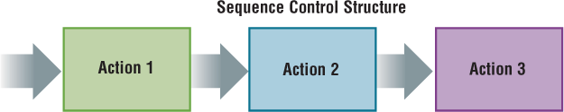
Sequential Control Structure
var a = 2;
var b = 3;
var c = a * b;

Slide 15
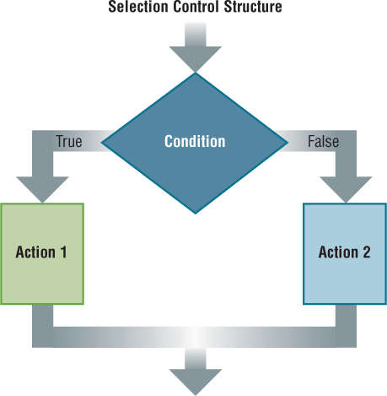
Conditional Control Structure
if (gender == “male”) {
greeting = “Hello, Sir”;
} else {
greeting = “Hello, Madam”;
}

Slide 16
Test Conditions
x == y true if x and y are equal
x != y true if x and y are not equal
x > y true if x is greater than y
x <= y true if x is smaller than or equal to y
x && y true if both x and y are true
x || y true if either x or y is true
!x true if x is false

Slide 17
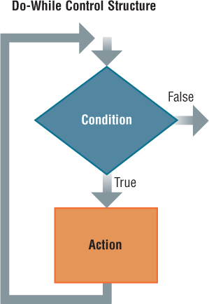
Repetition Control Structure
Program Example 1:
n = 1;
while ( n <= 10) {
document.writeln(n);
n++;
}
Program Example 2:
For (n = 1; n <= 10; n++) {
document.writeln(n);
}

Slide 18
Arrays
A set of elements grouped together
  For example, the number of days in each month
Each element is assigned an index
  A number used to refer to that element
    For example, x[4] is the fifth element (count from zero!)
  Arrays and repetitions work naturally together

Slide 19
Functions
Reusable code for doing a single task
A function takes in one or more parameters and returns one value
function convertToCelsius(f) {
var celsius = 5/9 * (f-32);
return celsius;
}
function weirdAddition(a, b) {
var result = a + b - 0.5;
return result;
}

Slide 20
Calling Functions
When you “call” a function, you invoke the set of instructions it represents
c = convertToCelsius(60);
function convertToCelsius(f) {
var celsius = 5/9 * (f-32);
return celsius;
}

Slide 21
More Examples
var f = 60;
c = convertToCelsius(f);
r = weirdAddition(2, 4);
var a = 2;
var b = 3;
r = weirdAddition(a, b);

Slide 22
Programming Paradigms
Procedural Programming
  Group instructions into meaningful functions
  Examples: C, Pascal, Perl
Object oriented programming
  Group “data” and “methods” into “objects”
  Naturally represents the world around us
  Examples: C++, Java

Slide 23
Algorithms
Derived from the name of the Persian mathematician Al-Khwarizmi
A sequence of well-defined instructions designed to accomplish a certain task

Slide 24
Programming for the Web
Common Gateway Interface (CGI) [Server-side]
  User inputs information into a form
  Form values passed to the sever via CGI
  Program on the server generates a Web page as a response
JavaScript [Client-side, interpreted]
  Human-readable “source code” sent to the browser
  Web browser runs the program
Java applets [Client-side, compiled]
  Machine-readable “bytecode” sent to browser
  Web browser runs the program
  Not related to JavaScript (other than similarities in syntax)

Slide 25
Where is the JavaScript?
JavaScript is usually kept in the <head> section of an HTML document
…
<head>
<script language="JavaScript" type="text/javascript">
<!--
function calculate() {
var num = eval(document.input.number.value);
…
document.output.number.value = total;
}
//-->
</script>
</head>
…

Slide 26
Handling Events
When does code actually get executed?
Events:
  User actions trigger “events”
  Embedded in all modern GUIs
Event handlers are used to respond to events
  Examples of event handlers in JavaScript
    onMouseover: the mouse moved over an object
    onMouseout: the mouse moved off an object
    onClick: the user clicked on an object

Slide 27
Input and Output
How do you get information to/from the user?
  Forms provide a method for accepting input and displaying output
In HTML
<form name="input" action="">
Please enter a number:
<input size="10" value=" " name="number"/>
</form>
<form name="output" action="">
The sum of all numbers up to the number above is
<input size="10" value=" " name="number" readonly="true"/>
</form>
Reads in a value
eval function turns it into a number
JavaScript code
var num = eval(document.input.number.value);
document.output.number.value = 10;
Changes the value in the textbox

Slide 28
JavaScript Resources
Google “javascript”
  Tutorials: to learn to write programs
  Code: to do things you want to do (“borrow”)
Books

Slide 29
Programming Tips
Details are everything!
  Careful where you place that comma, semi-colon, etc.
Write a little bit of code at a time
  Add a small new functionality, make sure it works, then move on
  Don’t try to write a large program all at once
Debug by outputting the state of the program
  Print out the value of variables using document.write
  Is the value what you expected?

