Slide 1

LBSC 690: Week 11
Information Retrieval and Search
Jimmy Lin
College of Information Studies
University of Maryland
Monday, April 16, 2007

Slide 2
What is IR?
“Information?”
  How is it different from “data”?
    Information is data in context
    Not necessarily text!
  How is it different from “knowledge”?
    Knowledge is a basis for making decisions
    Many “knowledge bases” contain decision rules
“Retrieval?”
  Satisfying an information need
  “Scratching an information itch”
Notes:
4

Slide 3
What types of information?
Text (Documents and portions thereof)
XML and structured documents
Images
Audio (sound effects, songs, etc.)
Video
Source code
Applications/Web services

Slide 4
The Big Picture
The four components of the information retrieval environment:
  User (user needs)
  Process
  System
  Data
What computer geeks care about!
What we care about!

Slide 5
The Information Retrieval Cycle
Source
Selection
Resource
Query
Formulation
Query
Search
Ranked List
Selection
Documents
query reformulation,
vocabulary learning,
relevance feedback
Examination
Documents
source reselection
Delivery

Slide 6
Supporting the Search Process
Source
Selection
Resource
Query
Formulation
Query
Search
Ranked List
Indexing
Selection
Index
Documents
Examination
Acquisition
Collection
Documents
Delivery

Slide 7
How is the Web indexed?
Spiders and crawlers
Robot exclusion
Deep vs. Surface Web

Slide 8
Modern History
The “information overload” problem is much older than you may think
Origins in period immediately after World War II
  Tremendous scientific progress during the war
  Rapid growth in amount of scientific publications available
The “Memex Machine”
  Conceived by Vannevar Bush, President Roosevelt's science advisor
  Outlined in 1945 Atlantic Monthly article titled “As We May Think”
  Foreshadows the development of hypertext (the Web) and information retrieval system

Slide 9
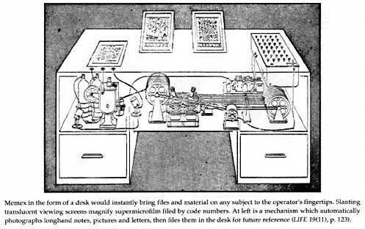
The Memex Machine

Slide 10
Types of Information Needs
Retrospective
  “Searching the past”
  Different queries posed against a static collection
  Time invariant
Prospective
  “Searching the future”
  Static query posed against a dynamic collection
  Time dependent
Notes:
When we’re talking about information retrieval, we’re talking mainly about searching.

Slide 11
Retrospective Searches (I)
Ad hoc retrieval: find documents “about this”
Known item search
Directed exploration
Identify positive accomplishments of the Hubble telescope since it was launched in 1991.
Compile a list of mammals that are considered to be endangered, identify their habitat and, if possible, specify what threatens them.
Find Jimmy Lin’s homepage.
What’s the ISBN number of “Modern Information Retrieval”?
Who makes the best chocolates?
What video conferencing systems exist for digital reference desk services?

Slide 12
Retrospective Searches (II)
Question answering
Who discovered Oxygen?
When did Hawaii become a state?
Where is Ayer’s Rock located?
What team won the World Series in 1992?
“Factoid”
What countries export oil?
Name U.S. cities that have a “Shubert” theater.
“List”
“Definition”
Who is Aaron Copland?
What is a quasar?

Slide 13
Prospective “Searches”
Filtering
  Make a binary decision about each incoming document
Routing
  Sort incoming documents into different bins?
Spam or not spam?
Categorize news headlines: World? Nation? Metro? Sports?
Notes:
5

Slide 14
Why is IR hard?
Why is it so hard to find the text documents you want?
What’s the problem with language?
  Ambiguity
  Synonymy
  Polysemy
  Morphological Variation
  Paraphrase
  Anaphora
  Pragmatics

Slide 15
“Bag of Words” Representation
Bag = a “set” that can contain duplicates
  “The quick brown fox jumped over the lazy dog’s back” →
  {back, brown, dog, fox, jump, lazy, over, quick, the, the}
Vector = values recorded in any consistent order
  {back, brown, dog, fox, jump, lazy, over, quick, the}
  →
  [1 1 1 1 1 1 1 1 2]
Notes:
8

Slide 16
Bag of Words Example
Document 1
Term
Document 1
Document 2
The quick brown
fox jumped over
the lazy dog’s
back.
aid
0
1
all
0
1
Stopword
List
back
1
0
brown
1
0
come
0
1
for
dog
1
0
is
fox
1
0
of
Document 2
good
0
1
the
jump
1
0
to
lazy
1
0
Now is the time
for all good men
to come to the
aid of their party.
men
0
1
now
0
1
over
1
0
party
0
1
quick
1
0
their
0
1
time
0
1
Notes:
9

Slide 17
Boolean “Free Text” Retrieval
Limit the bag of words to “absent” and “present”
  “Boolean” values, represented as 0 and 1
Represent terms as a “bag of documents”
  Same representation, but rows rather than columns
Combine the rows using “Boolean operators”
  AND, OR, NOT
Result set: every document with a 1 remaining
Notes:
10

Slide 18
Boolean Free Text Example
dog AND fox
  Doc 3, Doc 5
dog NOT fox
  Empty
fox NOT dog
  Doc 7
dog OR fox
  Doc 3, Doc 5, Doc 7
good AND party
  Doc 6, Doc 8
good AND party NOT over
  Doc 6
Term
Doc 2
Doc 3
Doc 1
Doc 4
Doc 5
Doc 6
Doc 7
Doc 8
aid
0
0
0
1
0
0
0
1
all
0
1
0
1
0
1
0
0
back
1
0
1
0
0
0
1
0
brown
1
0
1
0
1
0
1
0
come
0
1
0
1
0
1
0
1
dog
0
0
1
0
1
0
0
0
fox
0
0
1
0
1
0
1
0
good
0
1
0
1
0
1
0
1
jump
0
0
1
0
0
0
0
0
lazy
1
0
1
0
1
0
1
0
men
0
1
0
1
0
0
0
1
now
0
1
0
0
0
1
0
1
over
1
0
1
0
1
0
1
1
party
0
0
0
0
0
1
0
1
quick
1
0
1
0
0
0
0
0
their
1
0
0
0
1
0
1
0
time
0
1
0
1
0
1
0
0
Notes:
12

Slide 19
Why Boolean Retrieval Works
Boolean operators approximate natural language
  Find documents about a good party that is not over
AND can discover relationships between concepts
  good party
OR can discover alternate terminology
  excellent party
NOT can discover alternate meanings
  Democratic party
Notes:
13

Slide 20
The Perfect Query Paradox
Every information need has a perfect set of documents
  If not, there would be no sense doing retrieval
Every document set has a perfect query
  AND every word to get a query for document 1
  Repeat for each document in the set
  OR every document query to get the set query
But can users realistically expect to formulate this perfect query?
  Boolean query formulation is hard!
Notes:
14

Slide 21
Why Boolean Retrieval Fails
Natural language is way more complex
  She saw the man on the hill with a telescope
AND “discovers” nonexistent relationships
  Terms in different paragraphs, chapters, …
Guessing terminology for OR is hard
  good, nice, excellent, outstanding, awesome, …
Guessing terms to exclude is even harder!
  Democratic party, party to a lawsuit, …
Notes:
15

Slide 22
Proximity Operators
More precise versions of AND
  “NEAR n” allows at most n-1 intervening terms
  “WITH” requires terms to be adjacent and in order
Easy to implement, but less efficient
  Store a list of positions for each word in each doc
  Stopwords become very important!
  Perform normal Boolean computations
  Treat WITH and NEAR like AND with an extra constraint
Notes:
16

Slide 23
Boolean Retrieval
Strengths
  Accurate, if you know the right strategies
  Efficient for the computer
Weaknesses
  Often results in too many documents, or none
  Users must learn Boolean logic
  Sometimes finds relationships that don’t exist
  Words can have many meanings
  Choosing the right words is sometimes hard

Slide 24
Ranked Retrieval Paradigm
Some documents are more relevant to a query than others
  Not necessarily true under Boolean retrieval!
“Best-first” ranking can be superior
  Select n documents
  Put them in order, with the “best” ones first
  Display them one screen at a time
  Users can decided when they want to stop reading

Slide 25
Ranked Retrieval: Challenges
“Best first” is easy to say but hard to do!
  The best we can hope for is to approximate it
Will the user understand the process?
  It is hard to use a tool that you don’t understand
Efficiency becomes a concern

Slide 26
Similarity-Based Queries
Create a query “bag of words”
Find the similarity between the query and each document
  For example, count the number of terms in common
Rank order the documents by similarity
  Display documents most similar to the query first
Surprisingly, this works pretty well!

Slide 27
Counting Terms
Terms tell us about documents
  If “rabbit” appears a lot, it may be about rabbits
Documents tell us about terms
  “the” is in every document: not discriminating
Documents are most likely described well by rare terms that occur in them frequently
  Higher “term frequency” is stronger evidence
  Low “collection frequency” makes it stronger still
Notes:
18

Slide 28
The Information Retrieval Cycle
Source
Selection
Resource
Query
Formulation
Query
Search
Ranked List
Selection
Documents
query reformulation,
vocabulary learning,
relevance feedback
Examination
Documents
source reselection
Delivery

Slide 29
Search Output
What now?
  User identifies relevant documents for “delivery”
  User issues new query based on content of result set
What can the system do?
  Assist the user to identify relevant documents
  Assist the user to identify potentially useful query terms
Notes:
16

Slide 30
Selection Interfaces
One dimensional lists
  What to display? title, source, date, summary, ratings, ...
  What order to display? retrieval status value, date, alphabetic, ...
  How much to display? number of hits
  Other aids? related terms, suggested queries, …
Two+ dimensional displays
  Clustering, projection, contour maps, VR
  Navigation: jump, pan, zoom
Notes:
18

Slide 31
Query Enrichment
Relevance feedback
  User designates “more like this” documents
  System adds terms from those documents to the query
Manual reformulation
  Initial result set leads to better understanding of the problem domain
  New query better approximates information need
Automatic query suggestion

Slide 32
Example Interfaces
Google: keyword in context
Microsoft Live: query refinement suggestions
Exalead: faceted refinement
Vivisimo: clustered results
Kartoo: cluster visualization
WebBrain: structure visualization
Grokker: “map view”

Slide 33
Evaluating IR Systems
User-centered strategy
  Given several users, and at least 2 retrieval systems
  Have each user try the same task on both systems
  Measure which system works the “best”
System-centered strategy
  Given documents, queries, and relevance judgments
  Try several variations on the retrieval system
  Measure which ranks more good docs near the top

Slide 34
Good Effectiveness Measures
Capture some aspect of what the user wants
Have predictive value for other situations
  Different queries, different document collection
Easily replicated by other researchers
Easily compared
  Optimally, expressed as a single number

Slide 35
Defining “Relevance”
Hard to pin down: a central problem in information science
Relevance relates a topic and a document
  Not static
  Influenced by other documents
Two general types
  Topical relevance: is this document about the correct subject?
  Situational relevance: is this information useful?

Slide 36
Which is the Best Rank Order?
A.
B.
C.
D.
E.
F.
= relevant document

Slide 37
Set-Based Measures
Precision = A ÷ (A+B)
Recall = A ÷ (A+C)
Miss = C ÷ (A+C)
False alarm (fallout) = B ÷ (B+D)
 | Relevant | Not relevant
Retrieved | A | B
Not retrieved | C | D
Collection size = A+B+C+D
Relevant = A+C
Retrieved = A+B
When is precision important?
When is recall important?

Slide 38
Another View
Space of all documents
Relevant
Relevant +
Retrieved
Retrieved
Not Relevant + Not Retrieved

Slide 39
Precision and Recall
Precision
  How much of what was found is relevant?
  Often of interest, particularly for interactive searching
Recall
  How much of what is relevant was found?
  Particularly important for law, patents, and medicine

Slide 40
Abstract Evaluation Model
Query
Documents
Ranked
Retrieval
Ranked List
Evaluation
Relevance Judgments
Measure of Effectiveness

Slide 41
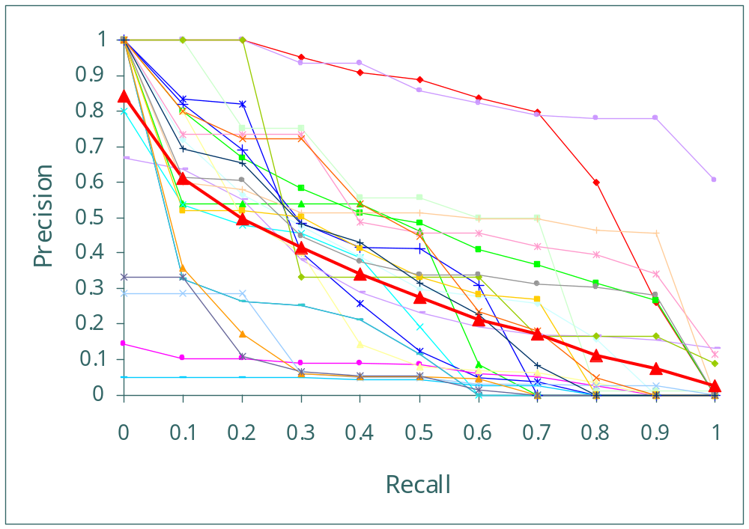
ROC Curves

Slide 42
User Studies
Goal is to account for interface issues
  By studying the interface component
  By studying the complete system
Formative evaluation
  Provide a basis for system development
Summative evaluation
  Designed to assess performance

Slide 43
Quantitative User Studies
Select independent variable(s)
  e.g., what info to display in selection interface
Select dependent variable(s)
  e.g., time to find a known relevant document
Run subjects in different orders
  Average out learning and fatigue effects
Compute statistical significance
  Null hypothesis: independent variable has no effect
  Rejected if p<0.05

Slide 44
Qualitative User Studies
Observe user behavior
  Instrumented software, eye trackers, etc.
  Face and keyboard cameras
  Think-aloud protocols
  Interviews and focus groups
Organize the data
  For example, group it into overlapping categories
Look for patterns and themes
Develop a “grounded theory”

Slide 45
Questionnaires
Demographic data
  For example, computer experience
  Basis for interpreting results
Subjective self-assessment
  Which did they think was more effective?
  Often at variance with objective results!
Preference
  Which interface did they prefer? Why?

Slide 46
By now you should know…
Why information retrieval is hard
Why information retrieval is more than just querying a search engine
The difference between Boolean and ranked retrieval (and their advantages/disadvantages)
Basics of evaluating information retrieval systems

