Slide 1

LBSC 690: Week 5
Metadata, Structured Documents, and XML
Jimmy Lin
College of Information Studies
University of Maryland
Monday, February 26, 2006

Slide 2

Blind Men and Elephants

Slide 3
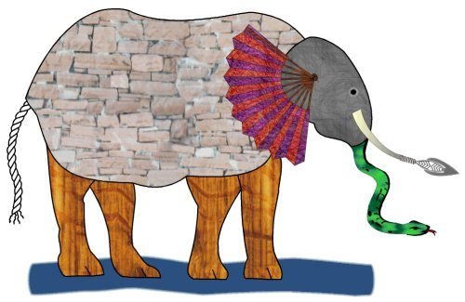
Is this an elephant?

Slide 4
Metadata
Literally “data about data”
  “a set of data that describes and gives information about other data” ― Oxford English Dictionary

Slide 5
Information Hierarchy
♦
More refined and abstract
Wisdom
Knowledge
Information
Data
Notes:
“Information” actually exists as part of a hierarchy, of how refined it is

Slide 6
Information Hierarchy
Data
  The raw material of information
Information
  Data organized and presented in a particular manner
Knowledge
  “Justified true belief”
  Information that can be acted upon
Wisdom
  Distilled and integrated knowledge
  Demonstrative of high-level “understanding”

Slide 7
A (Facetious) Example
Data
  98.6º F, 99.5º F, 100.3º F, 101º F, …
Information
  Hourly body temperature: 98.6º F, 99.5º F, 100.3º F, 101º F, …
Knowledge
  If you have a temperature above 100º F, you most likely have a fever
Wisdom
  If you don’t feel well, go see a doctor

Slide 8
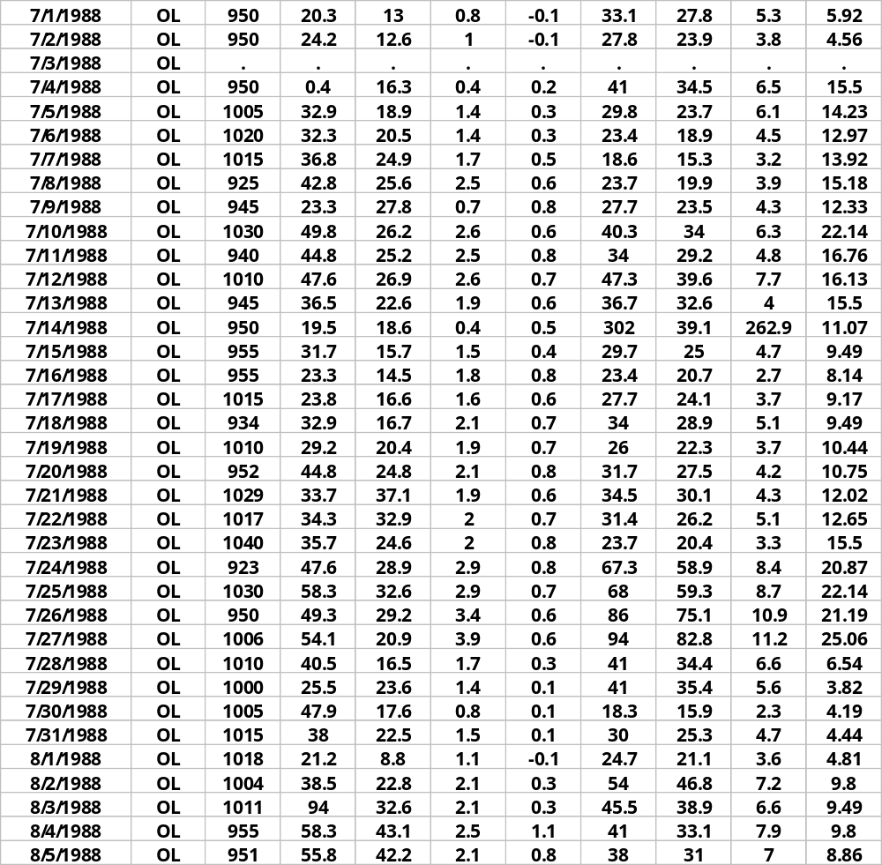
Data without Metadata…
Who:
authored it?
to contact about data?
What:
are contents of database?
When:
was it collected?
processed? finalized?
Where:
was the study done?
Why:
was the data collected?
How:
were data collected?
processed? Verified?
… can be pretty useless!

Slide 9
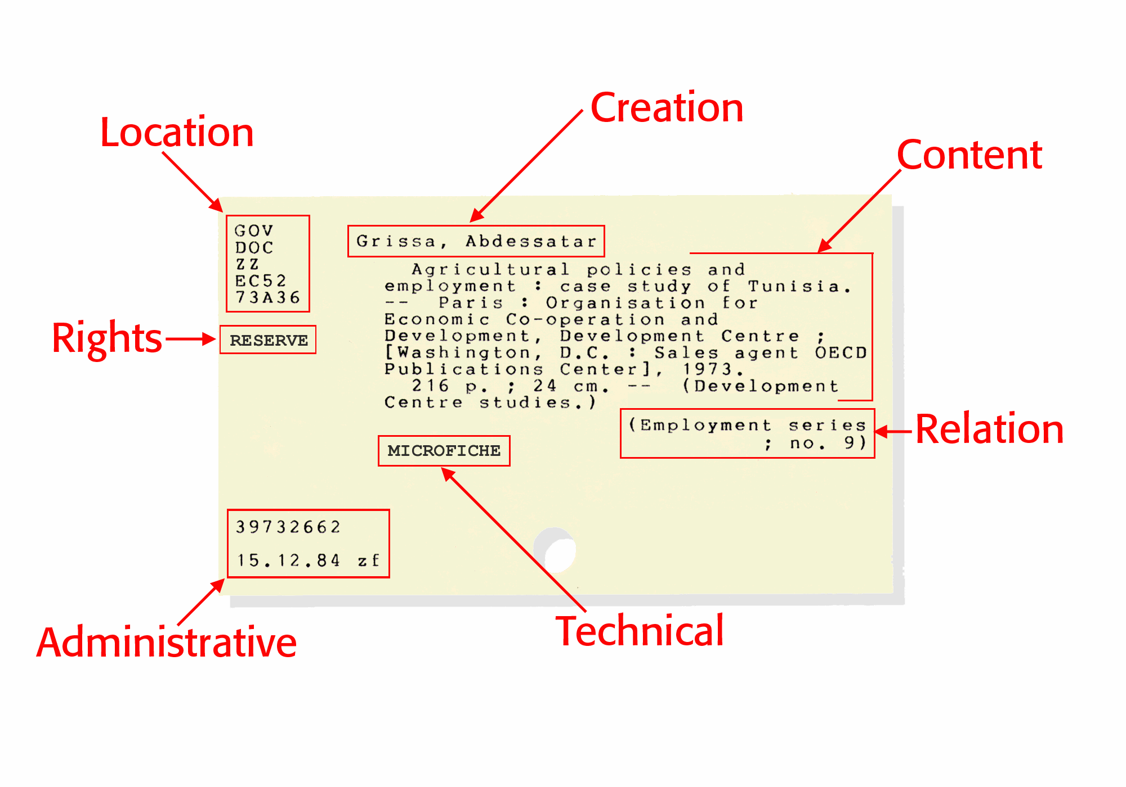
Early Example of Metadata

Slide 10
Encoding Metadata
Language for expressing metadata should be:
  Universal - so all can understand
  Flexible - to incorporate different types
  Extensible - flexible to custom types
  Simple - to encourage adoption
  Modular - so that schemes can be mixed, extended
From: Ian Graham, An Introduction to RDF. http://www.utoronto.ca/ian/talks/

Slide 11
Metadata
How do we encode metadata?
How do we encode metadata to support interoperability?
Simple example: January 31, 2001
31 janvier 2001
2001-01-31
01-31-2000
31012000

Slide 12
What is the Dublin Core?
A metadata standard for describing digital resources
An initiative to create a digital “library card catalog” for the Web
Dublin Core fields: (all optional)
Title Creator Subject
Description Publisher Contributor
Date Type Format
Identifier Source Language
Relation Coverage Rights

Slide 13
What’s a structured document?
A structured document is a document whose structure conforms to a certain set of rules
  Data and metadata encoded in an interoperable manner

Slide 14
What is XML?
♦
XML = eXtensible Markup Language
XML is a standard for exchanging structured data
  Provides standardization at the syntactic level
  Does not provide “meaning” for the tags
XML is a standard recommended by the W3C

Slide 15
Goals of XML
Easy to use
Easy to extend and adapt
Easy to write programs that use XML
Support a wide variety of applications
Should be human legible
Formal and concise

Slide 16
The Basic Rules
XML is case sensitive
All start tags must have end tags
Elements must be properly nested
XML declaration is the first statement
  <?xml version="1.0"?>
Every document must contain a root element
Attribute values must have quotation marks
  <item id=“33905”>
Certain characters are reserved for parsing
  &lt; = ‘<’

Slide 17
Questions about XML
How is XML like HTML?
How is HTML like XML?
What’s the relationship between XML and structured documents?
How are the rules governing a structured document encoded?

Slide 18
XML: Historic Perspective
HTML and the birth of the Web
HTML is not enough
Development of XML
This section contains slides adapted from presentations by Ian Graham: http://www.utoronto.ca/ian/talks/

Slide 19
In the beginning…
The foundations of the Web:
HTML
FTP
News
Email
HTTP
URLs
Web
Server
Db & other
software
URLs
(location
e.g.,http://www.foo.org/)
Internet
communication
protocols
HTML
(data/display)
HTTP
(transfer)

Slide 20
Three Core Technologies
HTTP - HyperText Transfer Protocol
  A protocol for transferring data between machines on the Internet
URL - Uniform Resource Locator
  A scheme for referencing the specific location of a resource
HTML - HyperText Markup Language
  A markup language for encoding information to be read by humans
HTTP and URLs have pretty-well stood the test of time.
But by 1996, HTML was already showing signs of age ....

Slide 21
HTML
Started with very few tags …
Language evolved as more tags were added:
  Forms
  Tables
  Fonts
  Frames
  …

Slide 22
Problems with HTML
Desire for personalized tags
  HTML can’t be extended
Desire to incorporate other types of data
  Mathematics, database entries, literary text, poems, purchase orders …
  HTML can’t accommodate other types of data
Desire for automatic processing by software
  HTML is too messy and inconsistent

Slide 23
Back to the Basics
HTML was defined using SGML
  Standard Generalized Markup Language
  A meta-language for defining languages
Complex, sophisticated, powerful
  … too difficult to use
Idea: create a simpler version of SGML
  The birth of XML!

Slide 24
Evolution of XML
XML can be used to define other languages
Many XML languages, optimized for different roles
  MathML: for mathematics
  SMIL: for synchronized multimedia
  RSS: for news feeds
  XHTML: HTML by XML rules
  RDF: for the Semantic Web
  …

Slide 25
MathML
An XML language for defining mathematic formulas
(a + b)²
<msup>
<mfenced>
<mi>a</mi>
<mo>+</mo>
<mi>b</mi>
</mfenced>
<mn>2</mn>
</msup>
x² + 4x + 4 =0
<mrow>
<mrow>
<msup><mi>x</mi><mn>2</mn></msup>
<mo>+</mo>
<mrow>
<mn>4</mn>
<mo>&invisibletimes;</mo>
<mi>x</mi>
</mrow>
<mo>+</mo><mn>4</mn>
</mrow>
<mo>=</mo><mn>0</mn>
</mrow>

Slide 26
MathML
What advantages does it offer?

Slide 27
SMIL
Synchronized Multimedia Integration Language
Integration of multimedia with text, audio, video
Support in RealPlayer

Slide 28
SMIL Example
<smil>
<head>
<meta name="title" content="Online Teaching Services promo" />
<meta name="author" content="Jay Moonah, CAT" />
<layout type="text/smil-basic-layout">
<root-layout width="280" height="316" background-color="white"/>
<region id="AnimChannel1" title="AnimChannel1"
left="0" top="0" height="265" width="280" fit="hidden"/>
</layout>
</head>
<body>
<par title="Online Teaching Services promo" author="Jay Moonah, CAT" >
<audio src="final.rm" id="Soundtrack" title="Soundtrack"/>
<animation src="otscompfin.swf" id="Animation"
region="AnimChannel1" title="Animation" fill="freeze"/>
<text src="cc.rt" id="caption" region="cc" title="cc" fill="freeze"/>
</par>
</body></smil>

Slide 29
RSS
RSS = Really Simple Syndication or Rich Site Summary
An XML format for distributing news
headlines on the Web

Slide 30
XHTML: Beyond HTML
<?xml version="1.0" encoding="iso-8859-1"?>
<html xmlns="http://www.w3.org/TR/xhtml1" >
<head>
<title> Title of text XHTML Document </title>
</head>
<body>
<div class="myDiv">
<h1> Heading of Page </h1>
<p> here is a paragraph of text. I will include inside this paragraph
a bunch of wonky text so that it looks fancy. </p>
<p>Here is another paragraph with <em>inline emphasized</em>
text, and <b> absolutely no</b> sense of humor. </p>
<p>And another paragraph, this one with an <img src="image.gif"
alt="waste of time" /> image, and a <br /> line break. </p>
</div>
</body></html>

Slide 31
XHTML
Just like HTML, but based on XML rules
Will support integration of different data into a single document

Slide 32
XHTML and other Data
<?xml version="1.0" encoding="iso-8859-1"?>
<html xmlns="http://www.w3.org/TR/xhtml1" >
<head>
<title> Title of XHTML Document </title>
</head><body>
<div class="myDiv">
<h1> Heading of Page </h1>
<mathml xmlns=“http://www.w3.org/TR/mathml”>
… MathML markup …
</mathml>
<p> more html stuff goes here </p>
<smil xmlns=“http://www.w3.org/TR/smil1”>
… SMIL markup …
</smil>
</div>
</body></html>

Slide 33
And Others…
CML – chemical Markup Lang
CellML – biological models
BSML – bioinformatic sequences
MAGE-ML – Microarray Gene Expression
XSTAR – for archaeological research
XMLMARC – MARC in XML
AML – astronomy markup language
SportsML – for sharing sports data

Slide 34
The XML Family Tree
SMIL
SpeechML
XUL
XHTML
MathML
RDF
HTML
TEI
. . .
. . .
XML
SGML

Slide 35
Mixing XML Dialects
XML is designed to support the integration of multiple standards
Allows users to mix elements from different standards
  Snapping together XML dialects like Lego pieces
  Based on the notion of “namespaces”

Slide 36
Example
<?xml version="1.0"?>
<rdf:RDF
xmlns:rdf="http://www.w3.org/1999/02/22-rdf-syntax-ns#"
xmlns:rss="http://purl.org/rss/1.0/"
xmlns:dc="http://purl.org/dc/elements/1.1/">
<rss:channel rdf:about="http://www.xml.com/xml/news.rss">
<rss:title>XML.com</rss:title>
<rss:link>http://xml.com/pub</rss:link>
<dc:description>
XML.com features a rich mix of
information and services for the XML community.
</dc:description>
<dc:subject>XML, RDF, metadata, information
syndication services</dc:subject>
<dc:identifier>http://www.xml.com</dc:identifier>
<dc:publisher>O'Reilly & Associates, Inc.</dc:publisher>
<dc:rights>Copyright 2000, O'Reilly &
Associates, Inc.</dc:rights>
</rss:channel>
</rdf:RDF>
Example from http://www.xml.com/pub/a/2000/10/25/dublincore/

Slide 37
Interoperability
What does it mean and what’s the role of XML?
XML as a universal format for data interchange
  Software exchange data as XML-format messages
Advantages?
  Eliminates proprietary data formats
  Promotes interoperability
  Encourages cooperation
  Leverages lots of existing XML processing software
Interoperability slides adapted from presentations by Ian Graham: http://www.utoronto.ca/ian/talks/

Slide 38
XML Messaging
Place order
Supplier
Factory
Supplier
Supplier
Response

Slide 39
XML Messaging
Send/request data
Database
Database
Database
Database
Request/send data

Slide 40
Example Message
<partorders xmlns=“http://myco.org/Spec/partorders.desc”>
<order ref=“x23-2112-2342” date=“25aug1999-12:34:23h”>
<desc> Gold sprockel grommets, with matching hamster</desc>
<part number=“23-23221-a12” />
<quantity units=“gross”> 12 </quantity>
<delivery-date date=“27aug1999-12:00h”>
</order>
<order ref=“x23-2112-2342” date=“25aug1999-12:34:23h”>
…. Order something else …..
</order>
</partorders>

Slide 41
The next best thing since…
What’s the big deal about XML?
What does XML not do?
How do XML tags acquire meaning?
How do standards arise?

Slide 42
What’s wrong with the Web?
It was meant for humans, not machines
The current Web contains only data, not knowledge
  From Web of data to Web of knowledge
Difficult to
  Aggregate/compare data across sites
  Delegate complex tasks to “agents”
  Formulate complex queries involving multiple constraints
  …

Slide 43
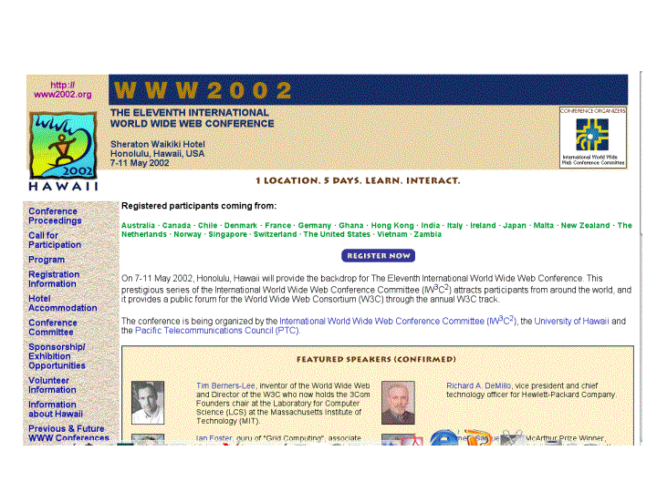
What is the Problem?
Consider a typical Web page:
This section contains slides adapted from a presentations by Peter F. Patel-Schneider

Slide 44
What we see…
WWW2002
The eleventh international world wide web conference
Sheraton waikiki hotel
Honolulu, hawaii, USA
7-11 may 2002
1 location 5 days learn interact
Registered participants coming from
australia, canada, chile denmark, france, germany, ghana, hong kong, india, ireland, italy, japan, malta, new zealand, the netherlands, norway, singapore, switzerland, the united kingdom, the united states, vietnam, zaire
Register now
On the 7th May Honolulu will provide the backdrop of the eleventh international world wide web conference. This prestigious event …
Speakers confirmed
Tim berners-lee
Tim is the well known inventor of the Web, …
Ian Foster
Ian is the pioneer of the Grid, the next generation internet …

Slide 45
What a machine sees…




  




…


…

…

Slide 46
Add “meaningful” tags?
<name>
</name>
<location>
</location>
<date>  </date>
<slogan></slogan>
<participants>
</participants>
<introduction>
…
</introduction>
<speaker></speaker>
<bio></bio>…

Slide 47
But what about…
<conf>
</conf>
<place>
</place>
<date>  </date>
<slogan></slogan>
<participants>
</participants>
<introduction>
…
</introduction>
<speaker></speaker>
<bio>…

Slide 48
Machine sees…
<>
</>
<>
</>
<>  </>
<></>
<>
</>
<>
…
</>
<></>
<□></□>
<></>
<□></□>

Slide 49
Approaches to “Semantics”
External agreement on meaning of annotations
  Agree on the meaning of a set of annotation tags, e.g., Dublin core
  Problems with this approach?
Use of on-line ontologies to specify meaning of annotations
  Ontologies provide a vocabulary of terms
  New terms can be formed by combining existing ones
  Meaning (semantics) of such terms is formally specified
  Can also specify relationships between terms in multiple ontologies
Semantic Web takes second approach

Slide 50
Ontology: Origins and History
A philosophical discipline
  A branch of philosophy that deals with the nature and the organization of reality
Science of Being (Aristotle, Metaphysics, IV, 1)
Tries to answer the questions:
  What characterizes being?
  Eventually, what is being?

Slide 51
Ontology in Computer Science
An ontology is an engineering artifact:
  It is composed of vocabulary used to describe a certain reality, plus
  A set of explicit assumptions regarding the intended meaning of the vocabulary
Thus, an ontology describes a formal specification of a domain:
  Shared understanding of a domain
  A model that is formal and machine manipulable
How does an ontology differ from a taxonomy?

Slide 52
Structure of an Ontology
Names for important concepts in the domain
  Elephant is a concept whose members are a kind of animal
  Herbivore is a concept whose members are exactly those animals who eat only plants or parts of plants
  Adult_Elephant is a concept whose members are exactly those elephants whose age is greater than 20 years
Background knowledge/constraints on the domain
  Adult_Elephants wseigh at least 2,000 kg
  All Elephants are either African_Elephants or Asian_Elephants
  No individual can be both a Herbivore and a Carnivore

Slide 53
Coding Ontologies
♦
RDF = Resource Description Framework
RDF is a graphical model
  Organized as a directed graph
  < resource, property, value >

Slide 54
Adding Semantics to Links
HTML
Web page
Any Web Resource
<a href=
URI>
RDF
URI
URI
URI

Slide 55
A Simple Example
Resource
Property
Value
http://...
dc:Title
“Metadata and Database”
dc:Creator
“Jimmy Lin”

Slide 56
XML Encoding
dc:Title
“Metadata and Databases”
http://...
dc:Creator
“Jimmy Lin”
<RDF
xmlns=“http://www.w3.org/TR/ … ”
xmlns:dc=“http://purl.org/dc/…” >
<Description about=“http://...”>
<dc:Title> Metadata and Databases </dc:Title>
<dc:Creator>Jimmy Lin</dc:Creator>
</Description>
</RDF>

Slide 57
Elaborating “me”
http://...
dc:Title
“Metadata and Databases”
dc:Creator
“me”
bib:Aff
http://umd.edu
bib:Email
bib:Name
“Jimmy Lin”
“jimmylin@umd.edu”

Slide 58
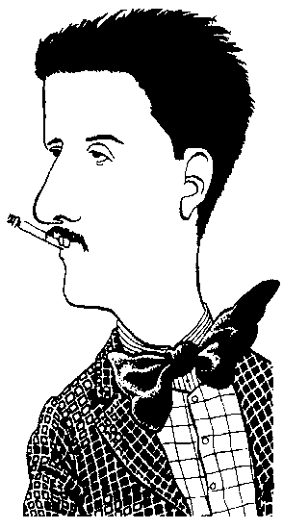


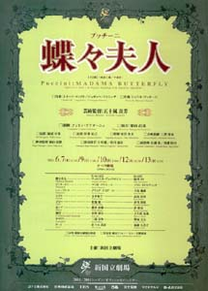
The Semantic Web
“REALITY”
composed by
COMPUTER
DOMAIN
composed by
Tosca
Puccini
born in
Madame
Butterfly
Lucca
knowledge layer
information layer
Slide from http://www.ontopia.net/

Slide 59
Web 2.0
Tagging (“folksonomy”)
Blogging
The “Long Tail”
Web services
Wikipedia

Slide 60
Back to the elephant…
Concepts covered:
  Metadata
  Structured Documents
  XML
  Semantic Web
  Ontologies
Questions?
Confused?

